Slide 1
Anchoring student learning in locally relevant problems and solutions
An example storyline from the Climate Education Pathways project
Enya Granados, Audrey Mohan, & Lindsey Mohan
National Science Teacher Association
Notes:
Welcome everyone. We are so glad to see you all here today.
This session is about anchoring student learning in local climate change phenomenon, and specially a phenomenon relevant to our location - some interesting changes for the Georgia peach.

Slide 2
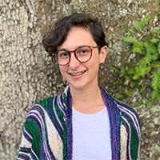
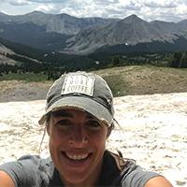
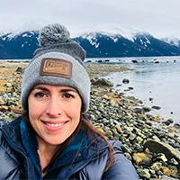
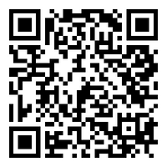
Introductions
Enya Granados
(she/her)
Cedar Shoals HS
Athens, GA
Audrey Mohan
(she/her)
BSCS Science Learning
Lindsey Mohan
(she/her)
BSCS Science Learning
Notes:
Introduce ourselves
Then have teachers respond to questions so we get to know them.
How many of you in the room are teachers?
How many of you teacher HS?
Teach biology?
What about EL or MS?
How many of you are from Georgia or the Southeast?

Slide 3
Our agenda for the session
Brief overview the Climate Education Pathways project
Experience the ‘Georgia Peaches’ Anchoring Phenomenon lesson in learner hat
Overview the rest of the storyline
Think about our own localizations opportunities
Notes:
Today we’re going to give a brief overview and context of the project, you’ll get to experience the Georgia peach anchoring phenomenon in learner hat, we’ll share the test of the storyline and then, if there is time remaining spend some of it brainstorming about possible climate change anchors for your own locations.

Slide 4
Partners
Project funded by the National Science Foundation (Award #2100808)
Notes:
The work you will see today is funded by NSF and is in partnership with OPB and NOAA.

Slide 5
Localized Storylines
What makes this new climate change work unique in the existing landscape of educational resources?
Phenomenon-driven
Storyline instructional model
Adaptable for local climate phenomena, problems, and solutions.
Designed for student outcomes beyond content → environmental science agency.
Notes:
So what makes this climate change curriculum different or unique than all the climate change stuff out there. Well a couple of things.
Driven by local phenomenon
Use the storyline format
Storylines are designed for you to adapt them to begin and end with local phenomena and solutions
Aiming for learning outcomes beyond content - environmental science agency and relevance

Slide 6
Problem foregrounded
Solution foregrounded
Lesson Set 1
Lesson Set 2
Lesson Set 3
Culminating Task
3-5 Lessons
4 Lessons
6 Lessons
Embedded Task, time varies
Salmon and orca population declines in Oregon
Riparian restoration and resilience solutions for salmon.
Base Unit
Forest recovery after wildfire in Colorado
Forest management and community adaptation solutions.
Why are temperatures rising?
What can we do to minimize CO₂ rise? How can we get CO₂ out of the air?
Resilience solutions for drought prone ecosystems and communities.
Pinyon and Juniper die off in Arizona
Longer and more severe allergy season in Michigan
Creating and posting artwork to social media with pollen satire and local city redesign solutions.
Agricultural changes for Georgia Peaches
Sharing stories and educating communities through a cookbook project.
Notes:
I’m going to give you a quick overview of the unit to set the context.
The unit is designed for hig

Slide 7
Learner Hat
While in learner hat, try to ‘think’ like a high school student and what they might think or be curious about.
*If that’s challenging, you can use your experiences with students to imagine what they might observe and share.

Slide 8
Lesson 1.1
Is Georgia really the
‘Peach State’?

Slide 9
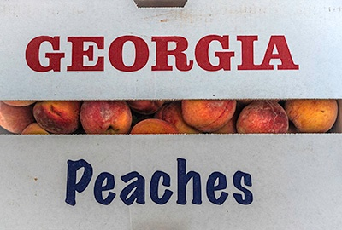
A. The Georgia Peach
Look closely at the images: Do you recognize these? Or have you seen any ‘Georgia peach’ symbols in your time at the conference?

Slide 10
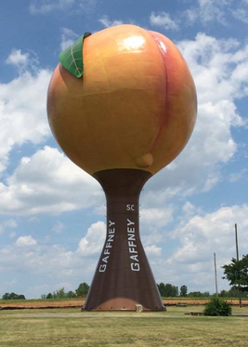
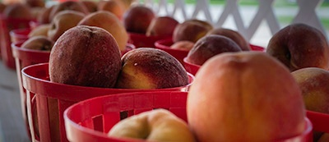
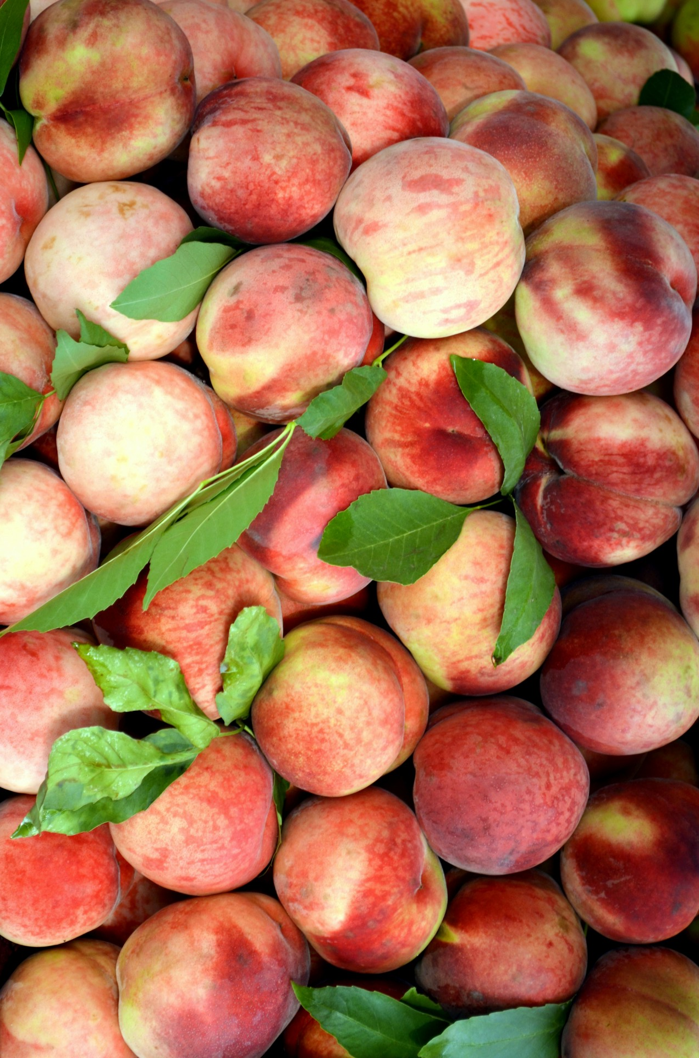
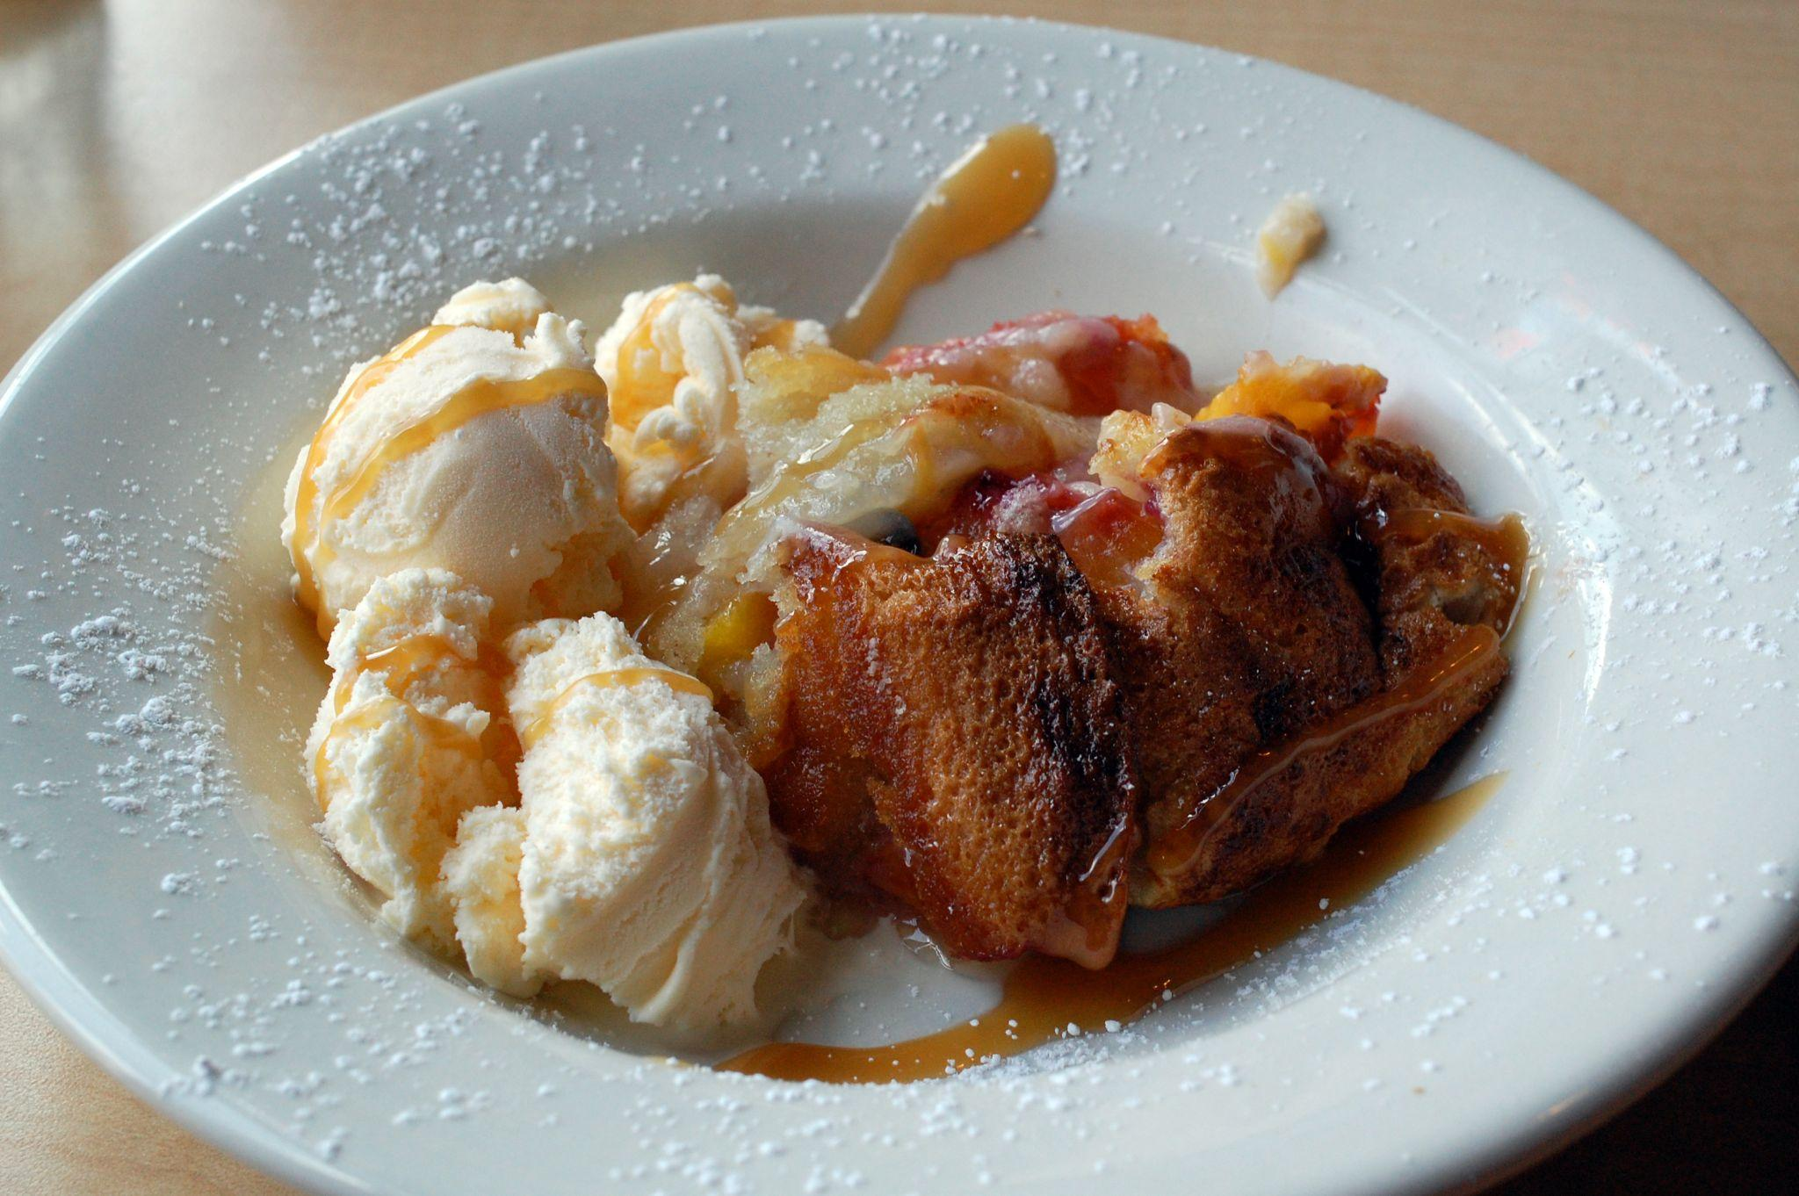
B. The Georgia Peach

Slide 11
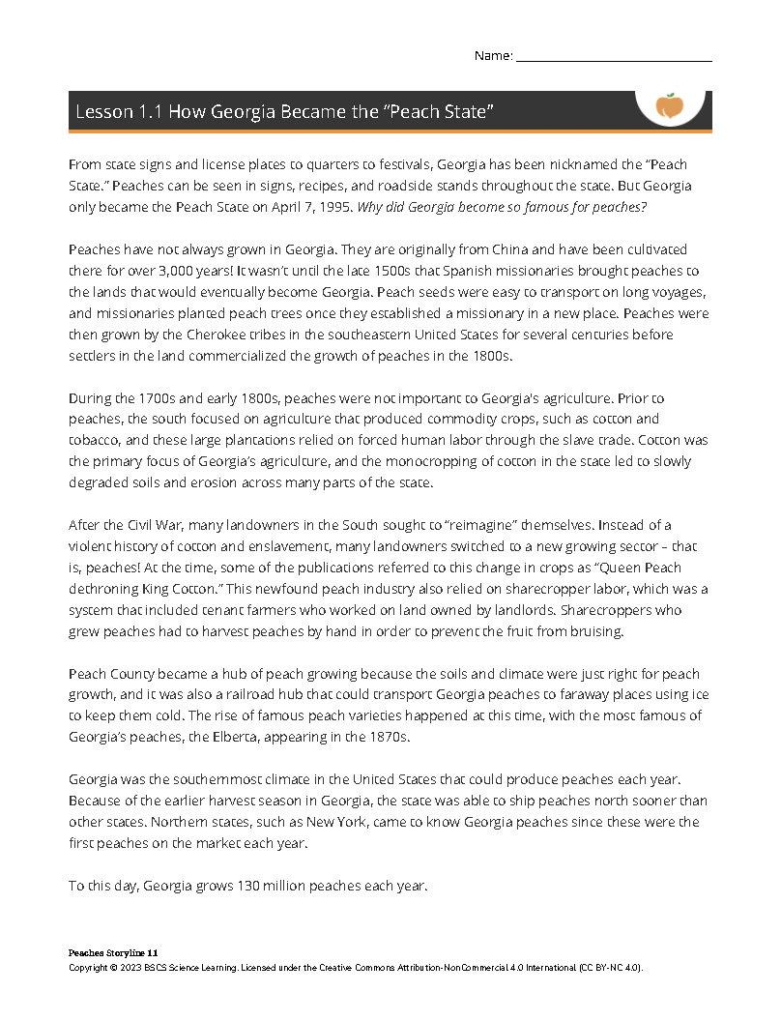
C. Read about the Georgia Peach
On your own
Read the short article about how peaches became an important cultural and agricultural icon of Georgia.
Highlight new ideas you learn about peaches.
With a partner
Turn and talk to share what you learned.

Slide 12
D. What stories or memories do you have?
What stories do you have about peaches from your childhood to present day?
A specific memory?
Family recipes?
Likes/dislikes?
Things you’ve noticed about Georgia?

Slide 13
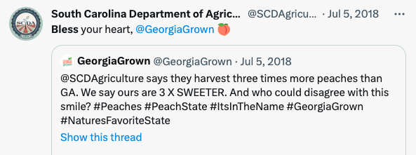
E. Is Georgia really the ‘Peach State’?
South Carolina and Georgia both claim peaches as the state fruit. So, is Georgia really the ‘peach state’?

Slide 14
F. US Peach Production Facts
Where does Georgia rank in peach production?
Data source: USDA

Slide 15
G. Georgia Peach Production Over Time
With a partner
What do you notice and wonder about the Georgia peach graph?

Slide 16
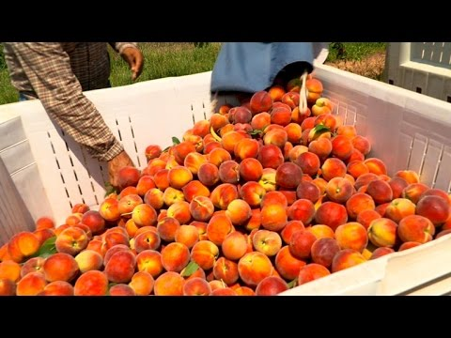
H. What happened in 2017?
Watch the video about peaches in 2017.
Notes:
Only watch first 1:30

Slide 17
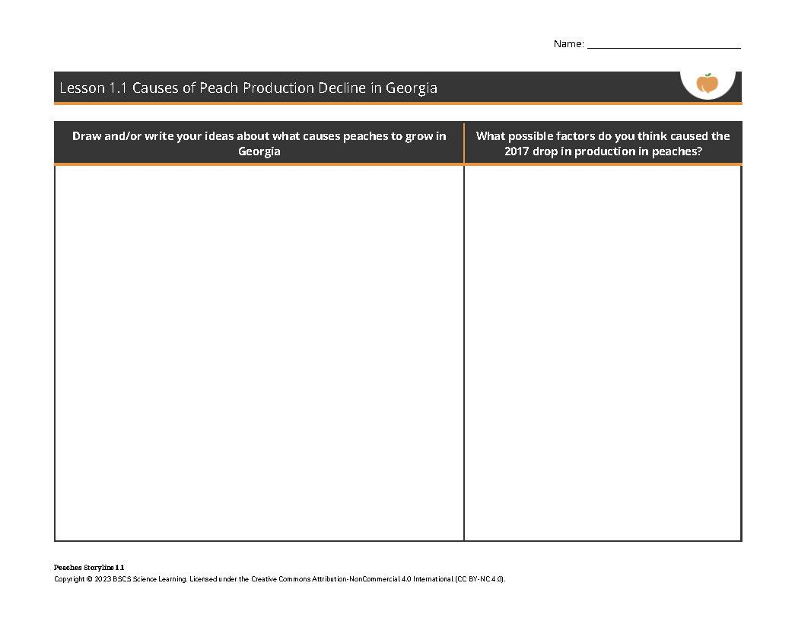
IA. Peaches growth and decline
What causes peaches to grow? And what would cause them to decline?
Draw and write on your own model sheet

Slide 18
IB. Peaches growth and decline
What causes peaches to grow? And what would cause them to decline?
2. Turn and talk with a neighbor

Slide 19
IC. Peaches growth and decline
What causes peaches to grow? And what would cause them to decline?
3. Update your work

Slide 20
ID. Peaches growth and decline
What causes peaches to grow? And what would cause them to decline?
4. Share ideas with class

Slide 21
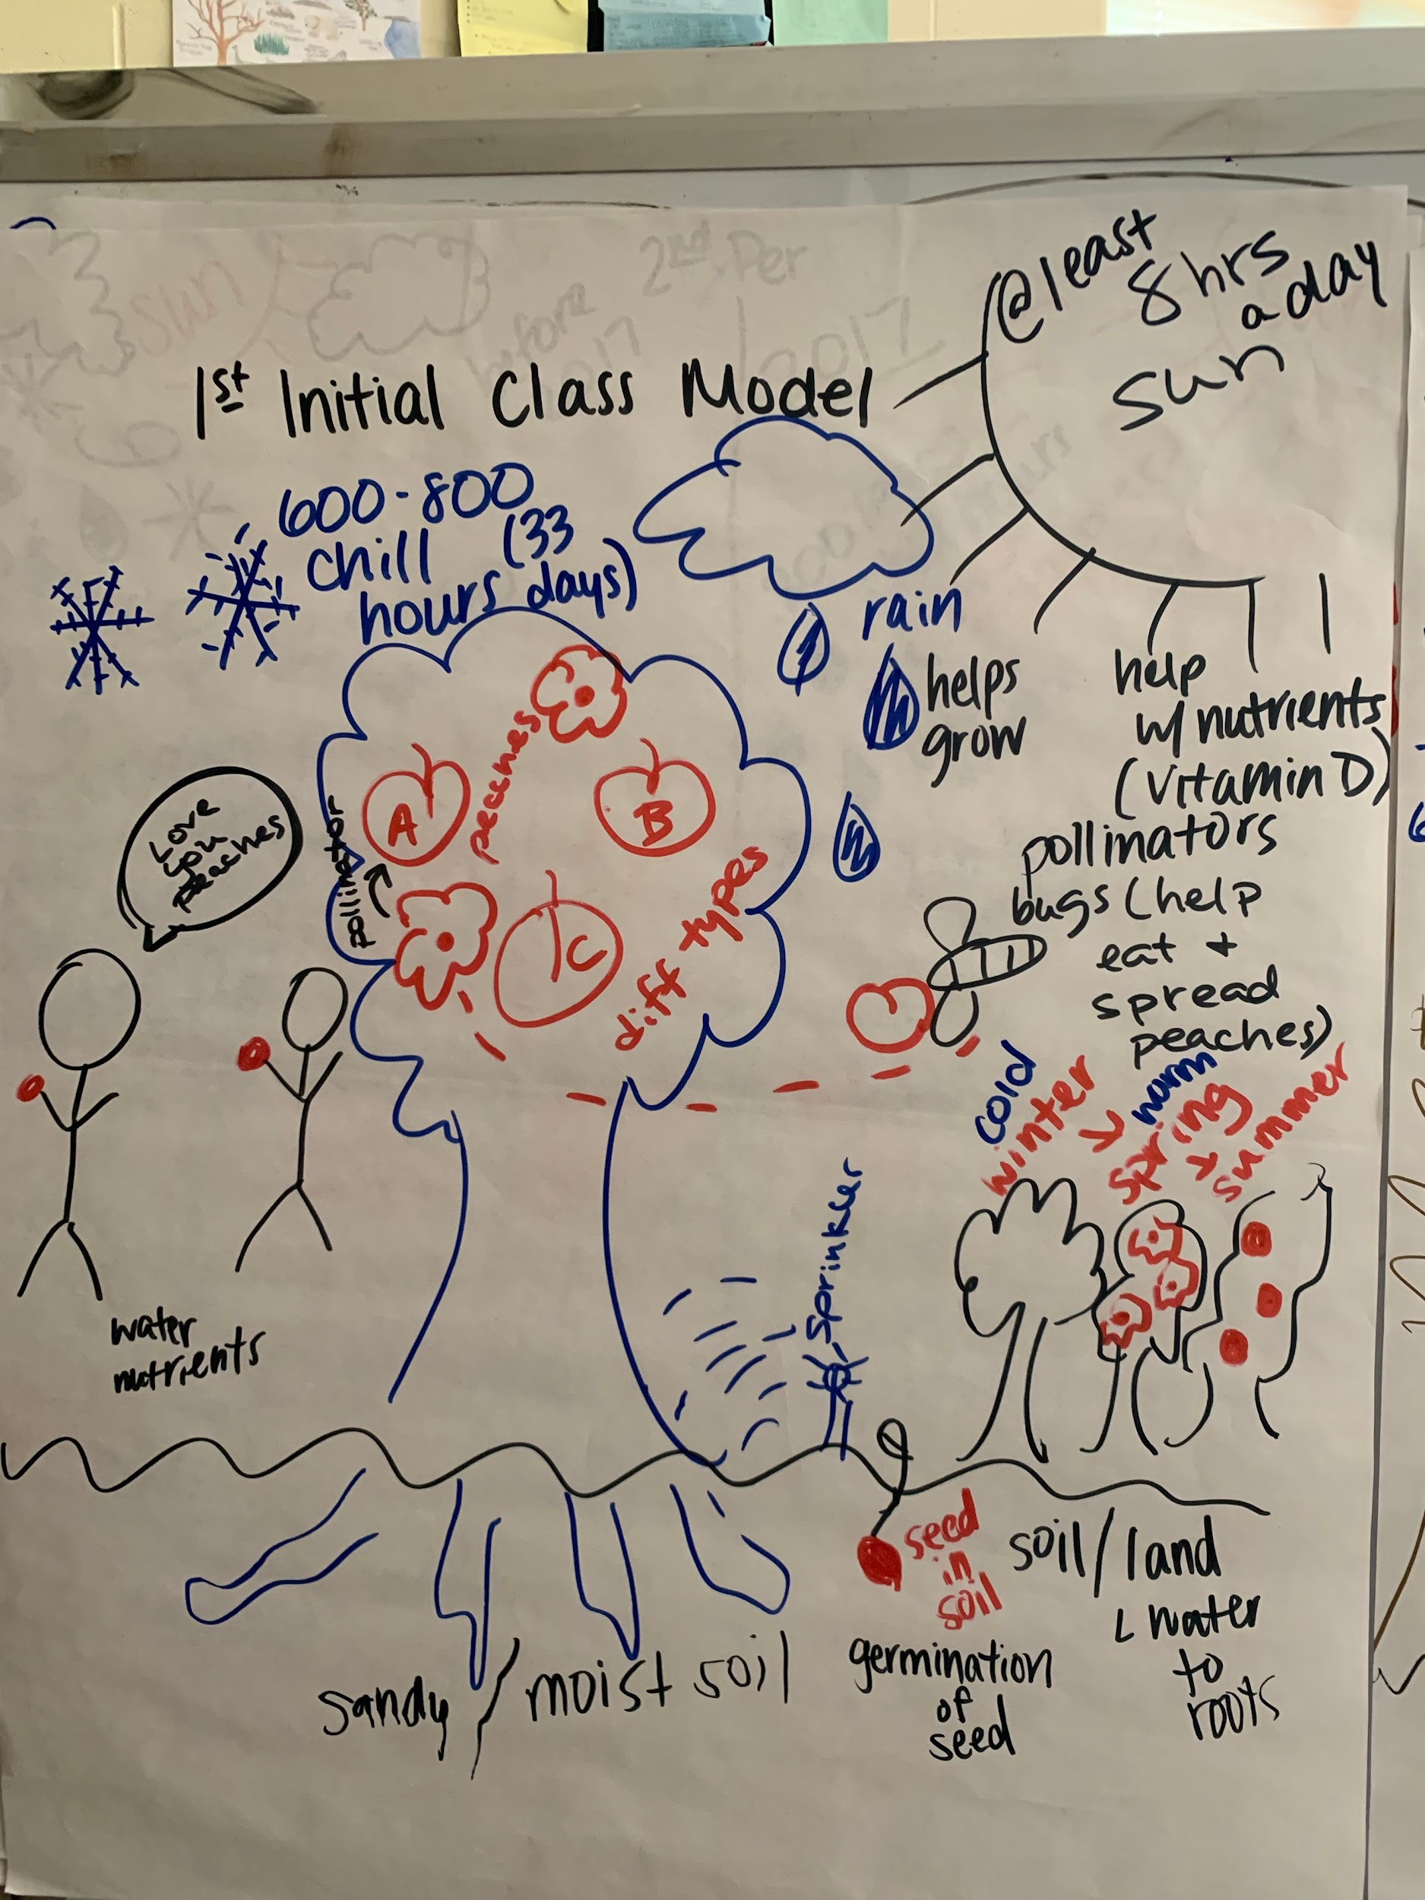
ID. Peaches growth and decline

Slide 22
J. Is this only a peach problem?
With a Partner
Share Ideas with Class
Is this a peach problem or are there other plants that have had changes in their harvests lately?
Have you ever heard of other plants that had a “bad year” in terms of production?
Our Ideas:

Slide 23
K. Home Learning
Ask community members, caregivers, or friends:
Is this just a peach problem or have other crops or plants changed production levels over time?
Are there other changes in Georgia that are similar to this?

Slide 24
L. Ask Questions to Guide our Investigations
On your own
Jot down questions on sticky notes about
peach production,
what caused the decline, or
any parts of the model?
Share questions as a class.
Write down your questions in dark marker - large print.
Write down your questions in dark marker - large print.
Write down your questions in dark marker - large print.

Slide 25
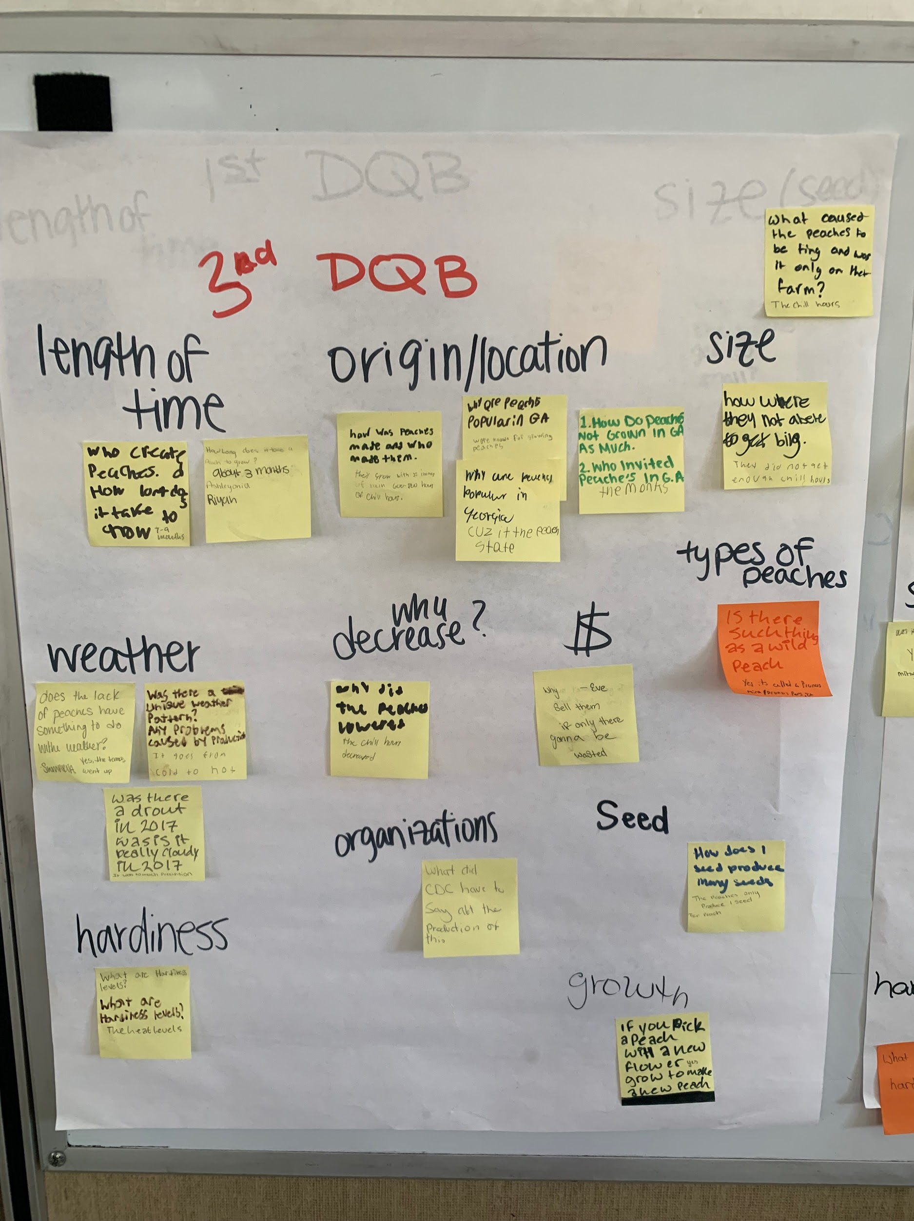

Slide 26
M. Ideas for Investigation
How should we go about investigating these questions?
What data, information, or labs might be helpful for us as we investigate?

Slide 27
N. What should we do next?
With a Partner
Look at the Driving Question Board.
What question(s) should we answer first? Why should we answer that question?
Look to our ideas for investigations. Are there any investigations that may help answer the question?

Slide 28
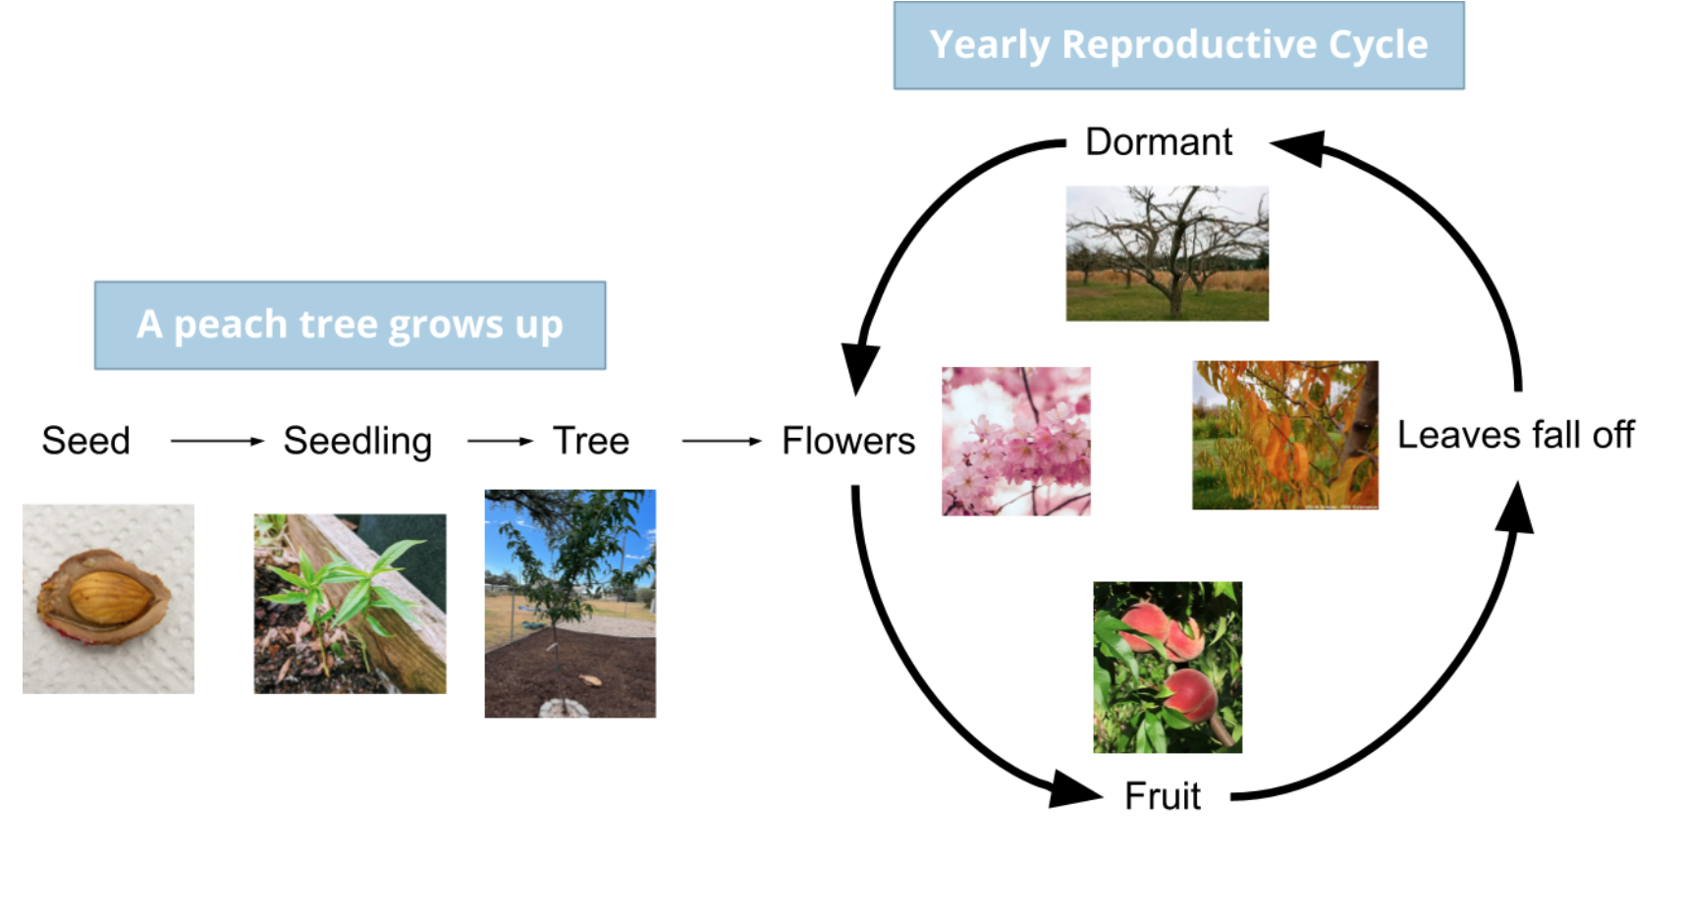
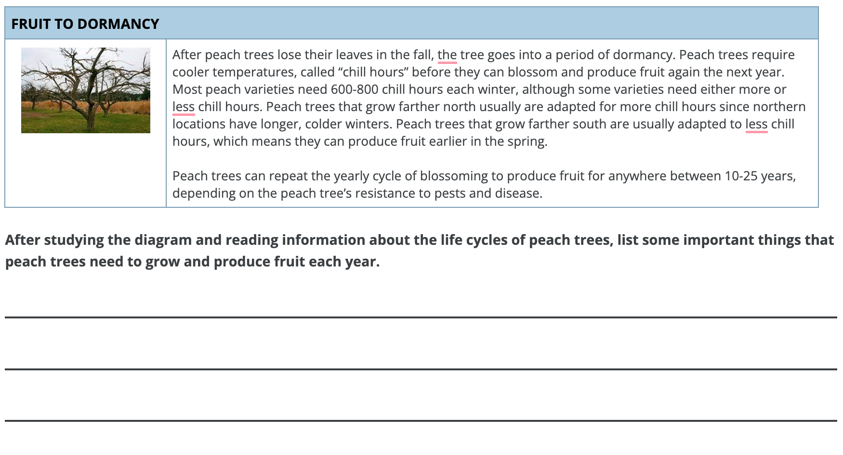
Where do we go from the anchor?
Lesson 2: How do peaches grow?
What we do:
Investigate the normal life cycle and phenophases of peach trees.
Normal conditions required to make peaches.
Example ideas we might figure out:
Peach trees go through certain normal lifecycle phases to produce fruit.
Peach trees need sunlight, warm temperatures, cool winters, and precipitation to survive.
Navigation: We study famous/common Georgia peach varieties to see what conditions they need to grow where they do.

Slide 29
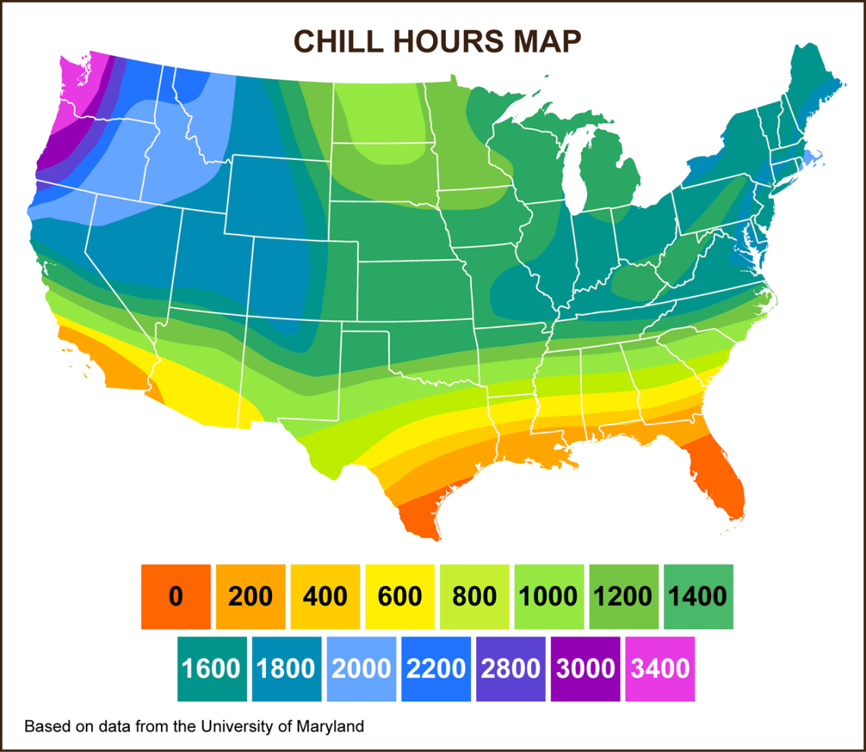
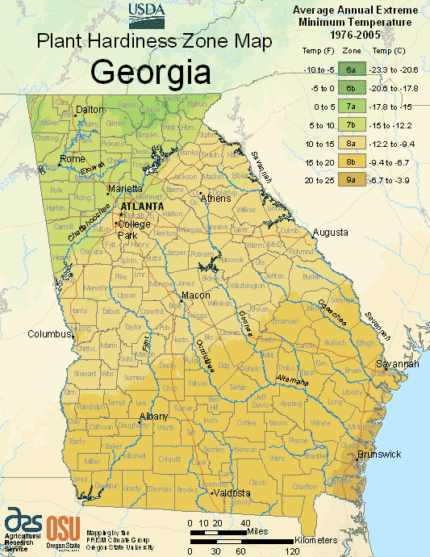
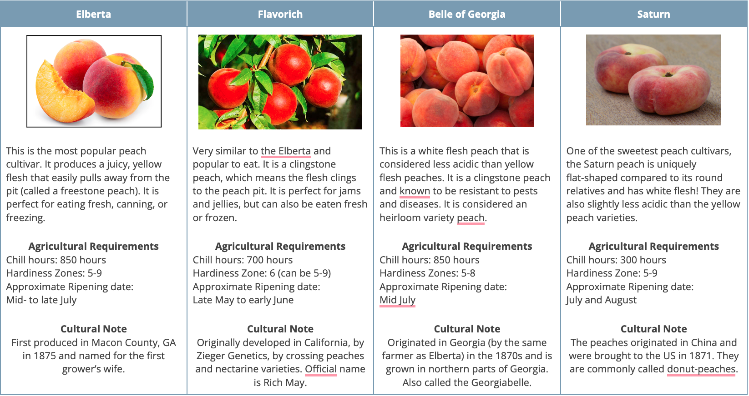
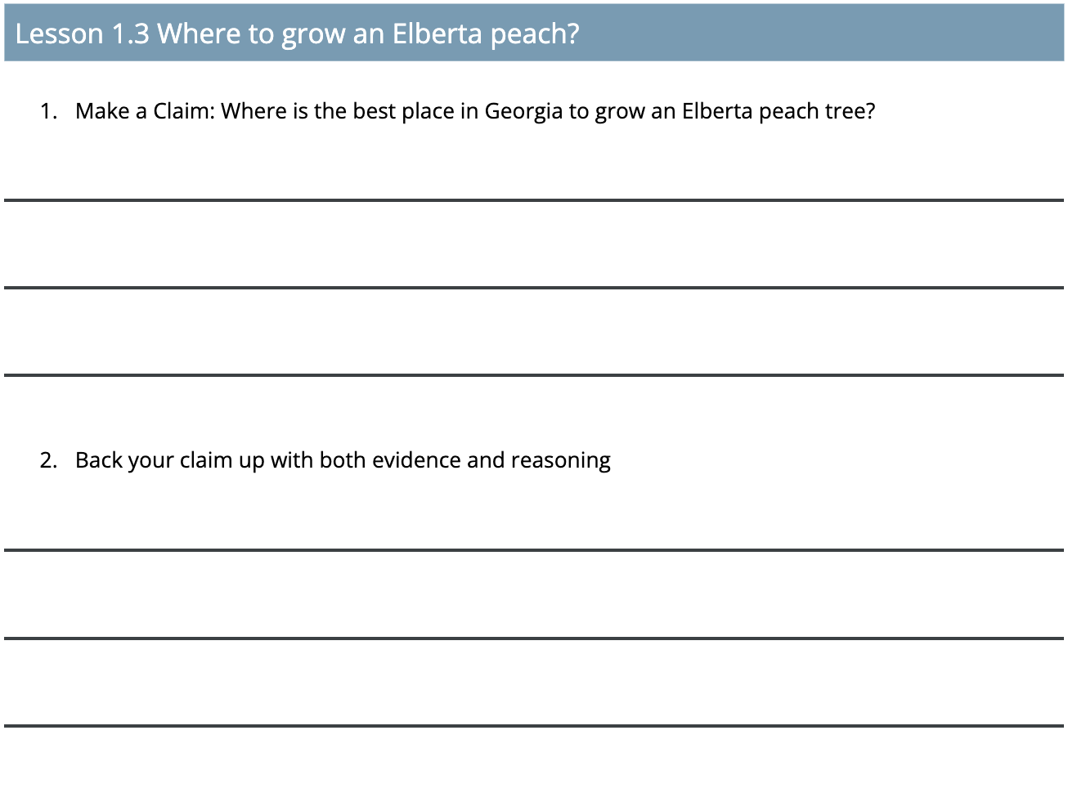
Where do we go from the anchor?
Lesson 3: Why is Georgia a good place to grow peaches?
What we do:
Use maps and infographics to gather evidence about Georgia’s agricultural growing conditions and match it to famous peach varieties.
Example ideas we might figure out:
Different species of peach trees have preferred environmental conditions necessary to produce peaches.
Historically, Georgia has been in a good hardiness and chill hour zone for peaches.
Historically, temperatures have been in the right range.
Indigenous and Georgia farmers have used agricultural practices that have supported the cultivation of peaches.
Navigation: We look at 2017 environmental conditions.

Slide 30
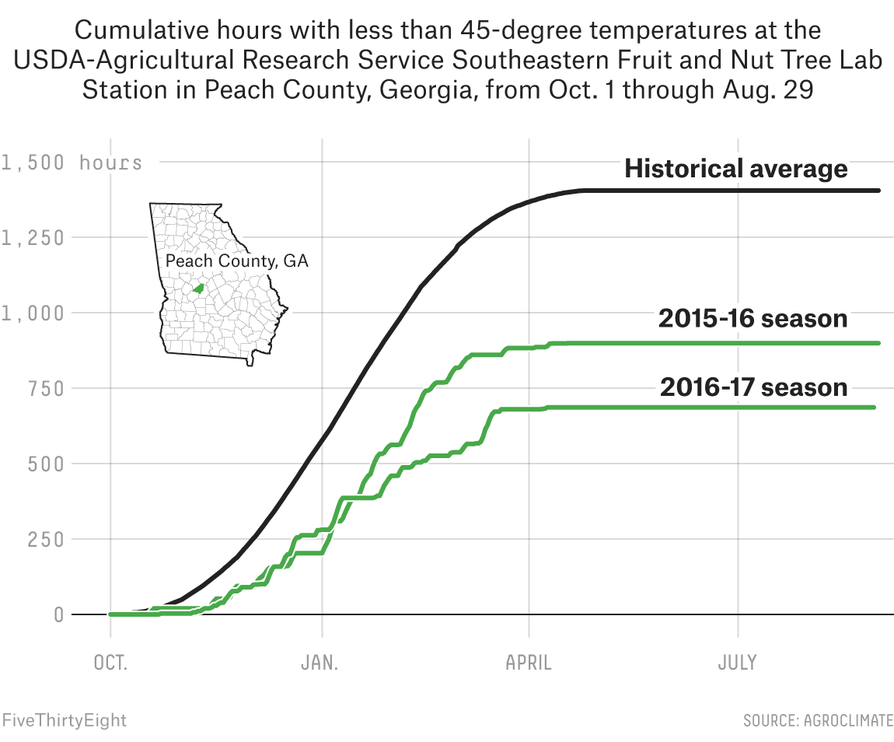
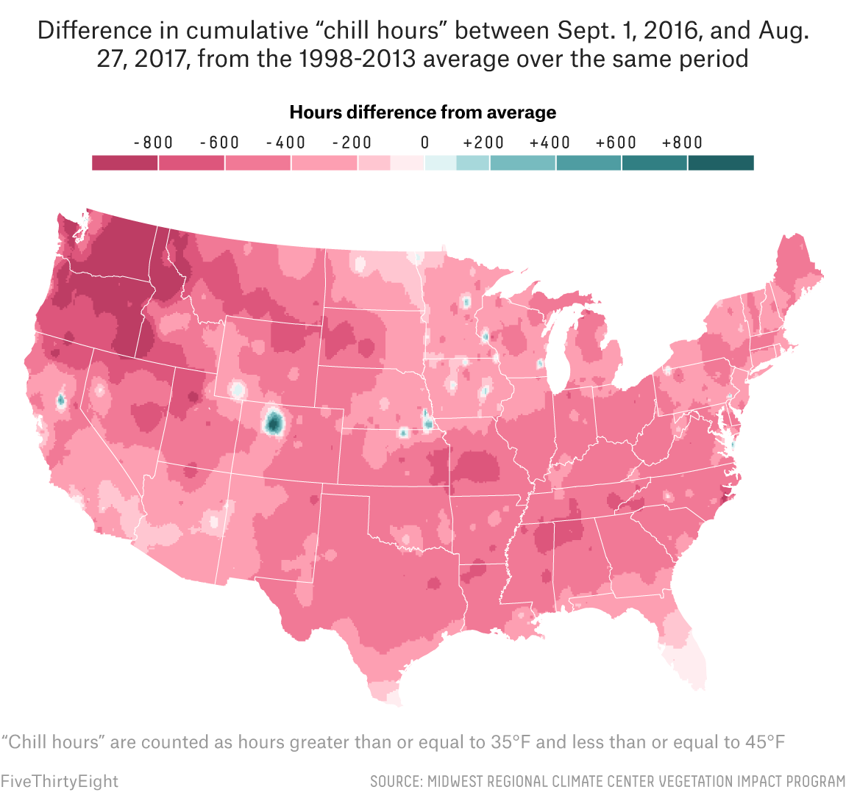
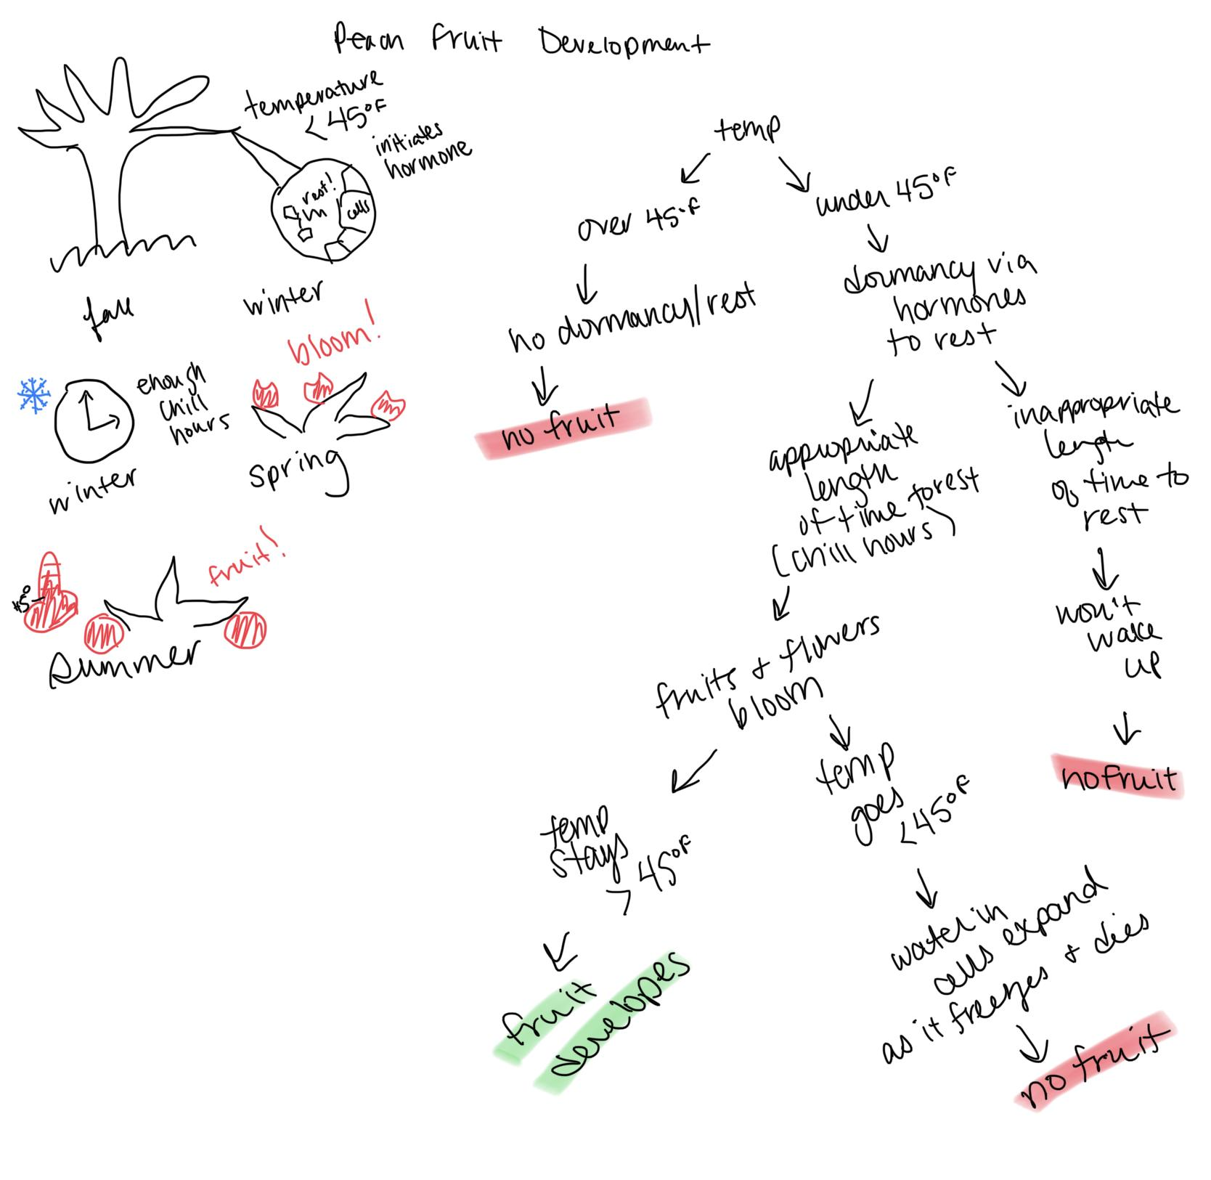
Where do we go from the anchor?
Lesson 4: What changed in 2017 to cause peach decline?
What we do:
Gather evidence about 2017 data and then build a model to explain the decline in peaches.
Example ideas we might figure out:
The winter in Georgia during 2017 was warmer than normal, and there were significantly less chill hours than necessary for peach trees to produce peaches.
Limited chill hours cause a significant reduction of harvest.
Navigation: We use this data and information to predict future possibilities for peach production.

Slide 31
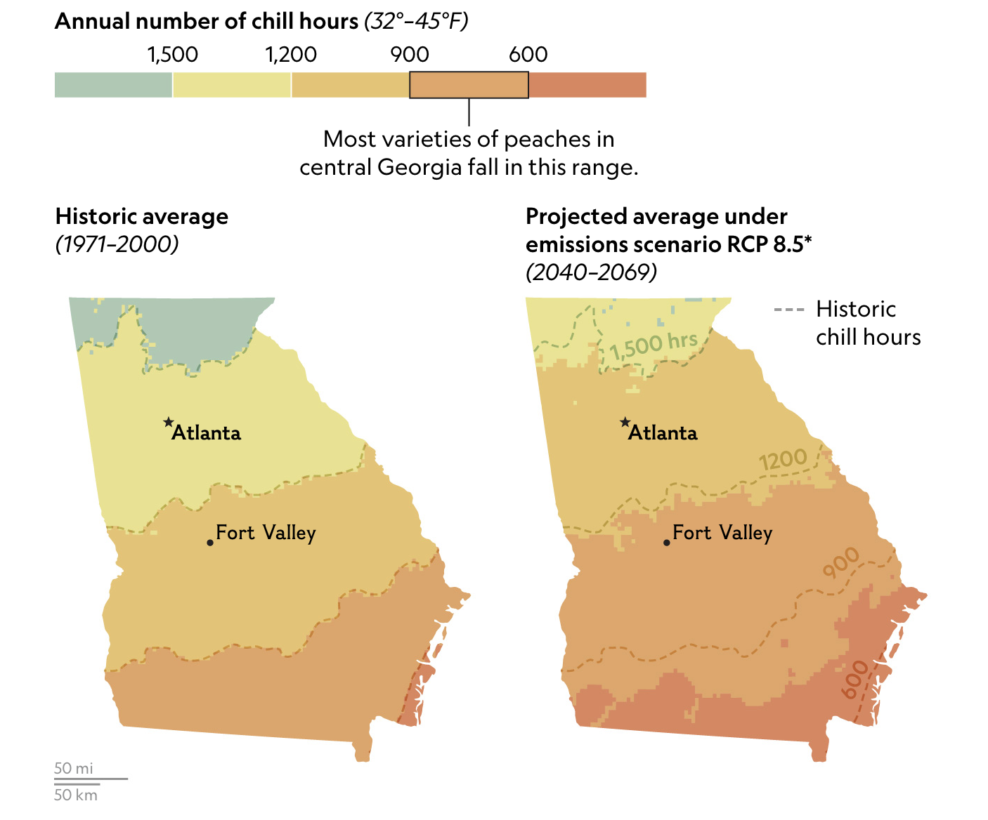
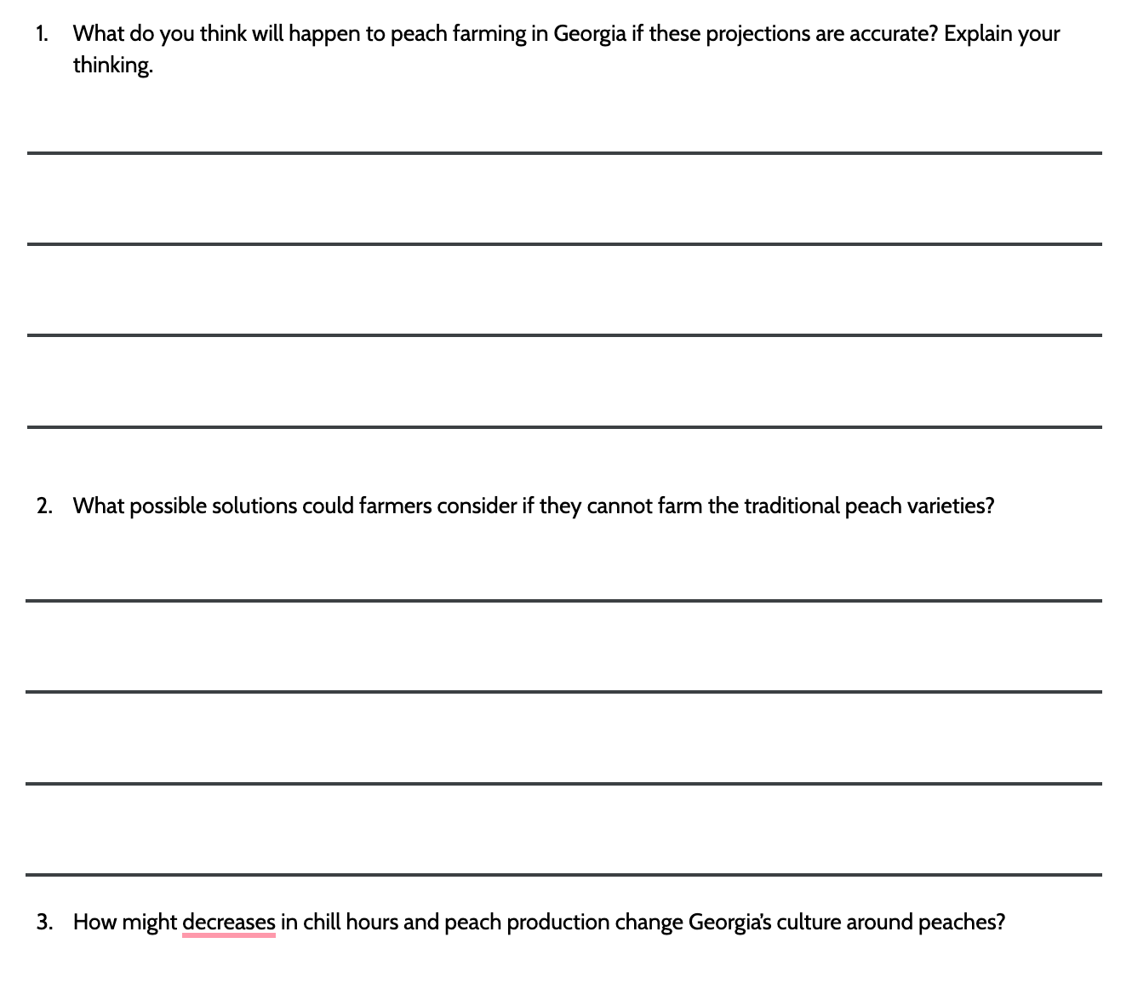
Where do we go from the anchor?
Lesson 5: What does the future of Georgia peaches look like?
What we do:
We use projected future chill hours to construct an explanation about future peach production in Georgia.
Example ideas we might figure out:
Chill hours are projected to decline in Georgia and will have an effect on future farming of and culture around Georgia peaches.
Navigation: Why are chill hours declining though? What is causing temperature patterns to change?

Slide 32
Problem foregrounded
Solution foregrounded
Lesson Set 1
Lesson Set 2
Lesson Set 3
Culminating Task
3-5 Lessons
4 Lessons
6 Lessons
Embedded Task, time varies
Salmon and orca population declines in Oregon
Riparian restoration and resilience solutions for salmon.
Base Unit
Forest recovery after wildfire in Colorado
Forest management and community adaptation solutions.
Why are temperatures rising?
What can we do to minimize CO₂ rise? How can we get CO₂ out of the air?
Resilience solutions for drought prone ecosystems and communities.
Pinyon and Juniper die off in Arizona
Longer and more severe allergy season in Michigan
Creating and posting artwork to social media with pollen satire and local city redesign solutions.
Agricultural changes for Georgia peaches
Sharing stories and educating communities through a cookbook project.

Slide 33
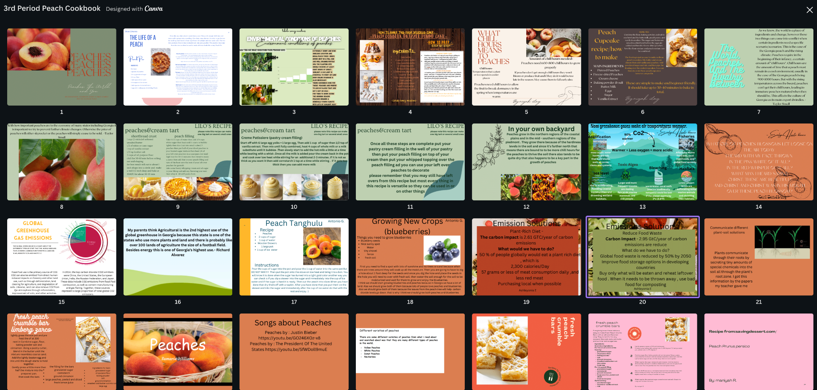
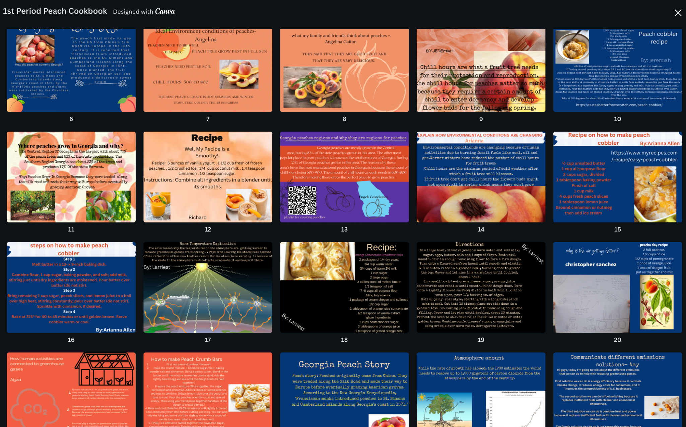
How do we finish the unit?
Culminating Task: How can we educate others about Georgia peaches and the impact of a changing climate?
What we do:
Work in teams to design and present a cookbook that includes both science and cultural ideas about peaches in Georgia.
Ideas we might figure out:
Educating community and family members is one solution for mitigating carbon emissions and reducing the impacts of climate change.
It takes a variety of roles and talents to design and deliver an educational cookbook that combines science, culture, and art into one product.

Slide 34
How could you localize a unit?
How could you leverage environmental or biological issues in your own community to start a unit like this?
Take a few minutes of quiet ‘think’ and planning time using the tool.
Share ideas with the group.

Slide 35
https://bscs.org/climate
enya.granados@knowlesteacher.org
amohan@bscs.org, lmohan@bscs.org
Thank you!

