Slide 1
Earth’s Changing Surface
Lesson 6
What can cause Earth’s surface to look the way it does?

Slide 2
Think Back to Lesson 5
What science ideas did you use in your explanation?

Slide 3
Lesson 6 Focus/ Unit Central Question
What can cause Earth’s surface to look the way it does?
Lesson 6 Focus and Unit Central Question
What can cause Earth’s surface to look the way it does?
You are now ready to answer this question!

Slide 4
Use CSW as You Discuss Your Ideas
Use CSW to SHARE your ideas
(rows 4 & 5)
Use CSW to ASK QUESTIONS
(row 6)
Use CSW to COMMENT or RESPOND
(rows 7 & 9)

Slide 5
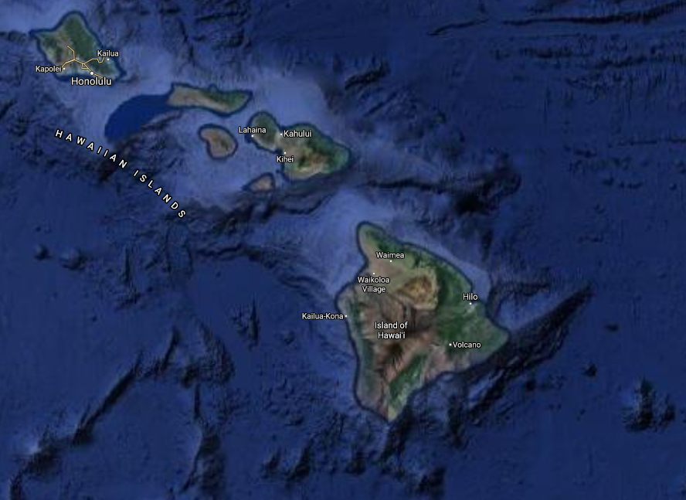
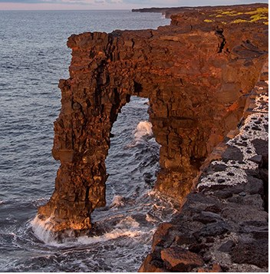
Over time, a sea arch forms out of a sea cliff.
Hōlei Sea Arch (NPS Photo/J. Wei)
Image ©2020 TerraMetrics; map data ©2020
Location #1
Notes:
Google image: https://www.google.com/maps/@20.1631564,-155.8522653,531162m/data=!3m1!1e3
NPS image: https://www.nps.gov/havo/learn/nature/sea-arches.htm
Other sea arch options:
https://unsplash.com/photos/ZZ-YMZ4PL5s (Tillamook, Oregon)

Slide 6
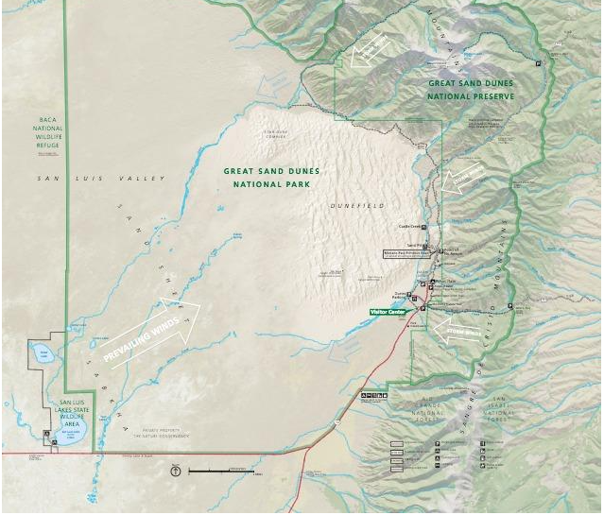
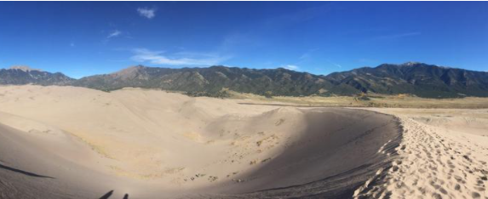
Over time, sand dunes form between a windy, sandy area and a mountain range.
National Parks Service map of Great Sand Dunes National Park (public domain)
Great Sand Dunes National Park, Colorado
with the San Juan Mountains visible in the distance.
(Credit: Cole Schubert; public domain)
Location #2
Notes:
https://www.usgs.gov/science-support/osqi/yes/national-parks/great-sand-dunes-national-park-and-preserve
https://www.usgs.gov/science-support/osqi/yes/national-parks/geology-great-sand-dunes-national-park

Slide 7
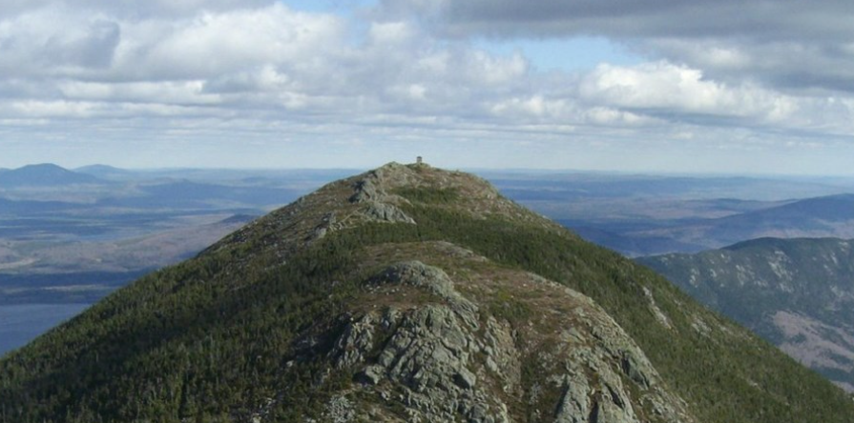
Over time, mountains became shorter and rounder.
On the Appalachian Trail (NPS)
USGS topographic map
Location #3
Notes:
https://www.nps.gov/appa/index.htm
https://store.usgs.gov/map-locator

Slide 8
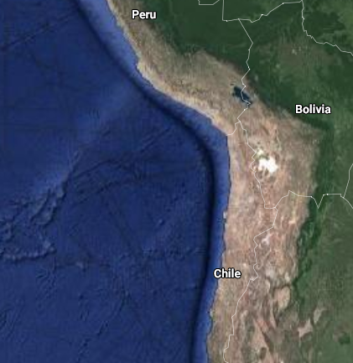
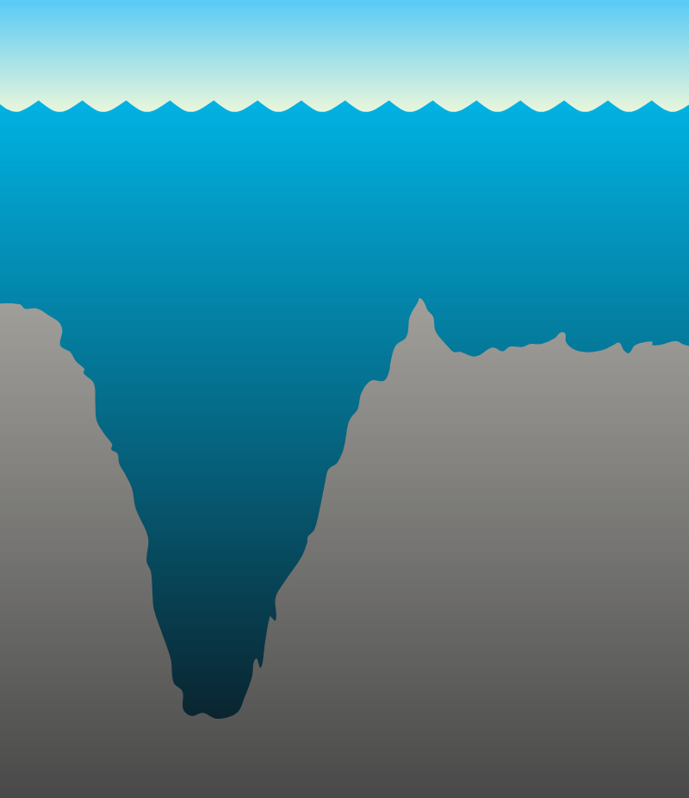
A mountain range becomes taller along the coast.
A deep ocean trench is found along the coast.
Image ©2020 NASA,TerraMetrics, Map Data ©2020 Google
Location #4
Notes:
https://www.ngdc.noaa.gov/mgg/image/2minrelief.html
https://www.nps.gov/subjects/geology/plate-tectonics-subduction-zones.htm
https://www.google.com/maps/@-21.5140602,-69.6320482,4685228m/data=!3m1!1e3
Photo by Matheus Frade on Unsplash

Slide 9
Lesson 6 Focus/ Unit Central Question
What can cause Earth’s surface to look the way it does?
Lesson 6 Focus and Unit Central Question
What can cause Earth’s surface to look the way it does?
Look back to your first answer.
How would you answer now?
What do you want to change or add?

