Slide 1
Energy: Every Day, Everywhere
Lesson 2:
Patterns of Energy in Collisions

Slide 2
Unit Central Question
How does the energy of an object or system change?

Slide 3
Science Ideas We’ve Figured Out
Science Ideas We've Figure Out
-
-
-
-
-

Slide 4
Lesson 2: Focus Question
What happens to motion energy when objects collide?

Slide 5
Marble-Ruler System
Identify the parts of the marble-ruler system.
What observable changes are happening in the system?

Slide 6
Representing Energy in the System
Draw a representation of the red marble before and after the push.
Before the push
After the push

Slide 7
Energy bars can represent energy.
No energy
Some energy
A lot of energy

Slide 8
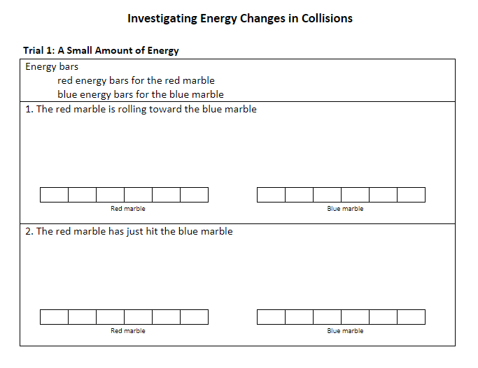
Investigating Energy Changes in Collisions

Slide 9
Science Ideas We’ve Figured Out
Science Ideas We've Figure Out
-
-
-
-
-

Slide 10
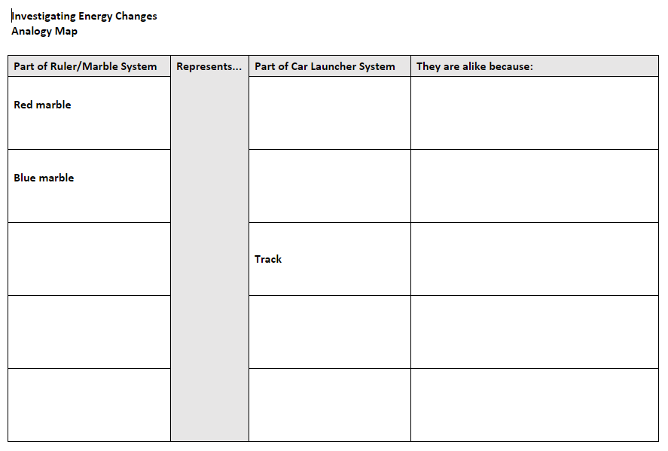
Analogy Map—Comparing Systems

Slide 11
Lesson 2: Focus Question
What happens to motion energy when objects collide?

Slide 12
Next Steps
Are there other ways to change the amount of motion energy of an object?

