Slide 1
Energy: Every Day, Everywhere
Lesson 3:
Predicting and Observing Changes in Energy

Slide 2
Unit Central Question
How does the energy of an object or system change?

Slide 3
Lesson 3: Focus Question
How can we change the amount of motion (kinetic) energy of an object?

Slide 4
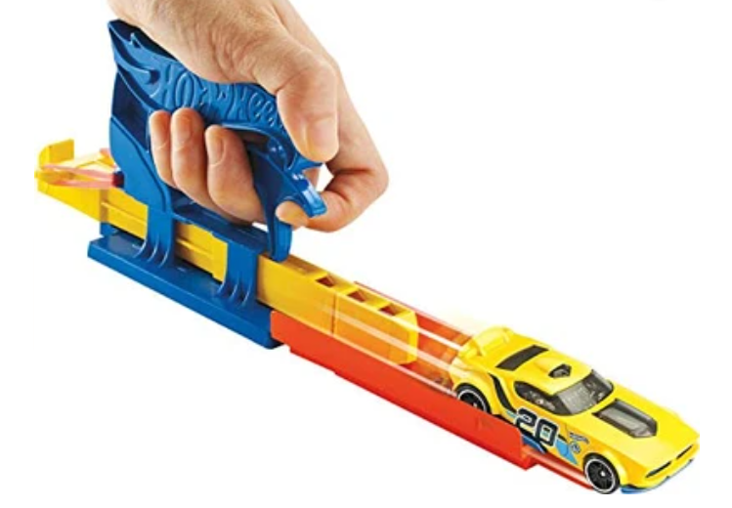
Changing Energy: Car Launcher System

Slide 5
Changing Energy: Marble-Ruler System
How could we change the amount of energy in the marble-ruler system?

Slide 6
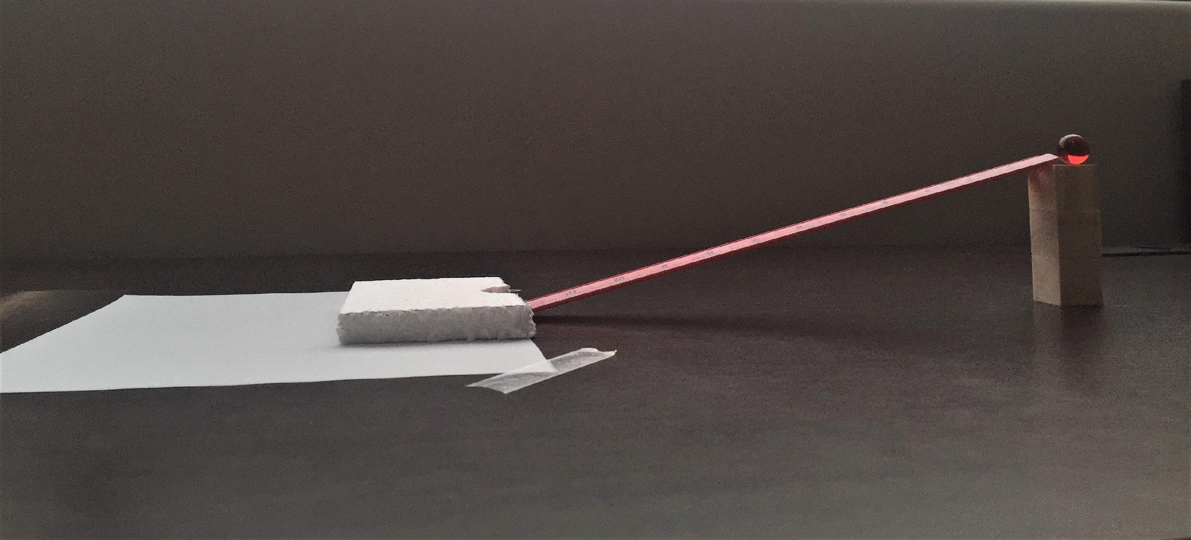
Marble-Ruler System

Slide 7
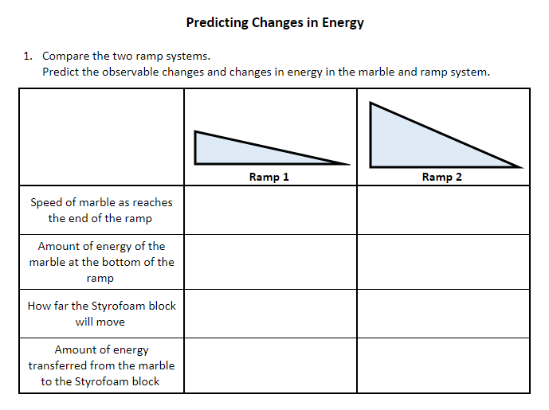
Predicting Changes in Energy

Slide 8
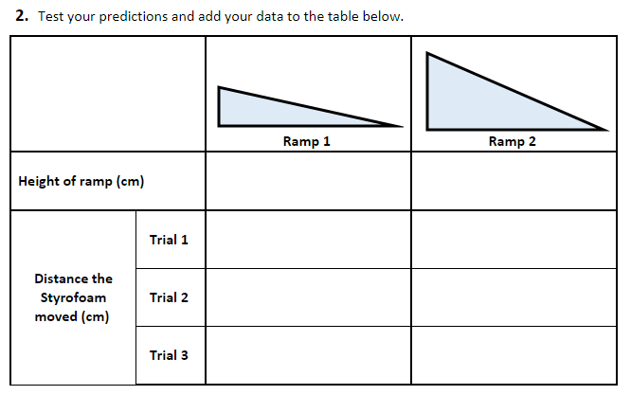
Test Your Predictions

Slide 9
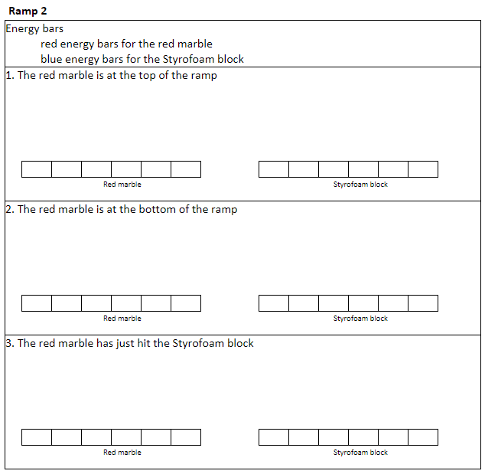
Representing Energy with Energy Bars

Slide 10
Science Ideas We’ve Figured Out
Science Ideas We've Figure Out
-
-
-
-
-

Slide 11
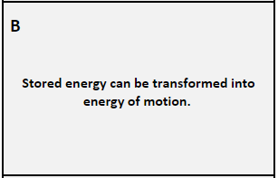
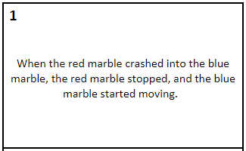
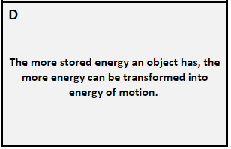
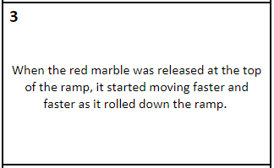
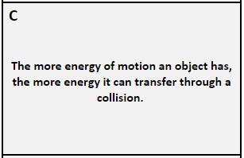
Scientific Explanations: Linking Observations and Science Ideas
Match the observed change in the system with a science idea.

Slide 12
Lesson 3: Focus Question
How can we change the amount of motion (kinetic) energy of an object?

Slide 13
Driving Question Board (DQB)
?
?
?
?
?
?
?
?
?
?
?
?
?
?
?

Slide 14
Next Steps
Next class, we will investigate ...

