Slide 1
Sun’s Effect on Climate
Lesson 1

Slide 2
The Sun’s Effect on Climate and Seasons
Today, we will begin a unit about the Sun’s effect on Earth’s climate and seasons.
Why is the Sun important to life on Earth?

Slide 3
Unit Central Question
Why are some places on Earth hotter than others at different times of the year?

Slide 4
Lesson 1 Focus Question
What patterns in temperature can you find on Earth at different times of the year?

Slide 5
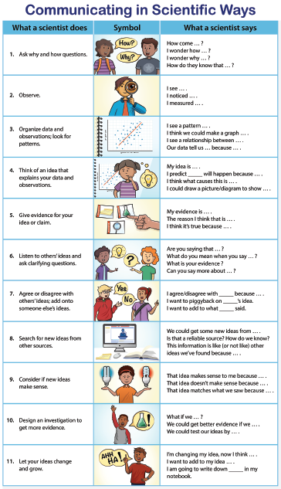
We will use these sentence starters today
Which are easy for you to use?
Which are harder?

Slide 6
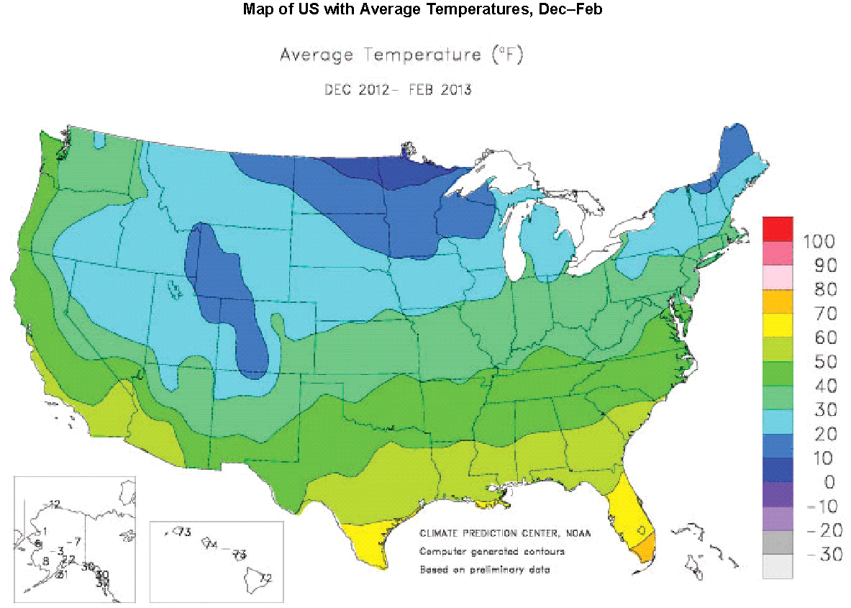
What patterns in temperature can you find on Earth at different times of the year?

Slide 7
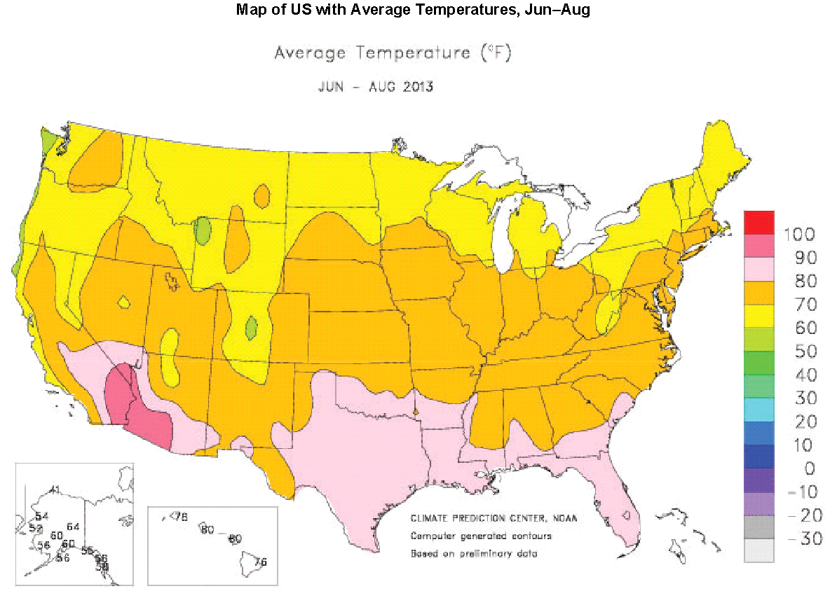
What patterns in temperature can you find on Earth at different times of the year?

Slide 8
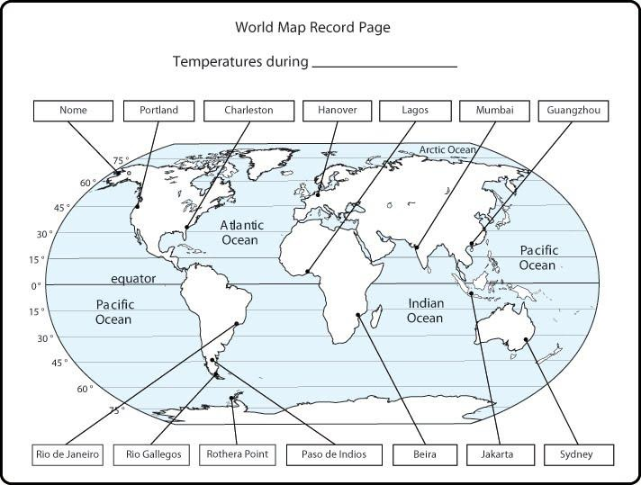
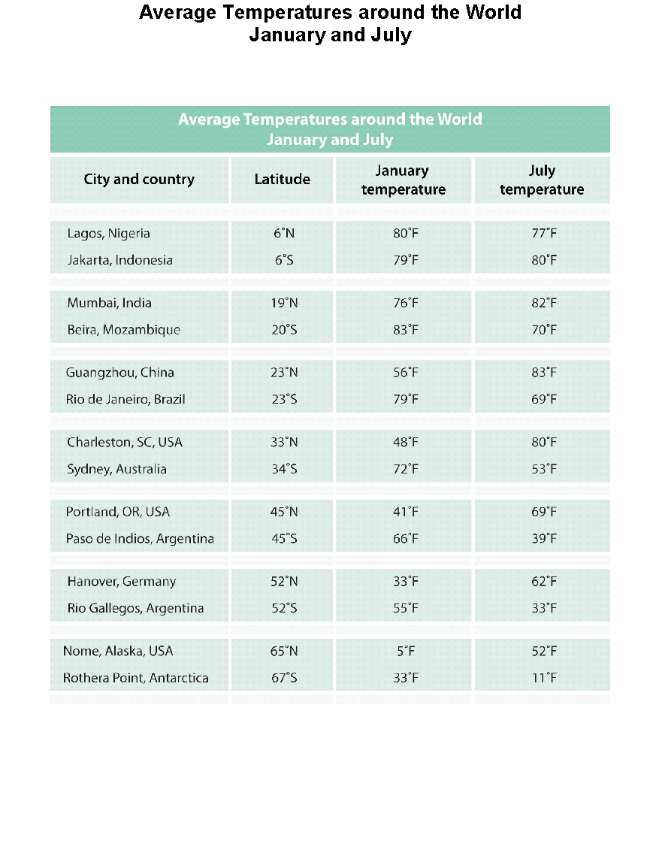
What patterns in temperature can you find on Earth at different times of the year?

Slide 9
What patterns in temperature can you find on Earth at different times of the year?
With your partner, record on the World Map Record Pages the temperature for each city.
Make sure you write temperatures for January on the map labeled “January” and temperatures for July on the map labeled “July”.
Notice the latitude of each city as you add the temperature.

Slide 10
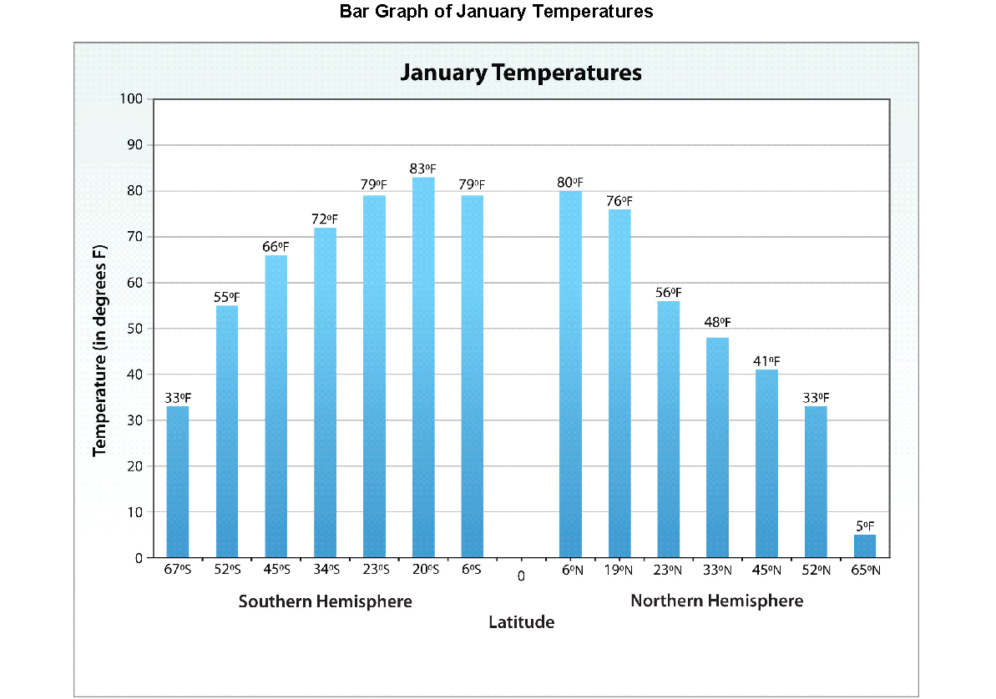
What patterns in temperature can you find on Earth at different times of the year?
Mark the equator on your maps.
The equator is at what degree of latitude?
Where do you see the latitude of the equator on this bar graph?

Slide 11
What patterns in temperature can you find on Earth at different times of the year?
Let’s make sense of our bar graphs.
What do the bars represent?
What labels are on the x- and y-axes?
How do the bars relate to the temperatures you wrote on the World Map Record Pages?

Slide 12
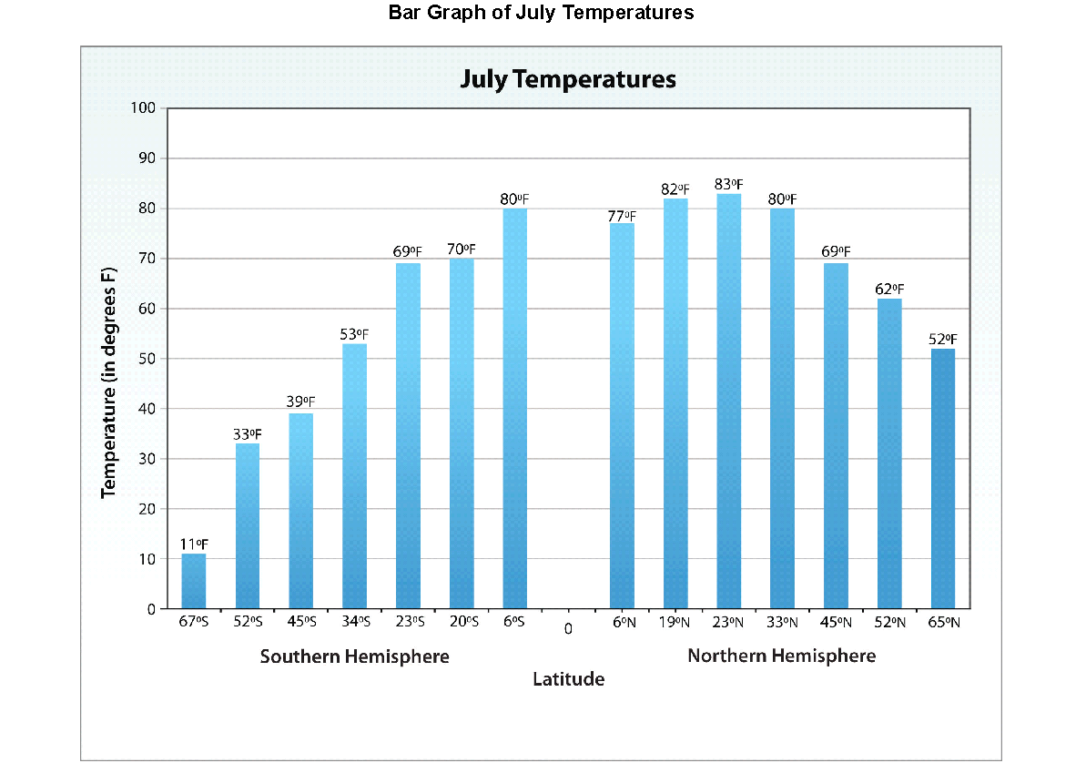
What patterns in temperature can you find on Earth at different times of the year?

Slide 13
What patterns in temperature can you find on Earth at different times of the year?
What patterns do you observe on the bar graphs of January and July temperatures?
Write the patterns in your science notebook.
Can you find patterns related to the month of the year—January versus July?
Can you identify patterns related to the Northern and Southern Hemispheres?
Use all your data sources to look for patterns.

Slide 14
What patterns in temperature can you find on Earth at different times of the year?
Let’s share our ideas.
Tell us one pattern you noticed related to latitude and temperature at various places on Earth.
Did any other team find the same pattern? Do you agree with the pattern your classmates described? If not, why not?

Slide 15
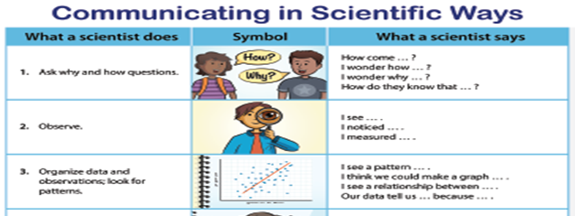
Summary: What patterns in temperature can you find on Earth at different times of the year?
In your science notebook, write all the patterns we identify. Remember, you can use this sentence starter:
The patterns I noticed in the data were …
1) …
2) …
3) …

Slide 16
Summary: What patterns in temperature can you find on Earth at different times of the year?
Did you notice these patterns?
What happens to the temperature if a city’s location is closer to the equator?
What happens to the temperature if a city’s location is farther away from the equator?
How do temperatures differ in January and July?
Are those patterns the same in the Northern Hemisphere and the Southern Hemisphere?

Slide 17
Summary: What patterns in temperature can you find on Earth at different times of the year?
bar graph
Which representation was most helpful to helping you identify the patterns in temperature?
Which was least helpful?
maps
data table

Slide 18
Introducing the Driving Question Board (DQB)
3.
1.
2.
?
?
?
4
1.
?
?
1.
1.
1.
?
?
?
1.
?
1.
1.
?
?
1.
1.
1.
?
1.
?
?
?

Slide 19
Summarizing Key Science Ideas
Refer to your list of patterns in your science notebook and answer this question:
What pattern do you think is most important in describing the temperature on Earth …
in different locations (circle these ideas) or
at different times of the year (underline these ideas)?

Slide 20
Lesson Summary: Key Science Ideas
Temperatures on Earth are generally warmer in locations closer to the equator.
Temperatures decrease as the latitude increases—as we move away from the equator either north or south.
Temperatures are not the same at all latitudes, especially at different times of the year. For example, temperatures are higher in the Northern Hemisphere during July and higher in the Southern Hemisphere in January.

Slide 21
How did using the sentence starters help you?

Slide 22
In the next lesson, you will think about …
What causes the average temperatures on Earth near the equator to be higher than the average temperatures on Earth far from the equator?

