Slide 1
Sun’s Effect on Climate
Lesson 2

Slide 2
Unit Central Question
Why are some places on Earth hotter than others at different times of the year?

Slide 3
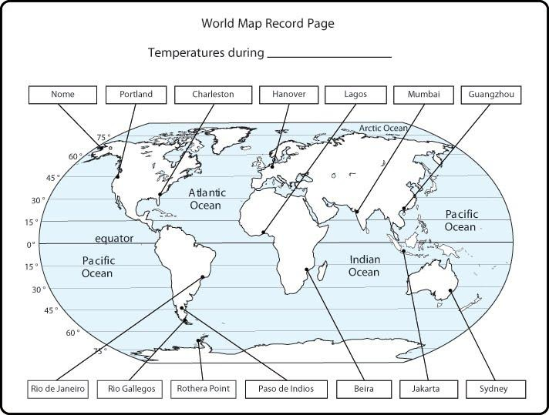
Link to Previous Lesson
What were some patterns we noticed in the temperature maps from last time?

Slide 4
Lesson 2 Focus Question
What causes the average temperatures on Earth near the equator to be higher than the average temperatures on Earth far from the equator?

Slide 5
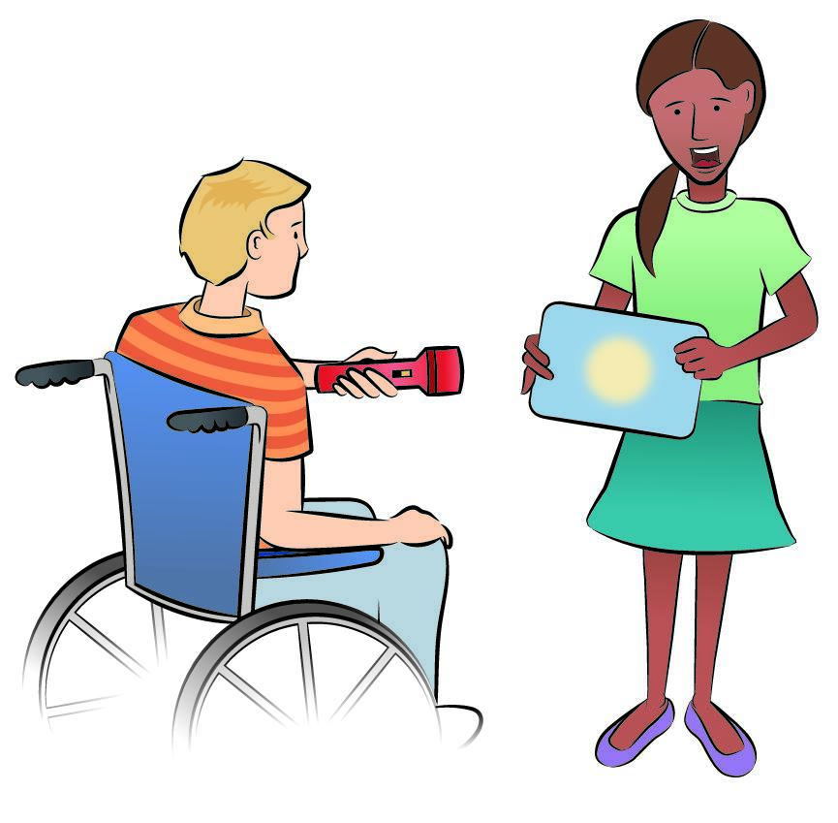
Investigation 1: Energy Angles
Today we will conduct an investigation to learn about angles of sunlight and Earth’s surface.
We will use trays, graph paper, and flashlights

Slide 6
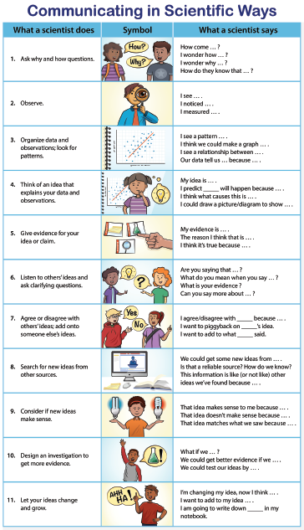
We will use these sentence starters today.

Slide 7
Investigation 1: Energy Angles
Before we begin, what do you think will happen to the image of light on the graph paper if the light shines straight at the tray?
Will the image of the light change in any way when you tilt the tray?
I predict the light will / won’t change because I think ______________________.

Slide 8
Analogy Map: Energy Angles Investigation
Part of the model | ... is/are like … | Part of the real world | They are alike because | They are different because

Slide 9
Investigation 1: Energy Angles
Number of Lighted Squares
Straight on | At an angle
What pattern do you see between the two columns?

Slide 10
Investigation 1: Energy Angles
In your science notebook, answer these questions:
On which piece of graph paper would you feel the most heat? Why do you think so?
On which piece of graph paper would you not feel as much heat? Why?

Slide 11
Investigation 1: Energy Angles
Let’s think about these questions:
Would each square on the graph paper in Column 2 have more or less light energy than the ones in column 1?
When is light energy more concentrated—when it shines straight on or when it shines at an angle? What is your evidence for this cause-effect relationship?

Slide 12
Investigation 1: Energy Angles and Earth
Now, let’s try it with our inflatable globes and flashlights. Think about these questions:
If we shined the flashlight horizontally on the globe, where do you think the light will shine most directly?
Are there parts of the globe where the light will strike the surface less directly, like when you tilted the tray?

Slide 13
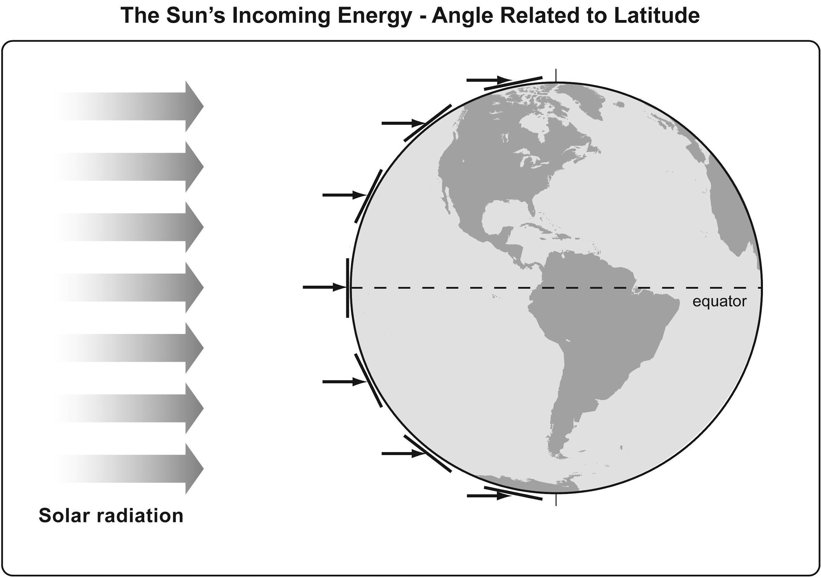
Making Connections
How does our flashlight-and-tray model relate to this model?

Slide 14
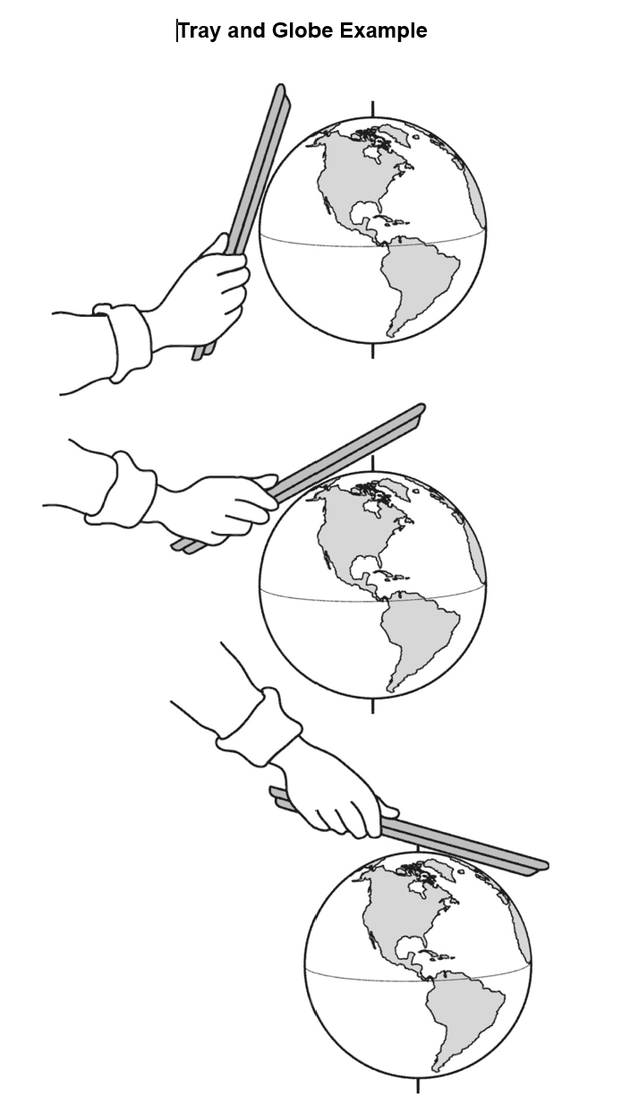
Making Connections
What similarities do you notice with this model and the previous diagram model?
What about the flashlight and tray model?

Slide 15
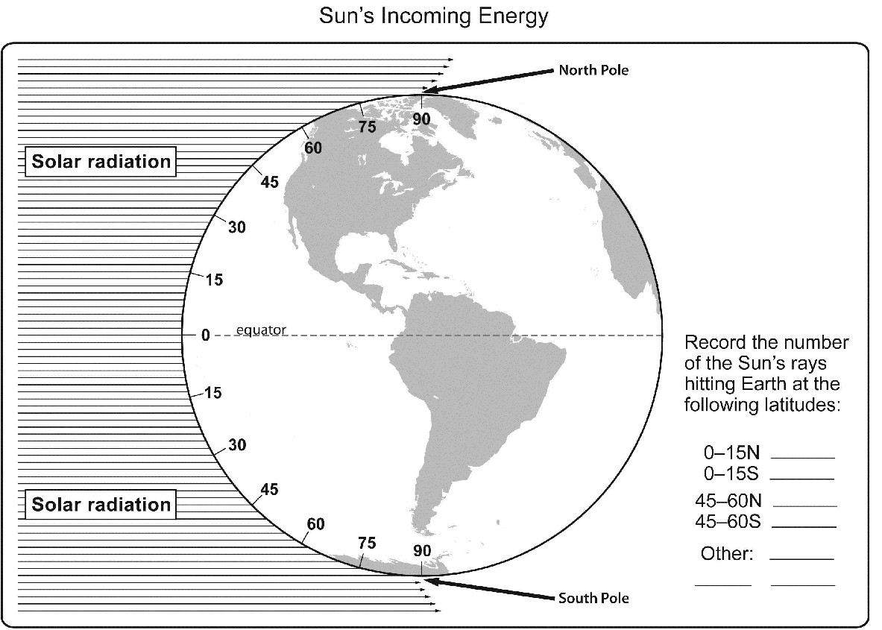
Investigation 2: Concentration of Solar Radiation

Slide 16
Investigation 2: Concentration of Solar Radiation
Now that you have counted the rays, let’s discuss:
Can we really count rays from the Sun?

Slide 17
Investigation 2: Concentration of Solar Radiation
Did you find any patterns in your data?
Where is the Sun’s light energy more concentrated? What is your evidence?
Where is the Sun’s energy more spread out? What is your evidence?

Slide 18
Lesson Summary: Focus Question
Let’s revisit today’s Lesson Focus Question:
What causes the average temperatures on Earth near the equator to be higher than the average temperatures on Earth far from the equator?
With your partner …
Come up with the best explanation for why you think it is hotter closer to the equator and cooler as you move toward the poles.

Slide 19
Lesson Summary: Key Science Ideas
We focused on the angle of the Sun’s light.
We used two different models to focus on what happens to the angle at which the Sun’s light strikes our curved Earth.
We used our data to explain that when sunlight directly hits Earth, the sunlight is more intense and Earth’s surface will get warmer.
When sunlight strikes Earth’s surface at an angle—when we move from the equator to the poles—then the Sun’s light is less concentrated and the surface does not warm as much.

Slide 20
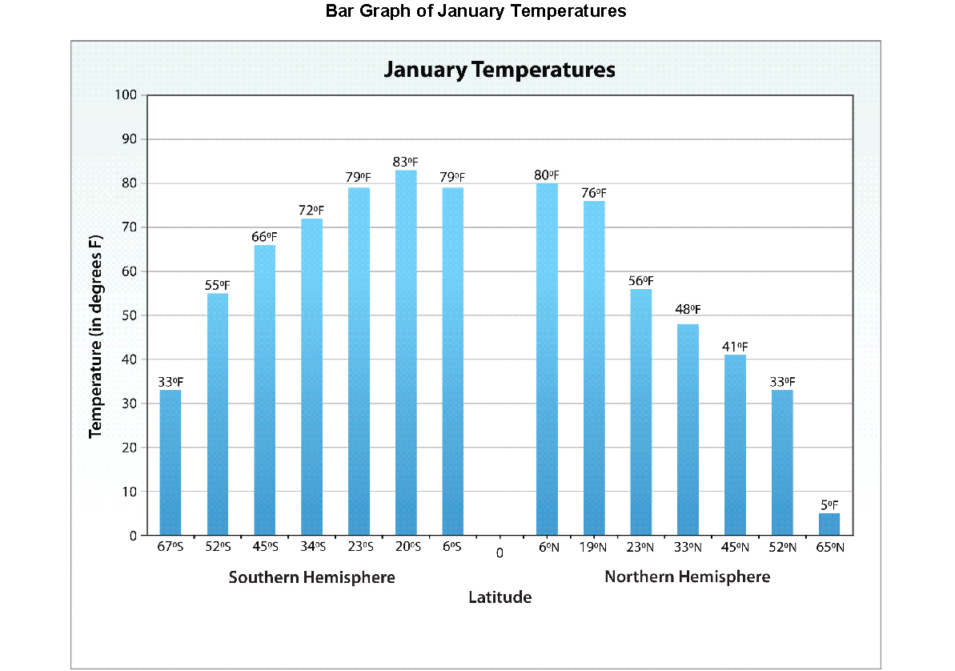
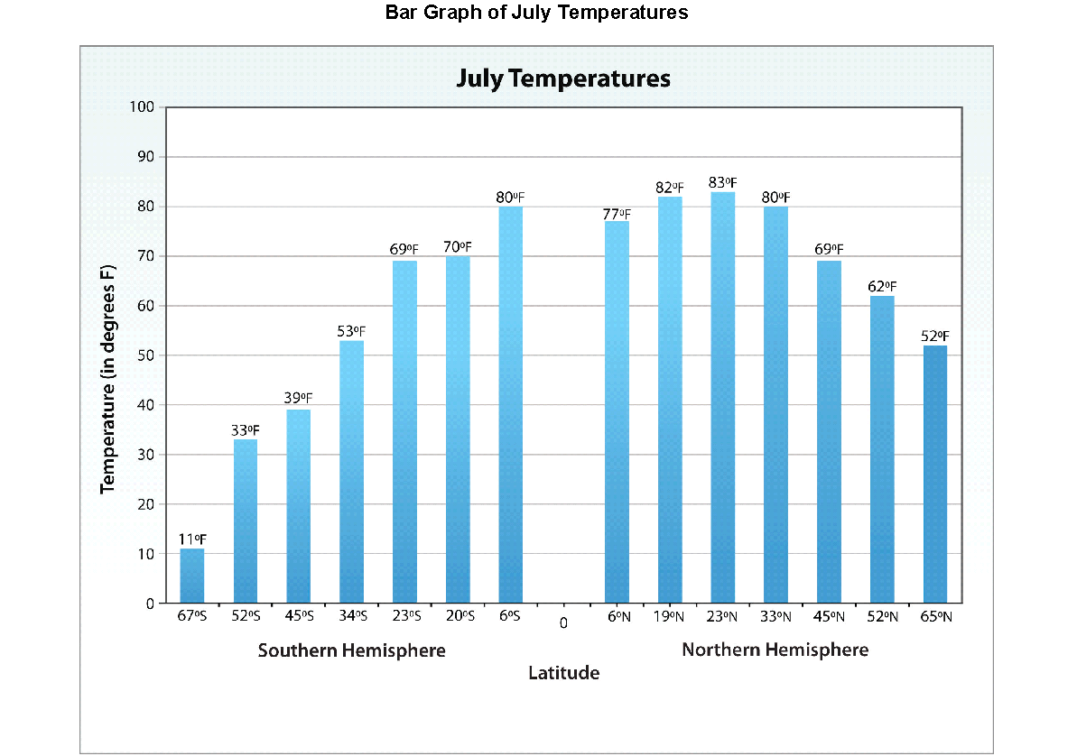
Link to Previous Lesson
Let’s look back at the bar graphs from Lesson 1: What do you observe?

Slide 21
Introducing the Driving Question Board (DQB)
3.
1.
2.
?
?
?
4
1.
?
?
1.
1.
1.
?
?
?
1.
?
1.
1.
?
?
1.
1.
1.
?
1.
?
?
?

Slide 22
In the next lesson, you will think about …
Why is it summer in the United States (Northern Hemisphere) when it is winter in Argentina (Southern Hemisphere)?

