Slide 1
Sun’s Effect on Climate
Lesson 4

Slide 2
Unit Central Question
Why are some places on Earth hotter than others at different times of the year?

Slide 3
Link to Previous Lessons: The Sun’s Effect on Climate and Seasons
What patterns did we observe on the temperature bar graphs from Lesson 1?
What important science ideas have we learned from our lessons so far?
(State the science ideas in complete sentences.)

Slide 4
Link to previous lessons: The Sun’s effect on climate and seasons
How did our model in Lesson 3 of Earth’s orbit around the Sun help us understand seasons?
What can you tell me about the angle of sunlight when it strikes Earth and how it affects temperatures?
What data did we use to help us investigate the angle of the Sun’s light when it strikes Earth?

Slide 5
Lesson 4 Focus Question
What causes winter in the United States to occur in December–February and summer to occur in the United States in June–August?
What is happening in Brazil, and why?

Slide 6
Investigation: Why is it warmer in the summer than in the winter?
Let’s use our model to remind ourselves of Earth’s orbit around the Sun.
What is important about the four positions in the orbit?
Do you agree/disagree with this team’s model of Earth’s orbit?
What would you like to add or change to make the model more scientifically accurate?

Slide 7
Investigation: Why is it warmer in the summer than in the winter?
Observe the position of Earth in our Sun's Incoming Energy handout from Lesson 2.
What is different about the position of Earth in this handout and in our model of Earth’s orbit?

Slide 8
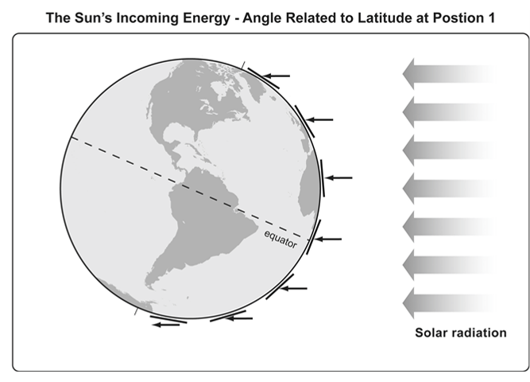
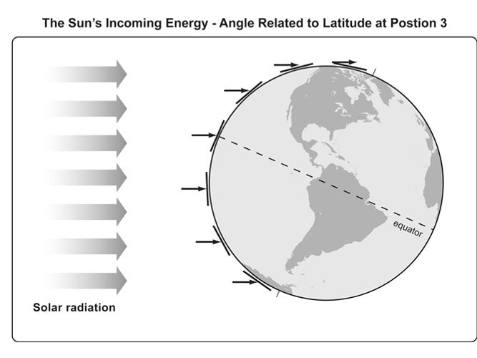
Investigation: Why is it warmer in the summer than in the winter?
Do you think the tilt will make a difference in where the Sun’s light strikes Earth directly or at an angle?

Slide 9
Investigation: Why is it warmer in the summer than in the winter?
Something to think about …
I think adding Earth’s tilt [will change/will not change] where the Sun’s light strikes Earth more directly or at an angle.
My evidence is _______________.

Slide 10
Investigation: Why is it warmer in the summer than in the winter?
Let’s review today’s investigation.
Angle of Sunlight and Seasons on Earth
Purpose: This activity will help us collect evidence to answer our focus questions: What causes winter in the United States to occur in December–February and summer to occur in the United States in June–August? What is happening in Brazil, and why?

Slide 11
Investigation: Why is it warmer in the summer than in the winter?
Team Task: As Earth orbits the Sun, describe what happens to the angle of sunlight hitting Earth at different times of the year.
Focus your attention on the effect of Earth’s orbit and tilt of the axis. Be prepared to share your ideas.

Slide 12
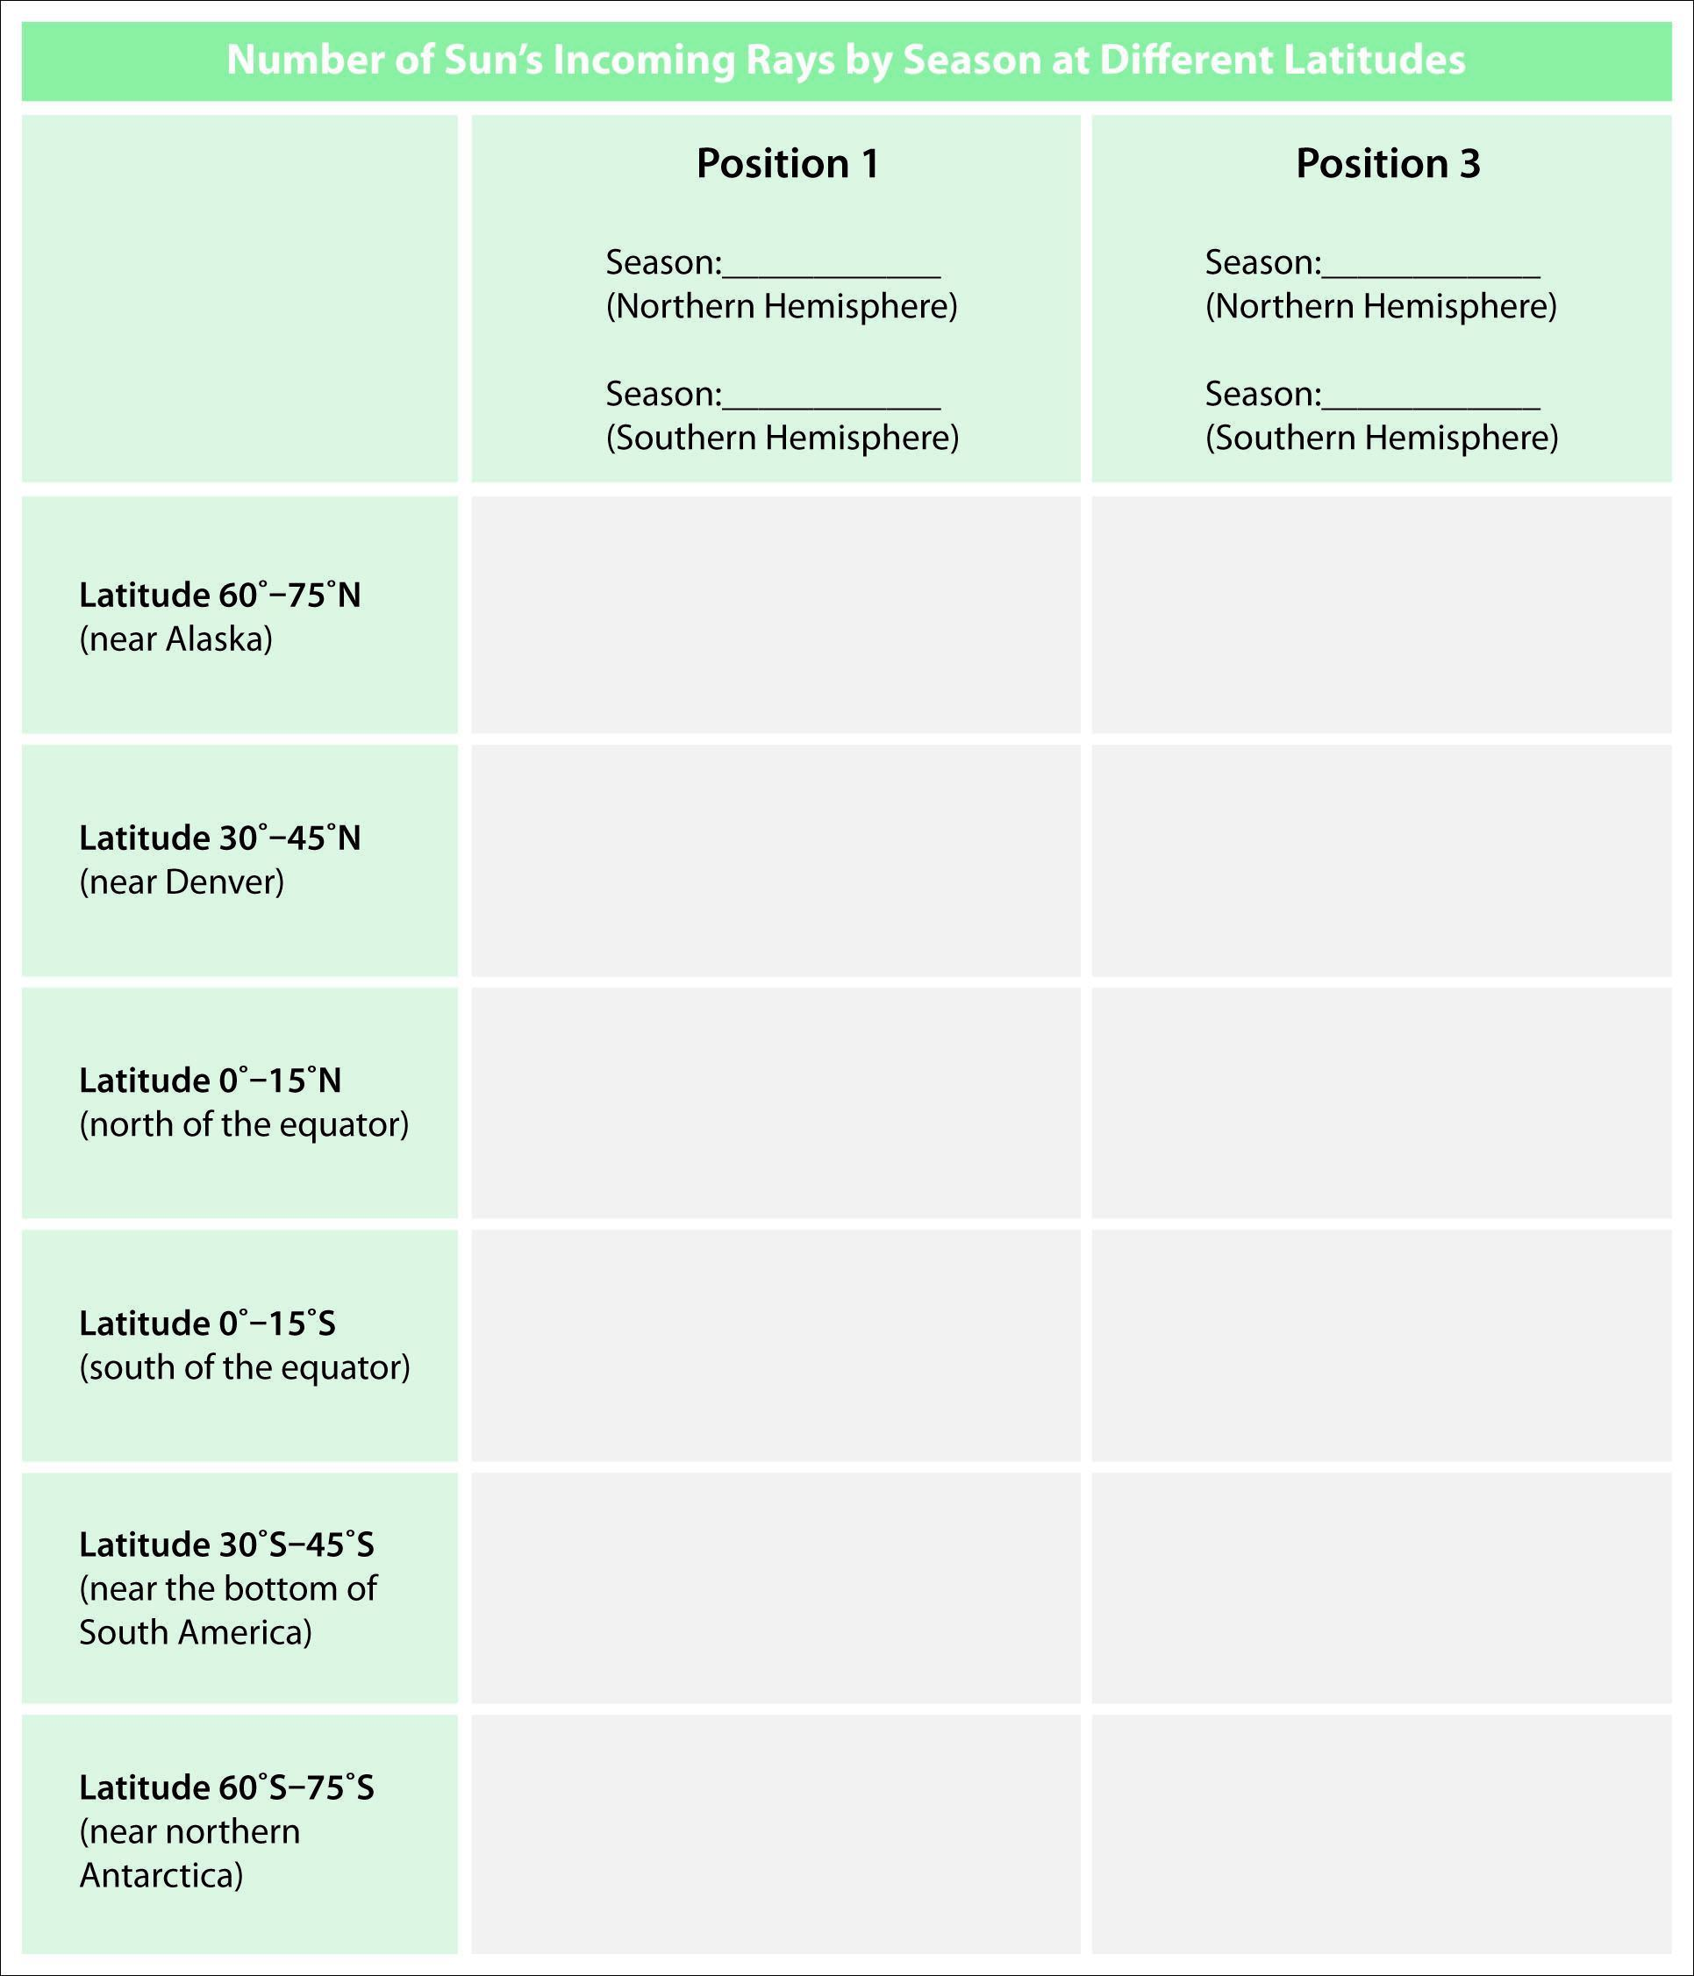
Investigation: Why is it warmer in the summer than in the winter?
Record your data.

Slide 13
Investigation: Why is it warmer in the summer than in the winter?
Set up your model of Earth’s orbit and start collecting your data to answer our Lesson Focus Question.
I will provide additional handouts as each team is ready.
As you complete your data table, record your data on chart paper so we can easily compare our class data. (Write in large numbers!)

Slide 14
Investigation: Why is it warmer in the summer than in the winter?
Let’s look at the data we collected:
What is the variation in the number of lines of solar radiation we counted?

Slide 15
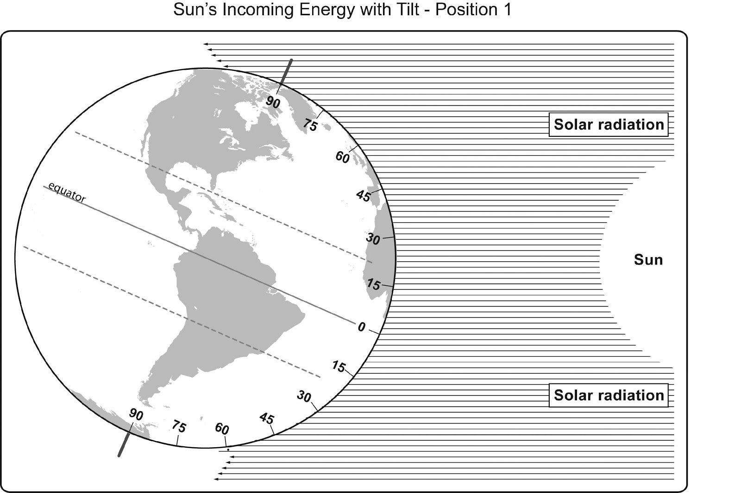

Slide 16
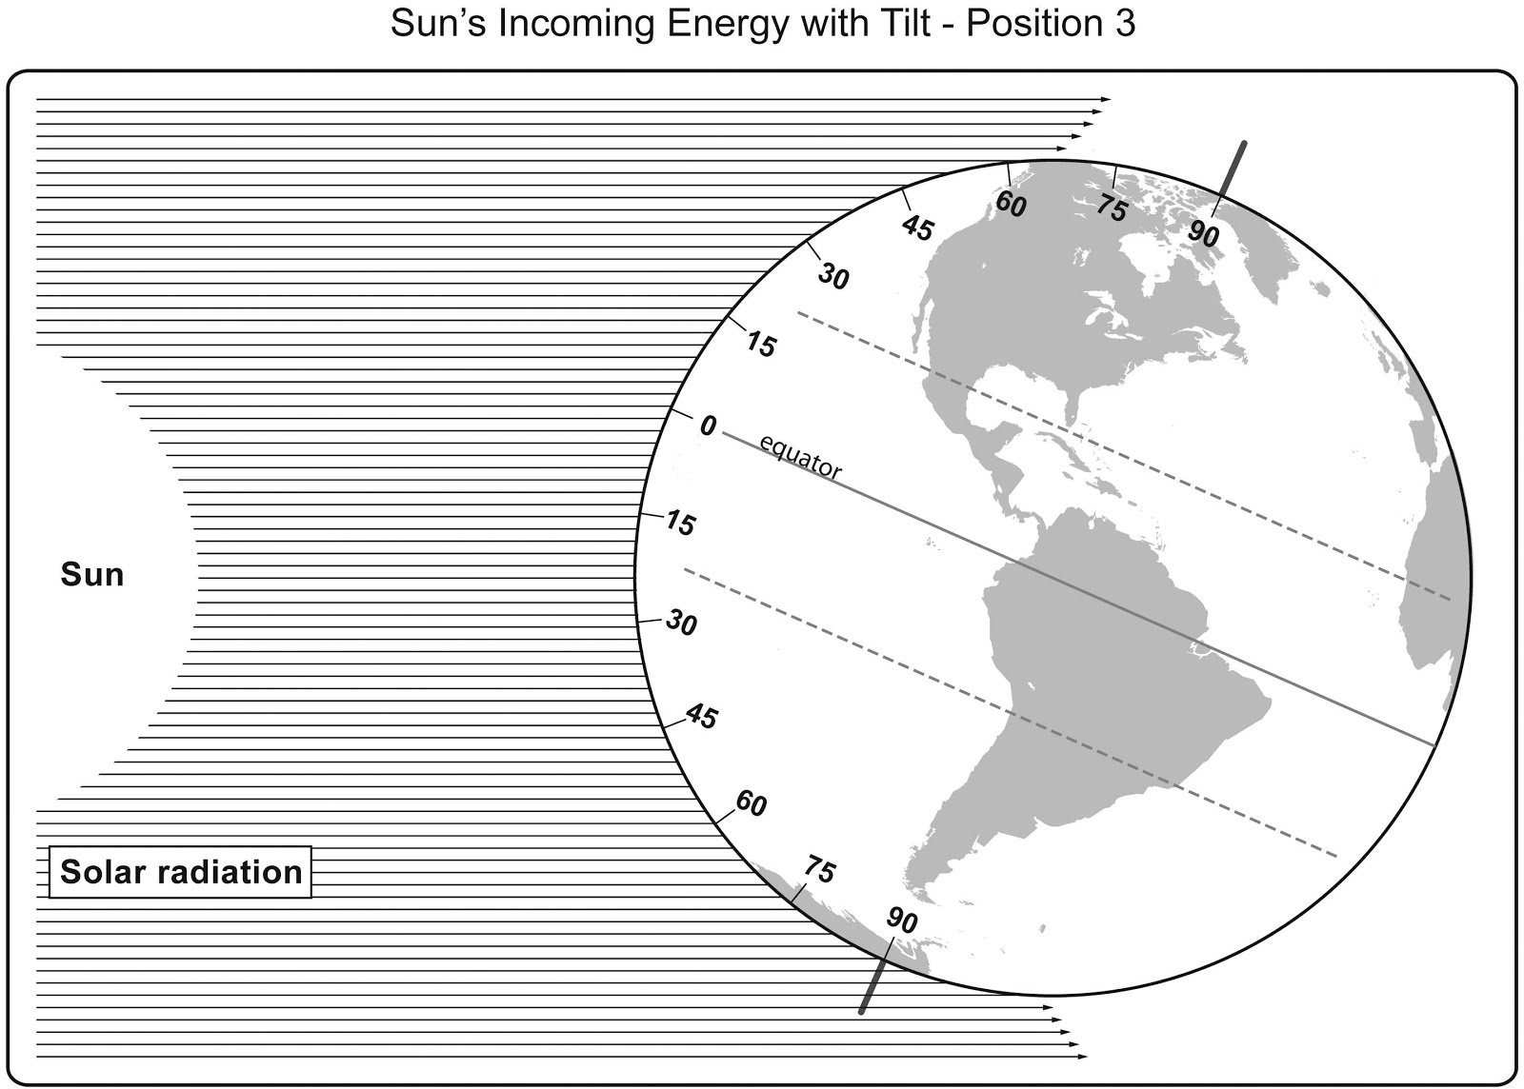

Slide 17
Investigation: Why is it warmer in the summer than in the winter?
Where was the Sun’s light more concentrated (more direct)?
In position 1?
In position 3?
Think about your graph paper cut outs from Lesson 2. Where on Earth’s surface would the light be
more concentrated?
more spread out?

Slide 18
Investigation: Why is it warmer in the summer than in the winter?
As Earth orbits the Sun, does the distance between the Sun and Earth ever change?
If it’s not the distance between Earth and the Sun that changes the average temperatures to be higher or lower in different seasons, then what does make the difference?

Slide 19
Investigation: Why is it warmer in the summer than in the winter?
Let’s compare our current data with our data from Lesson 2.
How do the numbers of the Sun’s rays compare with and without a tilted Earth at
0°–15° N latitude?
30°–45° S latitude?
60°–75° N latitude?

Slide 20
Investigation: Why is it warmer in the summer than in the winter?

Slide 21
Lesson Summary: Key Science Ideas and Today’s Focus Question
When the angle of sunlight is more direct, the sunlight is more intense and Earth’s surface will get warmer.
When sunlight striking Earth’s surface is less direct, then the Sun’s light is less concentrated and the surface does not warm as much.
Based on today’s investigation, use these key science ideas to answer today’s focus questions.

Slide 22
Lesson Summary: Key Science Ideas
We experience summer in June, July, and August in the Northern Hemisphere because Earth’s tilt gives us more-direct light at northern latitudes than during the other months of the year.
People in the Southern Hemisphere experience summer in December, January, and February because the Sun’s light is more direct in the southern latitudes when the South Pole points toward the Sun.

Slide 23
Lesson Summary: Key Science Ideas
Summer and winter in the two hemispheres occur at opposite times of the year because Earth stays consistently tilted as it orbits the Sun.
This consistent tilt causes the Northern and Southern Hemispheres to receive the most intense sunlight during opposite times of Earth’s orbit around the Sun.

Slide 24
Introducing the Driving Question Board (DQB)
3.
1.
2.
?
?
?
4
1.
?
?
1.
1.
1.
?
?
?
1.
?
1.
1.
?
?
1.
1.
1.
?
1.
?
?
?

Slide 25
In the next lesson, you will think about …
Is there another factor, beyond latitude, that influences varying temperatures on Earth?

