Slide 1
Sun’s Effect on Climate
Lesson 5

Slide 2
Unit Central Question
Why are some places on Earth hotter than others at different times of the year?

Slide 3
Link to Previous Lesson
Talk with your teammates about our Unit Central Question.
I think some places on Earth are hotter than others at different times of the year because ____________________________.
My evidence from our previous lesson is ____________________________.

Slide 4
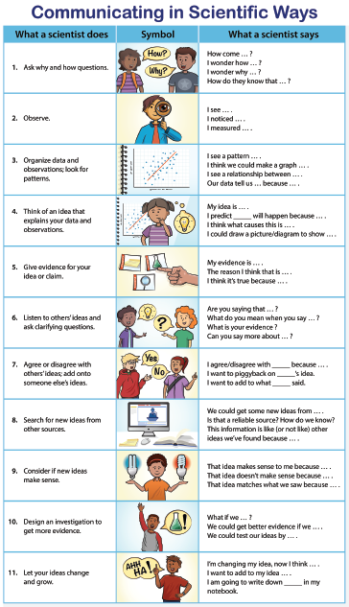
We’ll make meaning of data today. Choose one or two strategies that you will use when you share your thinking.

Slide 5
Before We Begin
How long does it stay light on summer evenings compared to winter evenings?
How late are you able to stay outside playing before you have to come inside because it gets dark in the summer compared to in the winter?

Slide 6
Lesson 5 Focus Questions
Why is there more daylight in the summer days than in the winter days? How does the amount of daylight affect the temperature of the area?

Slide 7
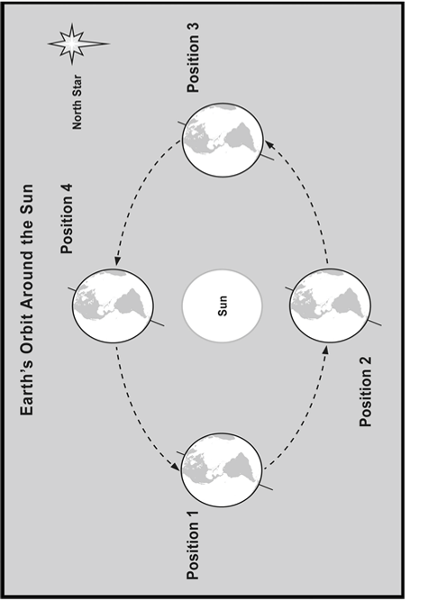
Investigation: Why is there more daylight in the summer days than in the winter days?

Slide 8
Investigation: Why is there more daylight in the summer days than in the winter days?
Now, let’s look at some additional data to see if they help us answer our focus question: Why is there more daylight in the summer days than in the winter days?
We also want to know, How does the amount of daylight affect the temperature of the area?

Slide 9
Using Data and Representations
What do you notice about this drawing? What does this drawing represent?

Slide 10
Using Data and Representations
Discuss in your small groups:
How does length of daytime change with latitude?
Are parts of Earth always dark? If yes, use latitude to describe where.
Are parts of Earth always in light? If yes, use latitude to describe where.
At which latitude(s) are there equal lengths of daytime and nighttime?

Slide 11
Using Data and Representations
Let’s share our ideas:
How do you think more or less daylight in different parts of the world might affect how warm (with higher average temperatures) or how cold (with lower average temperatures) it is?

Slide 12
Using Data and Representations
Another question to consider
If the length of daytime makes it warmer, will the summer temperatures at the poles when they have 24 hours of daylight be higher than at the equator?

Slide 13
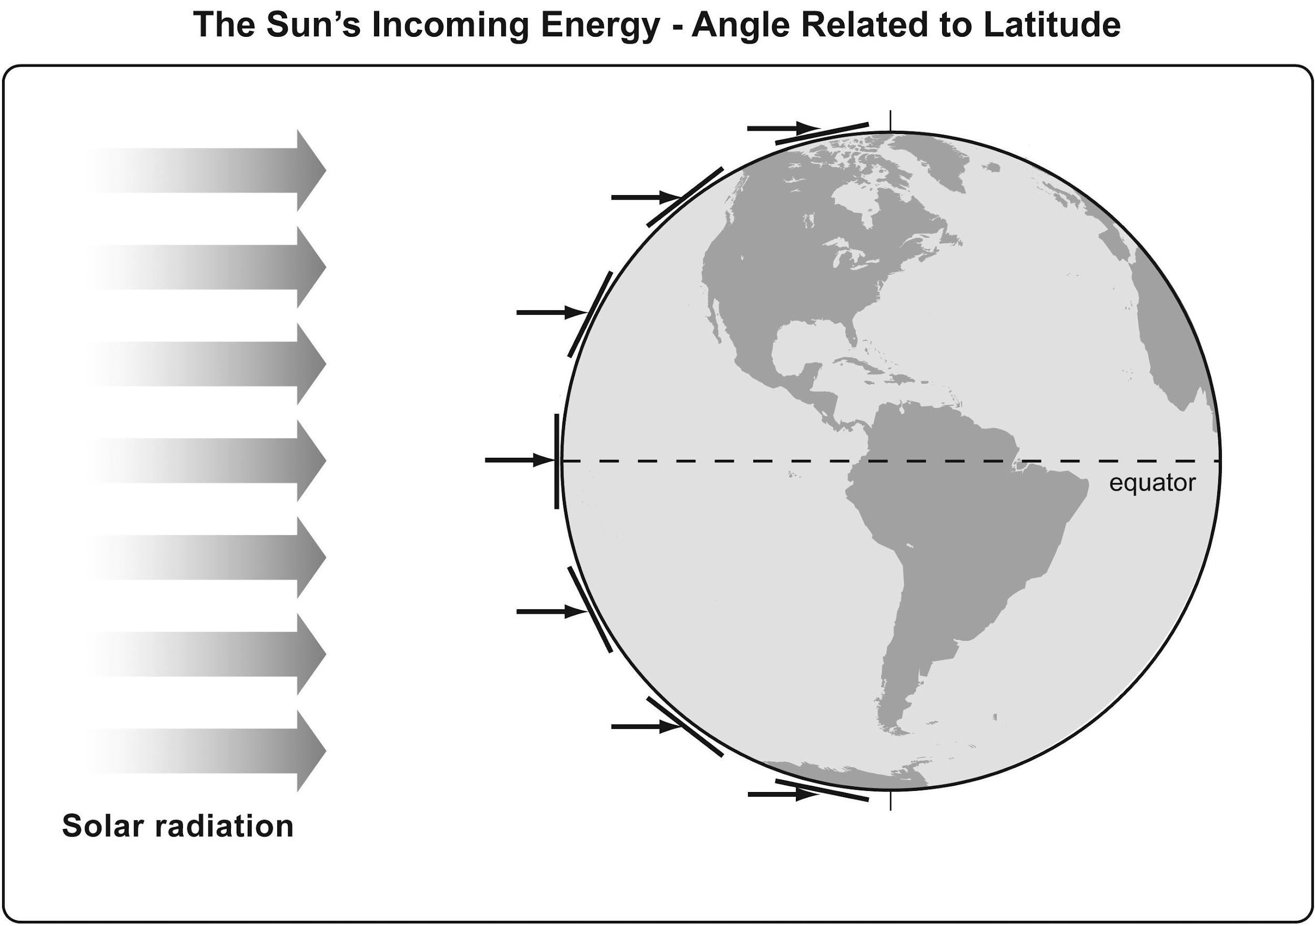
Lesson Summary: Key Science Ideas
We have seen one reason why it is warmer in the summer than in the winter:
The Sun’s rays hit certain parts of Earth more straight on and other places at more of an angle, more spread out.

Slide 14
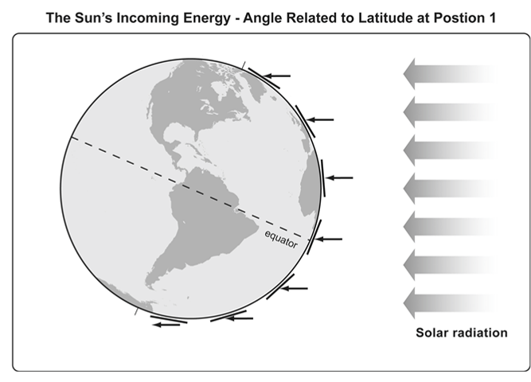
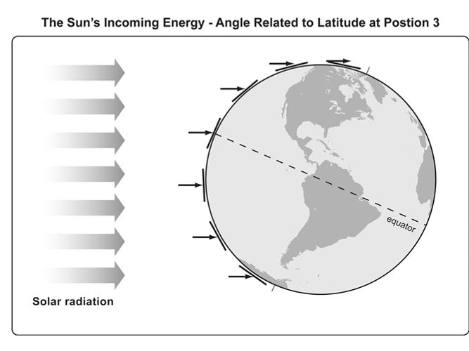
Making Connections
We also learned …
As Earth orbits the Sun, the angle that sunlight strikes the surface changes at different times of the year.

Slide 15
Lesson Summary: Key Science Ideas
Now, let’s think about the pattern:
How well does the pattern of daylight and nighttime match what we saw with the angle of sunlight striking Earth?

Slide 16
Lesson Summary
In today’s lesson, your diagram (model) and data table represented winter in the Northern Hemisphere. Discuss these questions in your group.
What would the model look like when it is summer in the Northern Hemisphere?
How do you think the data of sunlight hours would change? Why?

Slide 17
Lesson Summary
Your response should include the following:
A labeled diagram of Earth and the Sun’s rays when it is summer in the Northern Hemisphere
Under your diagram, complete the following sentence stems:
This diagram is different from the winter model because .
The difference in the number of sunlight hours data will be .
This is because .

Slide 18
Revisiting Lesson 5 Focus Questions
Why is there more daylight in the summer days than in the winter days? How does the amount of daylight affect the temperature of the area?

Slide 19
Introducing the Driving Question Board (DQB)
3.
1.
2.
?
?
?
4
1.
?
?
1.
1.
1.
?
?
?
1.
?
1.
1.
?
?
1.
1.
1.
?
1.
?
?
?

Slide 20
In the next lesson, you will think about …
How can you apply your knowledge about these concepts to four challenges related to our Unit Central Question: Why are some places on Earth hotter than others at different times of the year?

