Slide 1
Matter Lesson 1

Slide 2
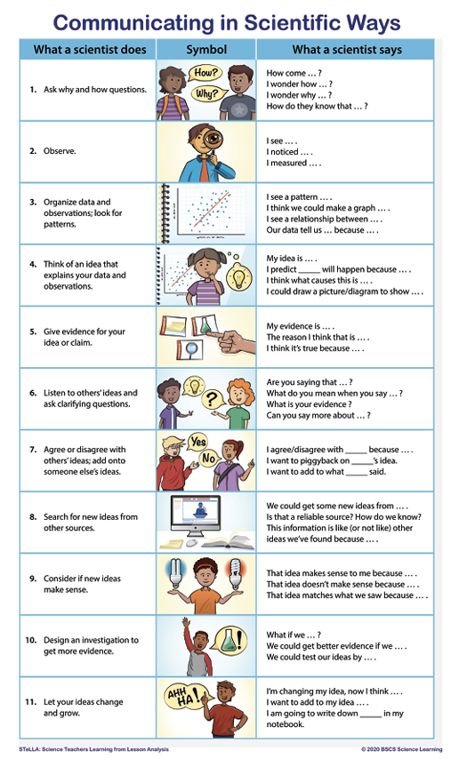
Communicating in Scientific Ways

Slide 3
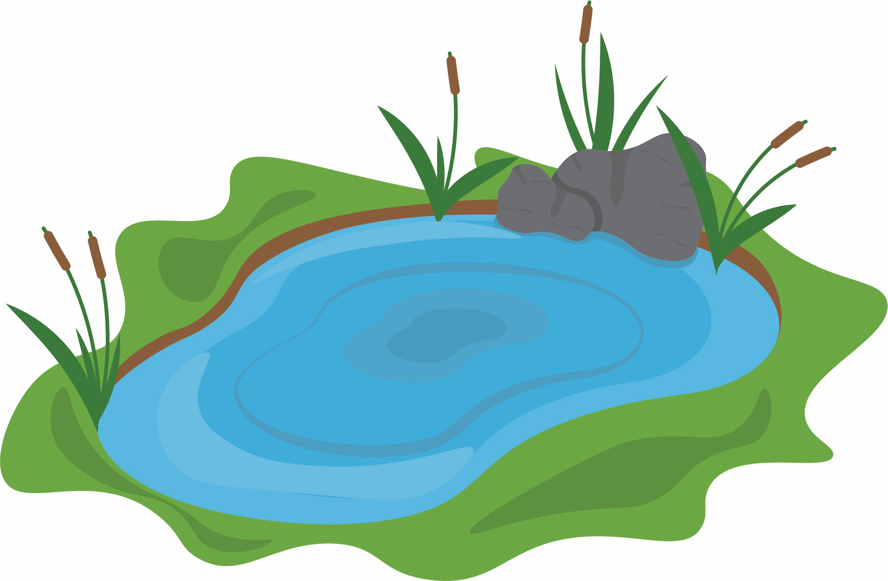
The Situation
Notes:
https://pixabay.com/photos/lake-aerial-view-fields-meadows-2755907/

Slide 4
Lesson 1 Focus Question
What is changing in the water that is causing the death of living things, and how can we, as scientists, investigate the water?

Slide 5
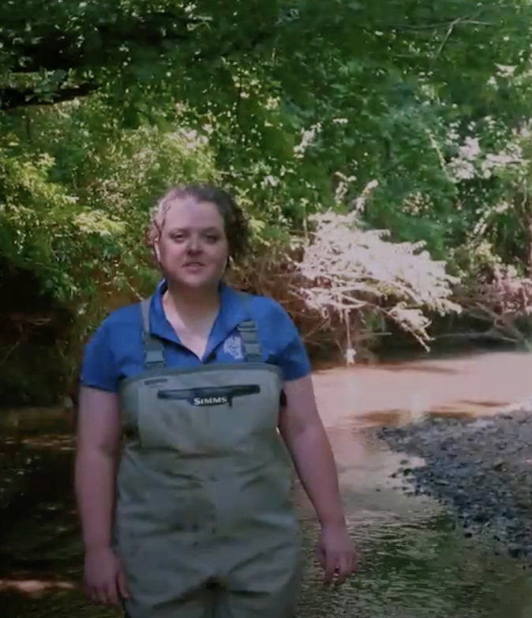
A Field Trip to the Tennessee Aquarium
Sarah is from the Tennessee Aquarium in Chattanooga, TN.
She is going to help us with our question:
How can we figure out what was mixed with pond water that could have changed the water?
Notes:
https://www.dropbox.com/sh/3ncw2sri0spfpe3/AACG0WViwHRu3P44B8t0-AL3a?dl=0

Slide 6
Notice and Wonder
Looking at the two samples, what do you notice? What do you wonder ?
Notice | Wonder

Slide 7
Developing Models
Develop a model to show us what you're picturing.
Imagine you zoom way WAY in to each sample.
Use words, pictures, and/or symbols to show what each sample looks like.
Capture your questions at the bottom of the page.
Testable or non-testable?

Slide 8
Our Questions
Write down your testable questions, one per sticky note.
Notes:
Create a list of pollutants (salt, dirt, fertilizer, Soap, oil)
Generate ideas for testing
Explain that we have samples of these pollutants to investigate
How might we investigate these pollutants to find out if they are in the water?
*Why might it me helpful for each of our groups to record information in a similar way?
*Does anyone have ideas about how we can organize that information ?

