Slide 1
Matter Lesson 5

Slide 2
Link to Our Last Lesson
What factors affect how quickly soluble solids dissolve into water?

Slide 3
Link to Our Last Lesson
What can we learn about possible dangerous materials in the pond water?
Are there any we have eliminated? Are there any that we can eliminate now?

Slide 4
Lesson 5 Focus Question
How can we identify the pollutants in the pond water?
What ideas and/or questions do you have?

Slide 5
What evidence would support each claim?
Counterclaims | Evidence
There is fertilizer in the unhealthy pond water.
There is not fertilizer in the unhealthy pond water.
There is detergent in the unhealthy pond water.
There is not detergent in the unhealthy pond water.
There is salt in the unhealthy pond water.
There is not salt in the unhealthy pond water.

Slide 6
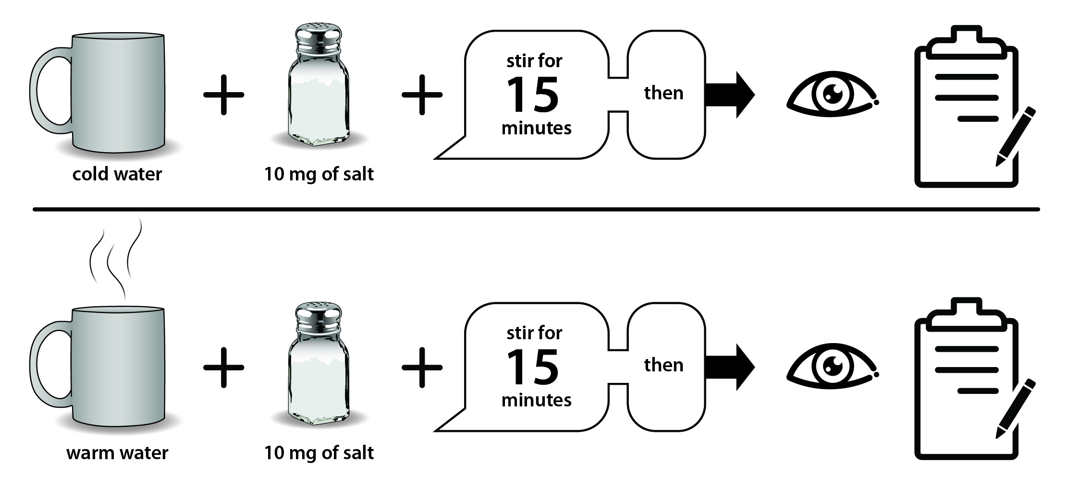
Example Investigation Procedure

Slide 7
Sharing Our Plans for Feedback
What are some examples of the type of feedback that will help your group improve your plan?
Write your feedback on a sticky note: write one comment per sticky note and put your name on the note so they know who to follow up with if the group has questions.
Each group should try to leave at least two comments on each of the other groups’ plans.

Slide 8
Considering Feedback
Review your feedback and consider what adjustments you should make to improve your investigation procedure.
When you have completed your revisions, you will show me your plan for one final review before you begin your investigation.

Slide 9
Review Your Data
You will have about 10 minutes to review the data you collected.
Discuss as a group what evidence you have and if any of that evidence supports one of the claims on our charts.
Write your evidence out on sticky notes just as you did earlier in this lesson.
Remember to write one piece of evidence per sticky note.

Slide 10
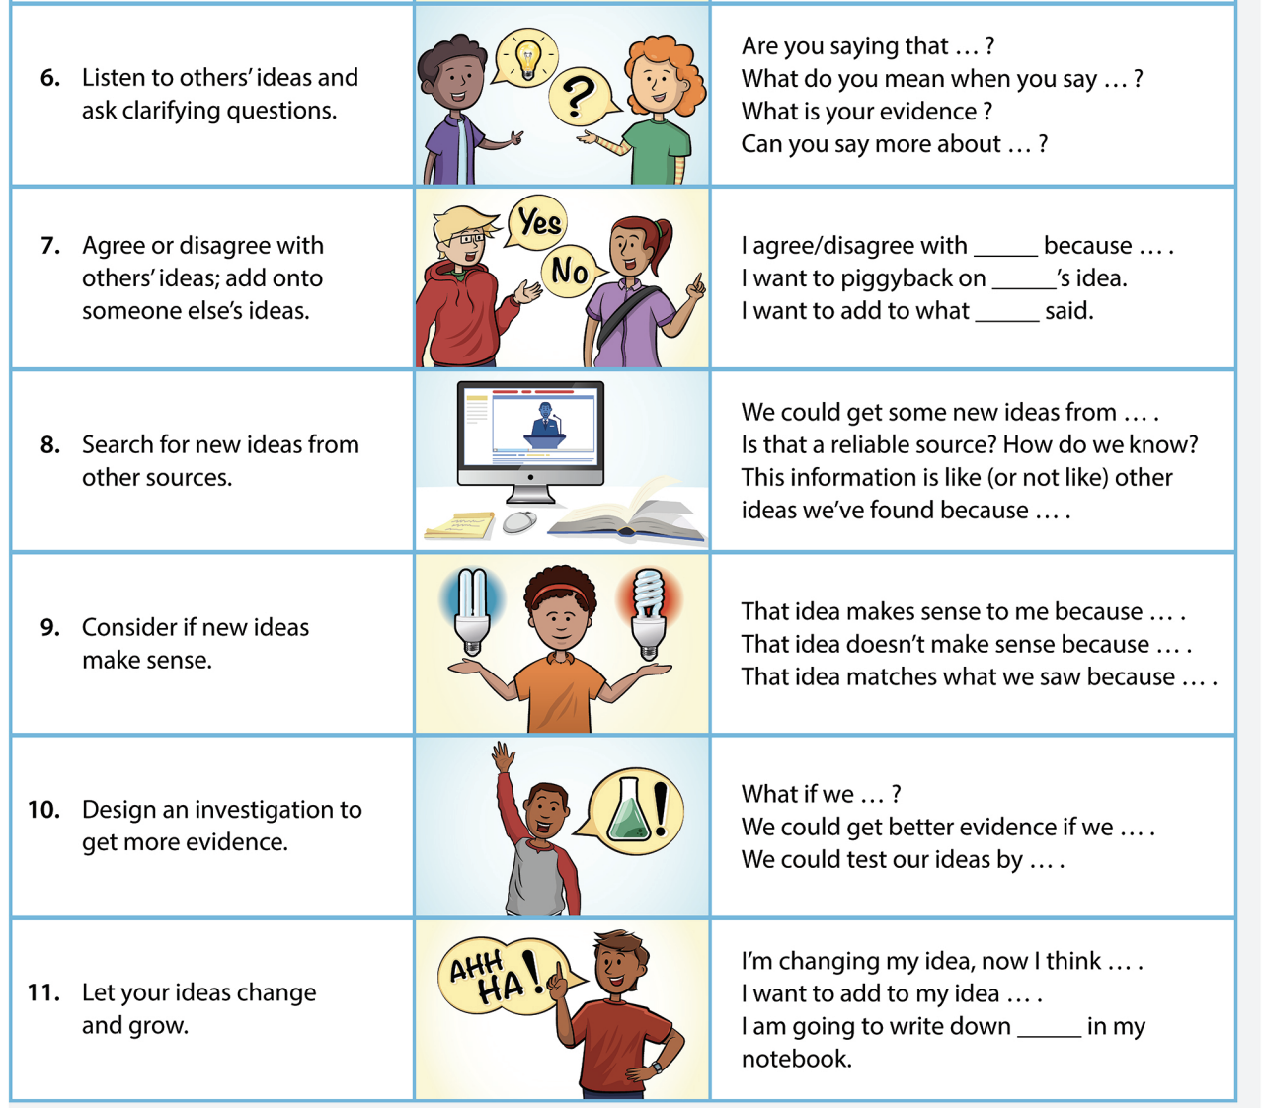
Sharing Our Evidence

Slide 11
Write an Argument: What pollution is in the pond water?
Select a claim and support that claim with evidence.
Include a statement about why you selected the evidence to support your claim.
You can have more than one piece of evidence to support a claim.
You may select more than one claim if you think there is evidence to support more claims.

Slide 12
Progress Tracker
Question​ | What I figured out​
How can we identify the pollutants in the pond water?​ | Use complete sentences! ​ ​ ​ ​ ​ ​ ​ ​

Slide 13
Link to Next Lesson
Can we get the water to be safe again?

