Slide 1
Matter Lesson 6

Slide 2
Link to Previous Lessons
Turn and talk with a partner.
Share about when you picture this pond water zoomed way, way in, what is the model you create in your mind to picture this pond water?

Slide 3
Returning to our Driving Question Board

Slide 4
Lesson 6 Focus Question
Can we get the water to be safe again?
Turn and talk with a partner

Slide 5
Removing Pollutants
Could we boil the water in the pond to clean it?
What else could happen in a pond that would be similar to this process?

Slide 6
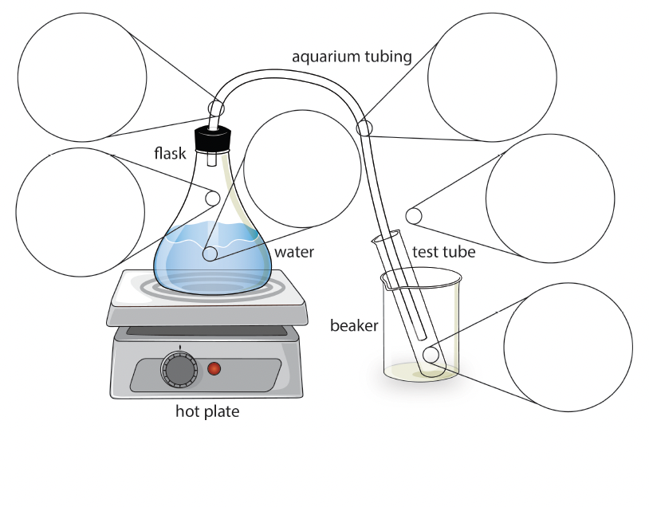
Water Distillation Apparatus

Slide 7
Predictions
Take a moment to think about what will happen when we boil the polluted water.
What do you predict will happen?
Would anyone like to share their predictions?

Slide 8
Recording Observations
Represent on the diagram what happened during the demonstration.
Share what you notice.
Think about how our understanding of this saltwater mixture as being made of different types of tiny particles too small to see may help explain what you notice.

Slide 9
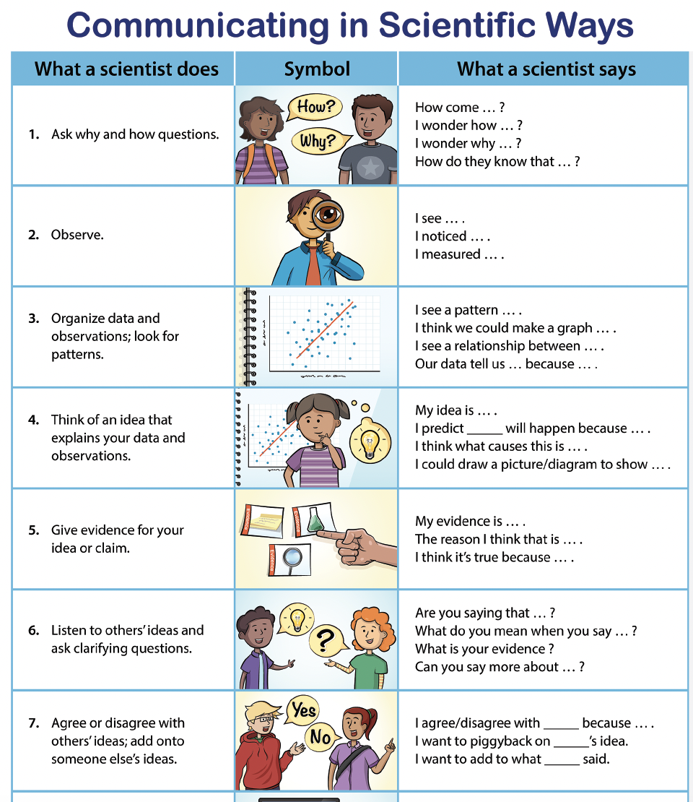
Using Our CSW Stems

Slide 10
Draw a sketch of what you picture inside

Slide 11
Sharing Our Diagrams
In your group, put all your papers together.
Take a couple minutes to observe one another’s ideas.
When signaled, share similarities and differences among all the diagrams.
This is not a time to agree or disagree with each other, but you may ask clarifying questions to understand why someone represented their ideas in a particular way.

Slide 12
Reviewing Our Data
When we boiled the polluted water, what happened? Where is the salt?
What evidence do we have to answer whether there is salt in the test tube in the end?
What does that tell us about whether and how we can make polluted water safe again?

Slide 13
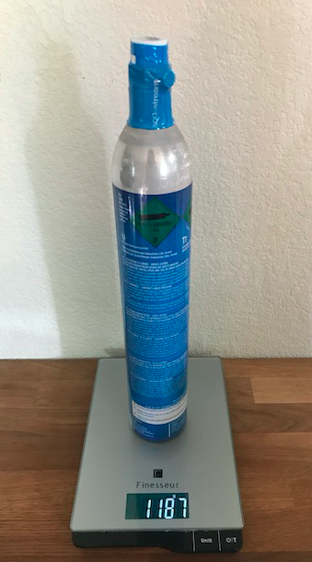
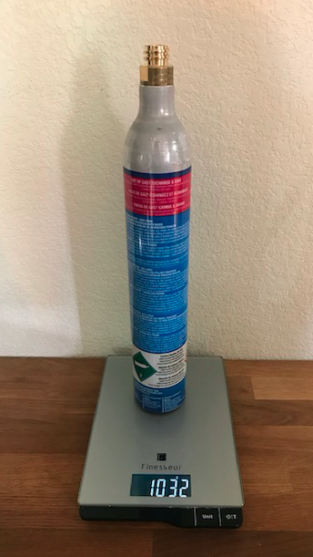
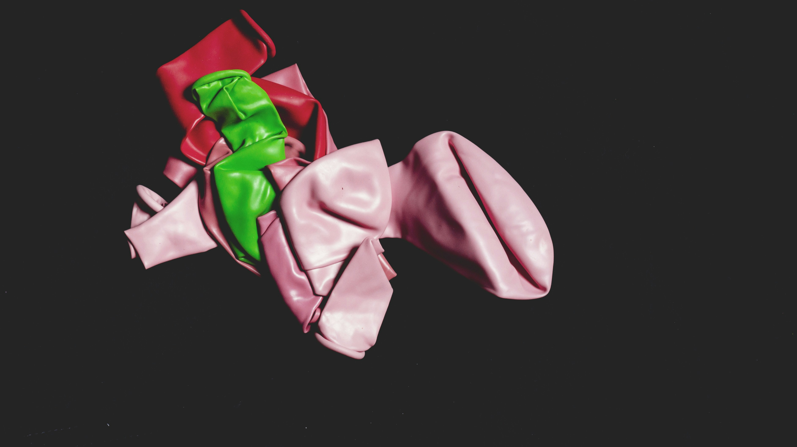
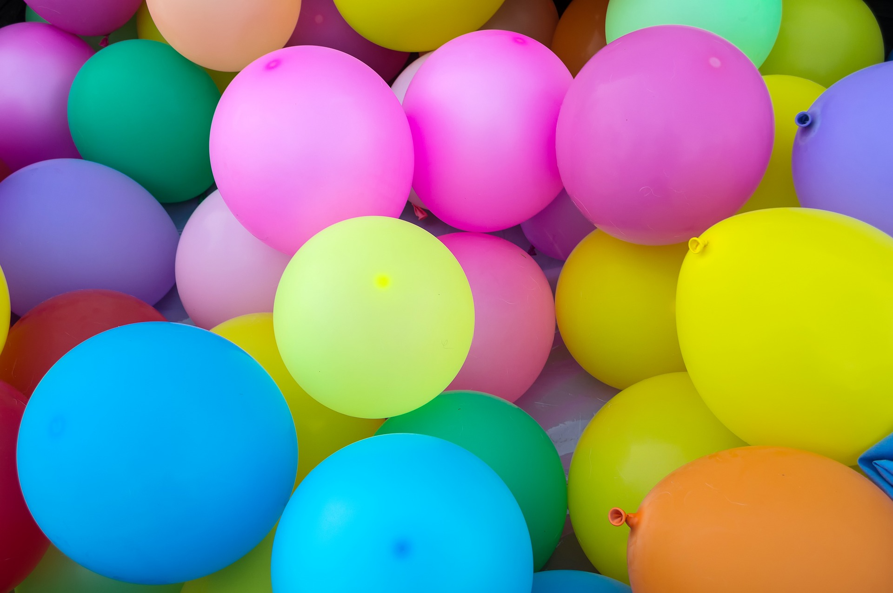
What happened to the water in this system?
Photo by Danilo Batista on Unsplash
What do you think of when you hear the word "gas"?
Photo by Danilo Batista on Unsplash
Image by Pexels from Pixabay
What do these images show us? ​
What would you see if you zoomed way, way in? ​
Notes:
2nd balloon picture: https://pixabay.com/photos/balloons-colorful-multicolored-1869790/
(not sure where the first one came from)
CO2 cartridge pictures are by Amy

Slide 14
What does it look like if you zoom way in?
With a partner, draw a sketch of what you think it looks like inside an empty balloon and inside a full balloon.
Photo by Danilo Batista on Unsplash
Image by Pexels from Pixabay

Slide 15
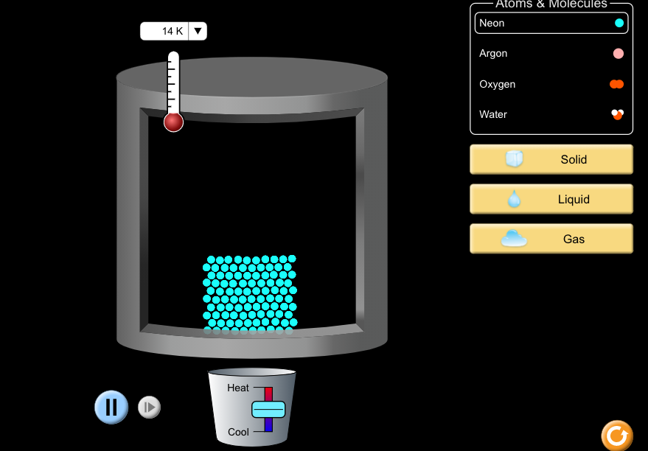
The PhET Computer Simulation
Link
Image is a screenshot from PhET simulation BSCS does not hold copyright to image.

Slide 16
Back to the Distillation Apparatus ...
Turn to a partner and talk about what happened to the water particles in the distillation apparatus earlier in our lesson.
Make sure you use the words “liquid” and “gas” when you talk about the particles.

Slide 17
Revising Our Diagrams
Take a minute to go back to your diagrams and add to or change the ideas you originally showed.
Be sure your sketches show that gas is made of particles too small to be seen.
Photo by Danilo Batista on Unsplash
Image by Pexels from Pixabay

Slide 18
Natural Boiling?
What is the process that happens in nature where liquid turns into a gas, like we saw today?

Slide 19
Progress Tracker
Question | What we figured out
Can we get the water to be safe again? | Use complete sentences!

Slide 20
Can we make water safe again?
What have we figured out?
What new questions do you have?

Slide 21
Link to Next Lesson
How did the pollutants get into the pond in the first place?

