Slide 1
Matter Lesson 7

Slide 2
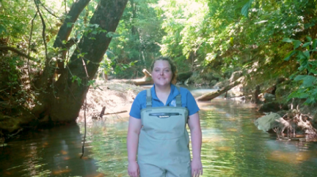
Link to Our Last Lesson
Last time, we learned that these pollutants are not easy to remove once they dissolve in the pond water.
Notes:
To review what we have learned, we will now watch the video from L2 again to review each pollutant
Link Video
Handout from lesson 2

Slide 3
Returning to Our Driving Question Board

Slide 4
Lesson 7 Focus Question
How did the pollutants get into the pond in the first place?

Slide 5
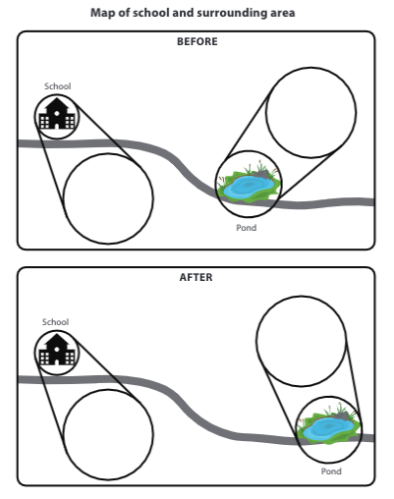
The School-Pond System
How might the pollutants have gotten into the pond if the school was the source of the pollution?

Slide 6
Creating a Class Consensus Model
Discuss with your group: What have we already learned, and how have we represented our learning?
What evidence have we collected already that would be useful in developing our model?
What models have we developed in past lessons that we can use here?
What information in our Progress Tracker should we consider?
Remember to use our CSW sentence stems as you share your ideas.

Slide 7
Pause and Reflect
How did thinking about matter as particles help us figure out and represent our ideas in a model about what was happening in the pond?

Slide 8
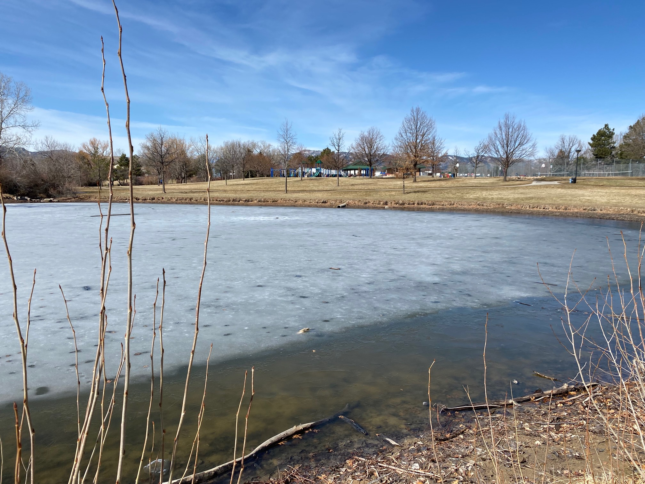
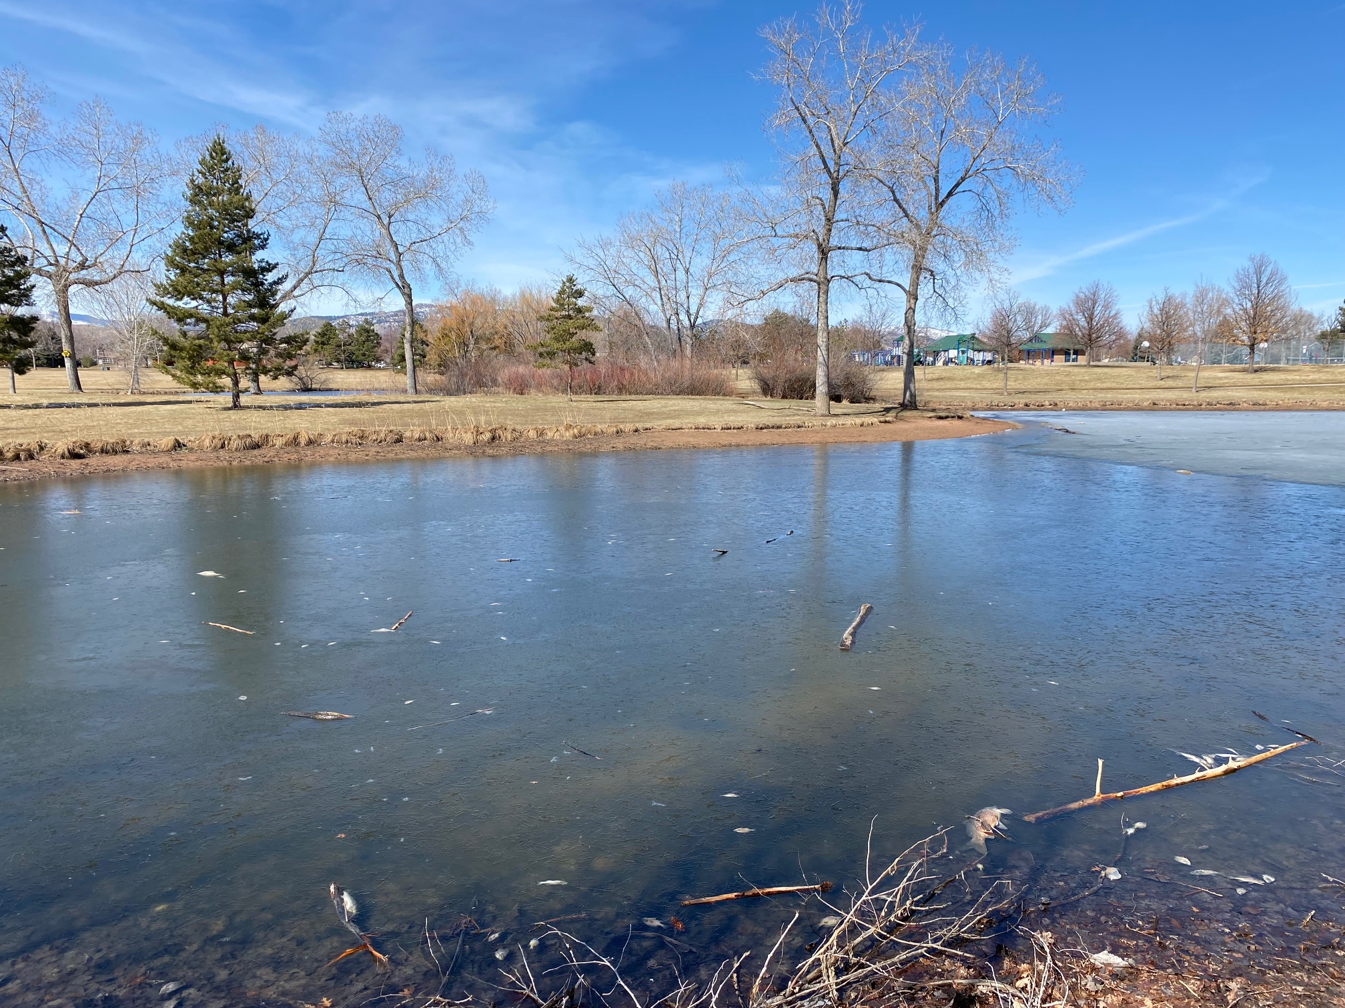
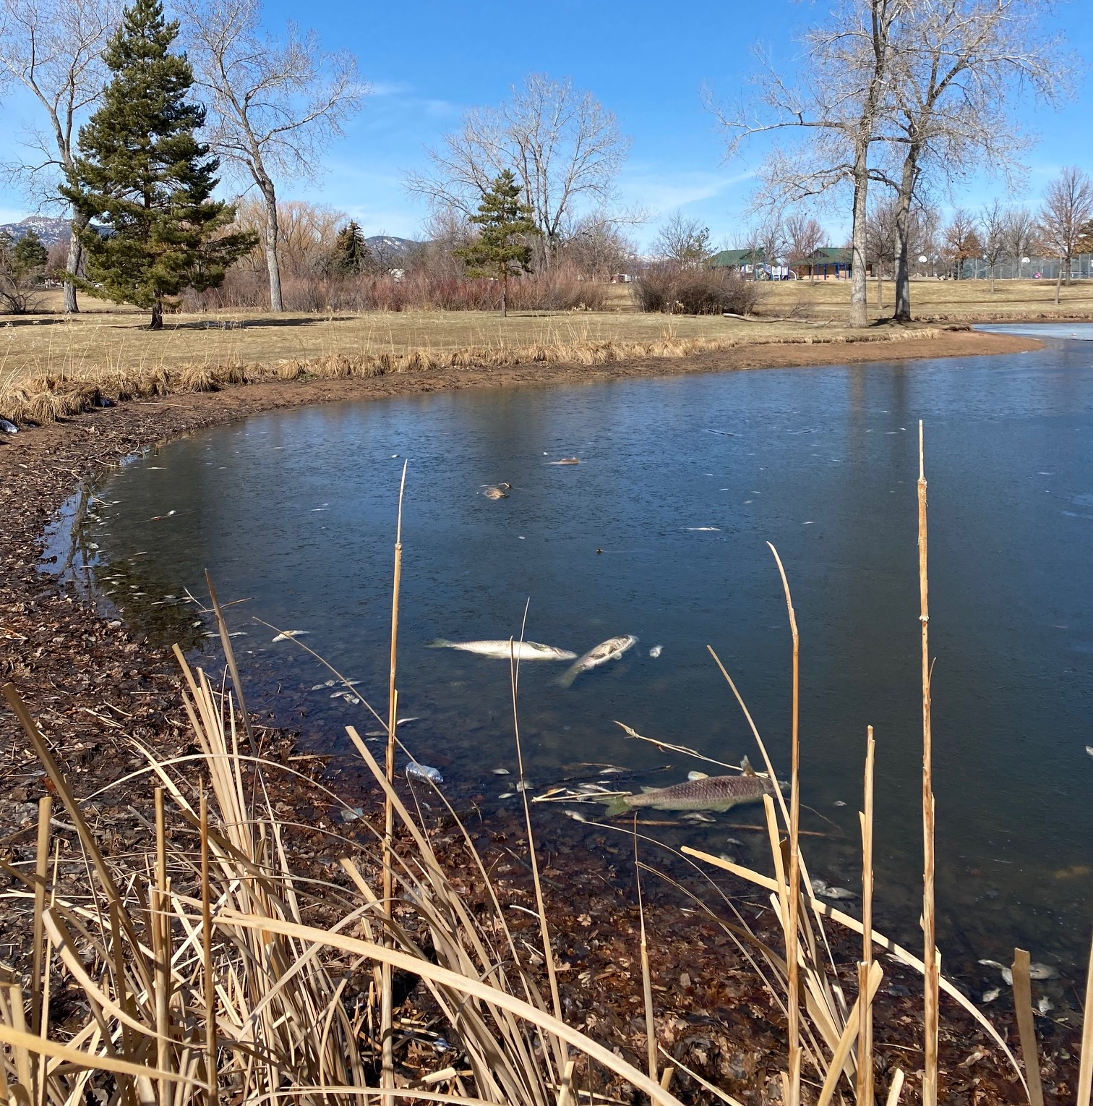
A Pond in Another Community

Slide 9
Data from Another School
Test | Solubility | Conductivity | Turbidity | pH | Observations
 | yes | yes | a little cloudy | 4-5 | murky

Slide 10
What is your explanation for the mystery pollutant?
What claim can you make about what could possibly be polluting the other school's pond water, and what additional test or data would make you more confident in your claim?
Support any claims with
data from investigations and
ideas we have learned during our own investigations.

Slide 11
Our last visit to Our Driving Question Board

