Slide 1
Earth’s Changing Surface
Lesson 4
What can cause a delta to shrink?

Slide 2
What have we figured out?
Lesson 3 Focus Question
What can change how fast deltas grow?
How did we answer this question in our last class?
Can we answer any questions on our DQB?

Slide 3
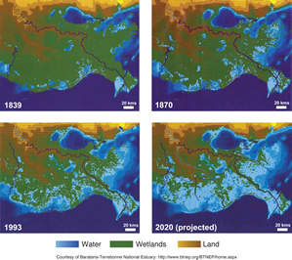
Lesson 4 Focus Question
What can cause a delta to shrink?

Slide 4
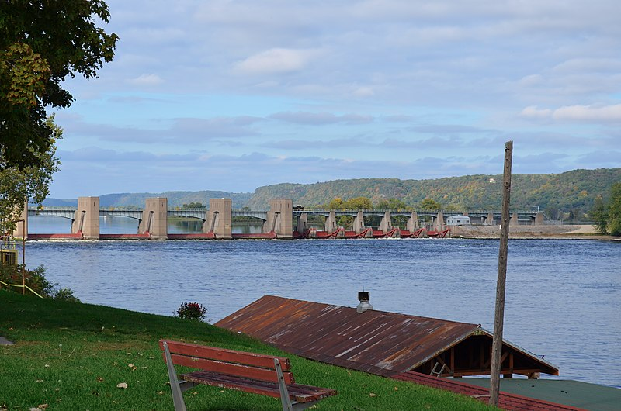
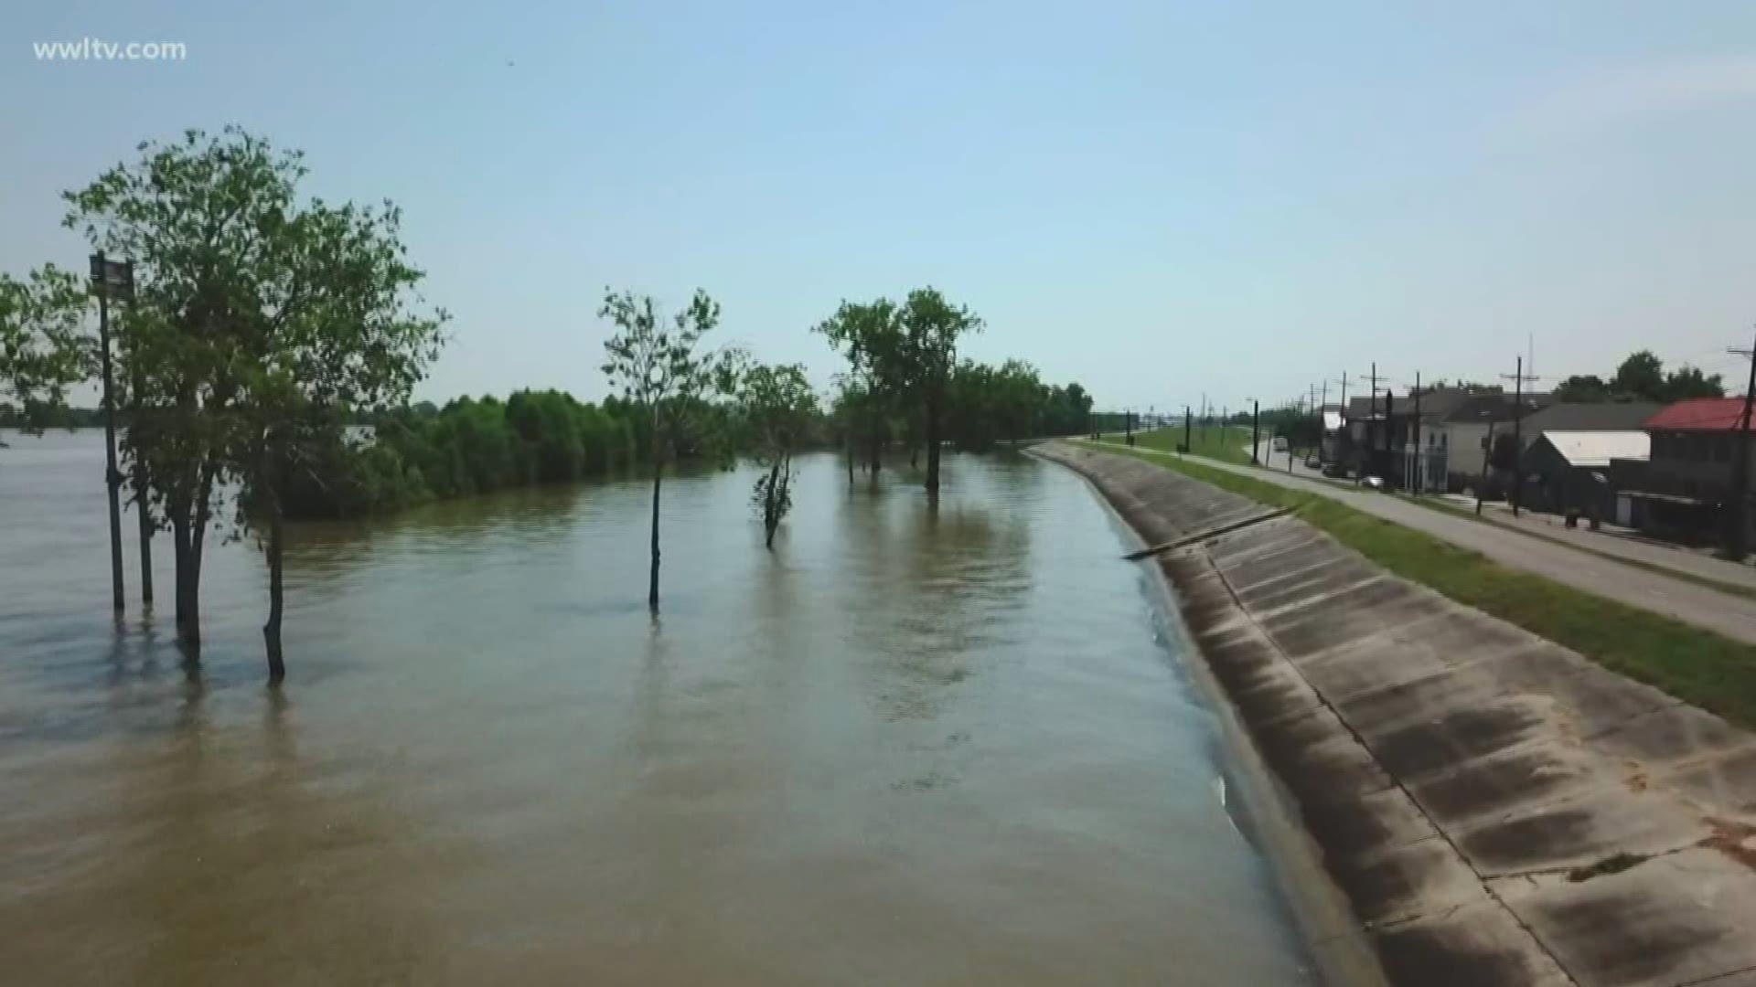
Human-made Structures on a River
A dam on the Mississippi River
A levee along the banks of the Mississippi River

Slide 5
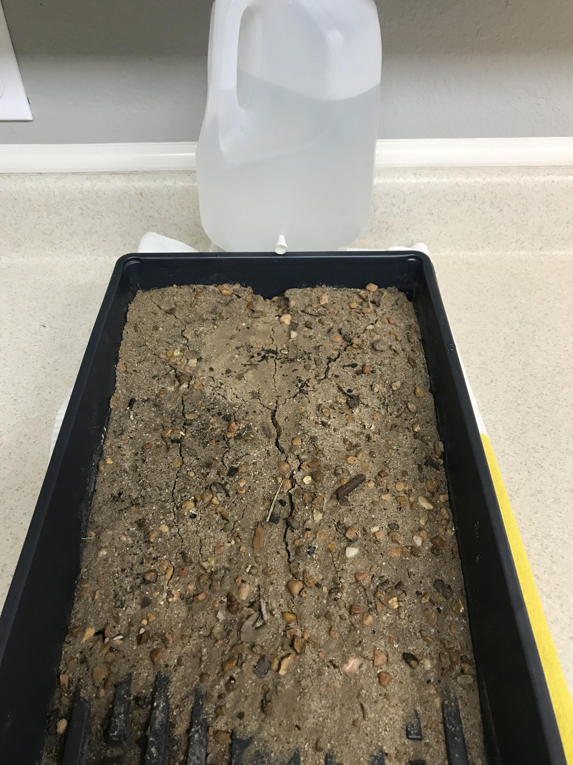


Slide 6
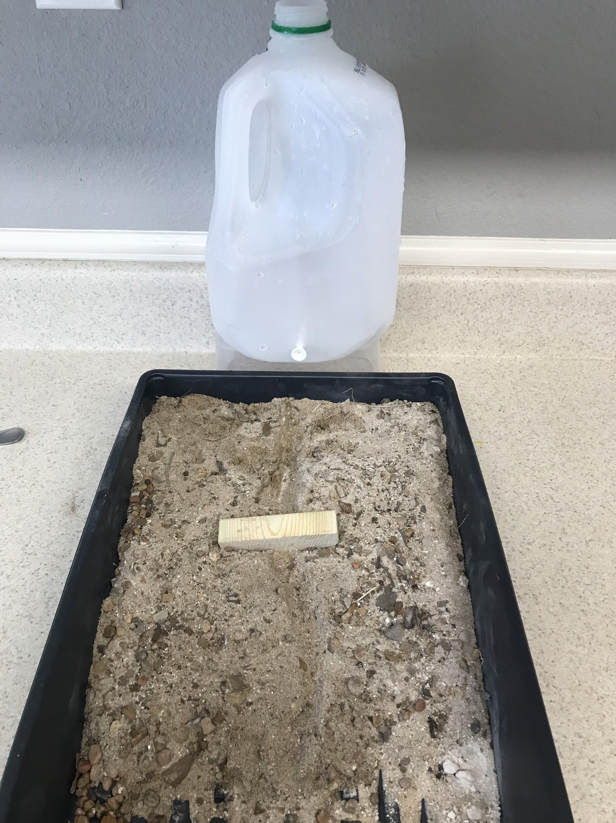
Turn and Talk with Your Partner
What are your ideas about how a dam changes a delta?
How do erosion and deposition change?

Slide 7
Return to the Focus Question
Lesson 4 Focus Question
What can cause a delta to shrink?
Share your ideas!
What are some positive effects of dams on a river?
What are some negative effects of dams on a river?
Record your ideas in #4 of your handout.

Slide 8
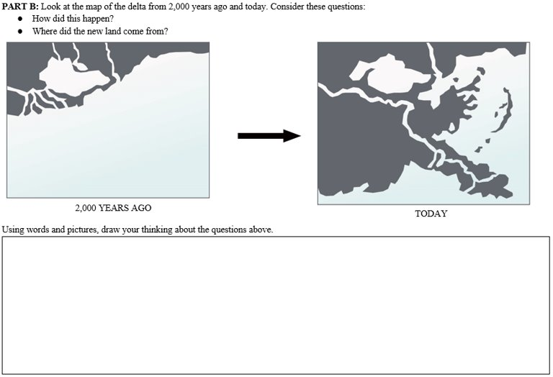
How have your ideas changed?
How would you draw your model now?

Slide 9



What’s next?
Where did all the sand in the delta come from?

