Slide 1
Matter Lesson 3

Slide 2
Link to Our Last Lesson
What does "pollutant" mean?
What properties did we discover about each pollutant?

Slide 3
Lesson 3 Focus Question
What can we learn about the possible dangerous materials in the pond water?
What ideas and/or questions do you have?

Slide 4
Where did the salt go?
What are your predictions?
Cup
Salt
Water

Slide 5
Where did the salt go?
What does "Conservation of Mass" mean?
Can you use an example of your own?

Slide 6
Communicating in Scientific Ways
What were some of the variables we talked about keeping consistent among all our groups?
Amount of water?
Amount of each pollutant?
Anything else that needs to be consistent?

Slide 7
Testing Our Pollutants
pH
Temperature
Electrical conductivity
Turbidity
What were your results?

Slide 8
Revisiting Our Models
Consider the model you made during Lesson 2. After our Lesson 3 investigation, is there anything you’d like to add (using pictures, words, and/or labels) to show what you think each pollutant mixed with water would look like.

Slide 9
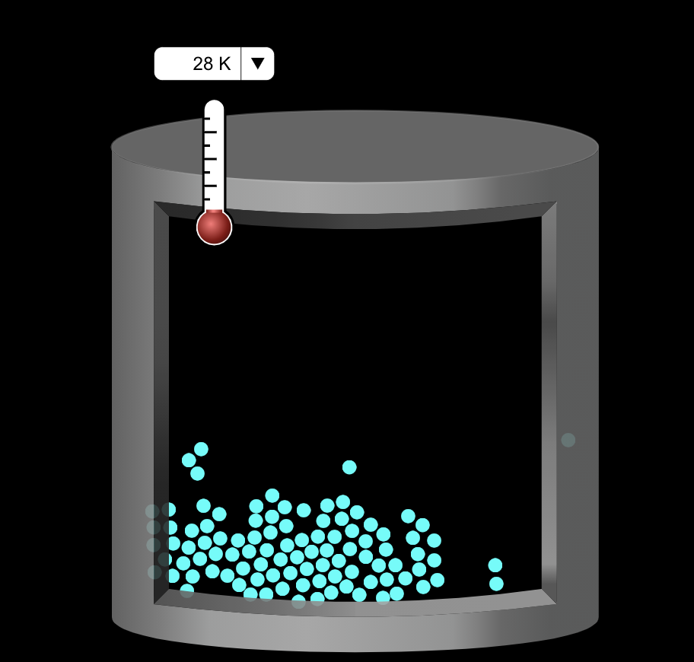
Considering Another Model
Here is one model scientists have developed to think about water when they zoom way, way in.
Image from the PhET simulation
Notes:
https://phet.colorado.edu/sims/html/states-of-matter-basics/latest/states-of-matter-basics_en.html

Slide 10
Creating a New Model
How can we show water particles mixed with our pollutant’s particles in a model?
Create a caption:
We showed ______.
This represents ______.

Slide 11
Comparing Our Models
Any clarifying questions or observations about these models?
Share your caption:
We showed ______.
This represents ______.

Slide 12
Defining Solubility and Dissolving
Dissolve: When a substance (like salt) seems to disappear when it’s mixed in with water
Solubility: A property of a substance that tells us how easily or whether a substance dissolves

Slide 13
Eliminating Some Pollutants?
With what we know about the properties of pollutants, are there any we can eliminate from our possibilities of what is in the pond?

Slide 14
Progress Tracker
Questions | What I figured out
What can we learn about the possible dangerous materials in the pond water? | Use complete sentences!

Slide 15
Link to Next Lesson
What factors affect how soluble solids dissolve into water?

