Slide 1
Matter Lesson 4

Slide 2
Link to Our Previous Learning
What does “dissolve” mean?
What does “solubility” mean?

Slide 3
Lesson 4 Focus Question
What factors affect how soluble solids dissolve into water?
What ideas and/or questions do you have?

Slide 4
Planning Our Investigation
What variable will your group change for each trial?
Which variables should we keep the same for each investigation?

Slide 5
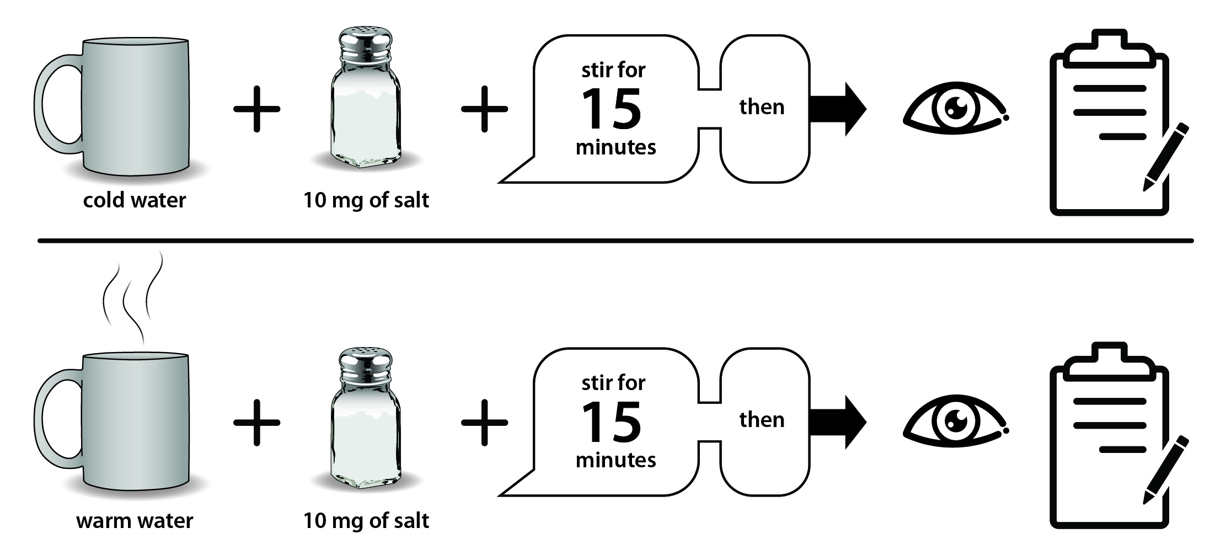
Example Investigation Plan

Slide 6
Communicating Our Results
Use your data to tell the class your results:
Claim: Salt dissolved ______________ (faster/slower) in ________ (condition).
Evidence from your data: We know this because our data show _________________.

Slide 7
Summarizing Our Results
Variable | Results
Temperature | When in warm water, the salt dissolved… (faster/slower) | When in room temperature water, the salt dissolved… | When in cold water, the salt dissolved…
Stirring
Salt size
Container size
Other variables?

Slide 8
Progress Tracker
Question | What we figured out
What factors affect how quickly soluble solids dissolve into water? | Use complete sentences!

Slide 9
Link to Next Lesson
How can we identify the pollutants in the pond water?

