Slide 1
Matter Lesson 2

Slide 2
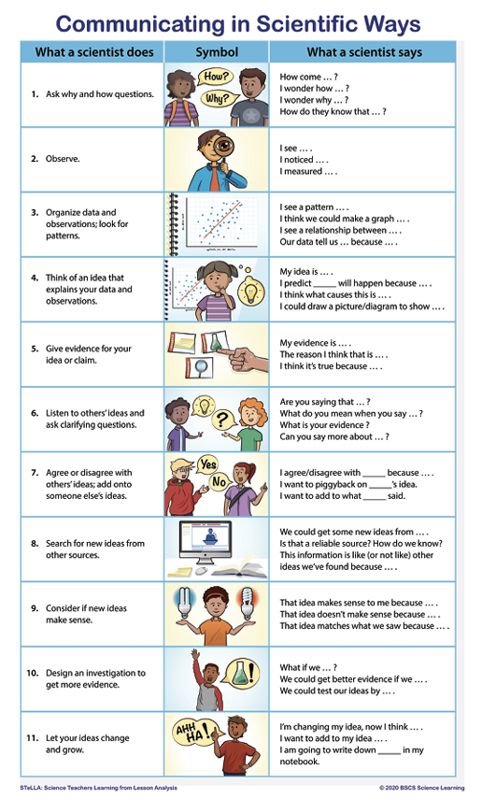

Slide 3
Link to Our Last Lesson
Take a look at our Driving Question Board.
What are our question clumps?
Do we have new questions?

Slide 4
Lesson 2 Focus Question
What can we learn about the possible dangerous materials in the pond water?
What ideas and/or questions do you have?

Slide 5
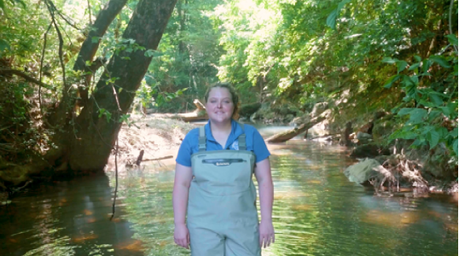
What might be in the water?
What did we learn from the video that can help us figure out if there are dangerous things in the pond water ?
What possible pollutants might we look for?
Notes:
Create a list of pollutants (salt, dirt, fertilizer, Soap, oil)
Generate ideas for testing/observing
Explain that we have samples of these pollutants to investigate
How might we investigate these pollutants to find out if they are in the water?
*Why might it me helpful for each of our groups to record information in a similar way?
*Does anyone have ideas about how we can organize that information ?

Slide 6
Data Collection
What might we want to look for and record as we observe each pollutant?

Slide 7
Example Investigation Procedure

Slide 8
Conducting Our Investigations

Slide 9
What are some things you found out?
 | Pollutant By Itself Observations | Pollutant Mixed with Water Observations
Salt
Detergent
Oil
Fertilizer
Dirt

Slide 10
What are some things you found out?
Properties
 | Pollutant By Itself Observations | Pollutant Mixed with Water Observations
Salt
Detergent
Oil
Fertilizer
Dirt

Slide 11
Mixtures with the Pollutants
For your expert group’s water-pollution mixture …
Use a combination of words and pictures to show what you imagine you would see if you zoom way, way in on the mixture.
If any new questions come up, add them to a sticky note for the Driving Question Board.

