Slide 1
STeLLA Scale Up and Sustainability Study (SSUP)
Day 1
Science Teachers Learning From Lesson Analysis

Slide 2
STeLLA Program Goals
Deepen knowledge of teaching and learning
Increase ability to analyze and reflect on teaching and learning
Increase ability to use content knowledge and knowledge of teaching and learning to transform classroom practice
Deepen teacher content knowledge
Increase student learning in science

Slide 3
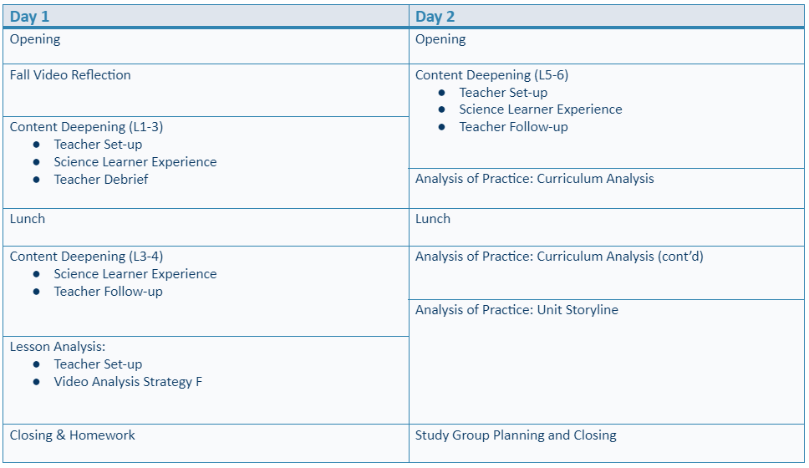
Winter Institute at-a-Glance

Slide 4
Agenda
Opening
Fall Unit Video Reflection
Content Deepening (L1-5)
Lesson Analysis: Video Analysis
Closing

Slide 5
STeLLA Norms
The Basics
Arrive prepared and on time; stay for the duration
Remain attentive, thoughtful, and STeLLAful; eliminate interruptions (turn off cell phones, email)
Make room for participation from all (monitor your floor time)
Purpose: Build trust and develop a productive study group for all participants
The Heart of STeLLA Lesson Analysis
Keep the goal in mind: We are analyzing teaching to improve student learning
Share your ideas, uncertainties, confusions, disagreements, questions—open up time so this can happen!
Expect and ask questions to deepen everyone’s learning—honor needs!

Slide 6
Day 1 Focus Questions
How does watching classroom video help you become a more reflective practitioner?
What can cause the Earth’s surface to look the way it does?
Why is it important to intentionally plan to use specific STeLLA strategies throughout a lesson?

Slide 7
Discussion about Teaching the Fall Unit
What did you learn about your own growth and/or about student learning/thinking from watching your fall video and completing the reflection about STeLLA Strategies or completing the FAC’s for the pre-and posttests?
Each teacher has 5 minutes to describe what she/he/they learned about personal growth and changes in student learning/understanding as a result of participating in the STeLLA PD program so far.
Teachers may ask one another questions.
The PD leader serves as a time-keeper only; teachers are in charge of the conversation.

Slide 8
Content Deepening: Teacher Set-up
How do you usually teach Earth's Systems?
What do you want students to learn?
What ideas do students struggle with?
Notes:
Slides 9 – 11 are placeholders for the anchor lesson slides

Slide 9
Content Deepening: Teacher Set-up
Consider the Ideas on the Mash Up.
Add dots to the left-hand column as you analyze each idea.
Green dot: science idea (accurate statement)
Yellow dot: uncertain
Red dot: common student idea (inaccurate statement)
Add sticky notes to clarify statements or add your own thoughts.
We’ll revisit these ideas periodically throughout the institute.
Notes:
Slides 9 – 11 are placeholders for the anchor lesson slides

Slide 10
Anchor Lesson Common Experience
Put on a "science learner hat"

Slide 11
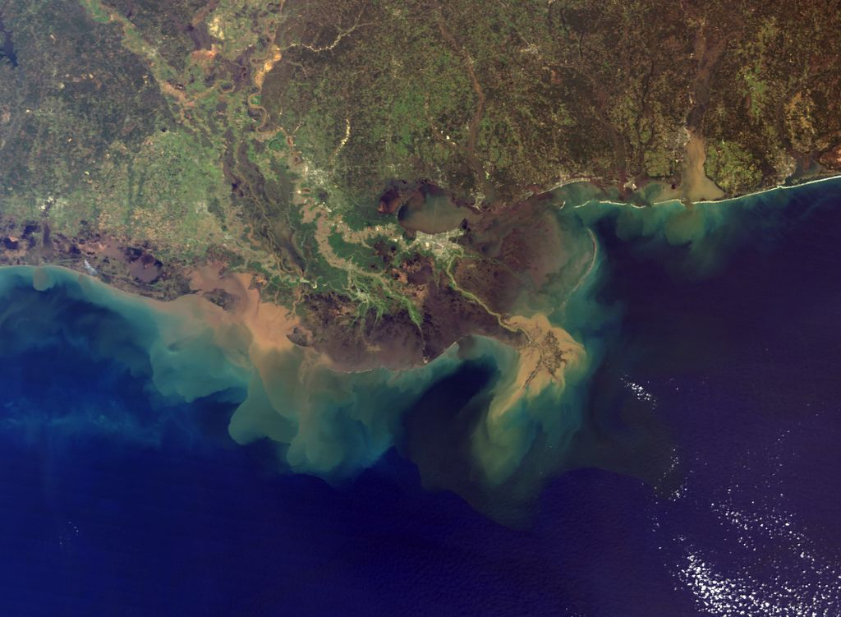
Earth’s Changing Surface
Lesson 1
Has the Earth’s surface always looked this way?

Slide 12
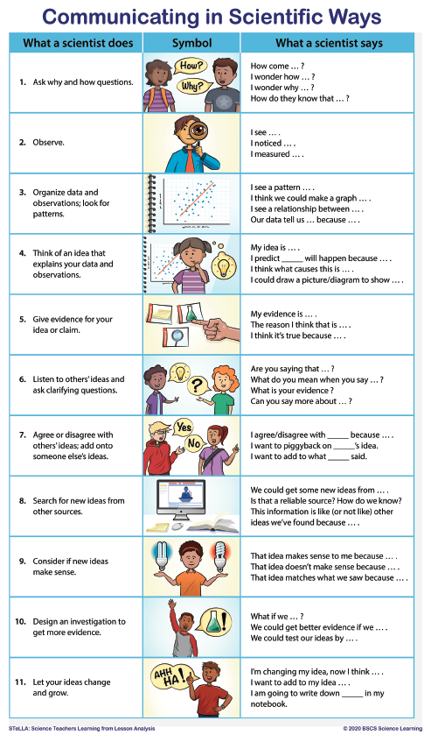

Slide 13
What do we know and wonder about the Earth’s surface?
What we KNOW
What we WONDER

Slide 14
Lesson 1 Focus Question
Focus Question: Has the Earth’s surface always looked this way? Why or why not?
I think that the Earth’s surface…..​
Write your ideas here

Slide 15
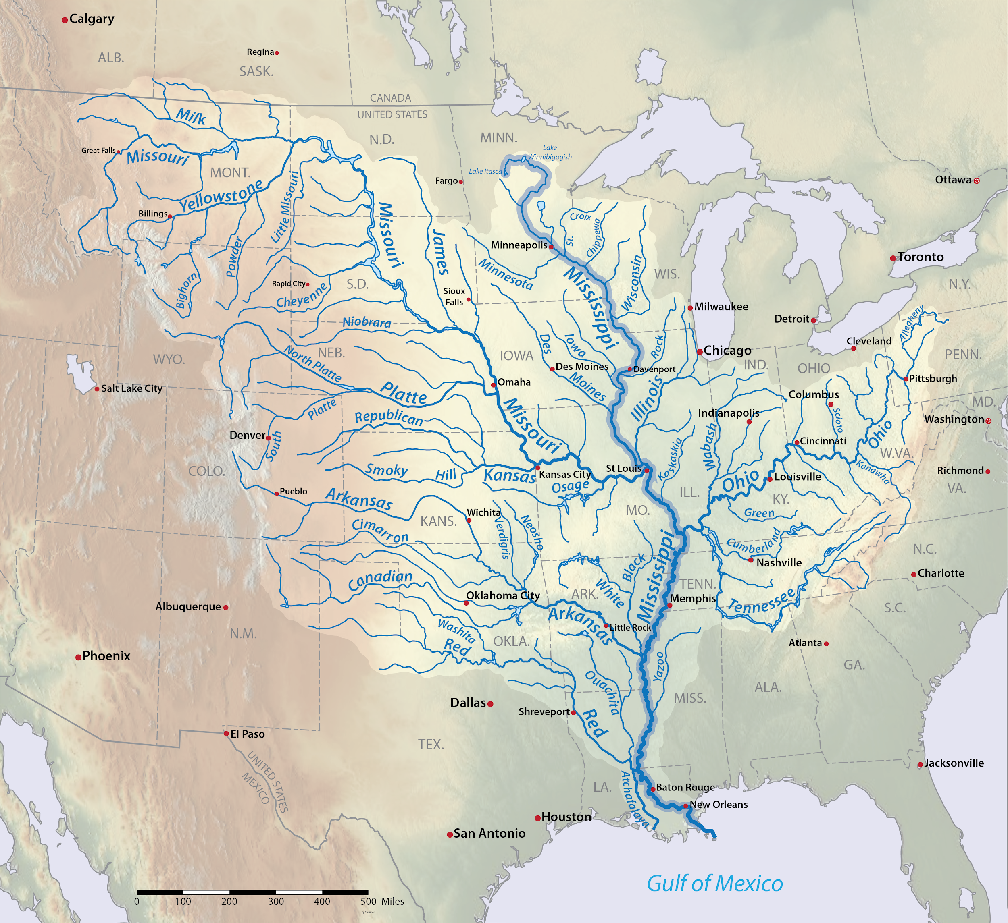
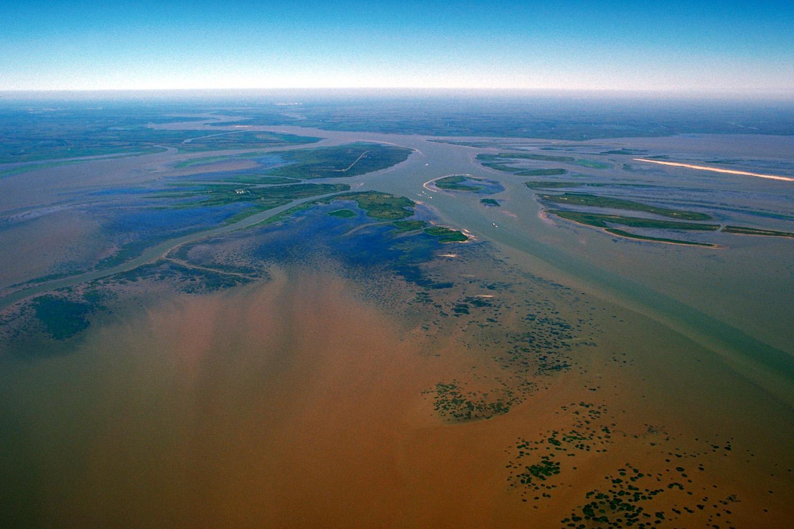
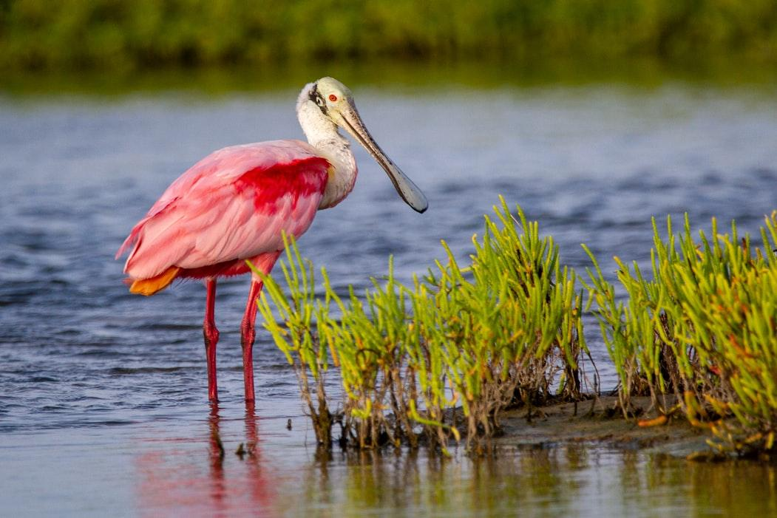

Slide 16
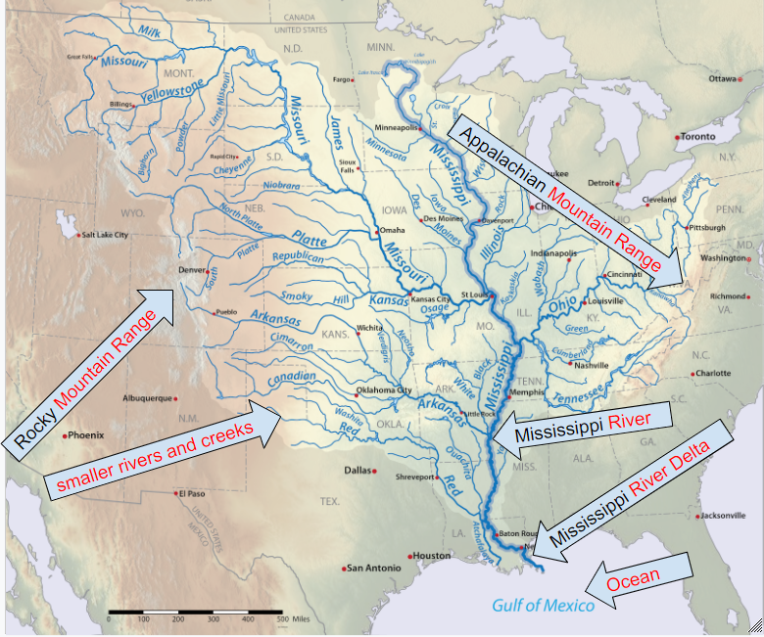

Slide 17
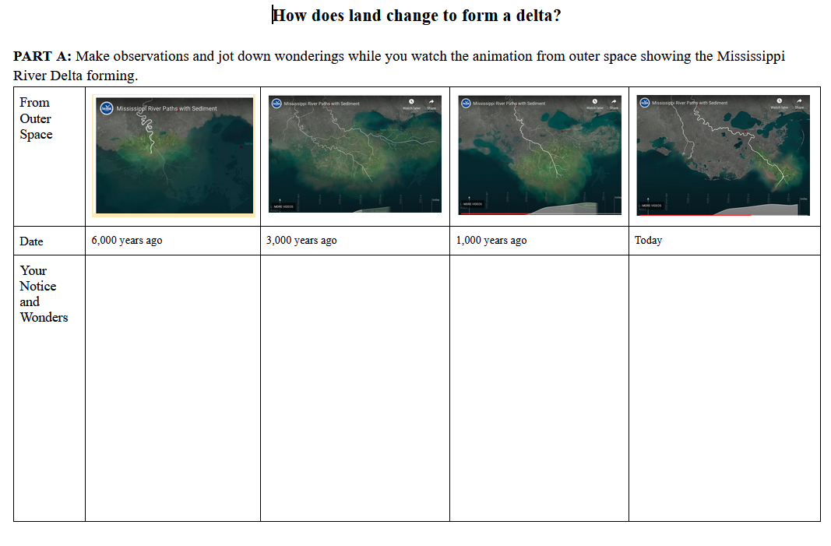
HO1.3: How does land change to form a delta?
Animation Link

Slide 18
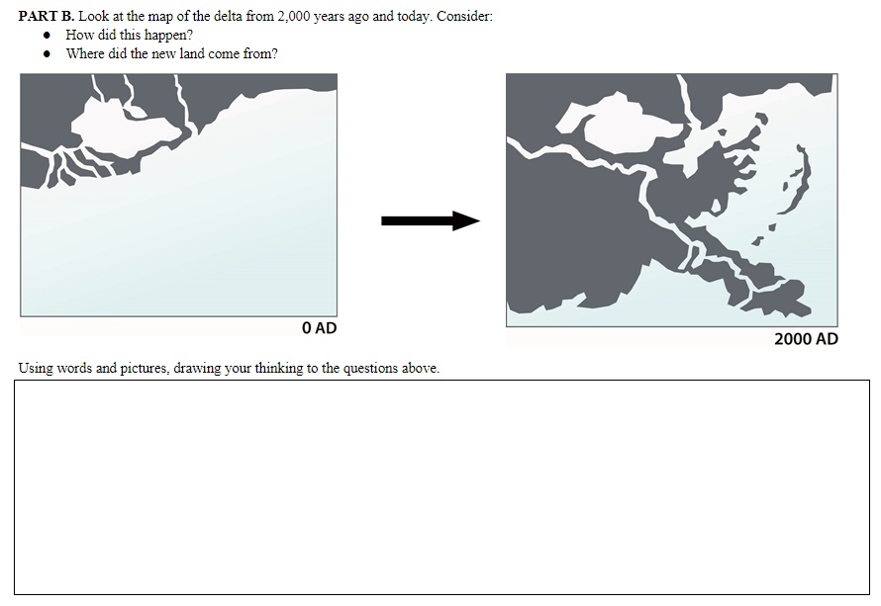
HO1.3: How does land change to form a delta?

Slide 19
How did this happen?
How did the delta form?
What are your ideas?
Share with your group.

Slide 20
Our Driving Question Board
Driving Question Board Protocol:
The 1st team reads their question aloud to the class, and then posts it on the Driving Question Board (DQB).
Students who are listening should raise their hands if their team has a question that relates to the question that was just read aloud.
The 1st steam selects the next team whose hand is raised.
The 2nd team reads their question, says why or how it relates, and then posts it near the question it most relates to on the DQB.
The student selects the next student. We will continue until every team has at least one question on the DQB.

Slide 21
Lesson 1 Focus Question
Focus Question: Has the Earth’s surface always looked this way? Why or why not?
I think that the Earth’s surface…..​
How would you answer this question now?
Share your new ideas with a partner.

Slide 22
What can cause the Earth’s surface to look the way it does?
Lesson 2 Focus Question:
What causes a delta to form?
What questions on our DQB will help us answer this unit central question?

Slide 23
Next steps
Next class we will investigate...

Slide 24
Content Deepening: Teacher Follow-up
Which STeLLA strategies were focal in this anchor lesson?
How did these focal strategies help support your thinking as a learner?
How will you use these STeLLA strategies to reveal, support, and challenge student thinking?
Notes:
Add notes for transition into whole group, bring effective science teaching charts
How do you think CSW can help your Ss? Why is that important?
Journal…
How did the experience invite you into wondering and learning?
What are the features that supported your curiosity and engagement?

Slide 25
Meta Moment
Journal….
What aspect(s) of effective teaching and learning do you aspire to focus on for the Earth's Changing Surface Unit?
How did the experience (e.g., aspects of the lesson) engage your curiosity and make you wonder?
What role did using the CSW stems play in the lesson?
What role did the “teacher/PDL” play in the process?
Notes:
Add notes for transition into whole group, bring effective science teaching charts
How do you think CSW can help your Ss? Why is that important?
Journal…
How did the experience invite you into wondering and learning?
What are the features that supported your curiosity and engagement?

Slide 26
Lesson 2 Focus Question
What causes deltas to form?

Slide 27
What did we figure out?
Lesson 1 Focus Question:
Has the Earth’s surface always looked this way? Why or why not?
How did we answer this question in our last class?

Slide 28
Lesson 2 Focus Question
What causes deltas to form?
Lesson 2 Focus Question:
What causes deltas to form?
I think deltas form at the end of the river because …
Write down how you think deltas might form.

Slide 29
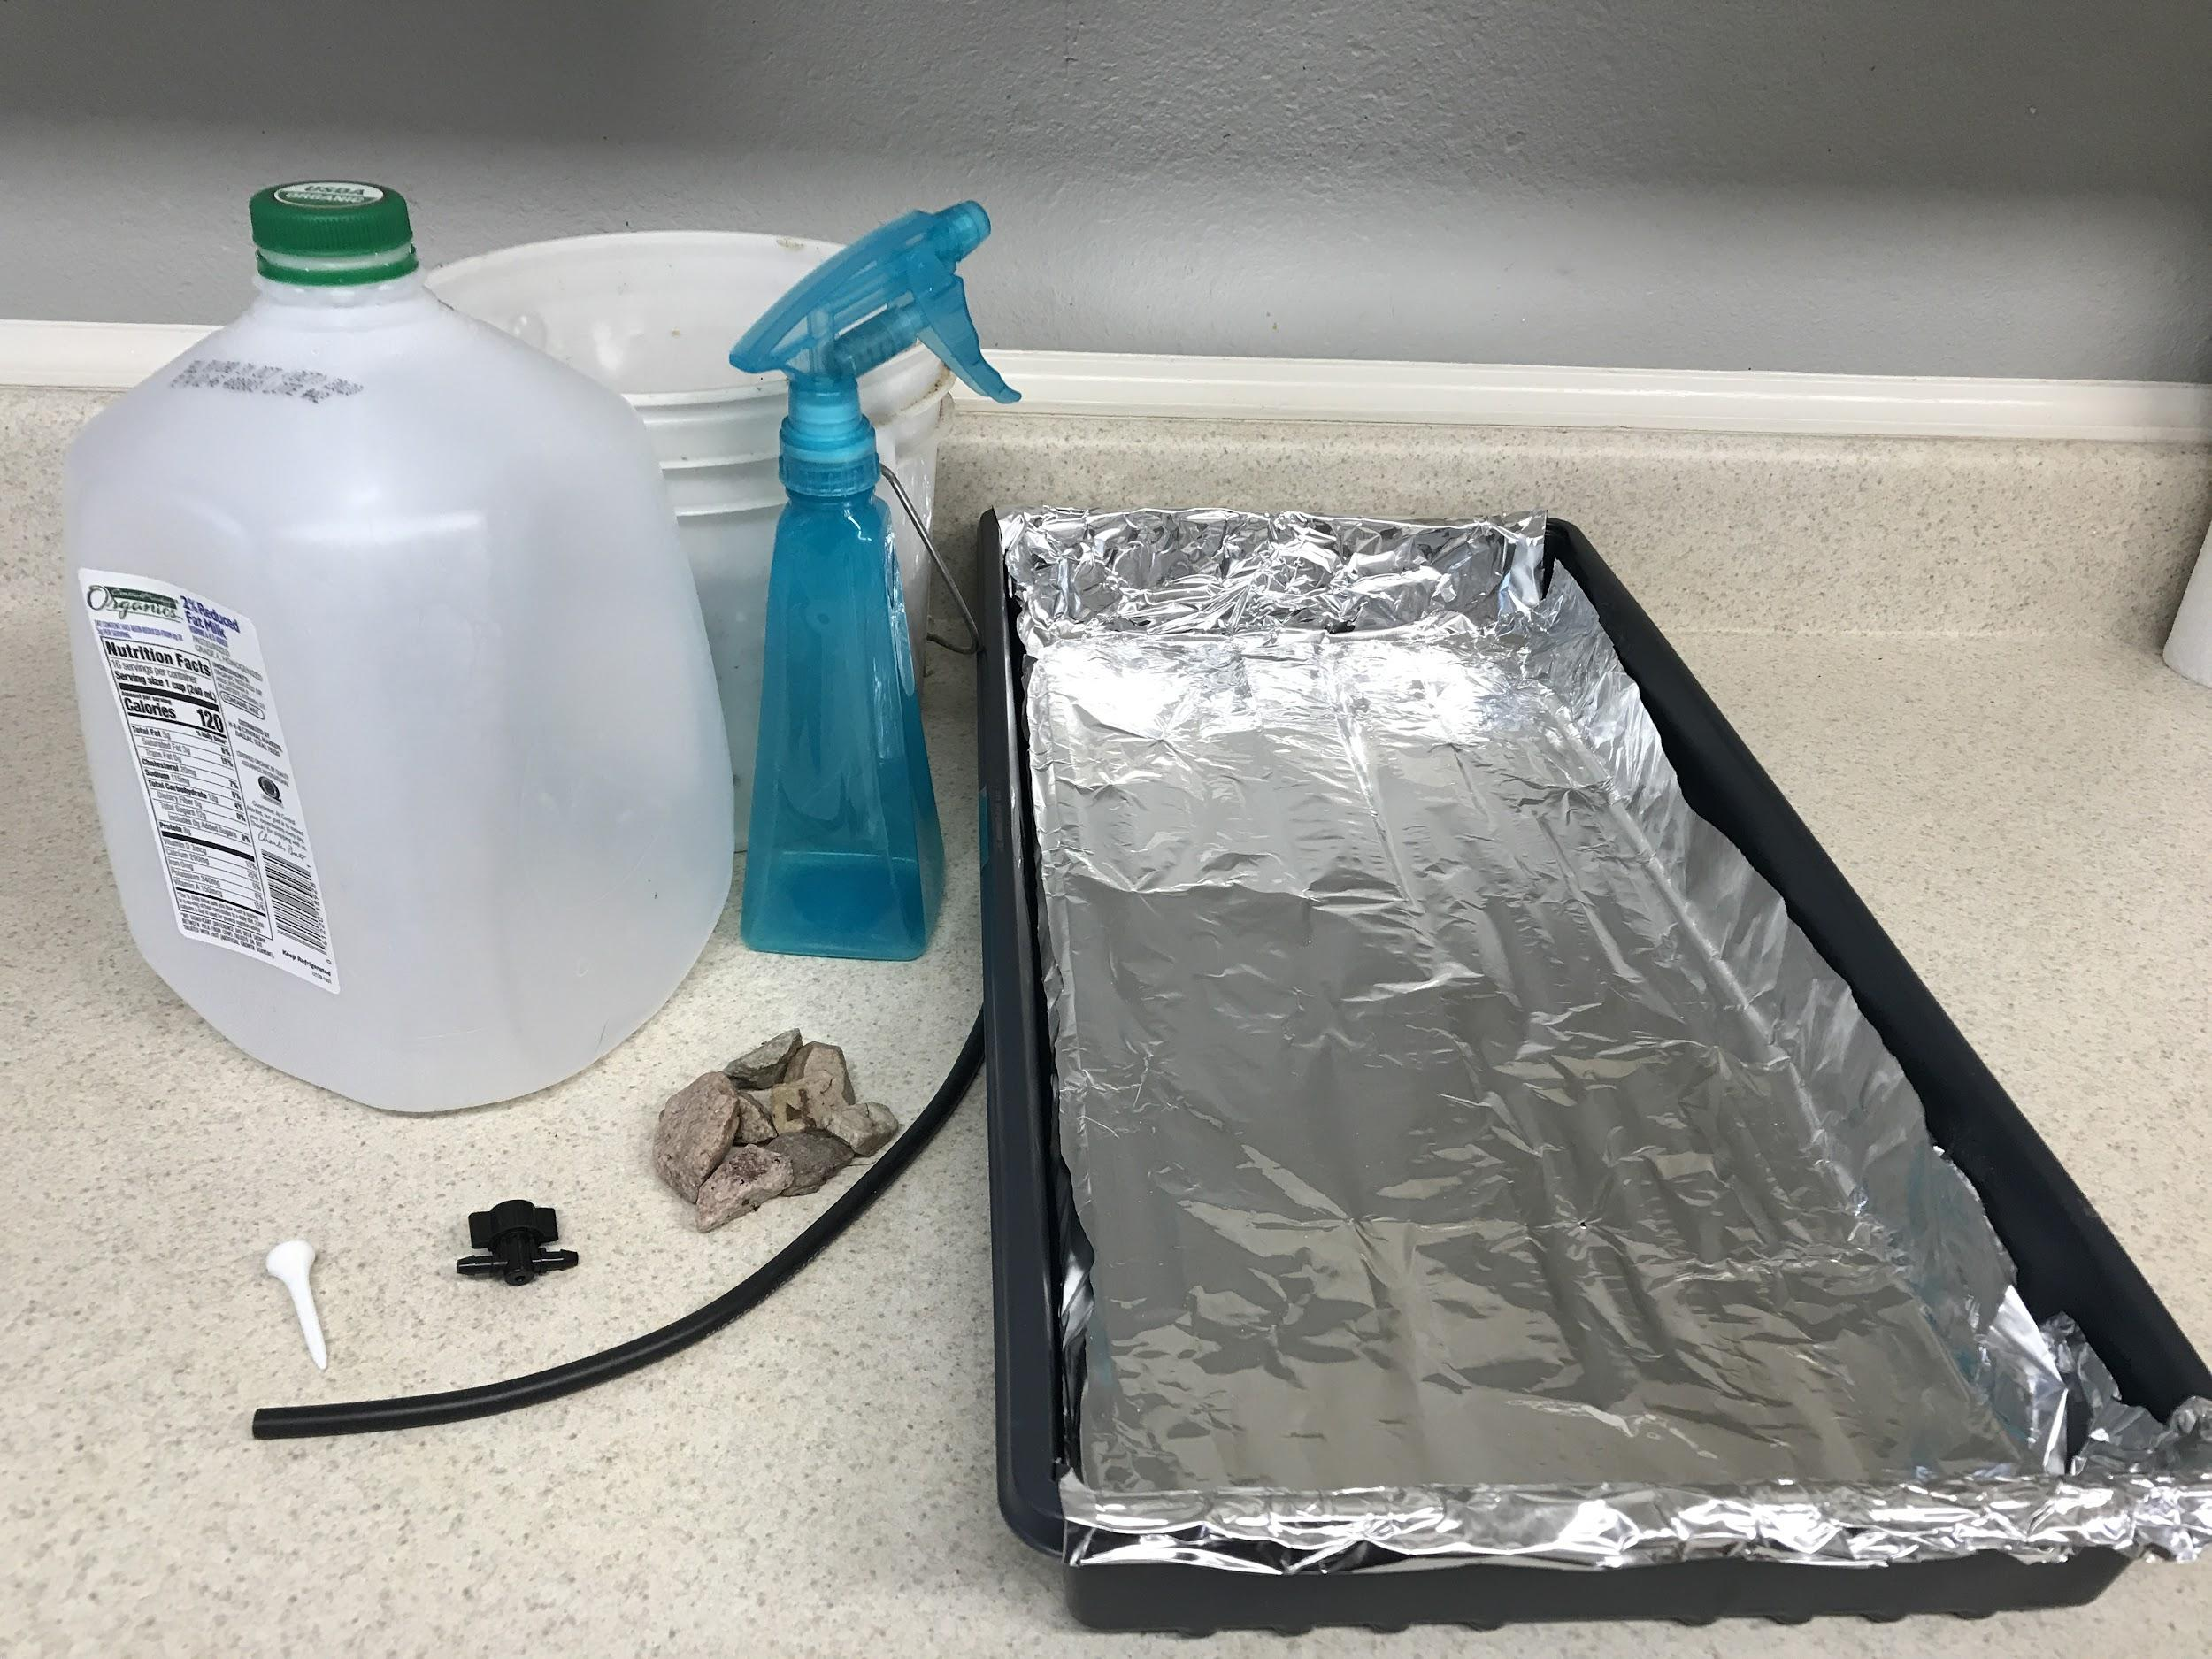
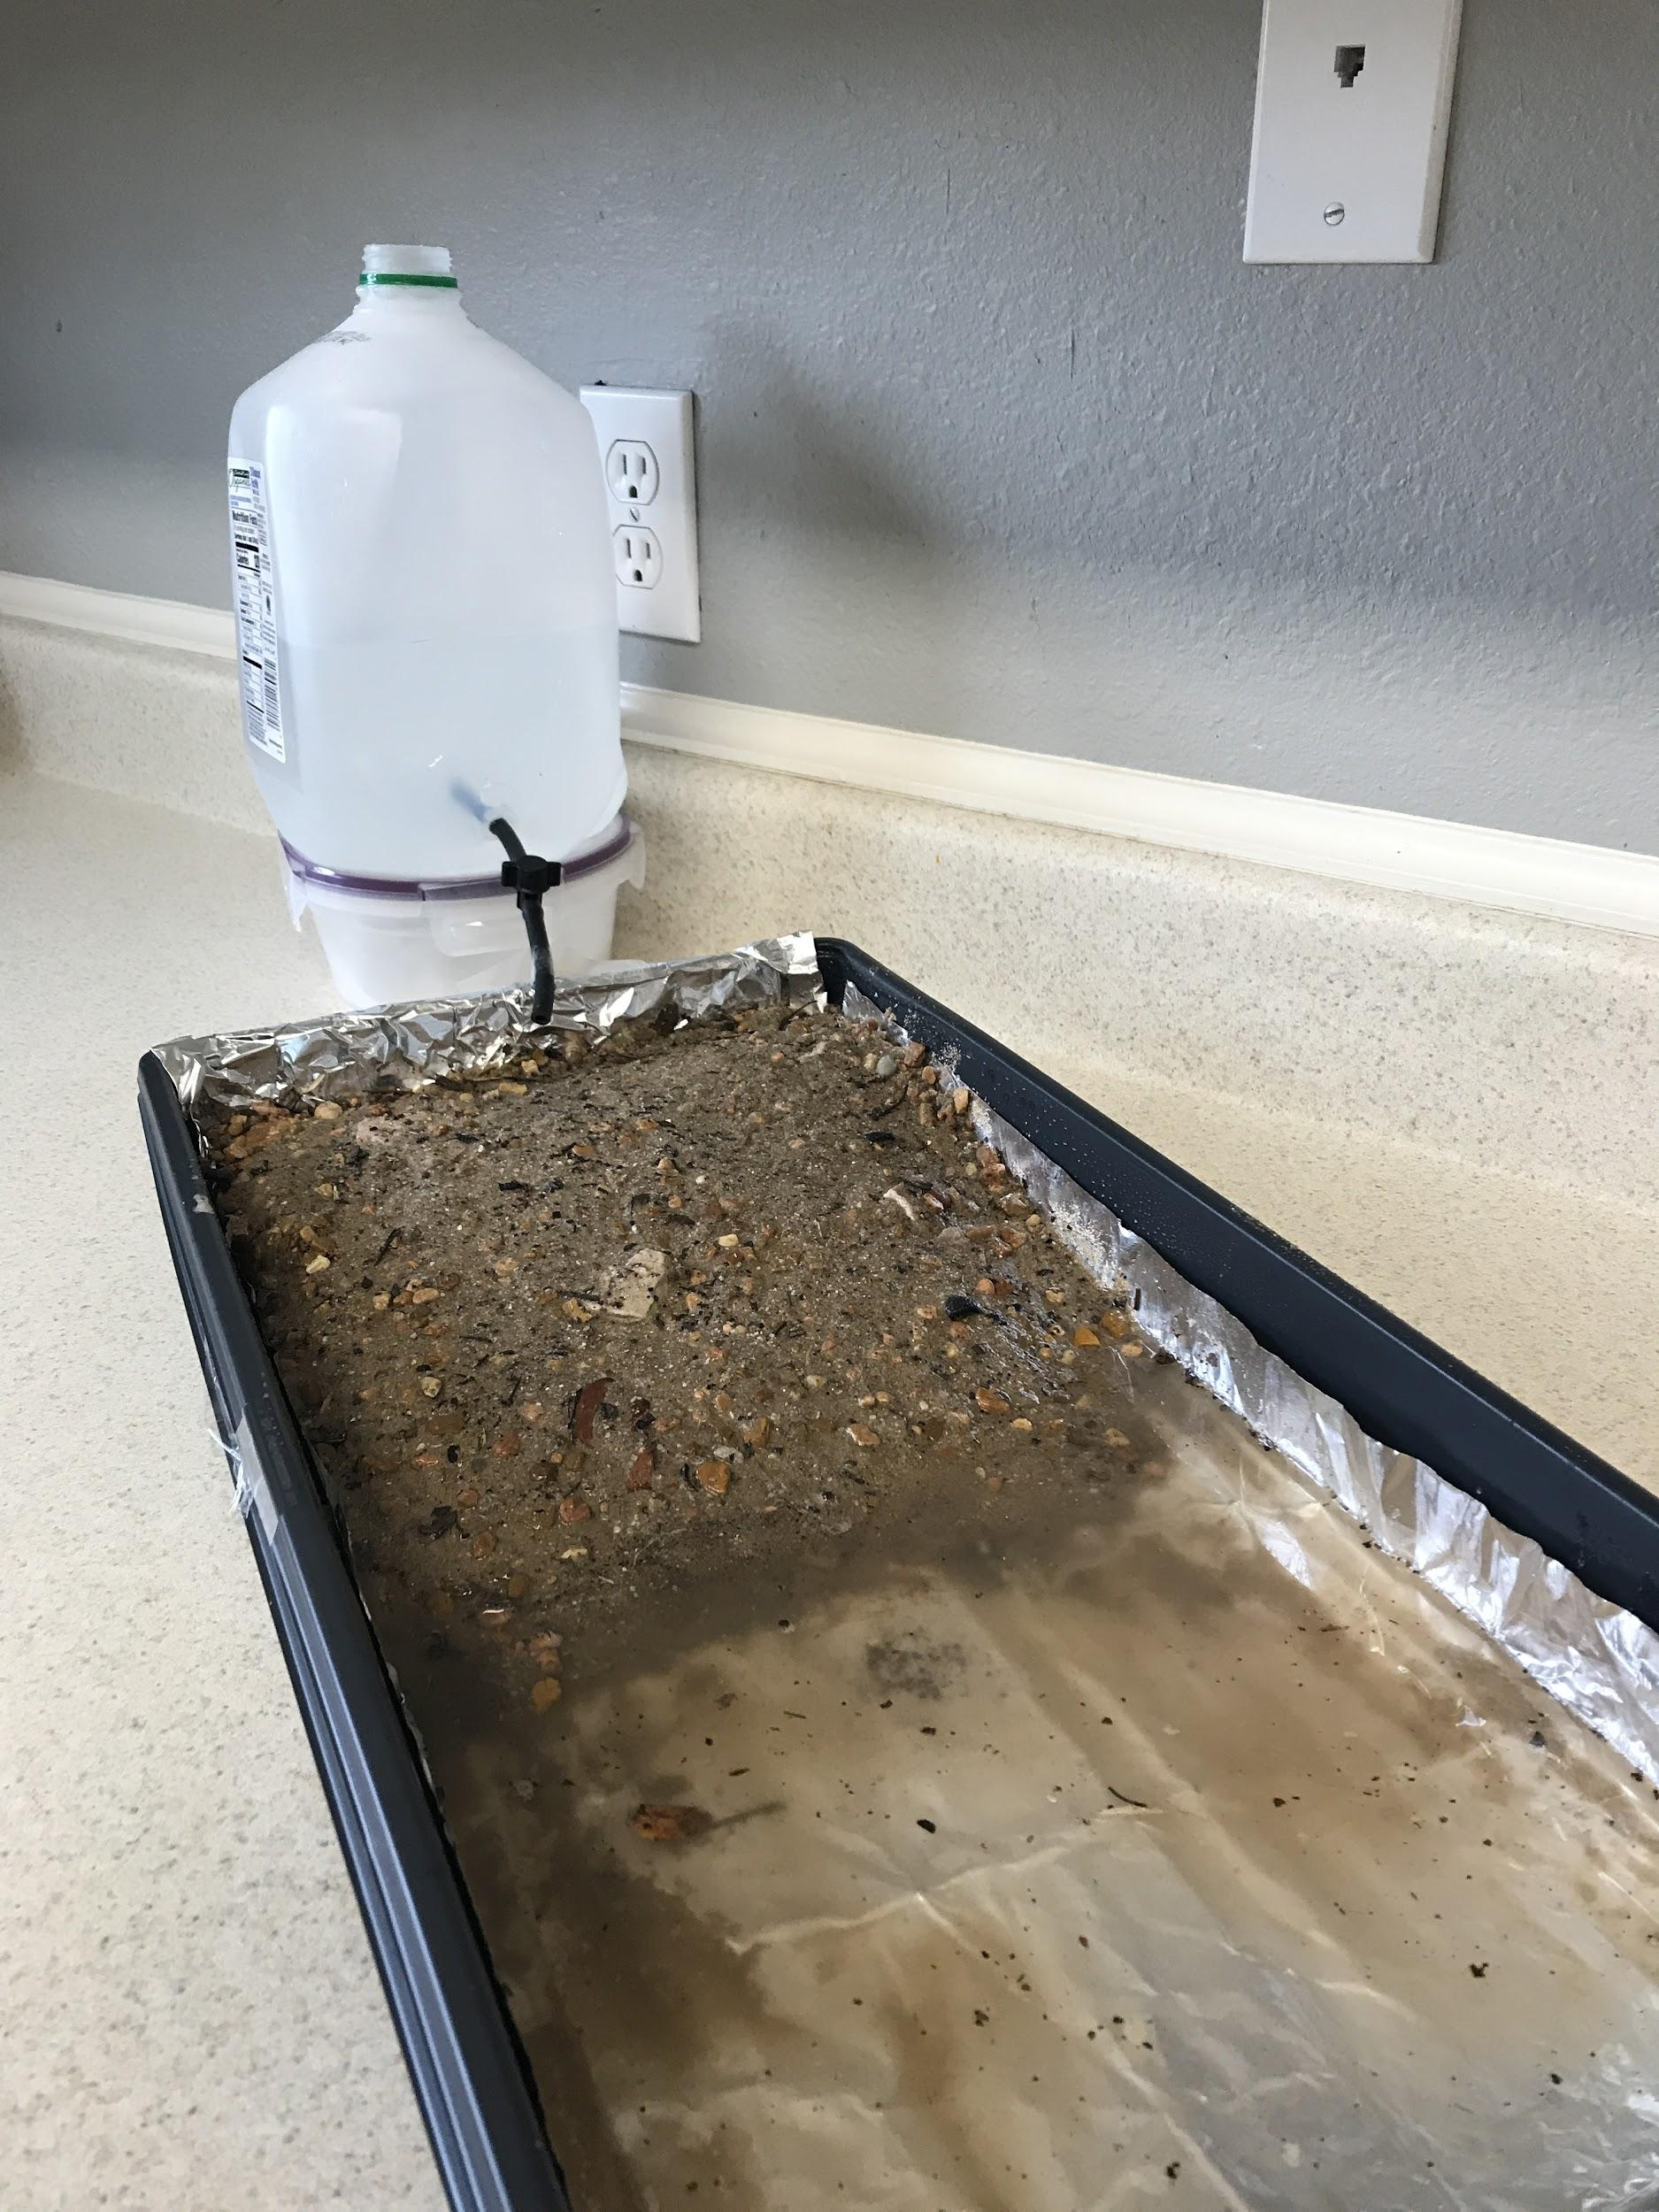
Investigating a River

Slide 30
Investigating a River
?
?
?
When we release the water, what do you think will happen?
?
As you investigate, look for:
where you see flowing water moving earth materials to a new location, and
where the earth materials are left or “deposited” in a new location.

Slide 31
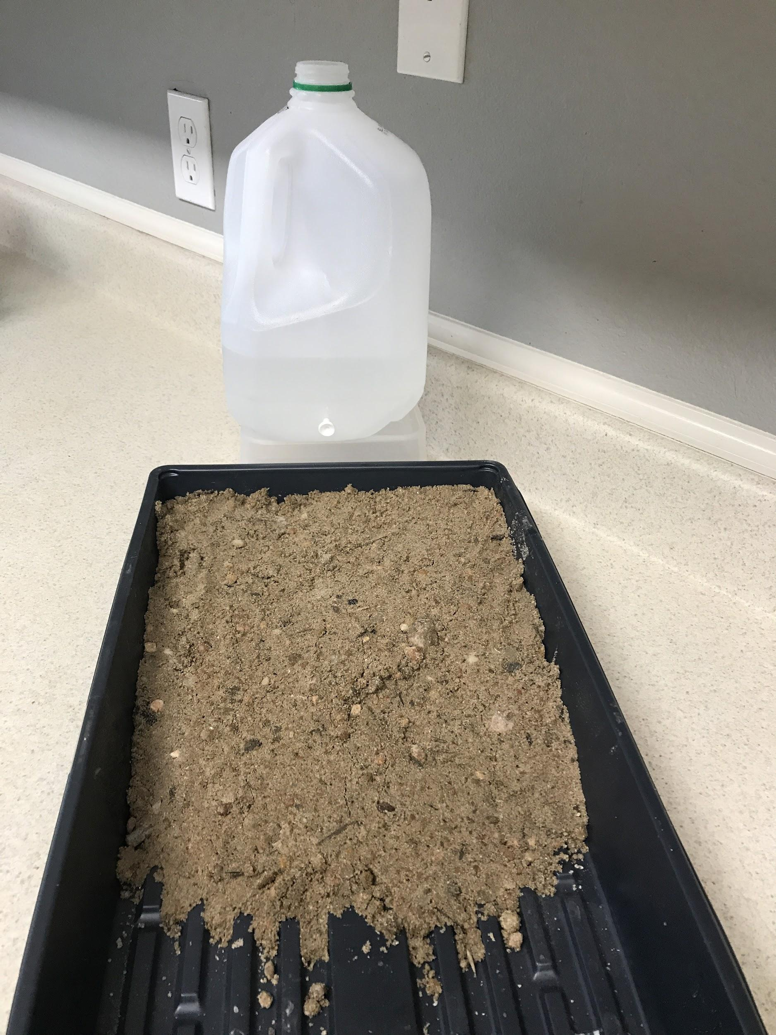
Investigating a River
As you investigate, look for:
where you see flowing water moving earth materials to a new location, and
where the earth materials are left or “deposited” in a new location.

Slide 32
How did water change the land?
Where did you see earth materials move because of the water?
Do all earth materials move the same?
Can you use ideas about speed and energy to explain how earth materials move?
Where do the earth materials go?
How will this help us answer our focus question?
What evidence did you get from investigating with a stream table?
What new questions do you have?

Slide 33
Investigating a River
As you investigated, you looked for:
where you see flowing water moving earth materials to a new location, and
where the earth materials are left or “deposited” in a new location.
Erosion: the process where flowing water or wind moves earth materials, such as sand, soil, gravel, and rocks to a different location.
Deposition: the process where flowing water or wind moves earth materials, such as sand, soil, gravel, and rocks to a different location.

Slide 34
Lesson 2 Focus Question
What causes deltas to form?
Lesson 2 Focus Question:
What causes deltas to form?
I think deltas form at the end of the river because …
Deltas form because...
Write down how deltas form.
Don’t forget to use ideas about erosion and deposition!

Slide 35
Lesson 3 Focus Question
What can change how fast deltas grow?

Slide 36
What did we figure out?
Lesson 2 Focus Question:
What causes deltas to form?
How did we answer this question in our last class?

Slide 37
Lesson 3 Focus Question
What can change how fast deltas grow?
Lesson 3 Focus Question:
What can change how fast deltas grow?
My Initial Ideas about Delta Formation
What are your ideas about what can change how fast a delta grows?
Write your ideas here
Be ready to share some ideas with the class!
Things that speed it up
Things that slow it down

Slide 38
How can we use our stream table to investigate our ideas?
Think-Pair-Share
Talk about your ideas with a partner.
Record your ideas on Part 1 of the handout.

Slide 39
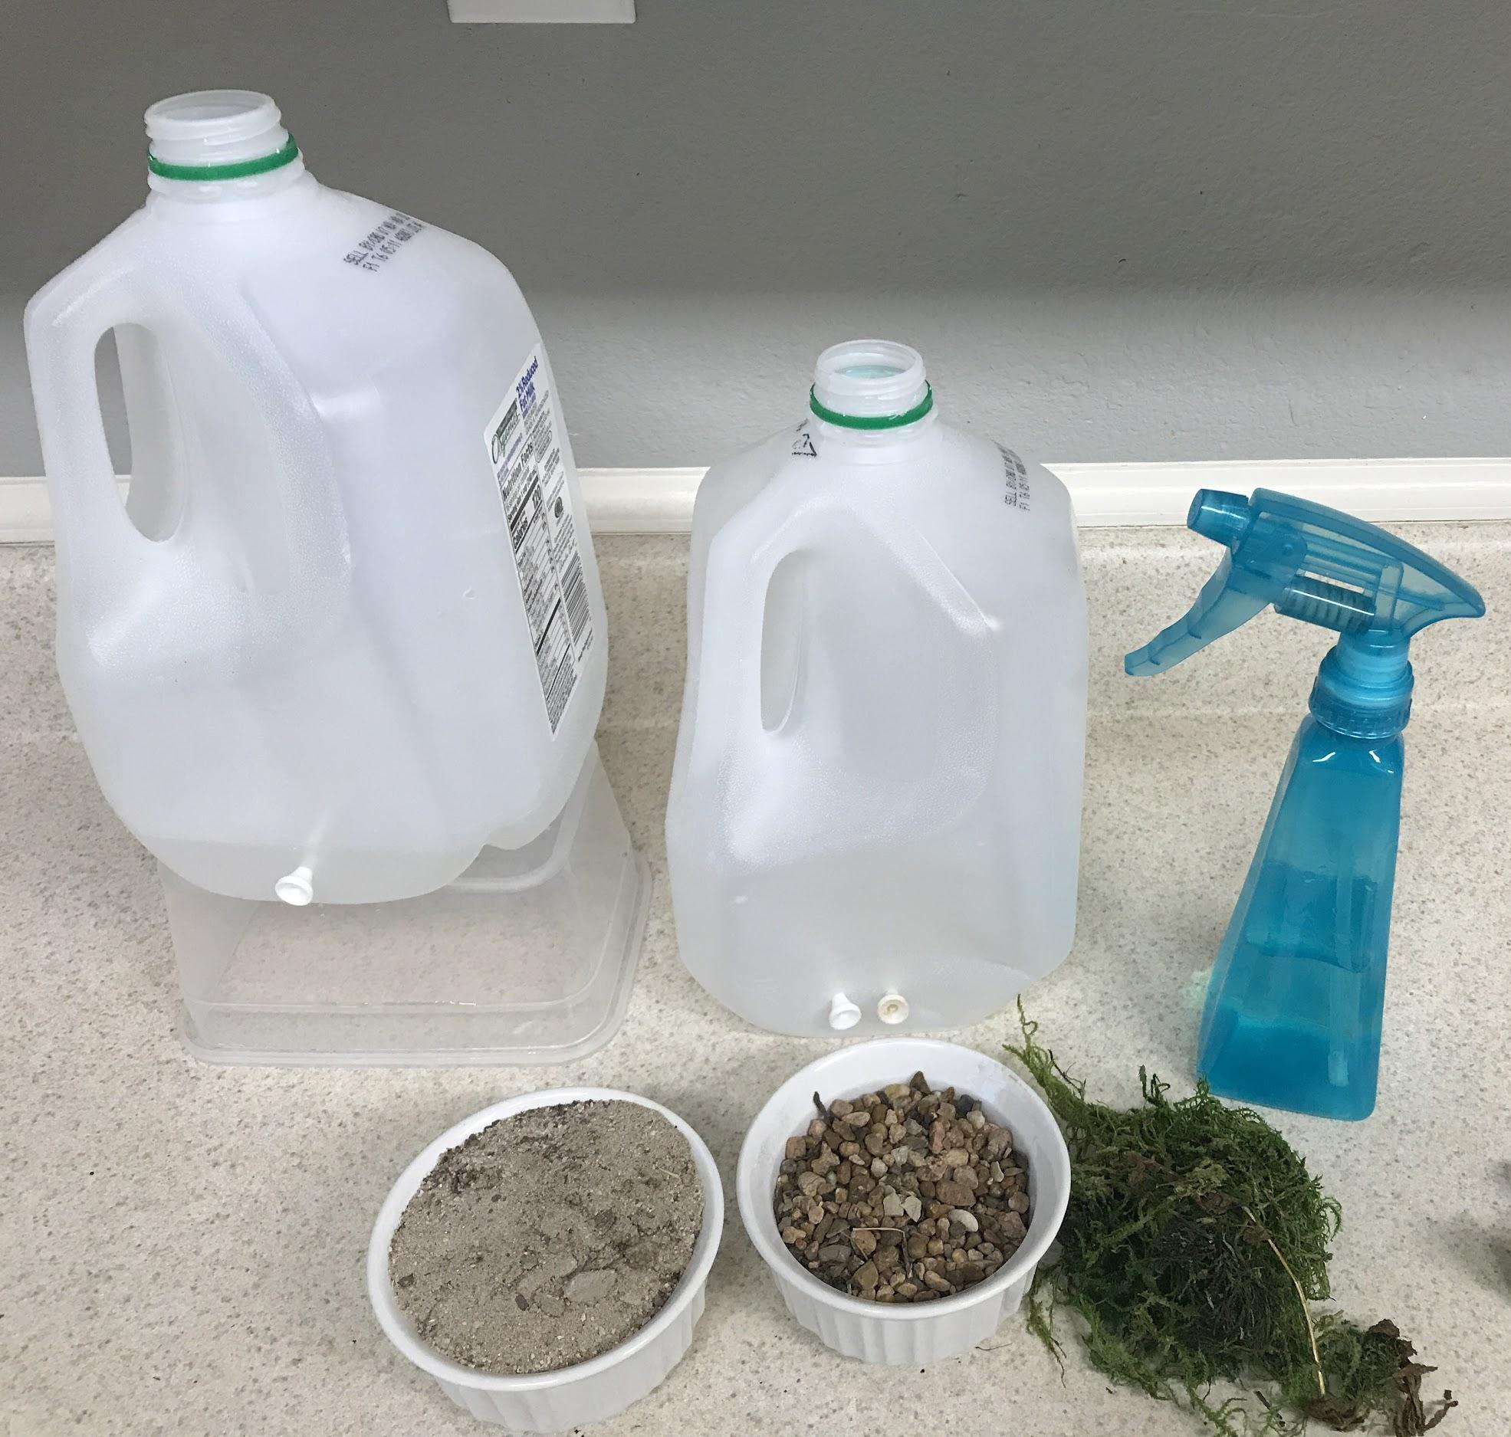
Designing an Investigation
How will we use these materials to test our conditions?
Conditions to test:
a bigger river,
more rain,
small sandy soil versus rocks,
a place with lots of vegetation, like grass and trees, and
faster water flow

Slide 40
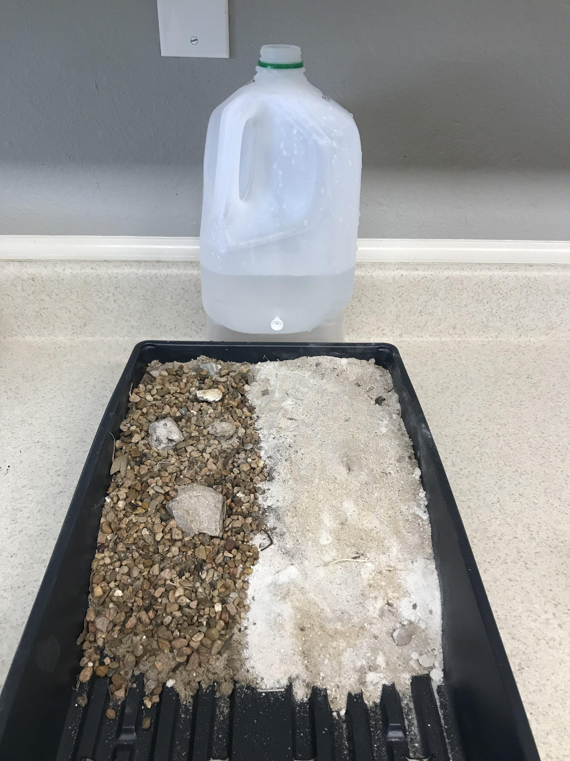
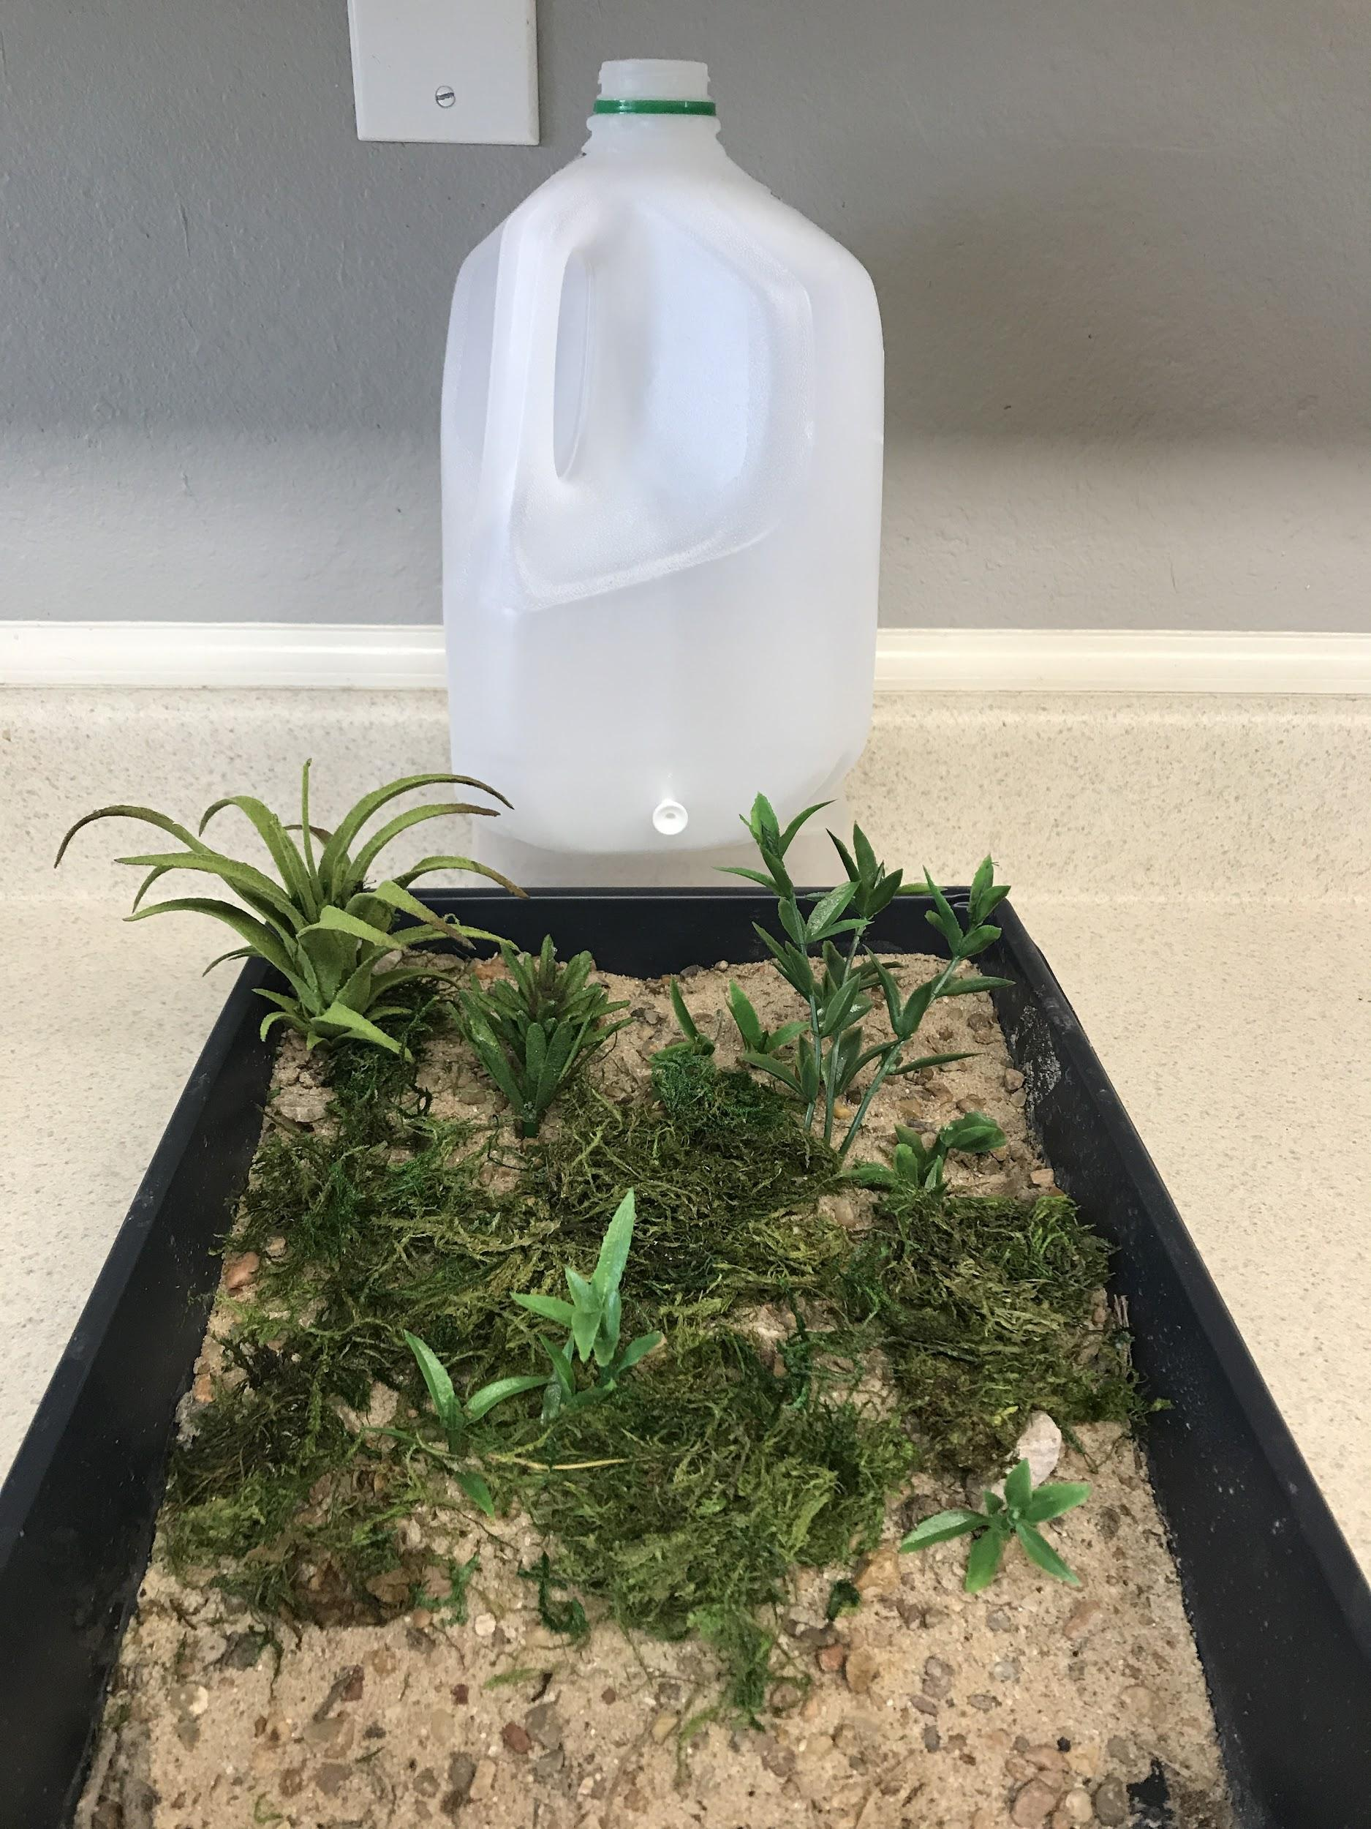
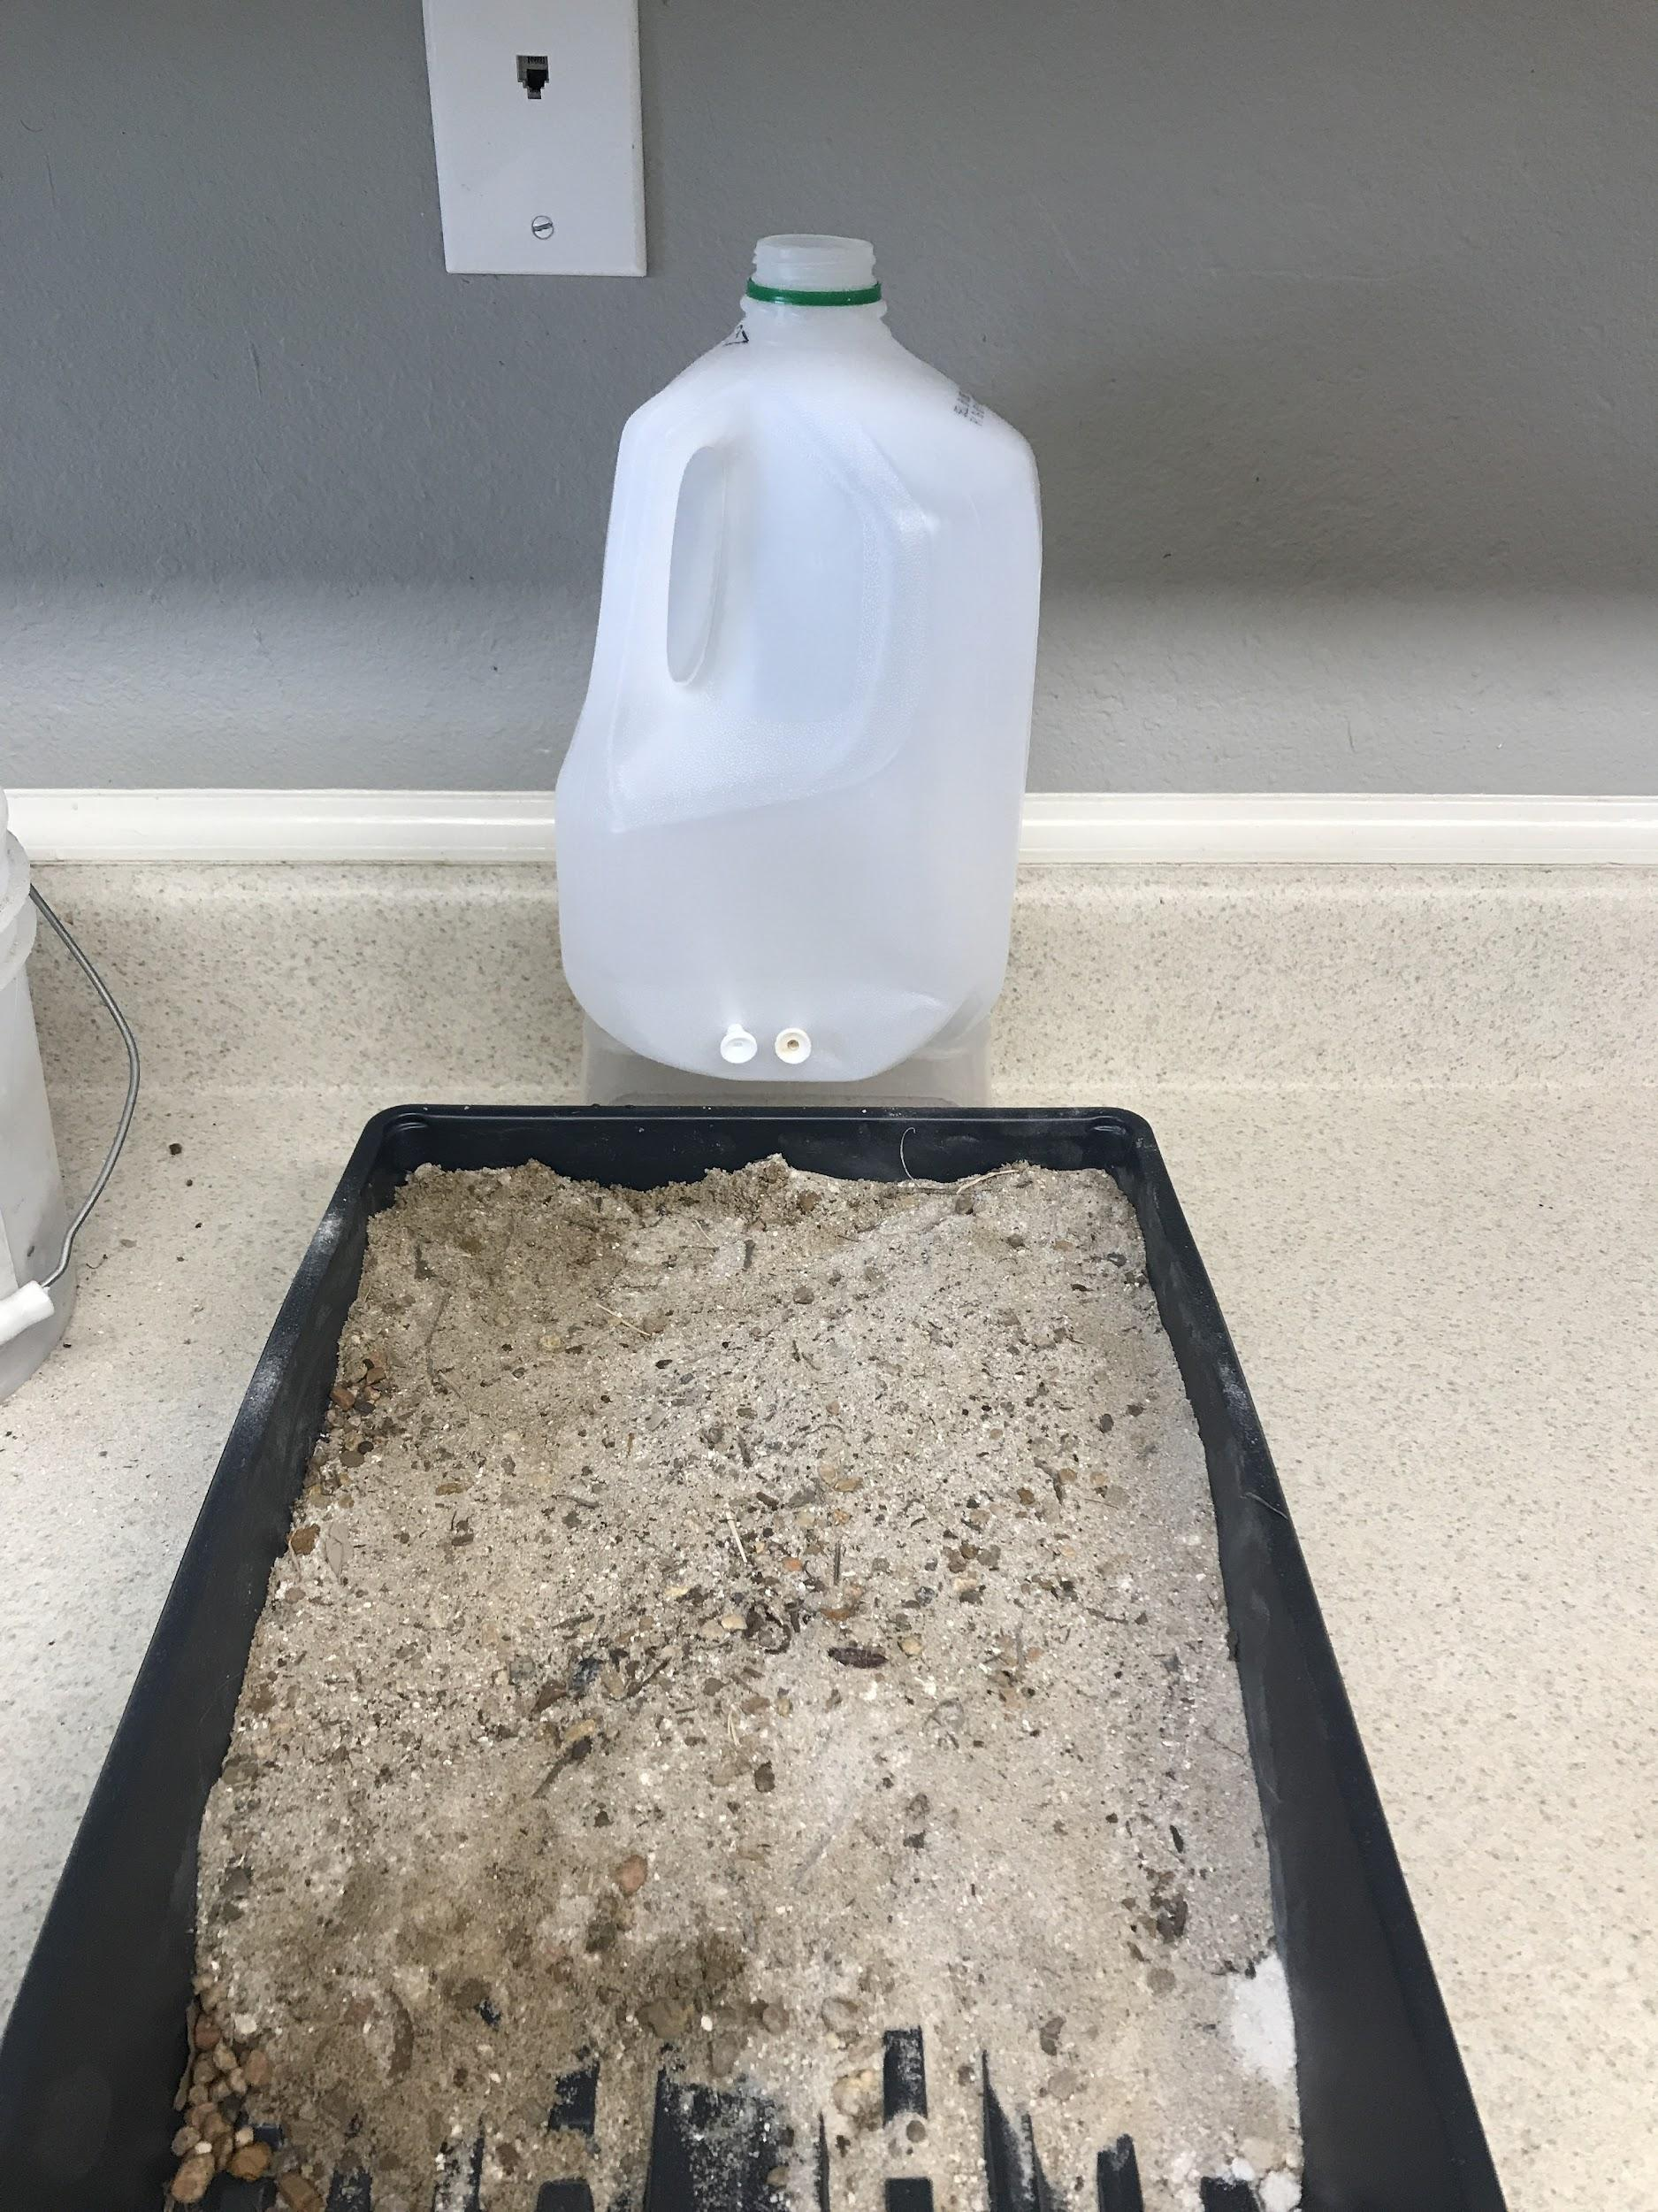
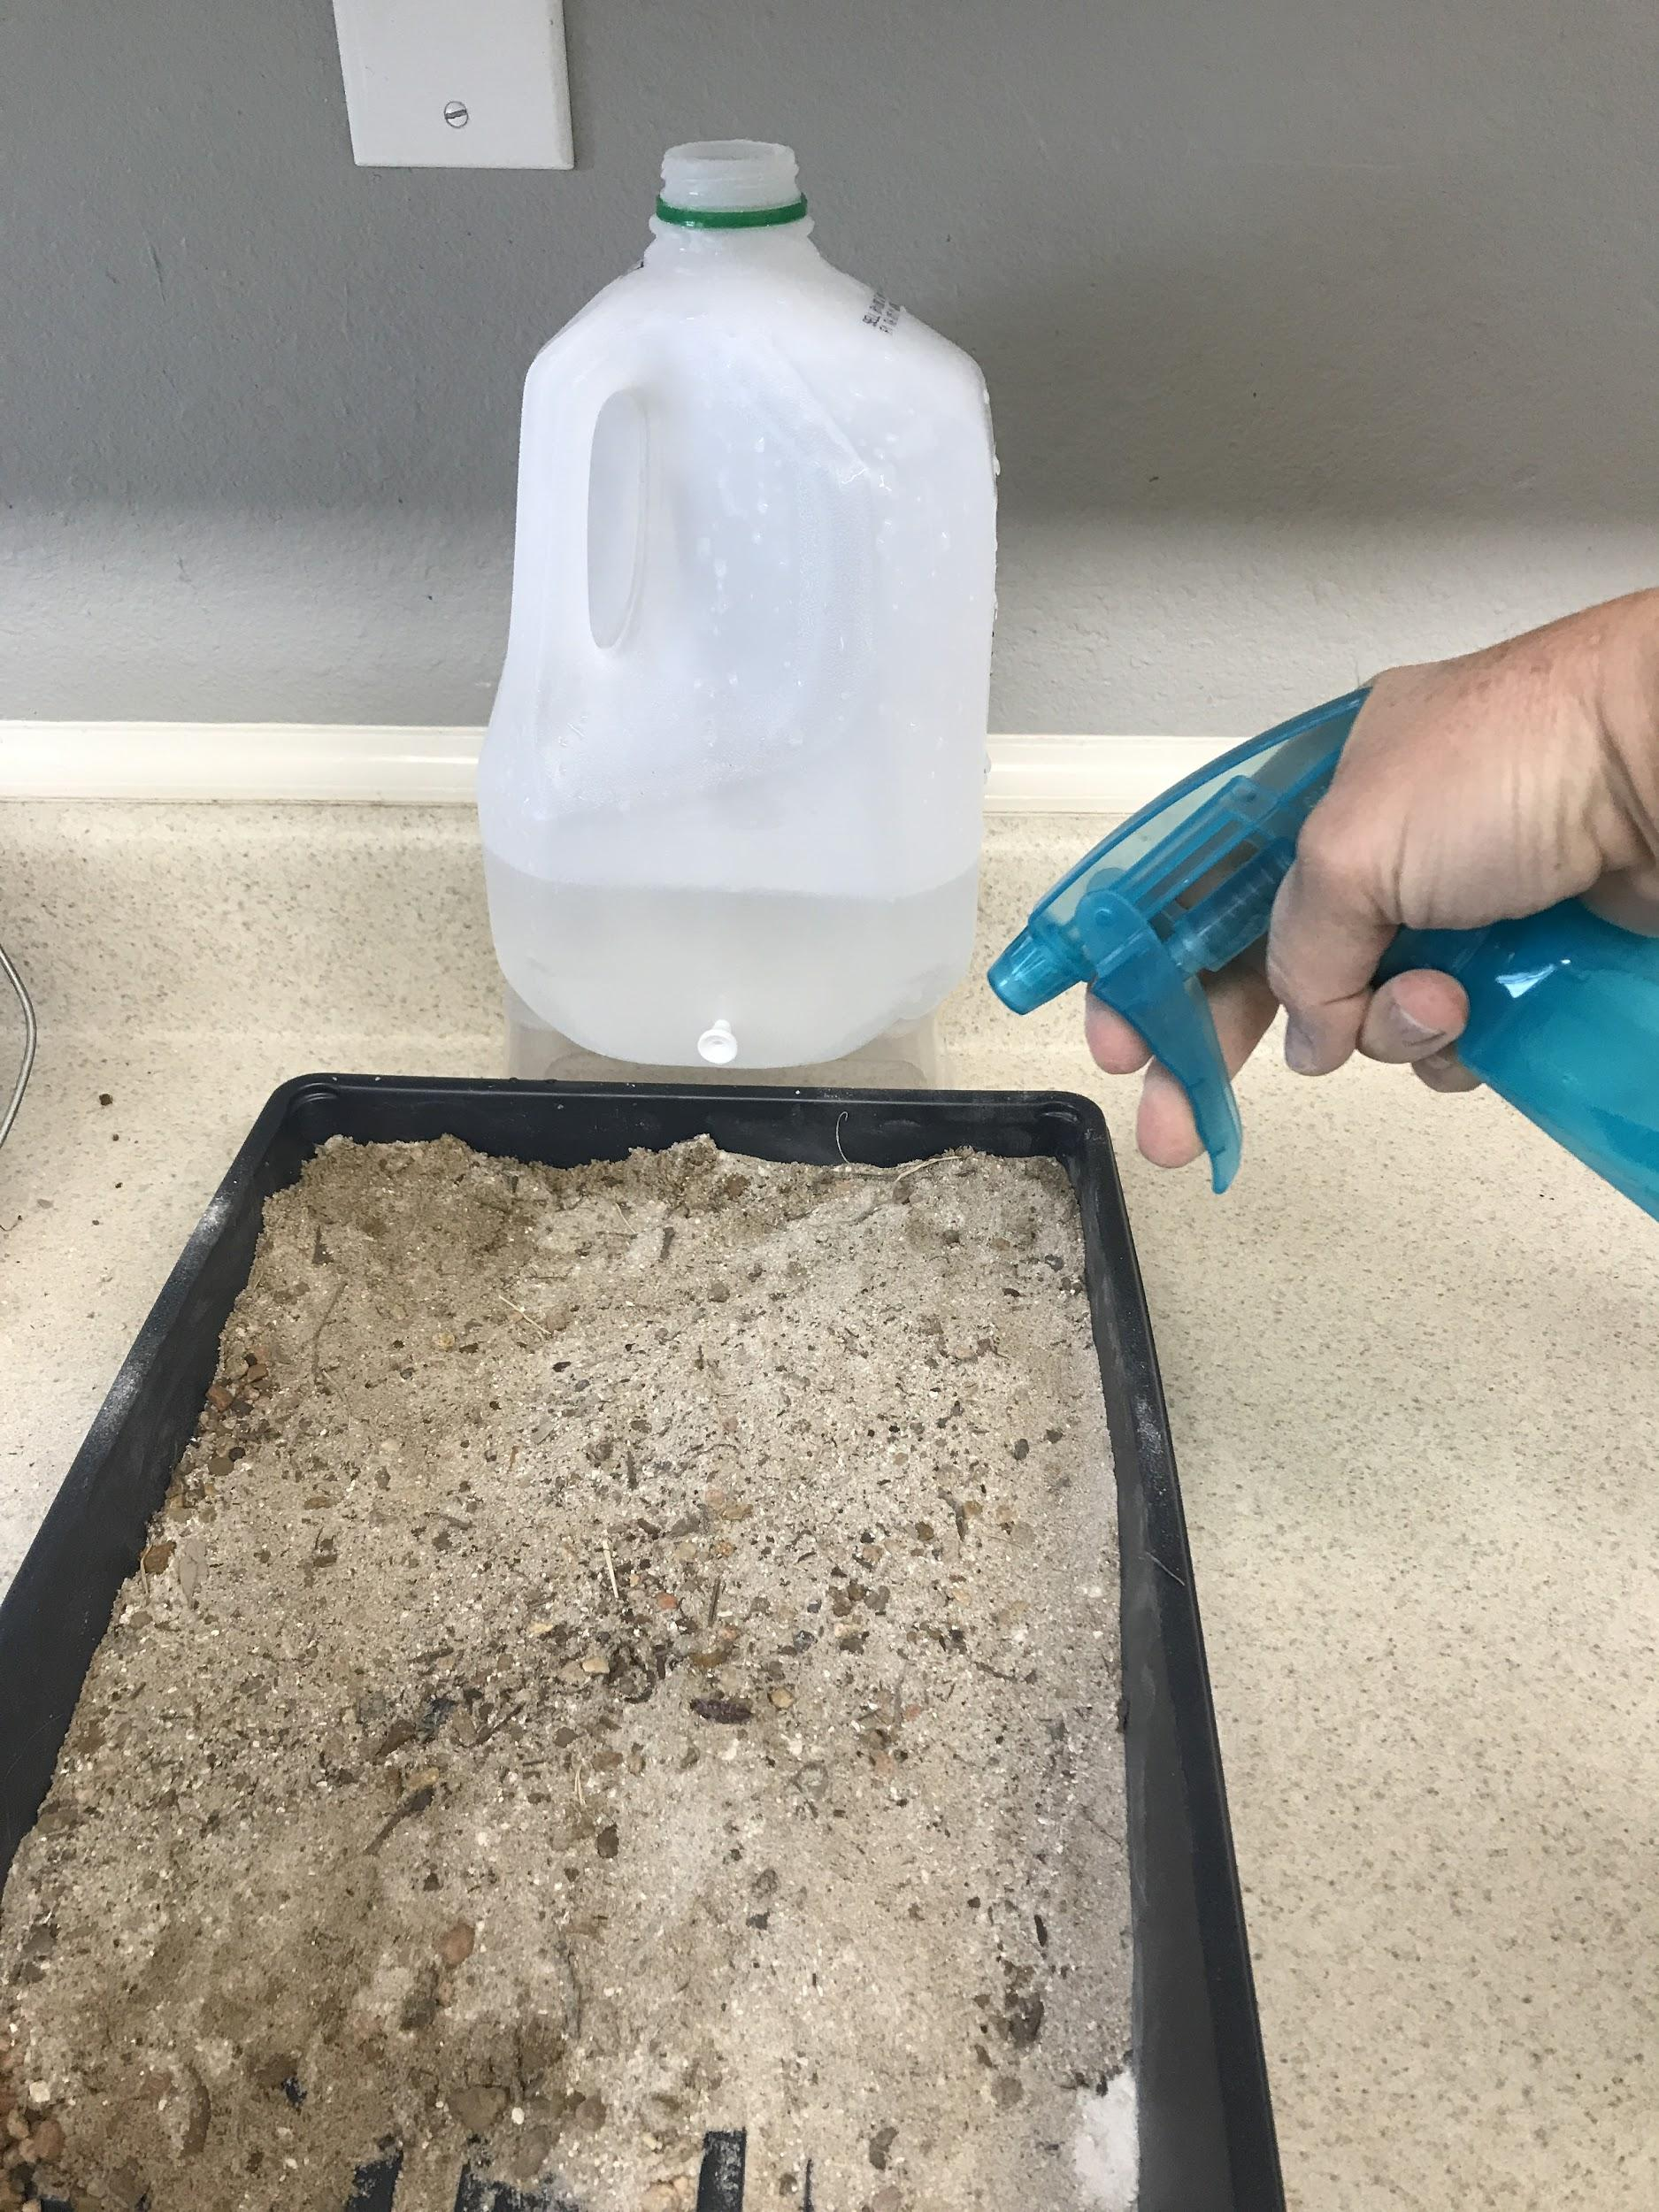
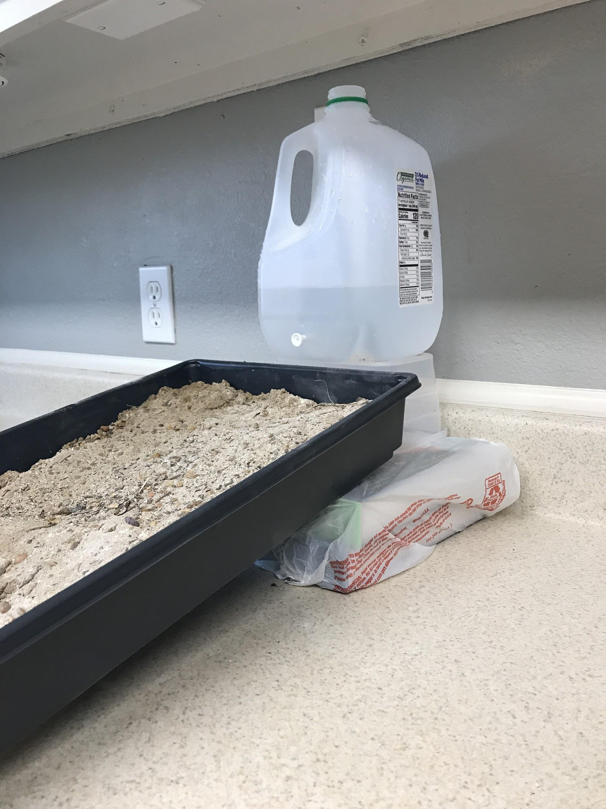
Rocks and sand
Plastic plants for more vegetation
Two holes for more water
Spray bottle for rain
Books for steeper slope

Slide 41
Stream table from Lesson 2 (comparison)
NOTE TO TEACHER: Insert video from Lesson 2 stream table for students to use as a comparison.

Slide 42
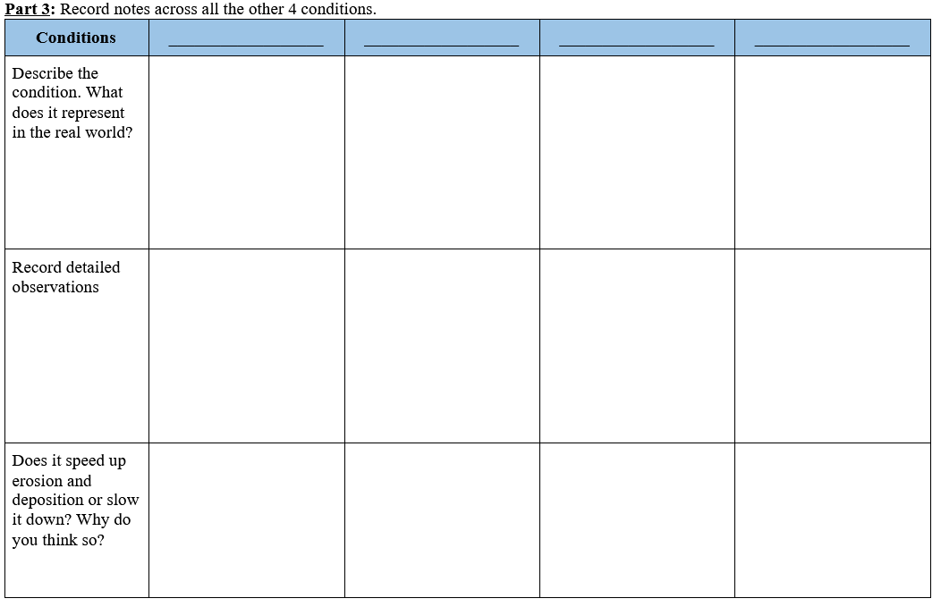
Investigation Follow-up
What can we say about what changes how fast a delta can grow?
What can you say about erosion and deposition?
What is our evidence?
What did we figure out?
Record data from other teams in Part 3 of your handout.

Slide 43
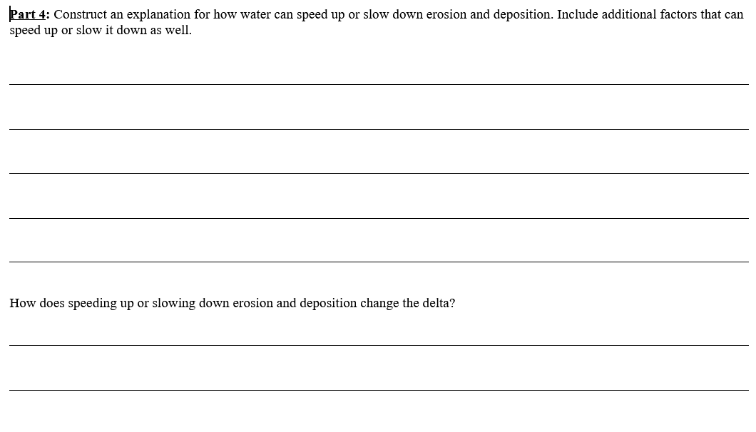
Putting it all Together
What can change how fast deltas grow?
Answer our focus question by completing Part 4 of your handout.

Slide 44
What’s next?
What we know from earlier reading:
Do you think building dams would affect erosion and deposition?
Do you think it would affect delta formation?
The Mississippi River has been known to flood a lot, but there are so many towns and neighborhoods along the Mississippi.
There are also a lot of ships going up and down the river carrying goods to different ports.
To protect homes along the river, people, and boats, they have built dams and levees along the river to control the water.

Slide 45
Earth’s Changing Surface
Lesson 4

Slide 46
What have we figured out?
Lesson 3 Focus Question:
What can change how fast deltas grow?
How did we answer this question in our last class?
Can we answer any questions on our DQB?

Slide 47
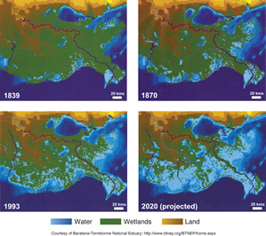
Lesson 4 Focus Question
What can cause a delta to shrink?

Slide 48
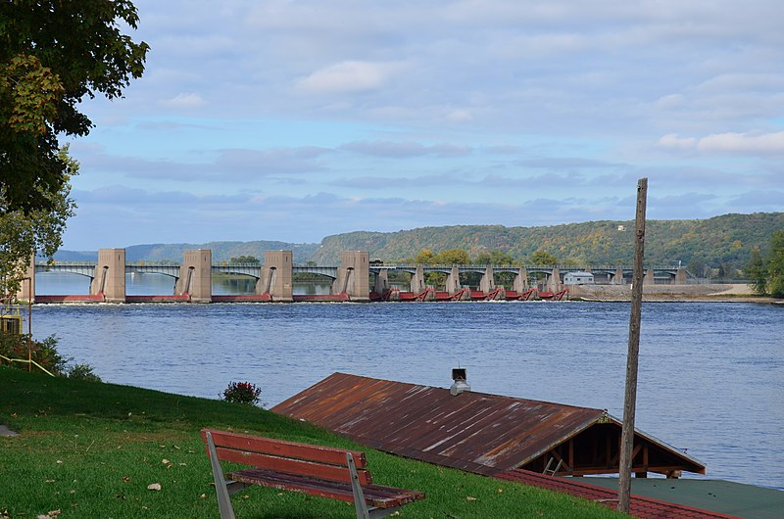
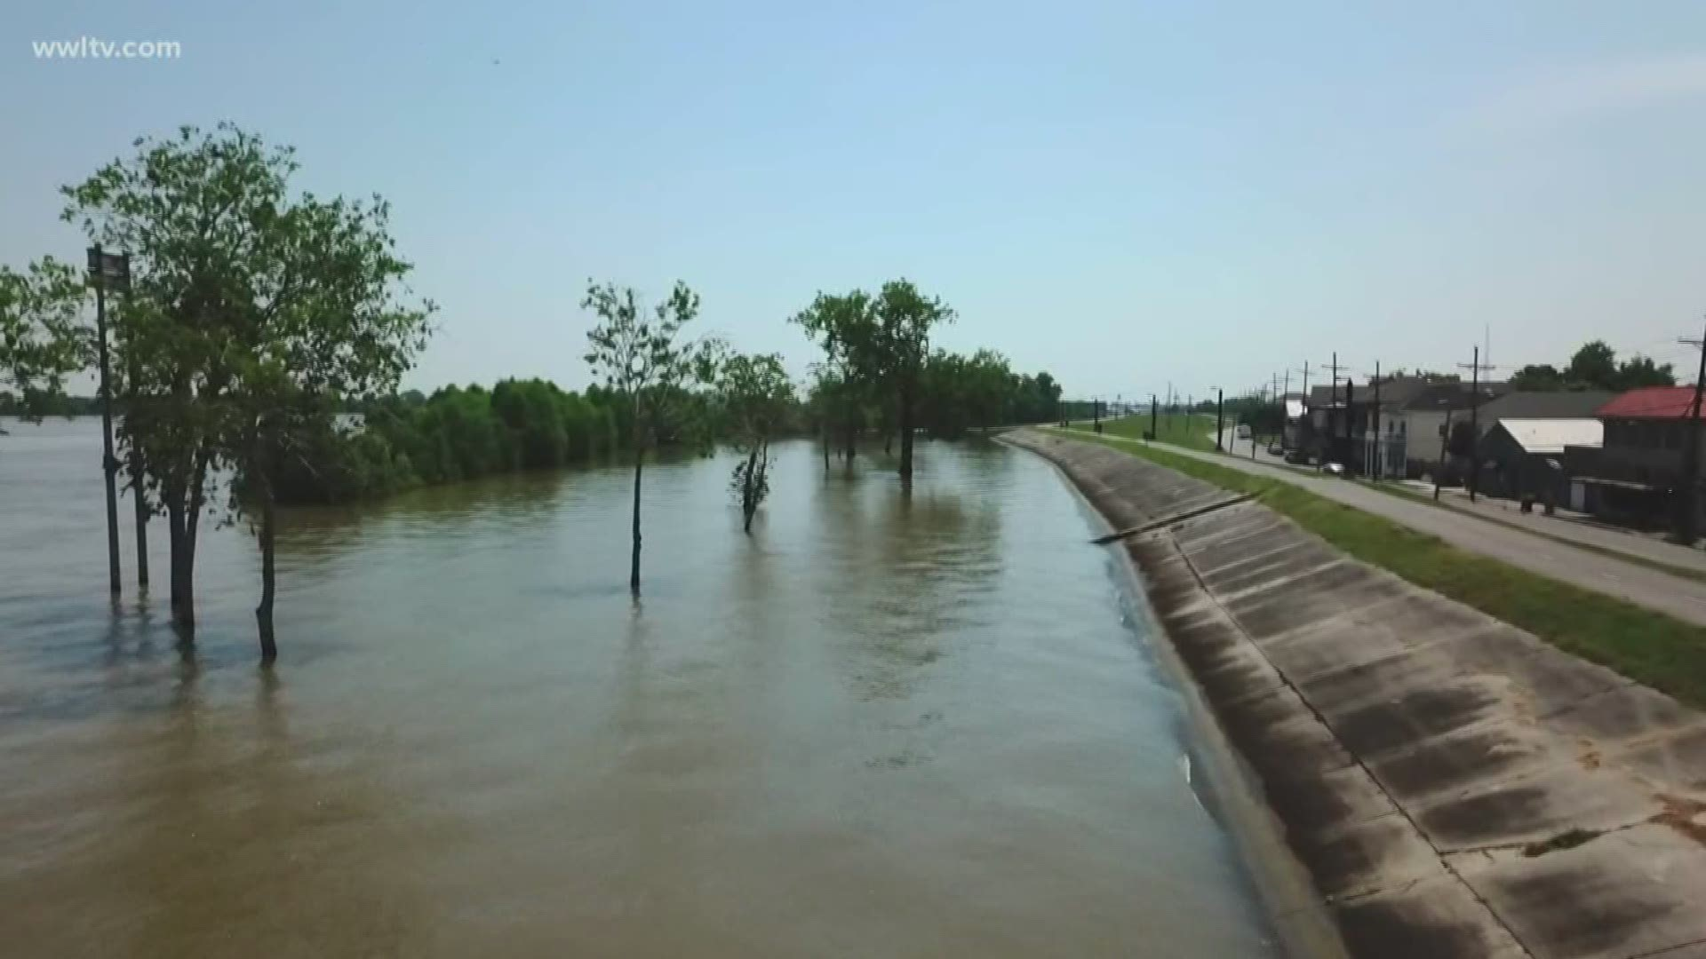
Human-made structures on a river
A dam on the Mississippi river.
Levees along the banks of the Mississippi river.

Slide 49
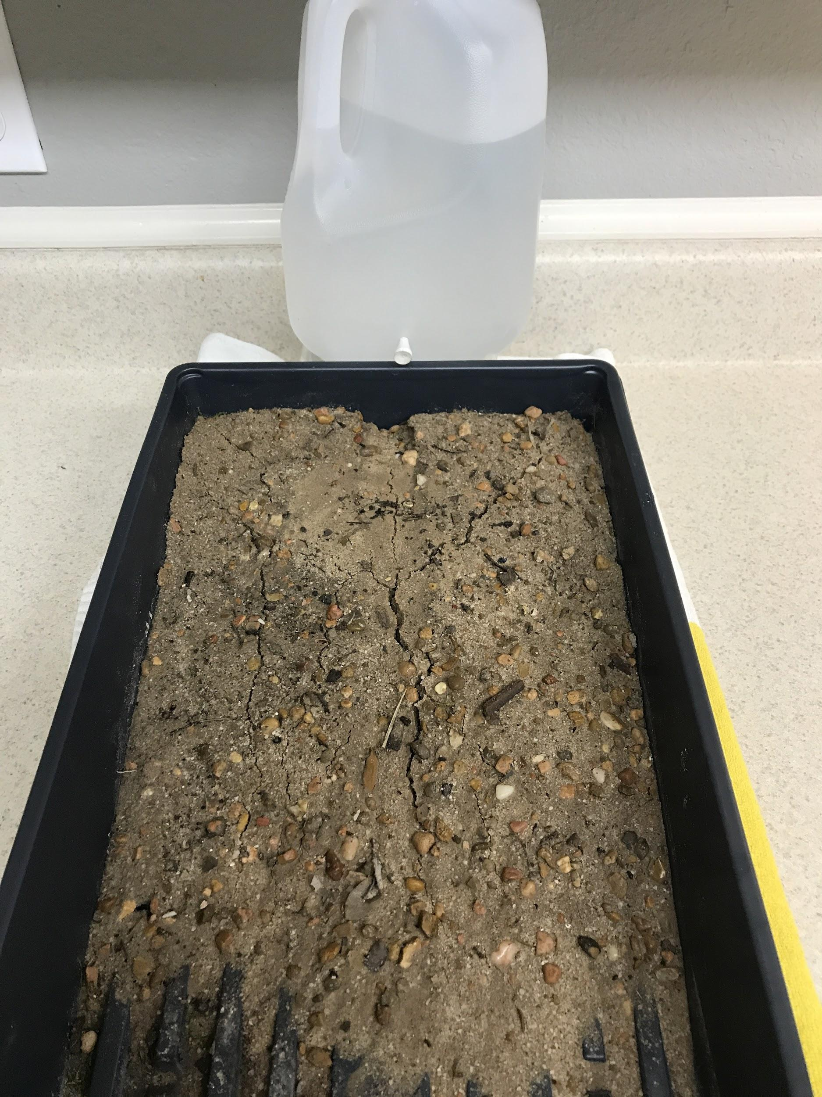

Slide 50
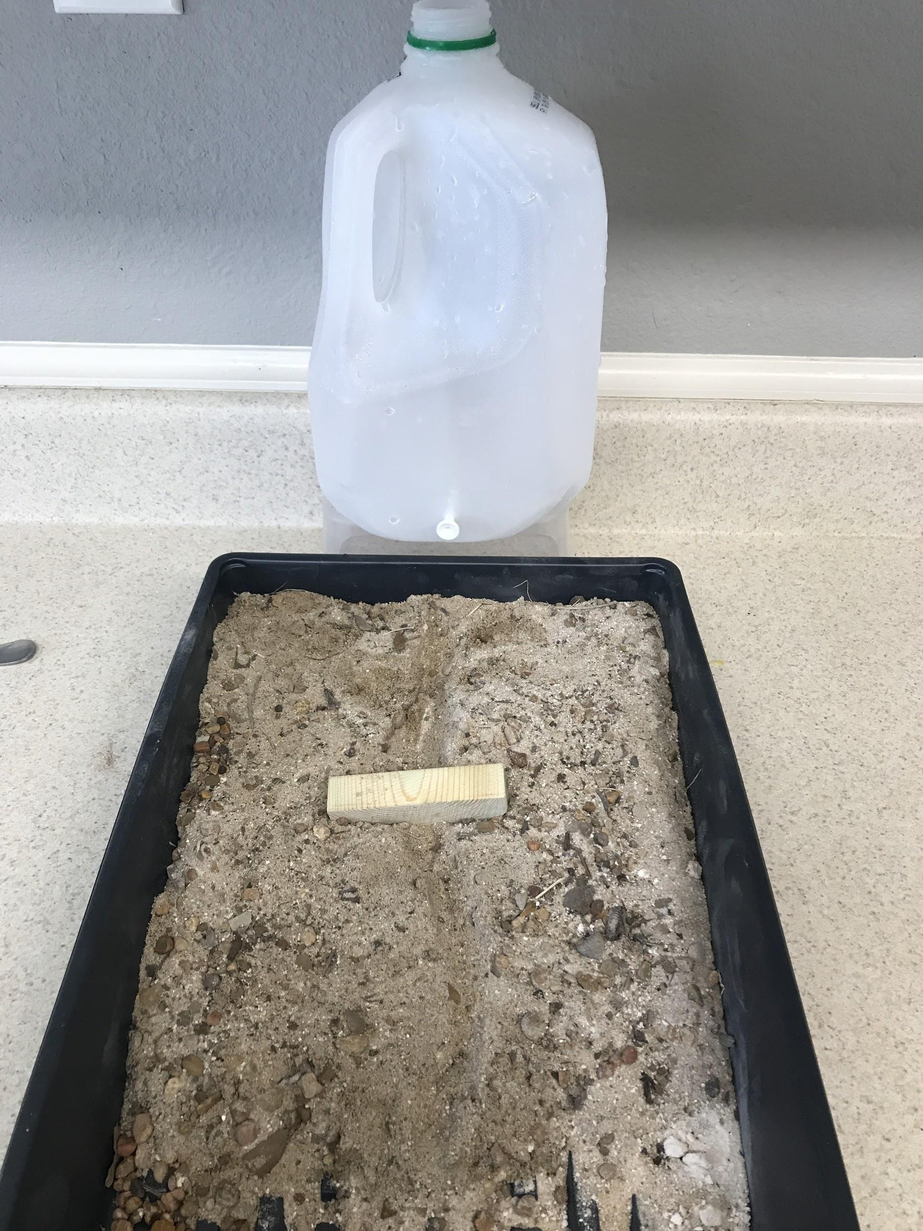
Turn and Talk with your partner
What are your ideas about how a dam changes a delta?
How do erosion and deposition change?

Slide 51
Returning to the Focus Question
Lesson 4 Focus Question:
What can cause a delta to shrink?
Share your ideas!
What are some positive effects of dams on a river?
What are some negative effects of dams on a river?
Record your ideas in #4 of your handout.

Slide 52
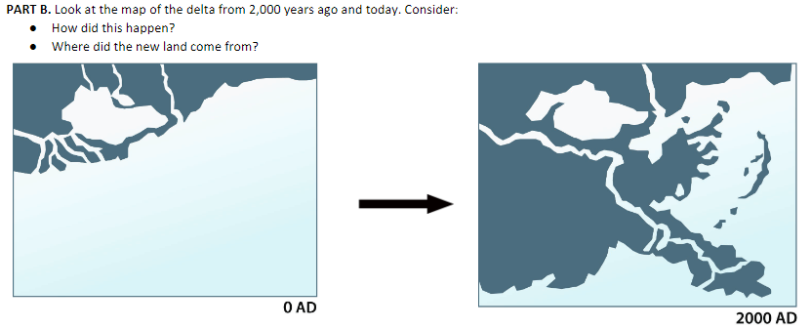
How have your ideas changed?
How would you draw your model now?

Slide 53
What’s next?
Where did all the sand in the delta come from?

Slide 54
Teacher Follow Up: Content Deepening
What science ideas do you think your students will have success with? Where might they struggle?
How can the intentional use of STeLLA Strategies support students as they figure out these science ideas?

Slide 55
Teacher Follow Up: STeLLA Strategies
Jigsaw Lessons 2-4
Which STeLLA strategies were focal in your assigned lesson?
How did these focal strategies help support your thinking as a learner?
How will you use these STeLLA strategies to reveal, support, and challenge student thinking?
Share out in home groups.

Slide 56
Teacher Follow Up: STeLLA Strategies
What repeating strategy structures do you see across lessons?

Slide 57
Return to Focus Questions
How does watching classroom video help you become a more reflective practitioner?
What can cause the Earth’s surface to look the way it does?
Why is it important to intentionally plan to use specific STeLLA strategies throughout a lesson?

Slide 58
Teacher Set Up
Start Lesson 5 in Teacher Hat
Peek into a classroom for the first half of lesson 5
Transition to Learner Hat

Slide 59
Earth’s Changing Surface
Lesson 5
Weathering

Slide 60
What have we figured out?
What have we figured out about how deltas grow and shrink?

Slide 61
Lesson 5 Focus Questions
Where does the soil and rock in a delta come from and where does it go?
Does the rock and soil ever change?
Lesson 5 Focus Questions:
Where does the soil and rock in a delta come from and where does it go?
Does the rock and soil ever change?

Slide 62
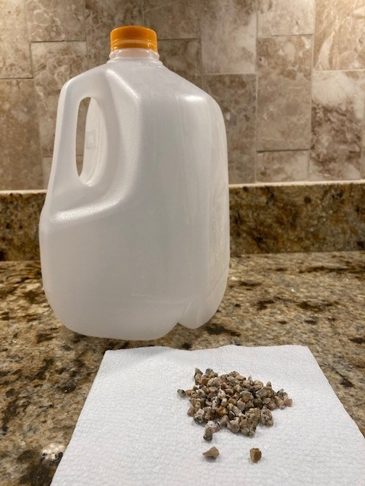
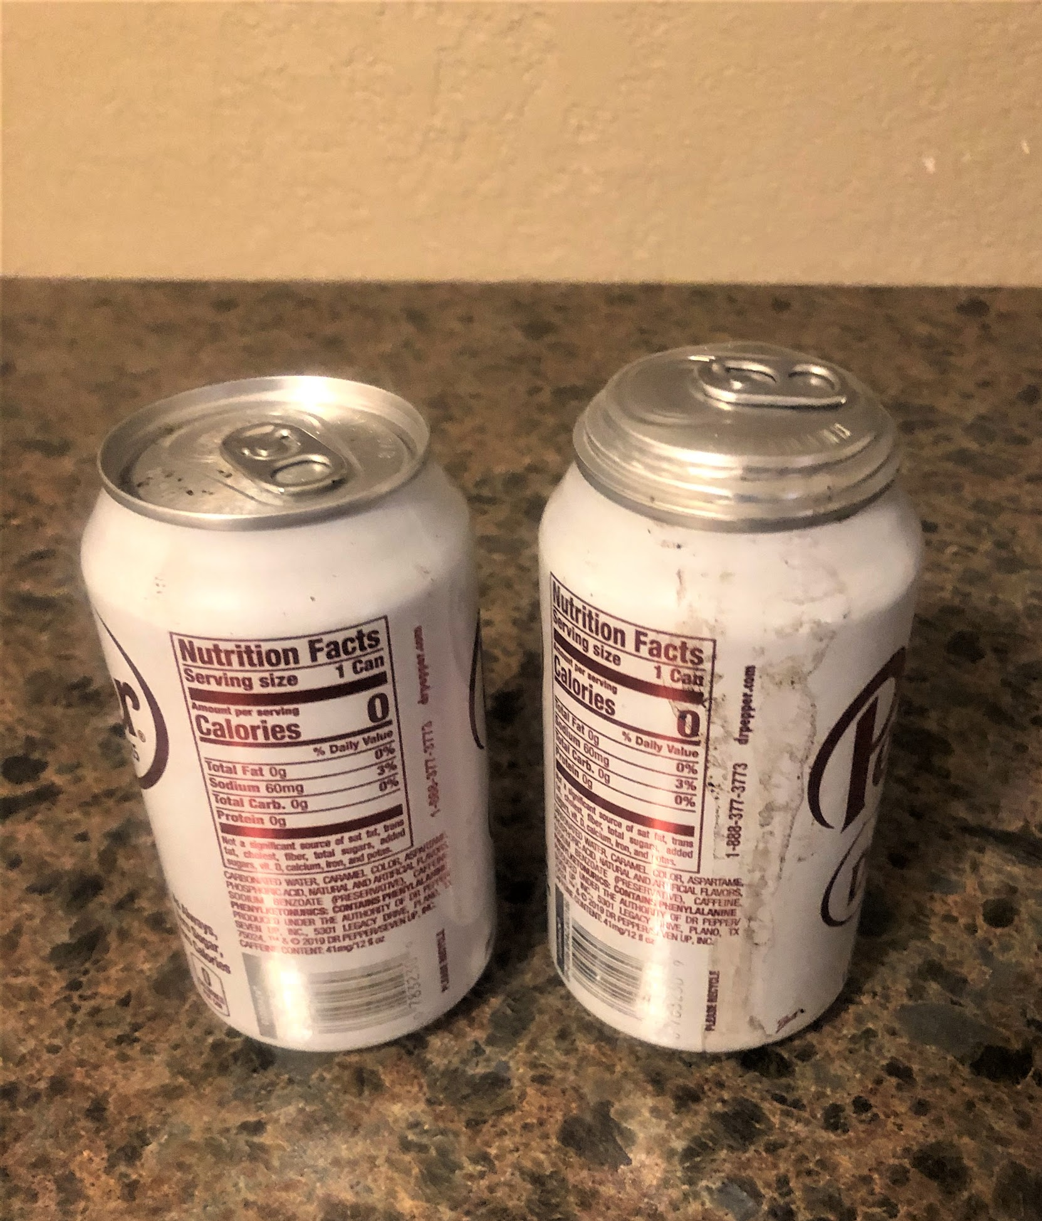
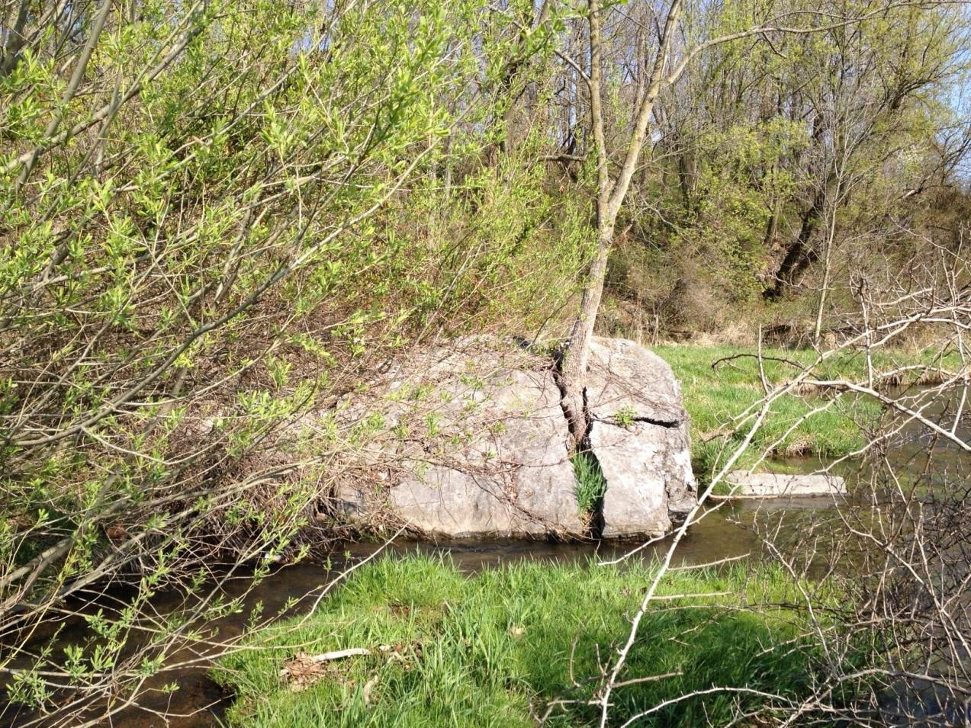
Three Investigation Stations

Slide 63
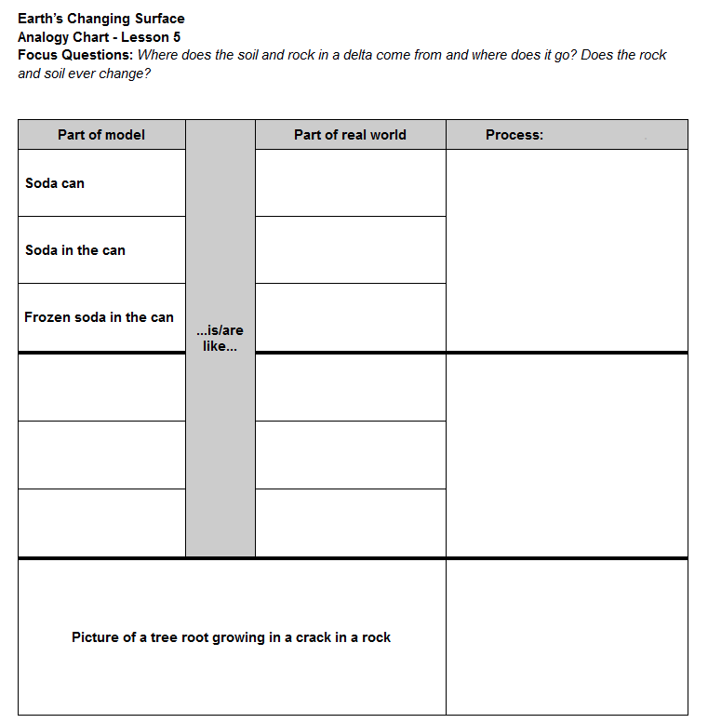
Analogy Chart

Slide 64
Investigating to Answer our Focus Question
Complete Investigation A.
2. When you finish Investigation A work with your group and:
read the focus questions,
talk about any ideas the activity gave you to answer the focus questions, and
write your ideas in your science notebook (in complete sentences).
3. Repeat with Investigation B and C.
Add link

Slide 65
Lesson Analysis: The Basics (pp. 1-2)
Viewing Basics
Analysis Basics
Viewing Basic #1: Look past the trivial, the little things that “bug” you.
Viewing Basic #2: Avoid the “this doesn’t look like my classroom” trap.
Viewing Basic #3: Avoid making snap judgments about the teaching or learning in the classroom you are viewing.
Analysis Basic #1: Focus on student thinking and the science content storyline
Analysis Basic #2: Look for evidence to support any claims
Analysis Basic #3: Look more than once
Analysis Basic #4: Consider alternative explanations and teaching strategies.
Notes:
Which stand out to you and why?

Slide 66
Preparing for Video Analysis: The Process
Identify - to create a shared understanding of the strategy
Analyze - to consider the influence of the use of strategy on student thinking and learning
Reflect and apply - to make the strategy part of our own practice
Notes:
We watch classroom video for 4 main purposes:
We’ve all read the strategy, but may have different mental images of what the strategies would look like in practice. The first role of video analysis is to make sure we have a common vision of the strategy - that we mean the same thing when we say the words selecting and engaging students with content representations and models. In the identify phase, we will make sure that we all see the same thing when we are talking about the strategy.
The second goal of video analysis is to see the potential of the strategy to impact student learning. We each have limited experiences in the classroom, and may not have thought about how our actions as teachers impact students’ opportunities to learn. In the analysis phase, we will consider the impact of the strategy on student thinking, and hone our skills as we develop a “student thinking lens.” To do this we make a claim about either the interesting student thinking made visible in the clip, or how the strategy influenced students’ ways of thinking.
Alternate 2: The second goal of video analysis is to see the potential of the strategy to impact student learning. We each have limited experiences in the classroom, and may not have thought about how our actions as teachers impact students’ opportunities to learn. In the analysis phase, we will consider the impact of the strategy on the classroom. In the case of these three strategies within the “science content storyline lens,” we want to think about where we see evidence of teacher planning and preparation that took these strategies into account and whether that preparation has an impact on student learning. To do this we make a claim about either the interesting student thinking made visible in the clip, or how we observed the strategy in practice..
In the analysis phase, we might also consider alternatives, what might I have done differently in this situation? Where would I like to know more about what a student is thinking or clarify what they mean. We might consider multiple ways of interpreting the teaching and learning in the selection. We’ll dig deeper into the analysis phase in future video analysis opportunities, but if you want to know more, refer to pg. 2 of the strategy document for norms for analysis.
The last goal of video analysis is to transfer what you learn by watching other teachers or discussing the strategy in action with your colleagues is to reflect and apply new learning to your own teaching practice.
This is a quick overview of the process we will use when viewing classroom video: Identify, Analyze, Reflect and Apply

Slide 67
Preparing for Video Analysis: The Context
Lesson Context:
This is lesson 5 in the Earth's Changing Surface unit. In this lesson, students explore three models to think about where the materials that are deposited in the Mississippi River delta come from.
In these clips, students make sense of what they observed while investigating 1) two pictures, taken a decade apart, of a tree growing in a rock, 2) what happens to rocks when they are shaken in a bottle, and 3) what happens to an unopened soda can when it is frozen.

Slide 68
Video Analysis: L5_Potter_C4-6
Identify
What instances of making explicit links between science ideas and activities do you observe in this clip?
Analyze
Reflect and apply
Add link

Slide 69
Video Analysis: L5_Potter_C4-6
Identify
Analyze
What do students understand (or not ) about weathering?
How did the teacher's use of the identified STeLLA strategies reveal, support, and challenge student thinking?
Reflect and apply
Notes:
n your journal,

Slide 70
Video Analysis: L5_Potter_C4-6
Identify
Analyze
Reflect and apply
What did you learn through this analysis that you want to apply to your own practice?
Notes:
n your journal,

Slide 71
Day 1 Focus Questions
How does watching classroom video help you become a more reflective practitioner?
What can cause the Earth’s surface to look the way it does?
Why is it important to intentionally plan to use specific STeLLA strategies throughout a lesson?

Slide 72
Homework
Skim the Teacher Content Background doc

Slide 73
Gots and Needs
Add one got or need to a sticky note and add to our poster on your way out.
Thanks, and we'll begin at 8:00 tomorrow morning!
Notes:
Slides 9 – 11 are placeholders for the anchor lesson slides

