Slide 1
STeLLA Scale Up and Sustainability Study (SSUP)
Day 1
Science Teachers Learning From Lesson Analysis

Slide 2
Welcome & Introductions
Welcome to the STeLLA Summer Institute!
In your table groups, introduce yourselves by sharing the following information:
Name
Organization, district or school site.
Your role
One thing that you are looking forward to getting out of our week together.

Slide 3
STeLLA Program Goals
Deepen knowledge of teaching and learning
Increase ability to analyze and reflect on teaching and learning
Increase ability to use content knowledge and knowledge of teaching and learning to transform classroom practice
Deepen teacher content knowledge
Increase student learning in science

Slide 4
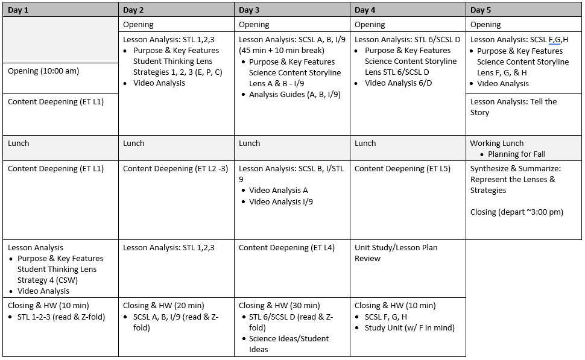
Week-at-a-Glance

Slide 5
STeLLA Norms
The Basics
Arrive prepared and on time; stay for the duration
Remain attentive, thoughtful, and STeLLAful; eliminate interruptions (turn off cell phones, email)
Make room for participation from all (monitor your floor time)
Purpose: Build trust and develop a productive study group for all participants
The Heart of STeLLA Lesson Analysis
Keep the goal in mind: We are analyzing teaching to improve student learning
Share your ideas, uncertainties, confusions, disagreements, questions—open up time so this can happen!
Expect and ask questions to deepen everyone’s learning—honor needs!

Slide 6
Day 1 Focus Questions
How can students be empowered to reveal their thinking and to listen to and interact with each other during classroom conversations?

Slide 7
Effective Science Teaching & Learning
What does effective science teaching and learning look like?
What are teachers doing?
What are students doing?
What is the classroom like?
Teachers Doing | Students Doing
Classroom

Slide 8
Content Deepening: Teacher Set-up
How do you usually teach energy transfer and transformation?
What do you want students to learn?
What ideas do students struggle with?
Notes:
Slides 9 – 11 are placeholders for the anchor lesson slides

Slide 9
Content Deepening: Teacher Set-up
Consider the Ideas about energy transfer on the Mash Up on p. __.
Add dots to the left-hand column as you analyze each idea.
Green dot: science idea (accurate statement)
Yellow dot: uncertain
Red dot: common student idea (inaccurate statement)
Add sticky notes to clarify statements or add your own thoughts.
We’ll revisit these ideas periodically throughout the week.
Notes:
Slides 9 – 11 are placeholders for the anchor lesson slides

Slide 10
Anchor Lesson Common Experience
Put on a "science learner hat"

Slide 11
Energy, Every Day, Everywhere Lesson 1
Launching an Investigation of Energy

Slide 12
What do we know and wonder about energy?
Know | Wonder

Slide 13
Focus Question
How do we know if something has energy?

Slide 14
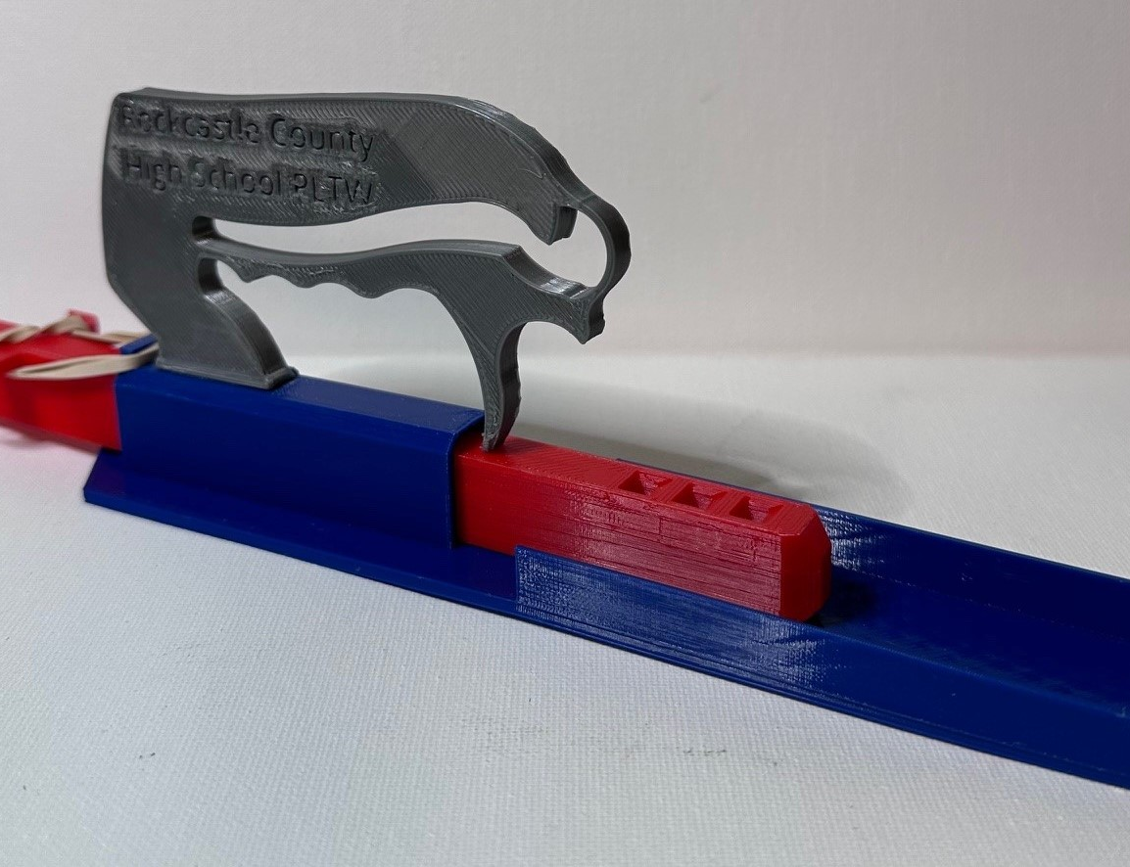
Car Launcher System
Identify the parts of the car launcher system

Slide 15
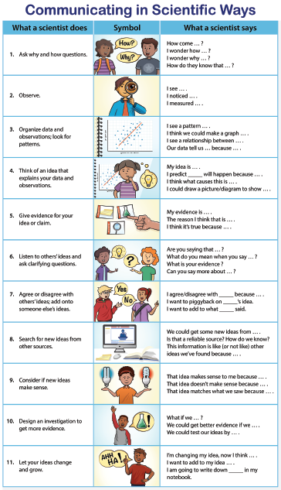
Communicating in Scientific Ways

Slide 16
Car Launcher System
Do any of the parts of the car launcher
system have energy?

Slide 17
Explore the car launcher system
Launch the car one time
Add observations to the Notice column
Add a question to the Wonder column
Something to investigate
Question about energy
Continue this process 3-4 times, adding noticings and wonderings
Know | Wonder

Slide 18
Class Notice and Wonder chart
Know | Wonder

Slide 19
Focus Question
How do we know if something has energy?

Slide 20
Generate questions
Write your questions on sticky notes
One question per sticky note
Write in complete sentences
Write big and bold so your questions are easy to read

Slide 21
Driving Question Board (DQB)
?
?
?
?
?
?
?
?
?
?
?
?
?
?
?

Slide 22
Unit Central Question
How does the energy of an object change?

Slide 23
Communicating in Scientific Ways
How did using the CSW sentence stems help you think like a scientist?

Slide 24
Next steps
Next class we will investigate...

Slide 25
Content Deepening: Teacher Follow-up
What could one learn through this experience?

Slide 26
Meta Moment
Journal….
What ideas do you want to add to your effective teaching and learning charts?
How did the experience (e.g., aspects of the lesson) engage your curiosity and make you wonder?
What role did using the CSW stems play in the lesson?
What role did the “teacher/PDL” play in the process?
Notes:
Add notes for transition into whole group, bring effective science teaching charts
How do you think CSW can help your Ss? Why is that important?
Journal…
How did the experience invite you into wondering and learning?
What are the features that supported your curiosity and engagement?

Slide 27
STeLLA Norms
The Basics
Arrive prepared and on time; stay for the duration
Remain attentive, thoughtful, and STeLLAful; eliminate interruptions (turn off cell phones, email)
Make room for participation from all (monitor your floor time)
Purpose: Build trust and develop a productive study group for all participants
The Heart of STeLLA Lesson Analysis
Keep the goal in mind: We are analyzing teaching to improve student learning
Share your ideas, uncertainties, confusions, disagreements, questions—open up time so this can happen!
Expect and ask questions to deepen everyone’s learning—honor needs!

Slide 28
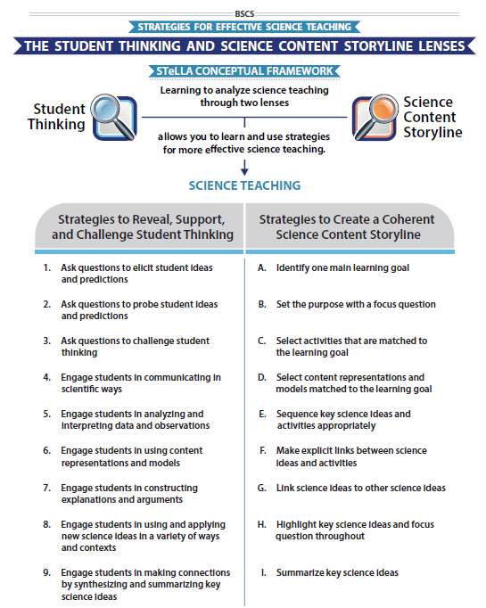
STeLLA Conceptual Framework
Focus Question:
How can students be empowered to reveal their thinking and to listen, probe, and challenge each other during classroom conversations?

Slide 29
STL Strategy 4: Communicating in Scientific Ways (CSW)
Read the Strategy Summary (p. 19) and complete the Student Thinking Lens Z-fold for STL Strategy 4: CSW
Purpose
Key Features
Examples
Be prepared to share your ideas
Purpose: WHY it’s important
Key Features: WHAT does it look like in the classroom
Notes:
2 or 3 per room. No BSCS
**Blue box from slide 12 added here

Slide 30
STL Strategy 4: Communicating in Scientific Ways (CSW)
STL #X
Purpose
Key Features
Purpose: WHY it’s important
Key Features: WHAT does it look like in the classroom
Notes:
6 rooms
Jamboard
**Slide has been updated

Slide 31
Lesson Analysis: The Basics (pp. 1-2)
Viewing Basics
Analysis Basics
Viewing Basic #1: Look past the trivial, the little things that “bug” you.
Viewing Basic #2: Avoid the “this doesn’t look like my classroom” trap.
Viewing Basic #3: Avoid making snap judgments about the teaching or learning in the classroom you are viewing.
Analysis Basic #1: Focus on student thinking and the science content storyline
Analysis Basic #2: Look for evidence to support any claims
Analysis Basic #3: Look more than once
Analysis Basic #4: Consider alternative explanations and teaching strategies.
Notes:
Which stand out to you and why?

Slide 32
Preparing for Video Analysis: The Process
Identify - to create a shared understanding of the strategy
Analyze - to consider the influence of the use of strategy on student thinking and learning
Reflect and apply - to make the strategy part of our own practice
Notes:
We watch classroom video for 4 main purposes:
We’ve all read the strategy, but may have different mental images of what the strategies would look like in practice. The first role of video analysis is to make sure we have a common vision of the strategy - that we mean the same thing when we say the words selecting and engaging students with content representations and models. In the identify phase, we will make sure that we all see the same thing when we are talking about the strategy.
The second goal of video analysis is to see the potential of the strategy to impact student learning. We each have limited experiences in the classroom, and may not have thought about how our actions as teachers impact students’ opportunities to learn. In the analysis phase, we will consider the impact of the strategy on student thinking, and hone our skills as we develop a “student thinking lens.” To do this we make a claim about either the interesting student thinking made visible in the clip, or how the strategy influenced students’ ways of thinking.
Alternate 2: The second goal of video analysis is to see the potential of the strategy to impact student learning. We each have limited experiences in the classroom, and may not have thought about how our actions as teachers impact students’ opportunities to learn. In the analysis phase, we will consider the impact of the strategy on the classroom. In the case of these three strategies within the “science content storyline lens,” we want to think about where we see evidence of teacher planning and preparation that took these strategies into account and whether that preparation has an impact on student learning. To do this we make a claim about either the interesting student thinking made visible in the clip, or how we observed the strategy in practice..
In the analysis phase, we might also consider alternatives, what might I have done differently in this situation? Where would I like to know more about what a student is thinking or clarify what they mean. We might consider multiple ways of interpreting the teaching and learning in the selection. We’ll dig deeper into the analysis phase in future video analysis opportunities, but if you want to know more, refer to pg. 2 of the strategy document for norms for analysis.
The last goal of video analysis is to transfer what you learn by watching other teachers or discussing the strategy in action with your colleagues is to reflect and apply new learning to your own teaching practice.
This is a quick overview of the process we will use when viewing classroom video: Identify, Analyze, Reflect and Apply

Slide 33
Preparing for Video Analysis: The Context
Lesson Context:
This clip is from Lesson 1 of 5 in the Energy, Every Day, Everywhere unit.
In this lesson students are introduced to the anchoring phenomenon, a toy car launcher system. Students first share what they know and wonder about energy, explore the car launcher system, and develop a Driving Question Board.
In this clip, the students are sharing their initial ideas about the lesson Focus Question, “How do we know if something has energy?”

Slide 34
Video Analysis: SSUP_ET_TN GR4_SG1_L1_Willett_C1
Identify
What instances do you observe of using STL Strategy 4: Communicating in Scientific Ways?
Analyze
Reflect and apply
Add link

Slide 35
Video Analysis: SSUP_ET_TN GR4_SG1_L1_Willett_C1
Identify
What instances do you observe of using STL Strategy 4: Communicating in Scientific Ways?
Analyze
How did the use of CSW stems support students in making their thinking visible?
What did the teacher do (or not) to promote the use of CSW stems or communicating like scientists?
Reflect and apply
Notes:
n your journal,

Slide 36
Video Analysis: SSUP_ET_TN GR4_SG1_L1_Willett_C1
Identify
What instances do you observe of using STL Strategy 4: Communicating in Scientific Ways?
Analyze
What did the teacher do (or not) to promote the use of CSW stems or communicating like scientists?
Reflect and apply
What did you learn from analyzing this video clip that you can apply to your own classroom?
Notes:
n your journal,

Slide 37
Ideas about Energy
What prior knowledge might students have about force and/or power?
What is force? How is force different than energy?
What is power? How is power different than energy?

Slide 38
CSW and the Anchor Lesson
Read the handout with the following questions in mind:
How does the anchor lesson set the stage for engaging in a 3D phenomenon/problem-focused set of lessons?
How do the CSW sentence stems support the purposes of the anchor lesson?
Be prepared to share your ideas.
Notes:
Introduce reading on anchor lesson

Slide 39
Day 1 Focus Questions
How do we know if something has energy?
How can students be empowered to reveal their thinking and to listen to and interact with each other during classroom conversations?

Slide 40
Reflection
Complete the Daily Reflection sheet
What are your first reactions to the STeLLA claim that it is important to plan and analyze science teaching through the Student Thinking and Science Content Storyline Lenses?
This week we will be focusing on energy. What struggles have you encountered teaching energy? What seems to get in the way of students developing a firm grasp of the concepts around energy transfer and transformation?
Provide feedback about today’s session and the program so far (likes, dislikes, questions, concerns, suggestions).

Slide 41
Homework
Read
Introduction to the Student Thinking Lens (STL) (p. 9)
Read the Strategy Summary documents and complete the Z-fold for purpose and key features for each of the following strategies
STL Strategy 1: Ask questions to elicit student ideas and predictions (pp. 11-12)
STL Strategy 2: Ask questions to probe student ideas and predictions (pp. 13-14)
STL Strategy 3: Ask questions to challenge student thinking (pp. 15-17)

