Slide 1
STeLLA Scale Up and Sustainability Study (SSUP)
Day 3
Science Teachers Learning From Lesson Analysis

Slide 2
Day 2 Reflections
Add day 2 reflections

Slide 3
STeLLA Program Goals
Deepen knowledge of teaching and learning
Increase ability to analyze and reflect on teaching and learning
Increase ability to use content knowledge and knowledge of teaching and learning to transform classroom practice
Deepen teacher content knowledge
Increase student learning in science

Slide 4
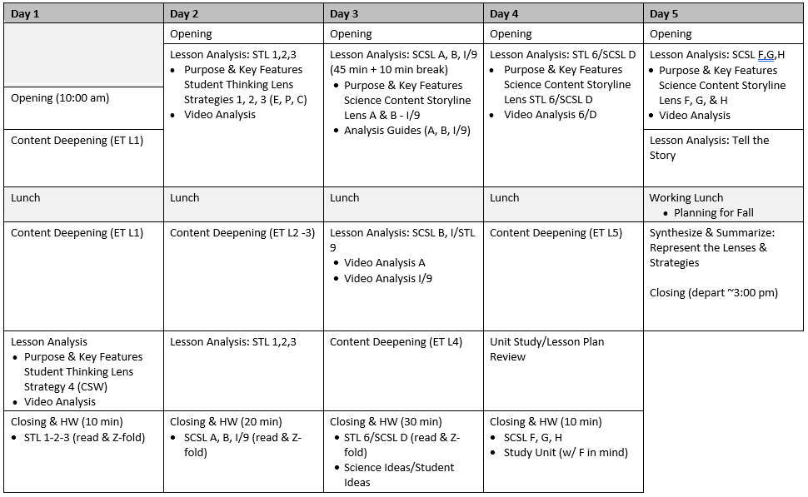
Week-at-a-Glance

Slide 5
STeLLA Norms
The Basics
Arrive prepared and on time; stay for the duration
Remain attentive, thoughtful, and STeLLAful; eliminate interruptions (turn off cell phones, email)
Make room for participation from all (monitor your floor time)
Purpose: Build trust and develop a productive study group for all participants
The Heart of STeLLA Lesson Analysis
Keep the goal in mind: We are analyzing teaching to improve student learning
Share your ideas, uncertainties, confusions, disagreements, questions—open up time so this can happen!
Expect and ask questions to deepen everyone’s learning—honor needs!

Slide 6
Reconnection: Walk-about-Review
My Ideas | Round 1 | Round 2
Recollection
Name
Insight
Name
Application
Name

Slide 7
Day 3 Focus Questions
Why is one main learning goal (SCSL Strategy A) essential for coherence of the Science Content Storyline?
How does the use of a focus question (SCSL Strategy B) contribute to the coherence of the Science Content Storyline?
How does synthesizing and summarizing key science ideas (SCSL I/STL 9) contribute to the coherence of the science content storyline?
How can we begin and end a lesson using STeLLA Strategies?

Slide 8
STeLLA Conceptual Framework

Slide 9
Science Content Storyline Lens Strategies A, B, and I Student Thinking Lens Strategy 9
In your grade level team
Complete the chart for your assigned strategy
Review the charts of others for any clarifications or questions.
SCSL/STL #X
Purpose
Key Features
Purpose: WHY it’s important
Key Features: WHAT does it look like in the classroom
Notes:
6 rooms
Jamboard
**Slide has been updated

Slide 11
Analysis Guide: Main Learning Goal (p. X)
Analysis guides include
questions that guide analysis,
ways to capture information, and
often, prompts to strengthen the artifact being analyzed.
Notes:
How did the AG support your understanding of the strategy?

Slide 12
Candidate Main Learning Goals
Practice identifying one main learning goal using the MLG Analysis Guide
Energy transformations
Students draw system diagrams to show energy changes in a system.
Motion energy can be transferred from object to object through collisions. The faster an object is moving, the more motion energy it has that can be transferred to another object in a collision.
An object that is not moving has no energy.
How do we detect and represent energy changes in a system?
Energy can be used up or destroyed.
Energy flows as it is transferred and transformed in various ways in between objects and in and out of systems.

Slide 13
Analysis Guide: Focus Questions (p. X)
How did the Analysis Guide enhance your understanding of the strategy?
Why do you think the analysis guides for SCSL strategies B and I are on the same page?

Slide 14
Candidate Focus Questions
MLG: Position energy (potential energy) can be transformed to motion energy (kinetic energy). The more position energy an object has, the more energy can be transformed to motion energy. As position energy is transformed to motion energy, the faster the object will move.
Candidate Focus Questions
Which candidate focus question would be best for this main learning goal?

Slide 15
SCSL Strategies A and B
With a partner
Sort the cards to match the main learning goals and focus questions
Compare your organization to that of another group’s.

Slide 16
Analysis Guide: SCSL Strategy B & I, STL 9 (p. X)
Why do we put the main learning goal at the top of the analysis guide?
How do the questions in the analysis guides link to the development of a coherent science content storyline?

Slide 17
Meta Moment
Journal
How do main learning goals, focus questions, and synthesis/summary support teacher planning for a coherent science content storyline? Student learning?

Slide 18
Lesson Analysis: The Basics (pp. 1-2)
Viewing Basics
Analysis Basics
Viewing Basic #1: Look past the trivial, the little things that “bug” you.
Viewing Basic #2: Avoid the “this doesn’t look like my classroom” trap.
Viewing Basic #3: Avoid making snap judgments about the teaching or learning in the classroom you are viewing.
Analysis Basic #1: Focus on student thinking and the science content storyline
Analysis Basic #2: Look for evidence to support any claims
Analysis Basic #3: Look more than once
Analysis Basic #4: Consider alternative explanations and teaching strategies.
Notes:
Which stand out to you and why?

Slide 19
Preparing for Video Analysis: The Context
Lesson Context:
This clip is from lesson 3 of 5 in the Energy Every Day, Everywhere unit.
In this lesson students use a ruler ramp/marble system to explore how the amount of motion energy of the object can be changed.
In this clip, students discuss energy changes when the marble is at the top of the ramp compared to when it is in the middle of the ramp.

Slide 20
Video Analysis: Grade 4: Norris (A)
Identify
Based on the series of clips, what do you think is the main learning goal?
Analyze
Reflect and apply
Add link

Slide 21
Analysis Guide: Main Learning Goal
Analyze
To what extent does the MLG from the videoclip(s) match the MLG identified in the lesson?
To what extent is the MLG a quality goal?

Slide 22
Video Analysis: Grade 4: Norris (A)
Identify
Based on the series of clips, what do you think is the main learning goal?
Analyze
scientists?
Reflect and apply
What did you learn from analyzing this video clip that you can apply to your own classroom?
Notes:
n your journal,

Slide 23
Preparing for Video Analysis: The Context
Lesson Context:
In clip 2, the teacher is eliciting students’ initial ideas about the lesson 2 focus question.
In clip 3, teacher is eliciting students’ ideas about how their thinking about the lesson 2 focus question has changed.

Slide 24
Video Analysis: Grade 4: Parco (B, I/9)
Identify
What instances do you observe of SCSL Strategies B & I/STL Strategy 9?
Analyze
Reflect and apply
Add link

Slide 25
Analysis Guide: SCSL Strategy B & I/ STL 9
Analyze Part 1
What is the quality of the focus question and synthesis/summary highlighted in the videoclips?

Slide 26
Video Analysis: Grade 4: Parco (B, I/9)
Identify
What instances do you observe of SCSL Strategies B & I/STL Strategy 9?
Analyze
What do students understand (or not) about energy transfer?
How did the use of the STeLLA strategies influence student thinking?
Reflect and apply
Notes:
n your journal,

Slide 27
Video Analysis: Grade 4: Parco (B, I/9)
Identify
What instances do you observe of SCSL Strategies B & I/STL Strategy 9?
Analyze
What do students understand (or not) about energy transfer?
How did the use of the STeLLA strategies influence student thinking?
Reflect and apply
What did you learn from analyzing this video clip that you can apply to your own classroom?
Notes:
n your journal,

Slide 28
Content Deepening: Teacher Set-up
What were the focus questions and main learning goals for Lessons 1, 2, and 3?
How were the lessons synthesized and summarized?
How would you tell the story of the unit so far?
Lesson 4 Focus Question
How do we detect and represent energy changes in a system?

Slide 29
Energy, Every Day, Everywhere Lesson 4
Keeping Track of Energy

Slide 31
Lesson 4: Focus Question
How do we detect and represent energy changes in a system?

Slide 32
Energy System Diagrams
Can anyone name a system that we have investigated in this unit?
What do you think is meant by a system?

Slide 33
Energy System Diagram
System Diagram Key Components:
The parts of the system
Observable changes taking place
Where in the system are energy changes occurring?
Where does the energy come from?
Where does the energy go?

Slide 34
Energy System Diagram
Identify the parts of the marble-ramp system or other system we have investigated in this unit.
Think about
where in the system you observed changes occurring and
where energy changes are happening.

Slide 35
Investigation: How do we know if something has energy?
How do we know if an object has energy?
What is your evidence?
(How do we detect energy?)

Slide 36
Investigation: How do we know if something has energy?
Investigate these objects for energy.
Use a data table to record your observations and evidence.

Slide 37
Object | Evidence of Energy
Marble rolling down the ramp

Slide 38
How do we know if something has energy?
I know that something has energy because it...
Share your sentences with the class.
You may demonstrate your ideas using the objects you explored.

Slide 39
Energy System Diagram
Draw a system diagram for the object you have been assigned.
Remember to include the System Diagram Key Components:
The parts of the system
Observable changes taking place
Where in the system are energy changes occurring?
Where does the energy come from?
Where does the energy go?

Slide 40
Energy System Diagram: Feedback
Use sticky notes to give feedback to the other group with which you traded system diagrams.
Does the system diagram identify the key components?
The parts of the system
Observable changes taking place
Where in the system are energy changes occurring?
Where does the energy come from?
Where does the energy go?

Slide 41
Energy System Diagram: Revisions
Use the feedback you received from the other group to revise your Energy System Diagram.
Sort and group the sticky notes.
Discuss as a group if you will accept or reject each piece of feedback.
Make your revisions by using a single line through changes and using a different color for added information.

Slide 42
Lesson Summary: Key Science Ideas
Write in your notebook all the ways we know that something has energy and how the energy of an object has changed.
Do any of these new ideas connect to our car launcher system?

Slide 43
Content Deepening: Teacher Follow-up
What could one learn from this experience?

Slide 44
STeLLA Conceptual Framework

Slide 45
Identifying Strategies in Our Content Experiences
How did the PD Leader model the use of Strategies A, B, I and 9 in our content experience today?
If you were to construct a MLG from our content experiences today, what would it be?
What was the focus questions for the content experiences today?
How did the FQs set you up for the learning?
How did you experience synthesizing and summarizing?

Slide 46
Meta Moment
Journal…
What would you add to our effective science T&L chart?
How do these strategies help teachers plan for coherence? How do these strategies help students develop the intended science content storyline?

Slide 47
Effective Science Teaching & Learning
What does effective science teaching and learning look like?
What are teachers doing?
What are students doing?
What is the classroom like?
Teachers Doing | Students Doing
Classroom

Slide 48
Day 3 Focus Questions
Why is one main learning goal (SCSL Strategy A) essential for coherence of the Science Content Storyline?
How does the use of a focus question (SCSL Strategy B) contribute to the coherence of the Science Content Storyline?
How does synthesizing and summarizing key science ideas (SCSL I/STL 9) contribute to the coherence of the science content storyline?
How can we begin and end a lesson using STeLLA Strategies?

Slide 49
Reflection
Complete the daily reflection:
We are discussing the use of main learning goals and focus questions across a series of lessons. What is your current thinking about how the main learning goals and focus questions contribute to the development of a coherent content storyline for students? Please explain your thinking.
How did developing a system model (the system diagram) help you think about energy changes in a system?

Slide 50
Homework
Read the Strategy Summary documents and complete the Z-fold for purpose and key features for each of the following strategies
STL Strategy 6: Engage students in developing and using content representations and models (pp. 27-28)
SCSL Strategy D: Select content representations and models matched to the learning goal (pp. 47-48)

