Slide 1
STeLLA Scale Up and Sustainability Study (SSUP)
Day 4
Science Teachers Learning From Lesson Analysis

Slide 2
Day 3 Reflections
Add day 2 reflections

Slide 3
STeLLA Norms
The Basics
Arrive prepared and on time; stay for the duration
Remain attentive, thoughtful, and STeLLAful; eliminate interruptions (turn off cell phones, email)
Make room for participation from all (monitor your floor time)
Purpose: Build trust and develop a productive study group for all participants
The Heart of STeLLA Lesson Analysis
Keep the goal in mind: We are analyzing teaching to improve student learning
Share your ideas, uncertainties, confusions, disagreements, questions—open up time so this can happen!
Expect and ask questions to deepen everyone’s learning—honor needs!

Slide 4
STeLLA Program Goals
Deepen knowledge of teaching and learning
Increase ability to analyze and reflect on teaching and learning
Increase ability to use content knowledge and knowledge of teaching and learning to transform classroom practice
Deepen teacher content knowledge
Increase student learning in science

Slide 5
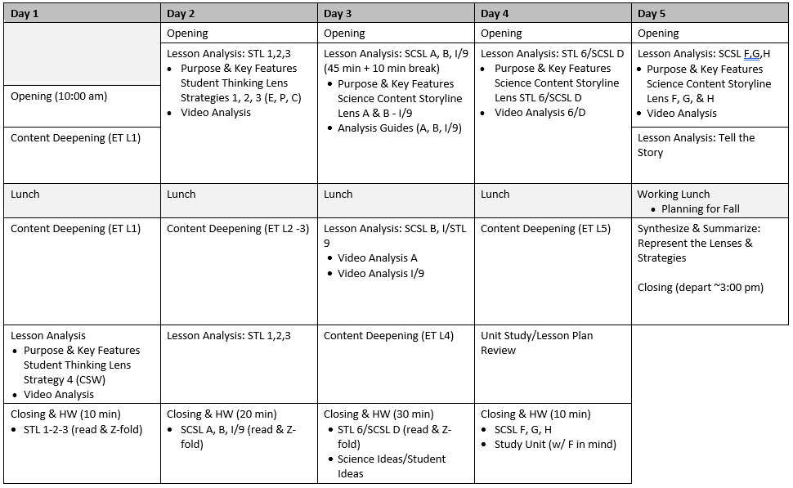
Week-at-a-Glance

Slide 6
Day 4 Focus Questions
How can developing and using content representation and models selected for their match to the main learning goal help students explain phenomena or solve problems?
How does the intentional use of Student Thinking Lens Strategies support a classroom culture of making thinking visible?
Where does the energy come from and where does it go when changes happen in a system?

Slide 7
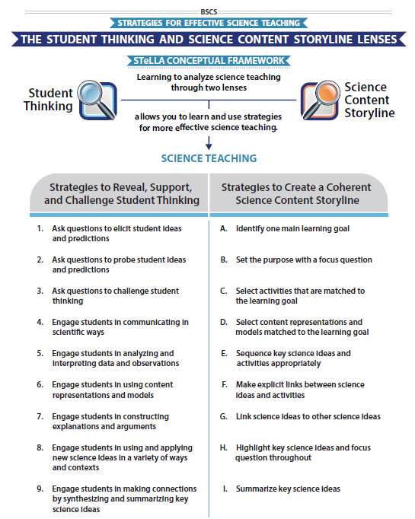
STeLLA Conceptual Framework

Slide 8
Science Content Storyline Lens Strategy D Student Thinking Lens Strategy 6
SCSL/STL #X
Purpose
Key Features
Complete the chart for your assigned strategy
Review the charts of others for any clarifications or questions.
Purpose: WHY it’s important
Key Features: WHAT does it look like in the classroom
Notes:
6 rooms
Jamboard
**Slide has been updated

Slide 9
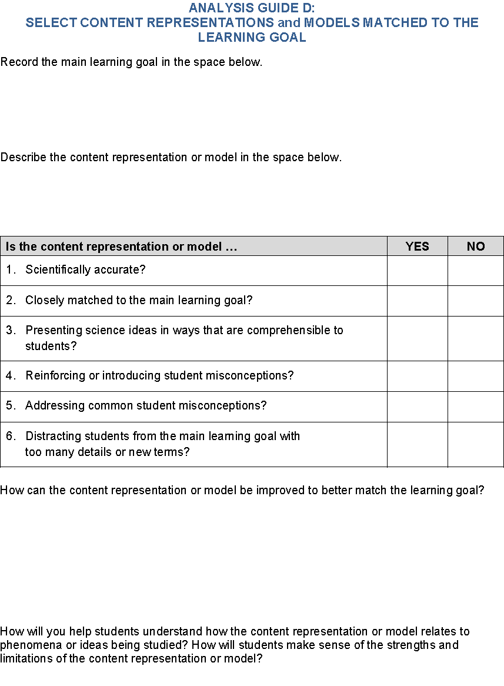
Analysis Guide: Content Reps & Models
Review the Analysis Guide for Strategy D.
What would you expect to find in a high-quality content representation or model?
Notes:
Jigsaw

Slide 10
Using the Analysis Guide: Models & Content Reps
What were the main learning goal and focus question for the Lesson 3 content deepening experience?
What science ideas were highlighted in the Lesson 3 experience?
Using your analysis guide, consider how well the system diagrams were matched to the main learning goal?

Slide 11
Using the Analysis Guide: Models & Content Reps
Use the analysis guide to evaluate one of the content representations or models used in your content deepening experience.
Notes:
Use UPDATED analysis Guide for strategy C
MLG L5 ET: Energy can be transformed—it can change from potential energy to kinetic energy.
FQ L5 ET: Where does the energy of a moving object come from?

Slide 12
Reflection
Journal…
How might the use of analysis guides develop teachers’ habits of mind in lesson planning?

Slide 13
Lesson Analysis: The Basics (pp. 1-2)
Viewing Basics
Analysis Basics
Viewing Basic #1: Look past the trivial, the little things that “bug” you.
Viewing Basic #2: Avoid the “this doesn’t look like my classroom” trap.
Viewing Basic #3: Avoid making snap judgments about the teaching or learning in the classroom you are viewing.
Analysis Basic #1: Focus on student thinking and the science content storyline
Analysis Basic #2: Look for evidence to support any claims
Analysis Basic #3: Look more than once
Analysis Basic #4: Consider alternative explanations and teaching strategies.
Notes:
Which stand out to you and why?

Slide 14
Preparing for Video Analysis: The Context
Lesson Context:
This is lesson 4 of 5 in the SSUP Energy Every Day, Everywhere series. In this lesson students use system diagrams to represent observable changes and evidence of changes in energy. In this clip, the class develops a common system diagram for the ramp/marble system used in Lesson 3.

Slide 15
Video Analysis: SSUP_ET_L4_Parco_Clip 1
Identify
What instances of engaging students in developing and using content representations or models do you observe?
What instances do you observe of STL strategies elicit, probe, and/or challenge questions?
Analyze
Reflect and apply
Add link

Slide 16
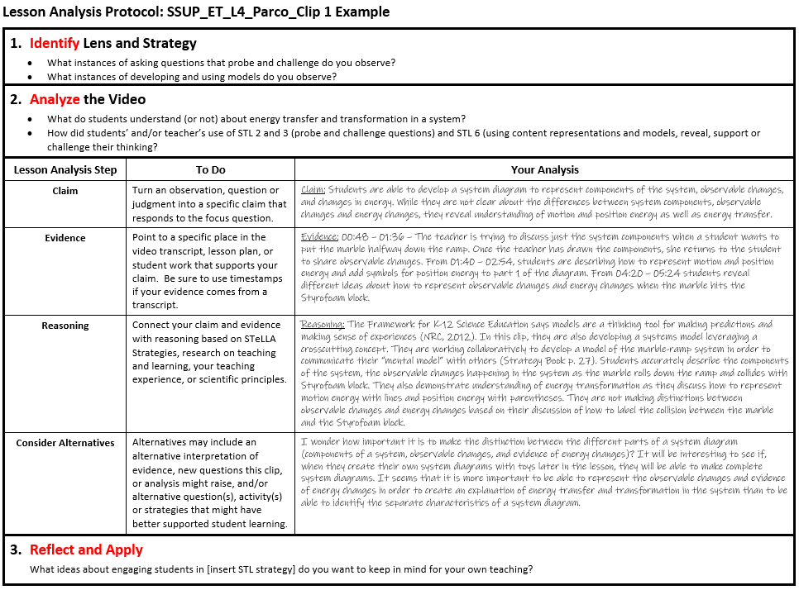
Lesson Analysis Protocol Example
Add link
Notes:
Add notes about introducing the LAP

Slide 17
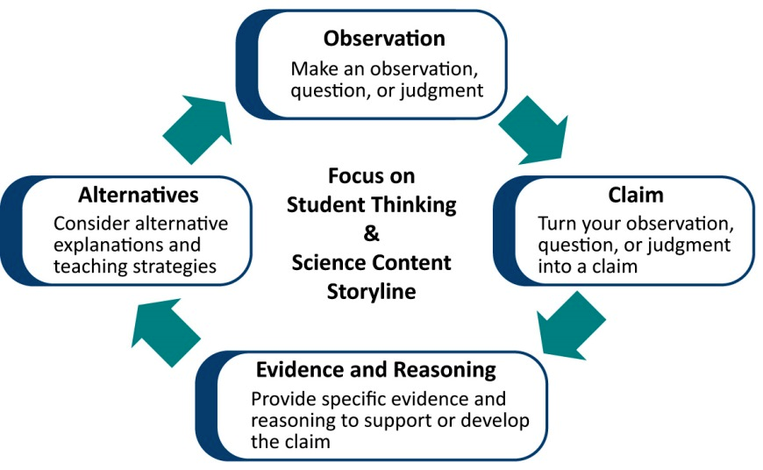
Learning from Lesson Analysis
Notes:
Reconnect to the process we used yesterday for analyzing the clips. Use this to transition to the new LAP tool being introduced.

Slide 18
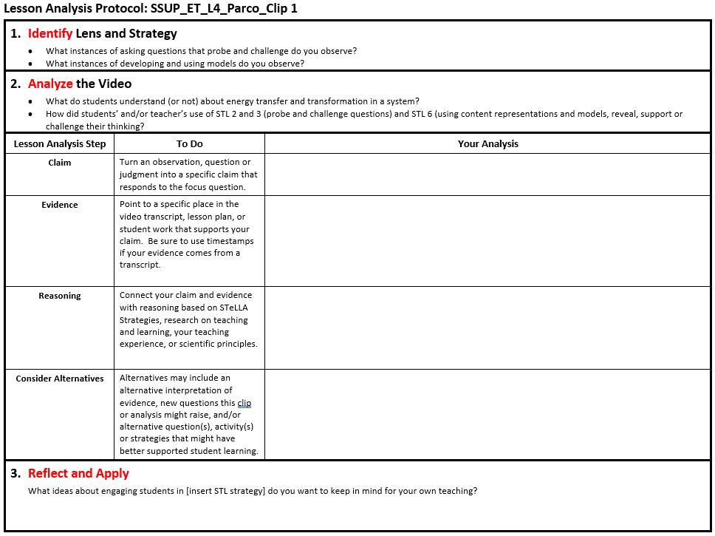
Lesson Analysis Protocol
Add link
Notes:
Include image of appropriate LAP—be sure Identify and Analyze questions match the LAP from the appropriate video and lesson set.

Slide 19
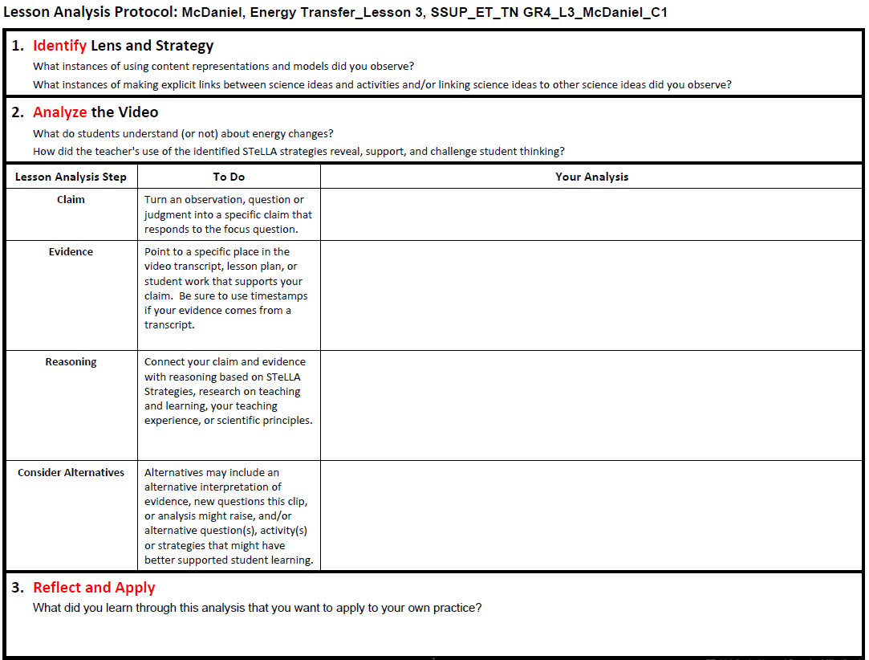
Lesson Analysis Protocol
Add link
Notes:
Include image of appropriate LAP—be sure Identify and Analyze questions match the LAP from the appropriate video and lesson set.

Slide 20
Day 4 Focus Questions
How can developing and using content representation and models selected for their match to the main learning goal help students explain phenomena or solve problems?
How does the intentional use of Student Thinking Lens Strategies support a classroom culture of making thinking visible?
Where does the energy come from and where does it go when changes happen in a system?

Slide 21
Content Deepening: Teacher Set-up
What can students say so far about where the energy comes from and where it goes when changes happen in a system?
What ideas will they “have”?
What ideas will they struggle with?
What other factors need to be considered?
Notes:
Slides 9 – 11 are placeholders for the anchor lesson slides

Slide 22
Energy, Every Day, Everywhere Lesson 5
Energy Coming and Going

Slide 23
Important Science Ideas We Have Figured Out

Slide 24
Lesson 5: Focus Question
Where does the energy come from and where does it go when changes happen in a system?

Slide 25
Energy System Diagram
System Diagram Key Components:
The parts of the system
Observable changes taking place
Where in the system are energy changes occurring?
Where does the energy come from?
Where does the energy come go?

Slide 26
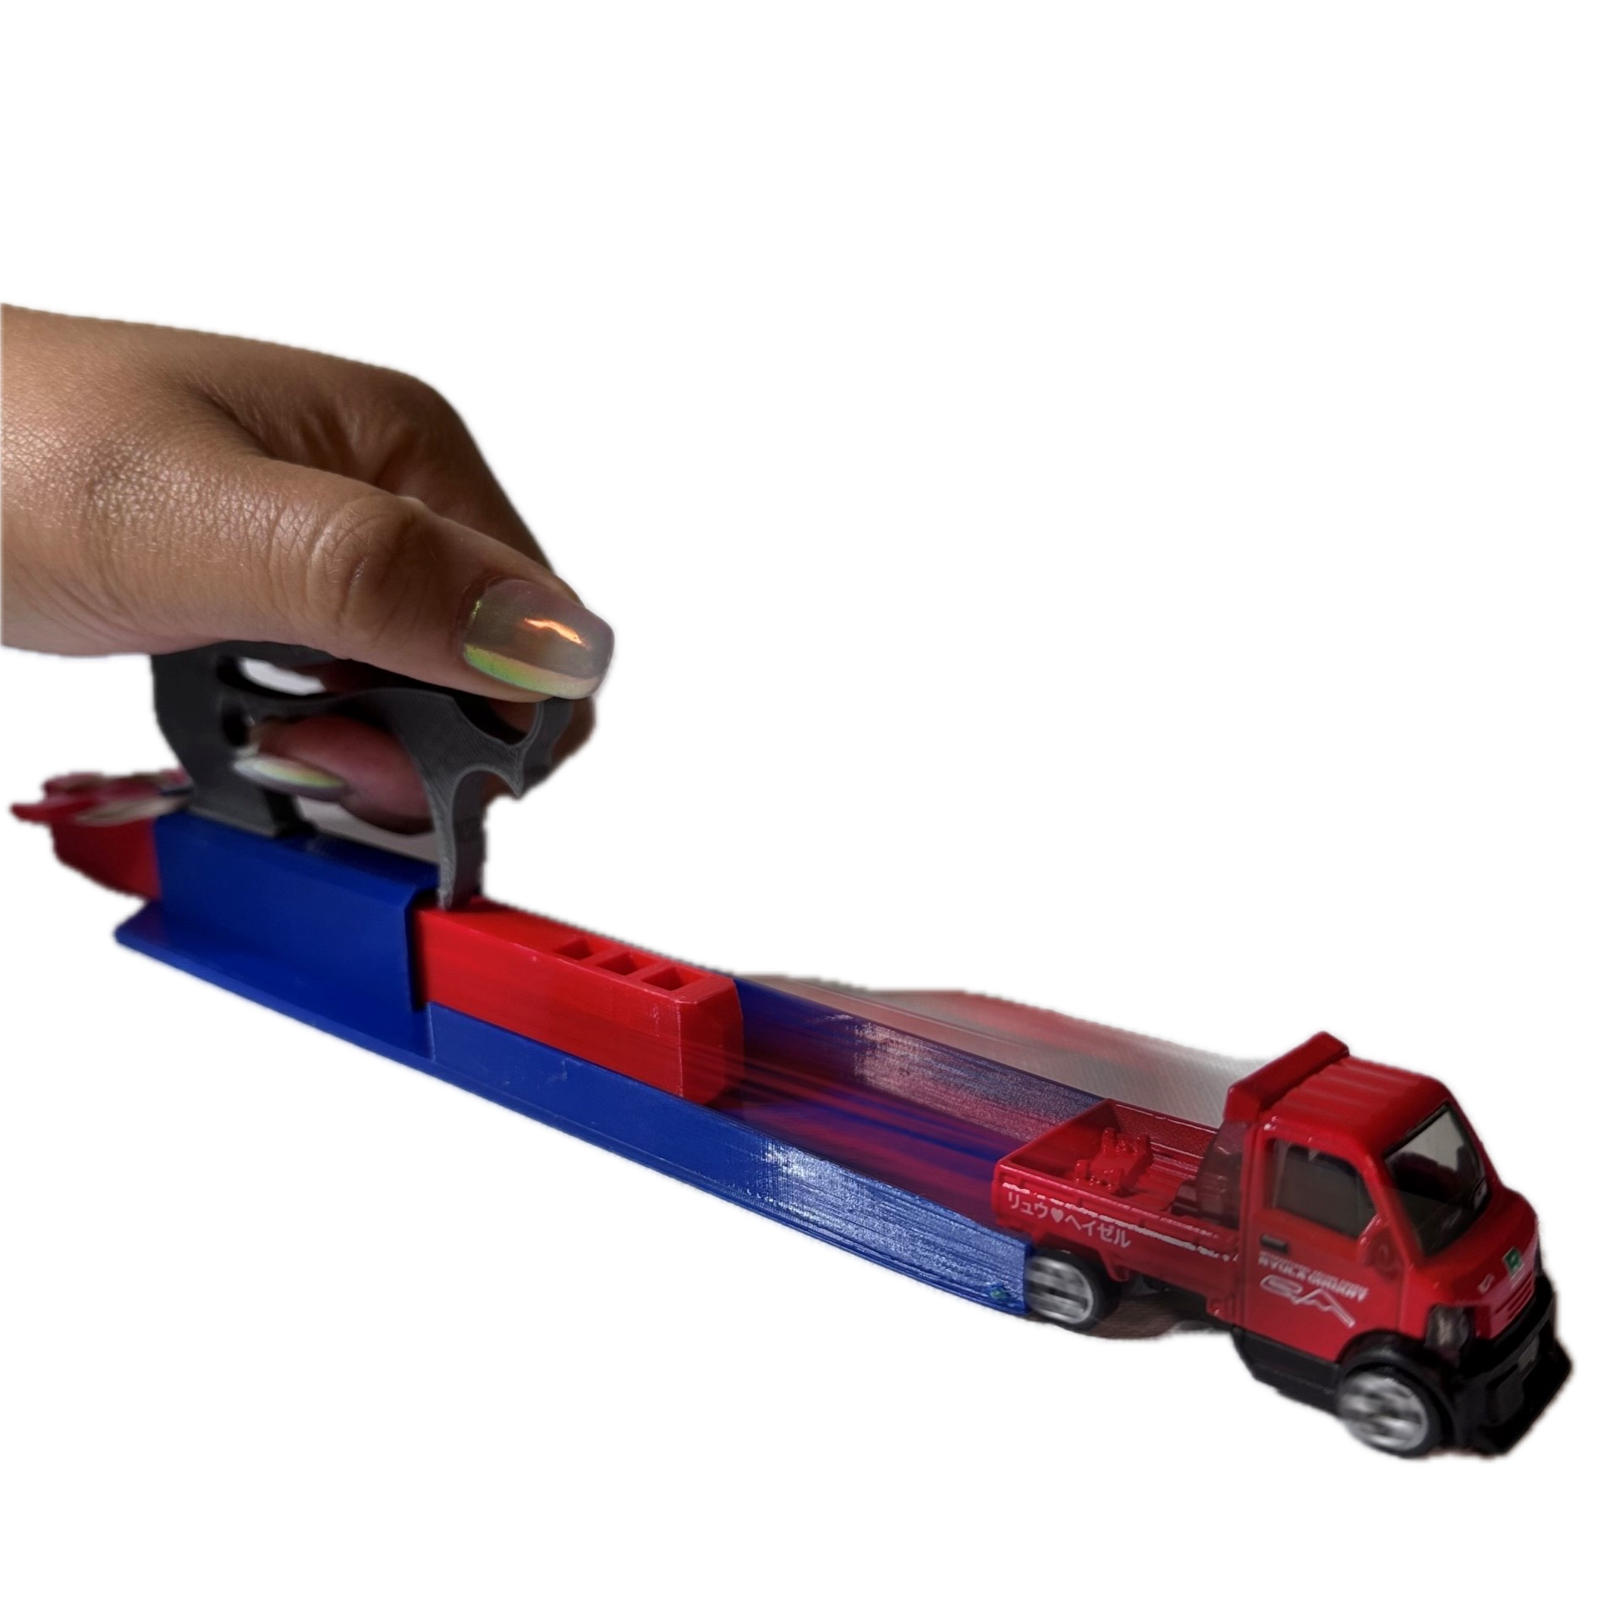
System Diagram: Car Launcher System

Slide 27
Car Launcher System Diagram: Feedback
Use sticky notes to give feedback to the other group with which you traded system diagrams.​
Does the system diagram identify the key components?​
The parts of the system
Observable changes taking place
Where in the system are energy changes occurring?
Where does the energy come from?
Where does the energy come go?

Slide 28
Car Launcher System Diagram: Revisions
Use the feedback you received from the other group to revise your Energy System Diagram.​
Sort and group the sticky notes.​
Discuss as a group if you will accept or reject each piece of feedback. ​
Make your revisions by using a single line through changes and using a different color for added information.​

Slide 29
Mumford and Leroy’s Big Crash! Part 1

Slide 30
Mumford and Leroy’s Big Crash! (Part 1 cont’d)
Make a prediction in your science notebook about what you think will happen next.
I predict when Mumford and Leroy collide...
I think the energy change(s) will be...
I think this because...

Slide 31
Mumford and Leroy’s Big Crash! Part 2
Make a list of observable changes that happened when Mumford started down the hill and then collided with Leroy.

Slide 32
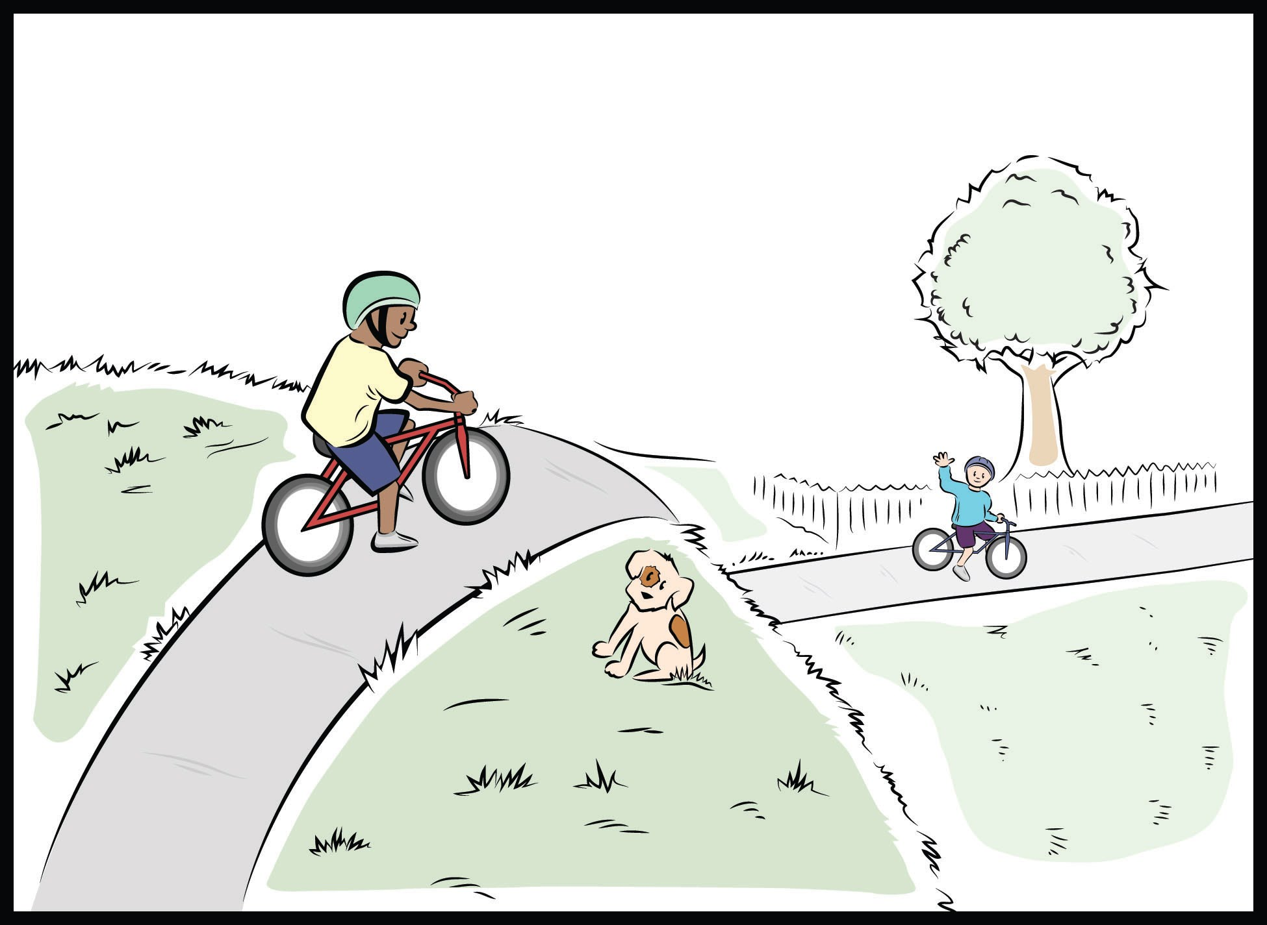
Mumford and Leroy’s Big Crash! System Diagram
1. Mumford is at the top of the hill. Leroy is
at the bottom of the hill.
2. Mumford is rolling down the hill.
Leroy is at the bottom of the hill.
3. Mumford collides with Leroy.
For each stage of the bike crash identify:
The parts of the system
Observable changes taking place
Where in the system are energy changes occurring?
Where does the energy come from?
Where does the energy come go?

Slide 33
Mumford and Leroy’s Big Crash!
Explain the changes in energy that happened during the bike crash.
Explain how these changes are similar to or different from the changes in the car launcher system.

Slide 34
Unit Central Question
How does the energy of an object change?

Slide 35
Bringing it all together….
Unit Central Question: How does the energy of an object or system change?
What key science ideas were developed in each lesson?
Lesson 1
Lesson 2
Lesson 3
Lesson 4
Lesson 5

Slide 36
Bringing it all together….
Unit Central Question: How does the energy of an object or system change?
Explanation: Post your group’s response to the unit central question on chart paper
Include a statement that answers the question.
Include the evidence you gathered from your investigations and use of models.
Include a representation to show how you make sense of what’s happening in the real world.

Slide 37
Meta Moment
How did developing and using models support your learning throughout this unit?

Slide 38
Content Deepening: Teacher Follow-up
Find your Mash-up handout that you “dotted” at the beginning of the week.
Re-dot the statements now that you have experienced the lessons in your unit.
Green dot: science idea (accurate statement)
Yellow dot: uncertain
Red dot: common student idea (inaccurate statement)
Notes:
Slides 9 – 11 are placeholders for the anchor lesson slides

Slide 39
Common Student Ideas
If you are still unsure of the ideas on the mash-up use
Common Student Ideas
Content Deepening document

Slide 40
Day 4 Focus Questions
How can developing and using content representation and models selected for their match to the main learning goal help students explain phenomena or solve problems?
How does the intentional use of Student Thinking Lens Strategies support a classroom culture of making thinking visible?
Where does the energy come from and where does it go when changes happen in a system?

Slide 41
Unit Review
What would you expect to see in a model STeLLA unit of instruction?
Read
Unit Overview
Your assigned lesson plan
Be prepared to “tell the science story” of your lesson as we build the storyline across the unit.
Be prepared to share how your lesson is similar to and different from what you experienced this week.

Slide 42
Revisit: Effective Science Teaching & Learning
What does effective science teaching and learning look like?
What are teachers doing?
What are students doing?
What is the classroom like?
Teachers Doing | Students Doing
Classroom

Slide 43
Reflection
We have been discussing and using content representations and models. How has their use impacted your own learning about energy?
How has your understanding of elicit, probe, and challenge questions been refined through our work today?
How does the teacher’s use of elicit, probe, and challenge questions influence students’ ability to productively develop and use content representations and models to make sense of phenomenon?

Slide 44
Homework
Read the Strategy Summary documents and complete the Z-fold for purpose and key features for each of the following strategies
SCSL Strategy F: Make explicit links between science ideas and activities (pp. 53-56)
SCSL Strategy G: Link science ideas to other science ideas (pp. 57-58)
SCSL Strategy H: Highlight key science ideas and focus questions throughout (pp. 59-60)
Read and be prepared to tell the story of your assigned lesson from the Unit Review

