Slide 1
STeLLA Scale Up and Sustainability Study (SSUP)
Day 5
Science Teachers Learning From Lesson Analysis

Slide 2
Day 4 Reflections
Add day 3 reflections

Slide 3
STeLLA Norms
The Basics
Arrive prepared and on time; stay for the duration
Remain attentive, thoughtful, and STeLLAful; eliminate interruptions (turn off cell phones, email)
Make room for participation from all (monitor your floor time)
Purpose: Build trust and develop a productive study group for all participants
The Heart of STeLLA Lesson Analysis
Keep the goal in mind: We are analyzing teaching to improve student learning
Share your ideas, uncertainties, confusions, disagreements, questions—open up time so this can happen!
Expect and ask questions to deepen everyone’s learning—honor needs!

Slide 4
STeLLA Program Goals
Deepen knowledge of teaching and learning
Increase ability to analyze and reflect on teaching and learning
Increase ability to use content knowledge and knowledge of teaching and learning to transform classroom practice
Deepen teacher content knowledge
Increase student learning in science

Slide 5
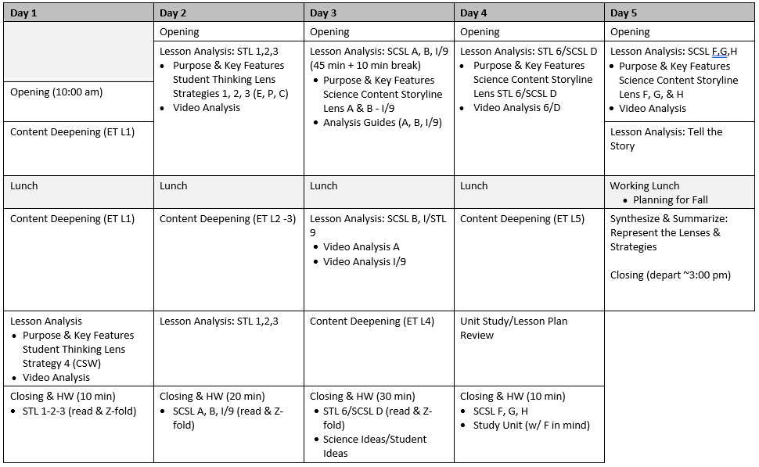
Week-at-a-Glance

Slide 6
Day 5 Focus Questions
How can we build coherence within and between lessons to help students craft a storyline of key science ideas?
How can we be intentional about how we move student thinking forward?
How could the strategies we’ve learned so far support your planning and enactment of lessons?

Slide 7
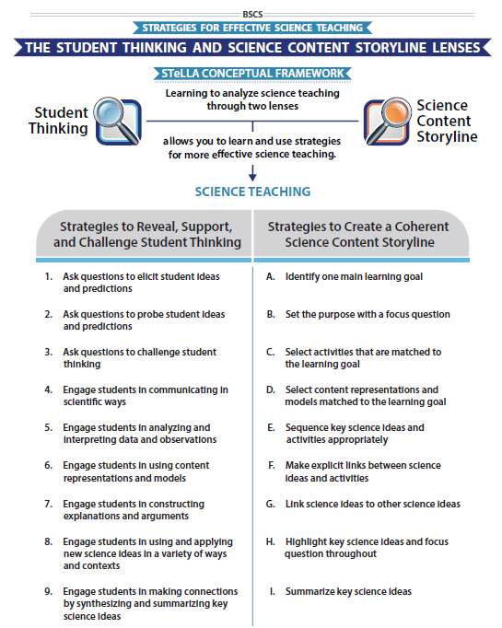
STeLLA Conceptual Framework

Slide 8
Science Content Storyline Lens Strategies F, G, & H
Complete the chart for your assigned strategy
Review the charts of others for any clarifications or questions.
SCSL #X
Purpose
Key Features
Purpose: WHY it’s important
Key Features: WHAT does it look like in the classroom
Notes:
6 rooms
Jamboard
**Slide has been updated

Slide 9
Lesson Analysis: The Basics (pp. 1-2)
Viewing Basics
Analysis Basics
Viewing Basic #1: Look past the trivial, the little things that “bug” you.
Viewing Basic #2: Avoid the “this doesn’t look like my classroom” trap.
Viewing Basic #3: Avoid making snap judgments about the teaching or learning in the classroom you are viewing.
Analysis Basic #1: Focus on student thinking and the science content storyline
Analysis Basic #2: Look for evidence to support any claims
Analysis Basic #3: Look more than once
Analysis Basic #4: Consider alternative explanations and teaching strategies.
Notes:
Which stand out to you and why?

Slide 10
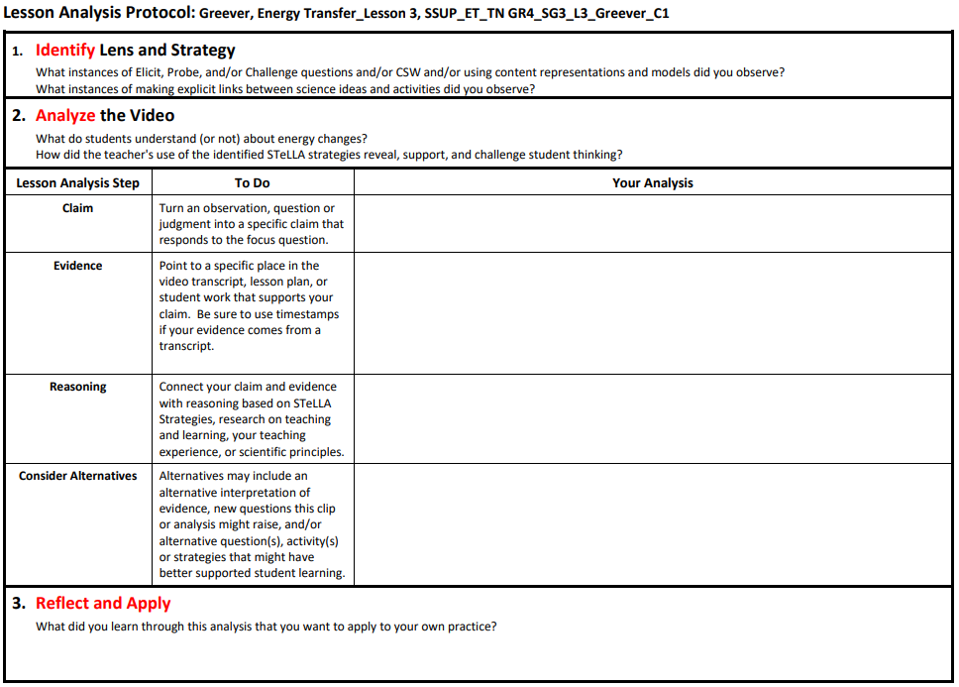
Lesson Analysis Protocol
Add link

Slide 11
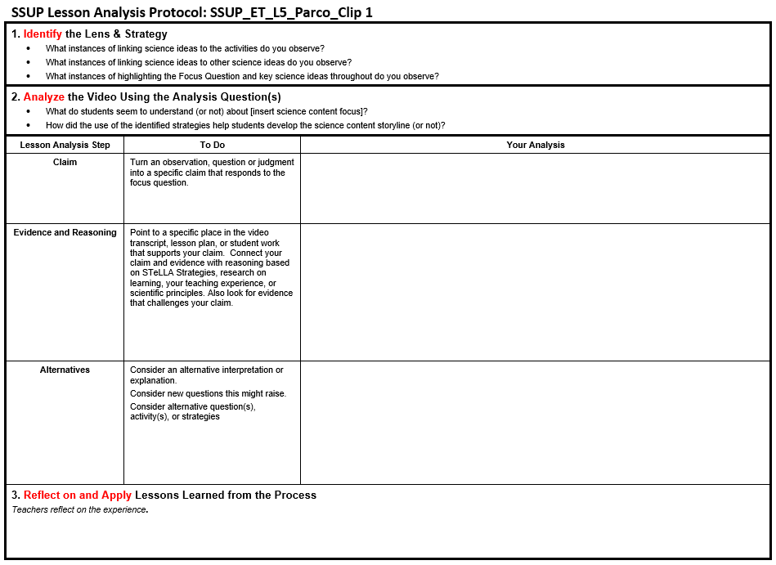
Lesson Analysis Protocol
Add link

Slide 12
Lesson Plan Analysis
Note how Strategies F, G, and H are written into the lessons.
Practice telling a coherent story with the science ideas that develop throughout your assigned lesson?
Notes:
Make sure Day 4 includes a HW assignment to read 1 lesson – jigsaw the lessons among the group. Orient each person to look at the lesson they read for HW

Slide 13
Tell the Story…
Example Sentence Stems
Yesterday we learned…
Today we’ll answer the focus question...
We’ll figure out the phenomenon/problem...
Today we learned…
Tomorrow we’ll answer…
Notes:
Ask about the ? Strategy in the chart. Teachers may mention 5-8 in addition to F.
Ask where you would expect to see Strategy H
Emphasize Strategy F – how do student ideas get revealed and developed during the activity? (Emphasize all three stages of F)
If this is charted earlier along with F, G, and H, refer to this chart as the group lines up in order of assigned lessons.
Less formal than NGT – most of the work is done verbally

Slide 14
Planning for Fall
Check calendars to find a good group time for synchronous work
Identify who will be able to teach a lesson and sign up for filming (Round 1 and Round 2?)

Slide 15
Day 5 Focus Questions
How can we build coherence within and between lessons to help students craft a storyline of key science ideas?
How can we be intentional about how we move student thinking forward?
How could the strategies we’ve learned so far support your planning and enactment of lessons?

Slide 16
Synthesize and Summarize
Use the materials at your disposal to represent the relationships among the STeLLA Approach, Lenses, and Strategies.

Slide 17
Reflection
How could the strategies we’ve learned so far support your planning and enactment of lessons?
Golden Nugget:

