Slide 1
STeLLA Scale Up and Sustainability Study (SSUP)
SG # 1: Science Teachers Learning From Lesson
Analysis
Grade 4
Energy, Every Day, Everywhere
TEAM NAME

Slide 2
Opening
Share...
Take a minute to update us on how your year has started. In your update, be sure to include a brag about a success that you've had so far.

Slide 3
Agenda
Opening
Analysis of Practice
Round 1
Round 2
Purpose/Key Features of Strategy 5
Closing
Notes:
*Timing should be adjusted for the number of video clips and discussion you plan for participants to have during video analysis.
*Deciding when and how participants chart strategies 5, 7, 8 during the Fall study group sessions should be done with intentionality.
Possible Timing:
Opening – 15 min
Analysis of Practice -
Round 1 – 45 min
Round 2 – 30-35 min
"Chart" Strategy 5 - 15 – 20 min
Closing – 10 min

Slide 4
STeLLA Program Goals
Deepen knowledge of teaching and learning
Increase ability to analyze and reflect on teaching and learning
Increase ability to use content knowledge and knowledge of teaching and learning to transform classroom practice
Deepen teacher content knowledge
Increase student learning in science

Slide 5
STeLLA Norms [CUSTOMIZE]
Purpose: Build trust and develop a productive study group for all participants
The Basics
Arrive prepared and on time; stay for the duration.
Remain attentive, thoughtful, and mindful of our community; eliminate interruptions.
Make room for participation from all and monitor your talk time.
The Heart
Keep the goal in mind: We are analyzing teaching to improve student learning.
Share your ideas, uncertainties, disagreements, and questions.
Expect and ask questions to deepen everyone’s learning!

Slide 6
SG # 1 Focus Questions
What can we learn from analysis of practice to intentionally use elicit, probe, and challenge questions, and analyzing and interpreting data and observations to reveal and challenge student thinking about content area?
How can students be empowered to reveal their thinking and to listen to and interact with each other during classroom conversations?
Notes:
*Update these focus questions based on the teacher learning goals for the session.

Slide 7
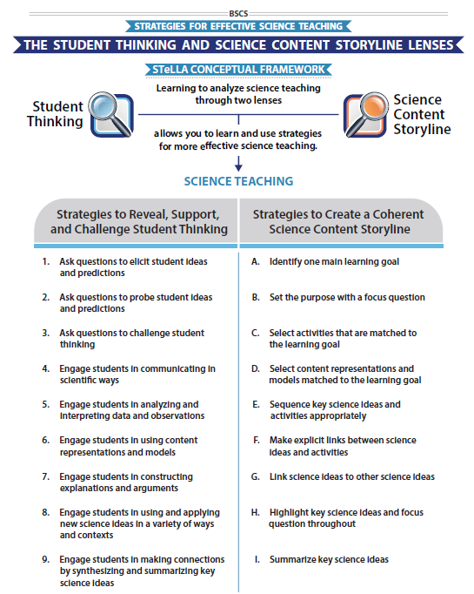
STeLLA Conceptual Framework
Copy yellow box (if needed) and move the yellow highlight over the strategies that will be focused on during the video analyses.
Notes:
*Move/add the yellow box to highlight which strategies will be focal during the analysis today.

Slide 8
Video Analysis: Purposes
Gain a deeper understanding of the strategies in messy reality
Slow analysis can lead to changes in practice at “full speed”
Practice our focus on what students are saying and thinking
Another way to dig into our ideas about the science

Slide 9
Lesson Analysis: The Basics (pp. 1-2)
Viewing Basics
Analysis Basics
Viewing Basic #1: Look past the trivial, the little things that “bug” you.
Viewing Basic #2: Avoid the “this doesn’t look like my classroom” trap.
Viewing Basic #3: Avoid making snap judgments about the teaching or learning in the classroom you are viewing.
Analysis Basic #1: Focus on student thinking and the science content storyline
Analysis Basic #2: Look for evidence to support any claims
Analysis Basic #3: Look more than once
Analysis Basic #4: Consider alternative explanations and teaching strategies.
Notes:
Which stand out to you and why?

Slide 10
Preparing for Video Analysis: The Process
Identify- to create a shared image of the strategy
Analyze- to consider the impact of the strategy on students
Reflect and apply- to make the strategy part of our own practice
Notes:
Which stand out to you and why?

Slide 11
Video Analysis: SSUP_ET_TN GR4_SG3_L3_Greever_C1
Identify
What instances of the use of Elicit, Probe and Challenge questions, CSW, content representations and models, analyzing and interpreting data, and making explicit links between activities and science ideas did you observe?
Analyze
Reflect and Apply
link video
Notes:
Which stand out to you and why?

Slide 12
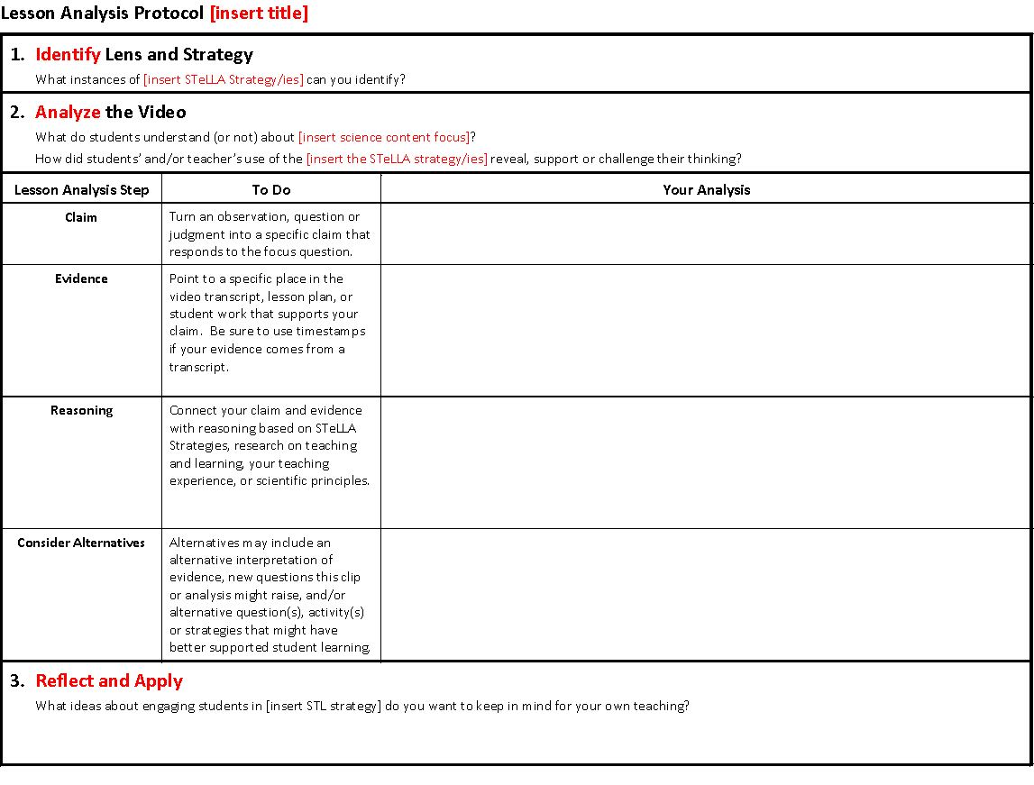
Lesson Analysis Protocol: L#_Name_C#
UPDATE Title and IMAGE once LAP is created

Slide 13
Video Analysis: SSUP_ET_TN GR4_SG3_L3_Greever_C1
Identify
Analyze
What do students understand (or not ) about energy changes?
How did the teacher's use of the identified STeLLA strategies reveal, support, and challenge student thinking?
Reflect and Apply
Notes:
Which stand out to you and why?

Slide 14
Video Analysis: SSUP_ET_TN GR4_SG3_L3_Greever_C1
Identify
Analyze
Reflect and Apply
What did you learn through this analysis that you want to apply to your own practice?
Notes:
Which stand out to you and why?

Slide 15
Video Analysis: SSUP_ET_TN GR4_L4_Neil_C1
Identify
What instances of the use of Elicit, Probe and Challenge questions, CSW, making explicit links between activities and science ideas did you observe?
Analyze
Reflect and Apply
link video
Notes:
Which stand out to you and why?

Slide 16
Lesson Analysis Protocol: L#_Name_C#
UPDATE Title and IMAGE once LAP is created

Slide 17
Video Analysis: SSUP_ET_TN GR4_SG3_L3_Greever_C1
Identify
Analyze
What do students understand (or not ) about energy changes?
How did the teacher's use of the identified STeLLA strategies reveal, support, and challenge student thinking?
Reflect and Apply
Notes:
Which stand out to you and why?

Slide 18
Video Analysis: SSUP_ET_TN GR4_SG3_L3_Greever_C1
Identify
Analyze
Reflect and Apply
What did you learn through this analysis that you want to apply to your own practice?
Notes:
Which stand out to you and why?

Slide 19
SG # Focus Questions
What can we learn from analysis of practice to intentionally use elicit, probe, and challenge questions, and analyzing and interpreting data and observations to reveal and challenge student thinking about content area?
How can students be empowered to reveal their thinking and to listen to and interact with each other during classroom conversations?
Notes:
*Update these focus questions based on the teacher learning goals for the session.

Slide 20
Closing
2 takeaways
1 question or aspiration

Slide 21
Next Steps
Asynchronous Work:
Watch video and "Identify"
FAC preparation (FAC, pictures of 6 students' work pre and post)
Our Next Session:
Date & Time
Whose video
Strategy/Strategies ___
Questions/Clarifications?
Notes:
*Update this slide based on the plan for the next study group.

