Slide 1
STeLLA Scale Up and Sustainability Study (SSUP)
SG #8: Science Teachers Learning From Lesson Analysis
Grade 4
Earth’s Changing Surface
TEAM NAME

Slide 2
Opening
XXX

Slide 3
Agenda
Opening
Analysis of Practice
Round 1
Round 2
FAC & Student Learning Artifacts
Closing
Notes:
*Timing should be adjusted for the number of video clips and discussion you plan for participants to have during video analysis.
*Deciding when and how participants chart strategies 5, 7, 8 during the Fall study group sessions should be done with intentionality.
Possible Timing:
Opening – 15 min
Analysis of Practice -
Round 1 – 45 min
Round 2 – 30-35 min
"Chart" Strategy 5 - 15 – 20 min
Closing – 10 min

Slide 4
STeLLA Program Goals
Deepen knowledge of teaching and learning
Increase ability to analyze and reflect on teaching and learning
Increase ability to use content knowledge and knowledge of teaching and learning to transform classroom practice
Deepen teacher content knowledge
Increase student learning in science

Slide 5
STeLLA Norms [CUSTOMIZE]
Purpose: Build trust and develop a productive study group for all participants
The Basics
Arrive prepared and on time; stay for the duration.
Remain attentive, thoughtful, and mindful of our community; eliminate interruptions.
Make room for participation from all and monitor your talk time.
The Heart
Keep the goal in mind: We are analyzing teaching to improve student learning.
Share your ideas, uncertainties, disagreements, and questions.
Expect and ask questions to deepen everyone’s learning!

Slide 6
SG #8 Focus Questions
Where and how do Strategies XXX influence teacher practice and student learning?
To what extent have students taken on the STeLLA-related habits of mind
What are you taking with you from this professional learning experience?
Notes:
*Update these focus questions based on the teacher learning goals for the session.

Slide 7
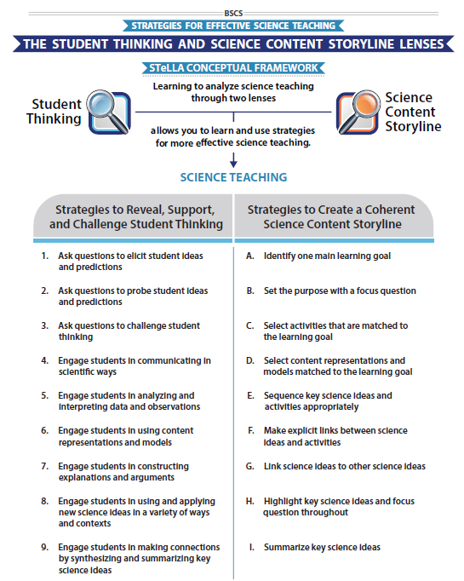
STeLLA Conceptual Framework
Copy yellow box (if needed) and move the yellow highlight over the strategies that will be focused on during the video analyses.
Notes:
*Move/add the yellow box to highlight which strategies will be focal during the analysis today.

Slide 8
Video Analysis: Purposes
Gain a deeper understanding of the strategies in messy reality
Slow analysis can lead to changes in practice at “full speed”
Practice our focus on what students are saying and thinking
Another way to dig into our ideas about the science

Slide 9
Lesson Analysis: The Basics (pp. 1-2)
Viewing Basics
Analysis Basics
Viewing Basic #1: Look past the trivial, the little things that “bug” you.
Viewing Basic #2: Avoid the “this doesn’t look like my classroom” trap.
Viewing Basic #3: Avoid making snap judgments about the teaching or learning in the classroom you are viewing.
Analysis Basic #1: Focus on student thinking and the science content storyline
Analysis Basic #2: Look for evidence to support any claims
Analysis Basic #3: Look more than once
Analysis Basic #4: Consider alternative explanations and teaching strategies.
Notes:
Which stand out to you and why?

Slide 10
Preparing for Video Analysis: The Process
Identify- to create a shared image of the strategy
Analyze- to consider the impact of the strategy on students
Reflect and apply- to make the strategy part of our own practice
Notes:
Which stand out to you and why?

Slide 11
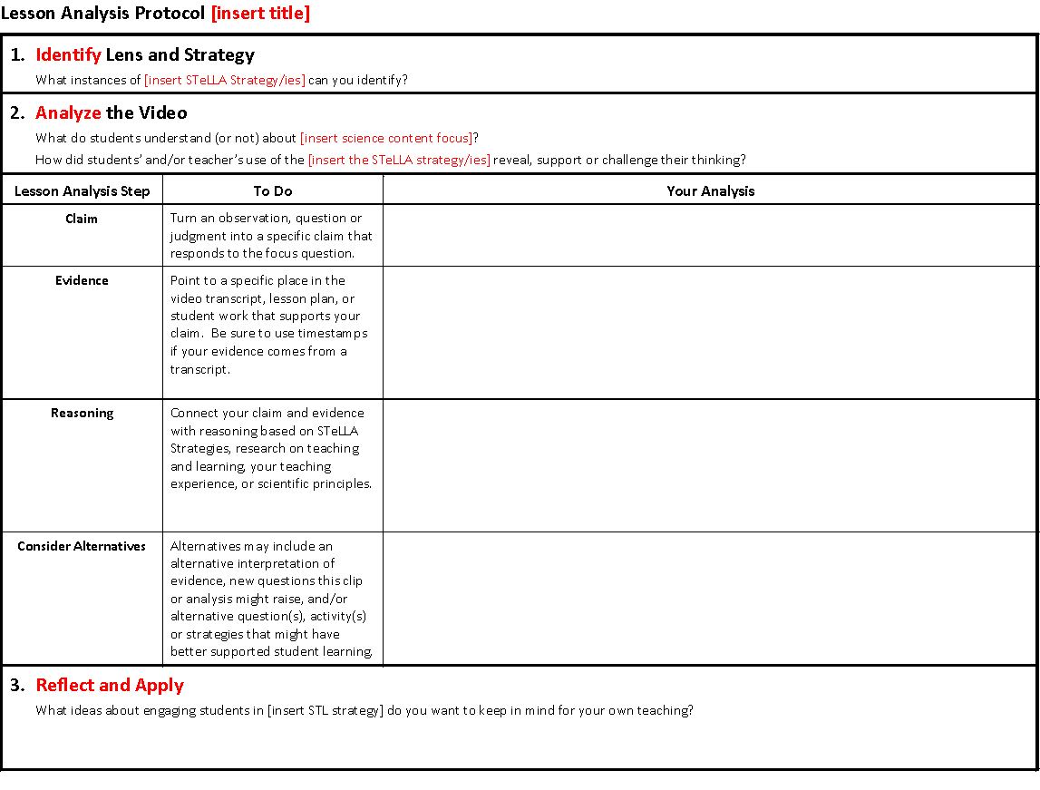
Lesson Analysis Protocol: L#_Name_C#
UPDATE Title and IMAGE once LAP is created

Slide 12
Lesson Analysis Protocol: L#_Name_C#
UPDATE Title and IMAGE once LAP is created

Slide 13
Analysis of Student Work
Individually, examine the student work samples and FACs on the Jamboard.
Where do you see evidence of
growth in understanding of science ideas and ability to engage in science and engineering practices and crosscutting concepts?
struggles or common student ideas?
Be prepared to share patterns in your observations with your small group.
Link to Jamboard

Slide 14
Analysis of Student Work
In your small group, share patterns in your observations.
Use the Jamboard to identify evidence of
growth in understanding of science ideas and ability to engage in science and engineering practices and crosscutting concepts?
struggles or common student ideas?
Be prepared to share your ideas with the whole group.

Slide 15
Analysis of Student Work
How do you now look at student work using a STeLLA lens?
What do you want to remember for your teaching going forward?

Slide 16
SG #8 Focus Questions
Where and how do Strategies XXX influence teacher practice and student learning?
To what extent have students taken on the STeLLA-related habits of mind
What are you taking with you from this professional learning experience?
Notes:
*Update these focus questions based on the teacher learning goals for the session.

Slide 17
Reflection & Celebration
Pick one of the following prompts and capture your thoughts. Be prepared to share.
Compare yourself as a teacher BEFORE this course to who you are as a teacher NOW. Are there differences? If so, what are those differences?
Describe a moment in your classroom that you feel captures something significant you learned from STeLLA.
How do you hope your STeLLA experience will impact your science teaching moving forward?
What is it that you want to celebrate and hold close in your teaching next week, next year, and 10 years from now.
Reflect on moments when you struggled learning or using the STeLLA strategies.
Reflect on any “Aha!” moments you may have had during your STeLLA experience.

Slide 18
Closing
What have you learned from teaching our fall unit and study group sessions that you want to remember for our spring unit?

Slide 19
Celebration and Gratitude
XXX

