Slide 1
STeLLA Scale Up and Sustainability Project (SSUP)
Science Teachers Learning From Lesson Analysis
Winter Institute
Day 2
DATE

Slide 2
Day 1 Reflections
Gots | Needs

Slide 3
STeLLA Program Goals: Professional Learning
Deepen knowledge of teaching and learning
Increase ability to analyze and reflect on teaching and learning
Increase ability to use content knowledge and knowledge of teaching and learning to transform classroom practice
Deepen teacher content knowledge
Increase student learning in science

Slide 4
Winter Institute at-a-Glance
Day 1 | Day 2
Opening | Opening
Fall Video Reflection | Content Deepening (L5-6) Teacher Set-up Science Learner Experience Teacher Follow-up
Content Deepening (L1-3) Teacher Set-up Science Learner Experience Teacher Debrief
 | Analysis of Practice: Curriculum Analysis
Lunch | Lunch
Content Deepening (L3-4) Science Learner Experience Teacher Follow-up | Analysis of Practice: Curriculum Analysis (cont’d)
 | Analysis of Practice: Unit Storyline
Lesson Analysis: Teacher Set-up Video Analysis Strategy F
Closing & Homework | Study Group Planning and Closing

Slide 5
Agenda
Opening
Content Deepening (Lessons 5-6)
Analysis of Practice: Curriculum Analysis
Analysis of Practice: Unit Storyline
Study Group planning and Closing

Slide 6
STeLLA Norms
Purpose: Build trust and develop a productive study group for all participants
The Basics
Arrive prepared and on time; stay for the duration
Remain attentive, thoughtful, and STeLLAful; eliminate interruptions (turn off cell phones, email)
Make room for participation from all (monitor your floor time)
The Heart of STeLLA Lesson Analysis
Keep the goal in mind: We are analyzing teaching to improve student learning
Share your ideas, uncertainties, confusions, disagreements, questions—open up time so this can happen!
Expect and ask questions to deepen everyone’s learning—honor needs!
Notes:
Update to

Slide 7
Focus Questions
What can cause the surface of the Earth to look the way it does?
How can we build coherence within and across lessons to help students craft a storyline of key science ideas?
How can we be intentional about how we move student thinking forward?

Slide 8
Content Deepening: Teacher Set-up
What can students say so far about what can cause the surface of the Earth to look the way it does?
What ideas will they “have”?
What ideas will they struggle with?
What other factors need to be considered?

Slide 9
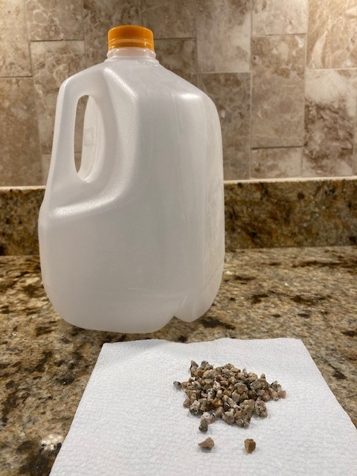
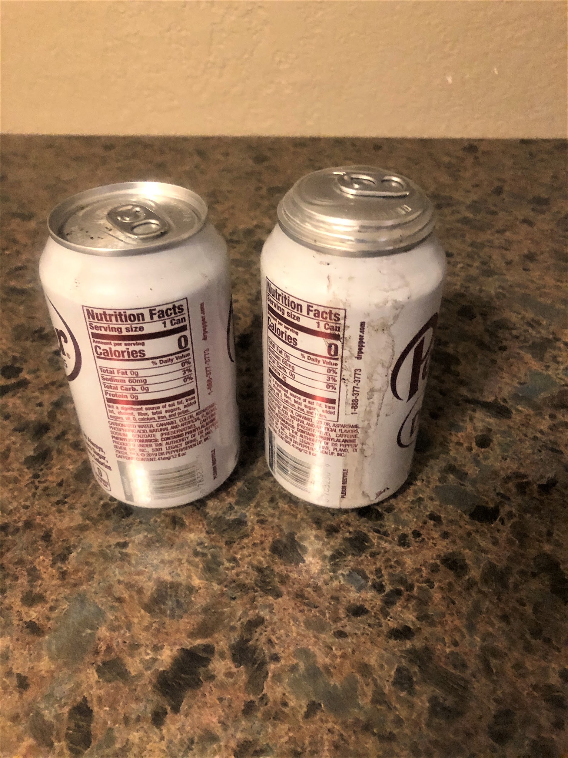
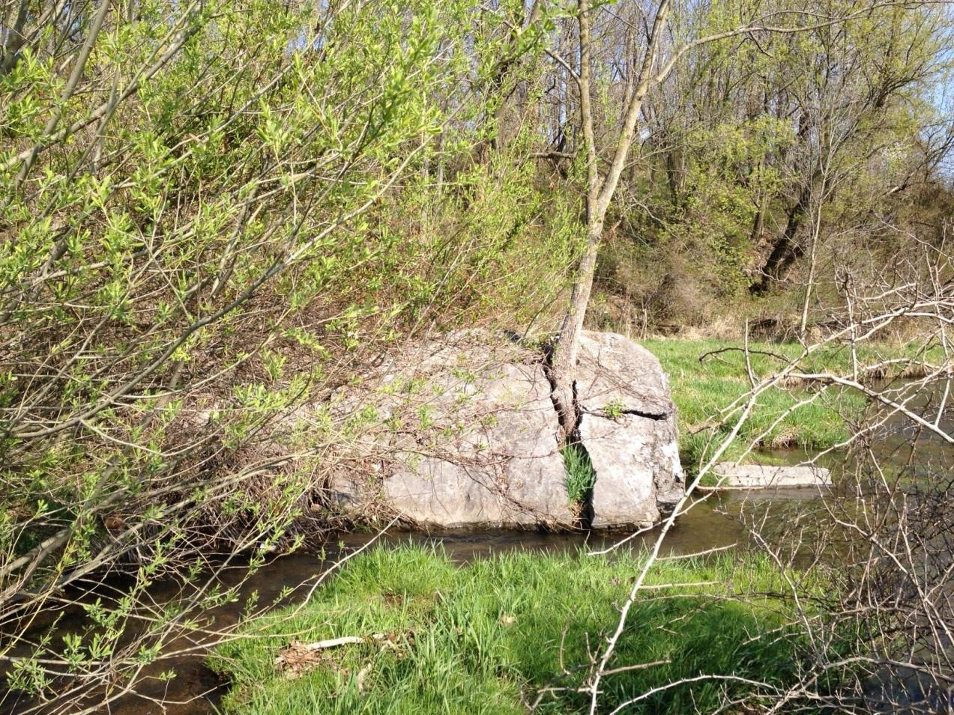
Content Deepening: Teacher Set-up
What have students figured out so far about the three investigation stations?

Slide 10
What do these stations have in common?

Slide 11
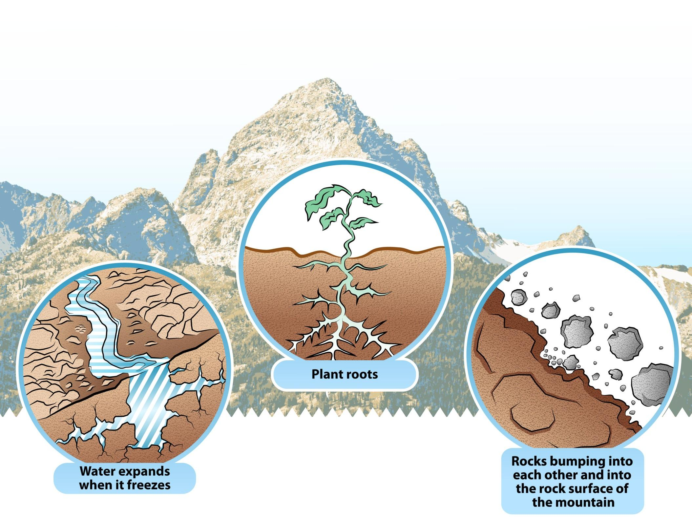
Weathering: the process that causes rock to crack, crumble, and break down into smaller and smaller pieces.

Slide 12
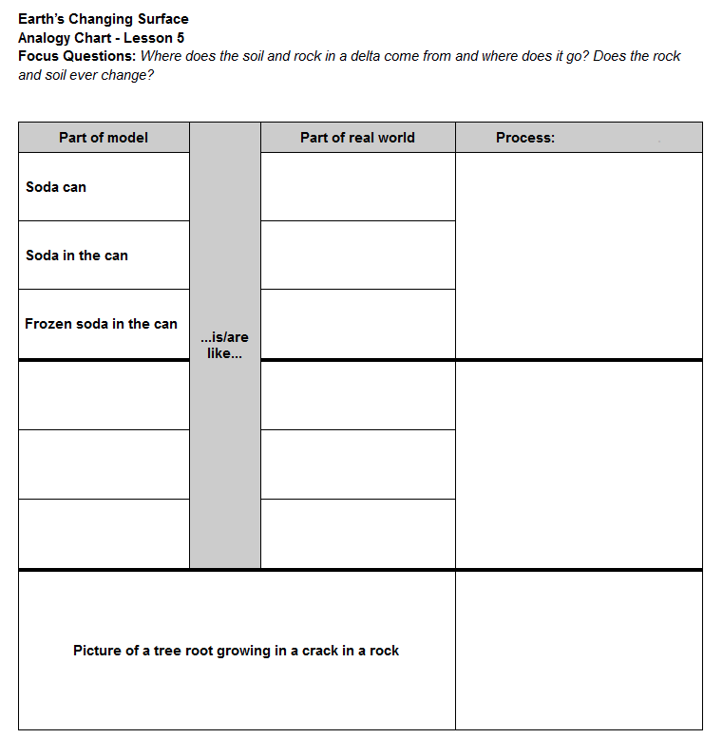
Analogy Chart
Notes:
Describe the process (how are each an example of weather

Slide 13
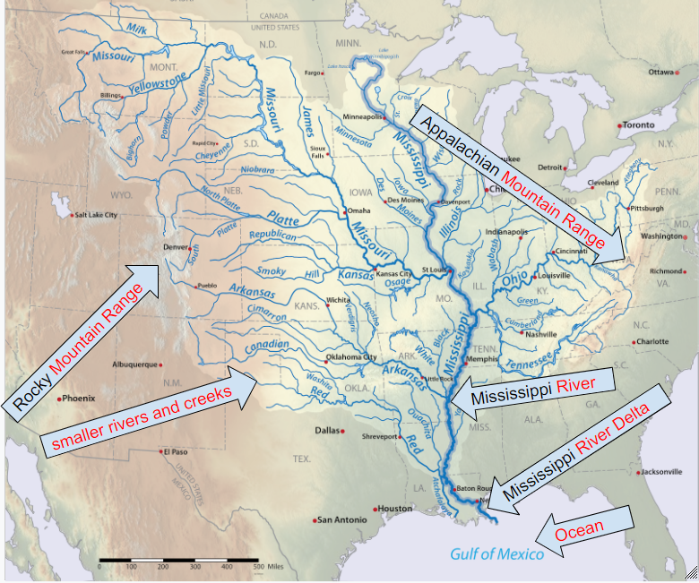

Slide 14
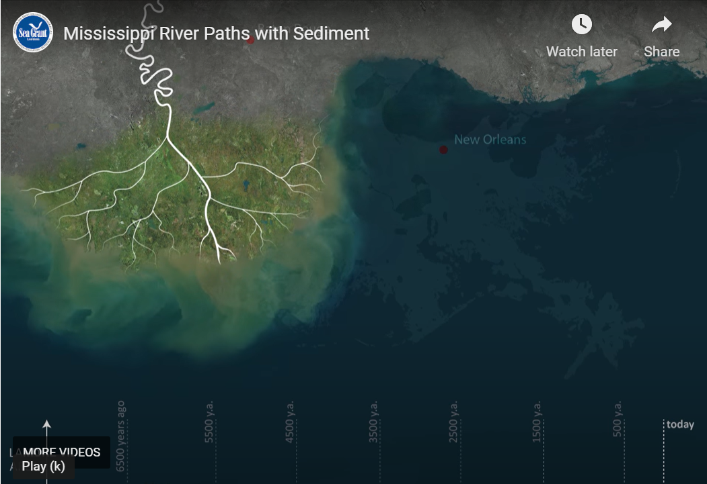
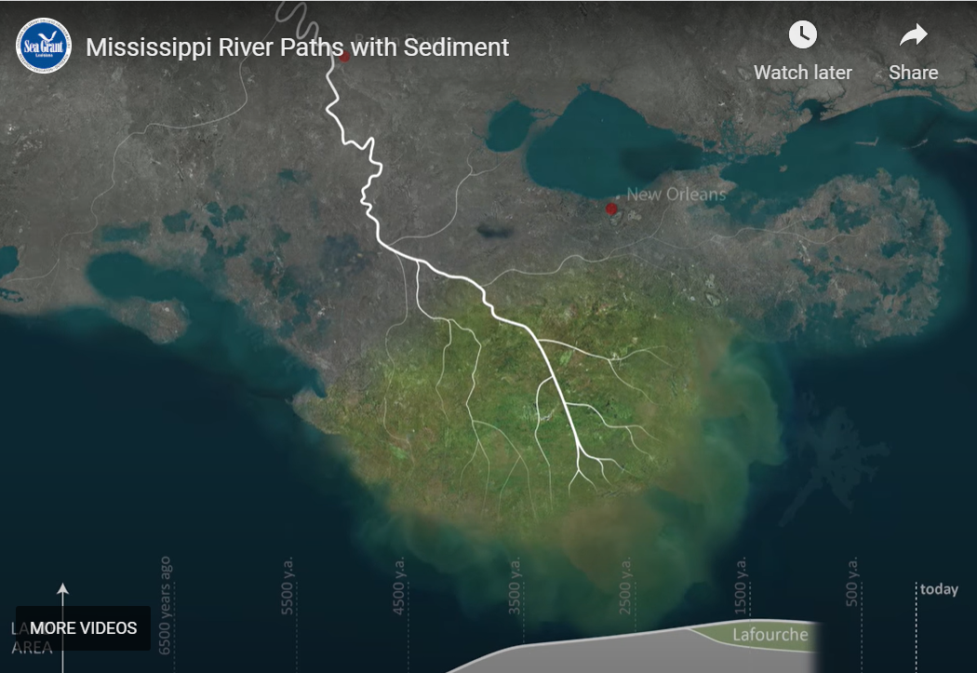
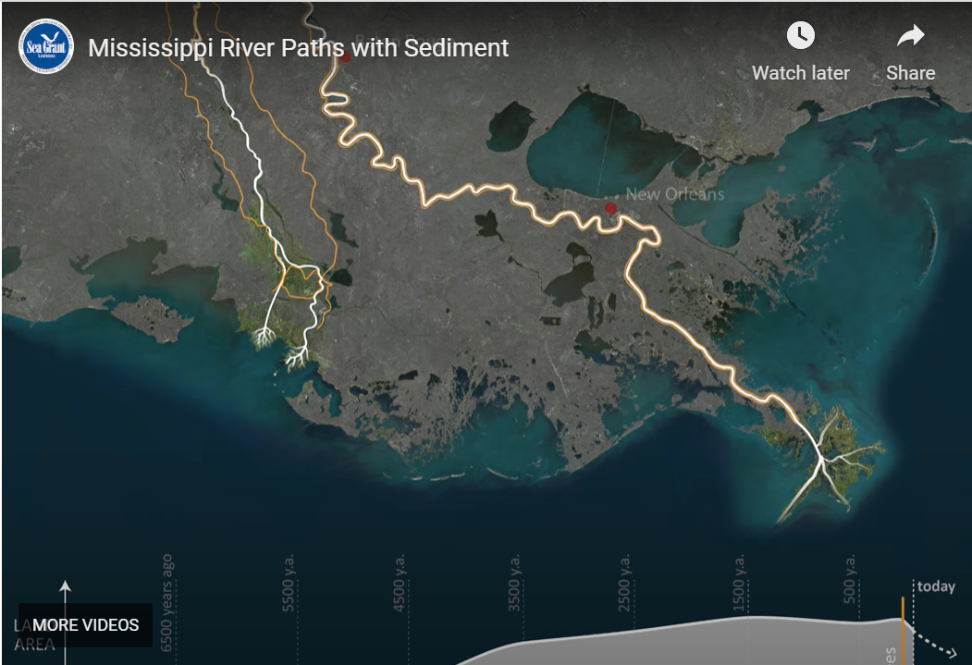
The Life of the Mississippi Delta

Slide 15
Putting it all Together
Why does the Mississippi Delta look the way it does?
Lesson 5 Focus Questions:
Where does the soil and rock in a delta come from and where does it go?
Does the rock and soil ever change?
Write an explanation to answer the focus questions.
Draw sketches to help explain your thinking.
Lesson 5 Focus Questions:
Where does the soil and rock in a delta come from and where does it go?
Does the rock and soil ever change?

Slide 16
How have your ideas changed?
Turn and talk with your partner.
Use row #11 from the CSW poster if you need help getting started.
What questions from our DQB can we answer now?

Slide 17
What other landforms can we explain?

Slide 18
Earth’s Changing Surface
Lesson 6
What can cause Earth’s surface to look the way it does?

Slide 19
Think Back to Lesson 5
What science ideas did you use in your explanation?

Slide 20
Lesson 6 Focus/ Unit Central Question
What can cause Earth’s surface to look the way it does?
Lesson 6 Focus and Unit Central Question
What can cause Earth’s surface to look the way it does?
You are now ready to answer this question!

Slide 21
Using CSW as You Discuss Your Ideas
Use CSW to SHARE your ideas (Rows 4 & 5)
Use CSW to ASK QUESTIONS
(Row 6)
Use CSW to COMMENT or RESPOND
(Rows 7 & 9)

Slide 22
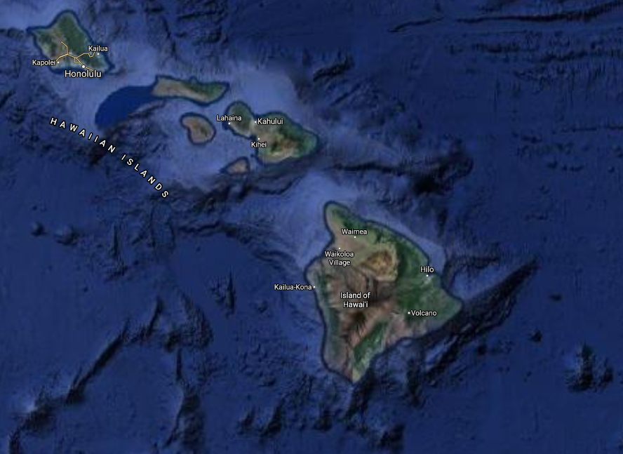
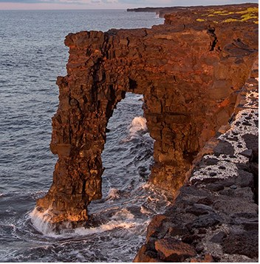
Imagery ©2020 TerraMetrics, Map Data ©2020
Over time, a sea arch forms out of a sea cliff.
Hōlei Sea Arch (NPS Photo/J. Wei)
Location #1
Notes:
Google image: https://www.google.com/maps/@20.1631564,-155.8522653,531162m/data=!3m1!1e3
NPS image: https://www.nps.gov/havo/learn/nature/sea-arches.htm
Other sea arch options:
https://unsplash.com/photos/ZZ-YMZ4PL5s (Tillamook, Oregon)

Slide 23
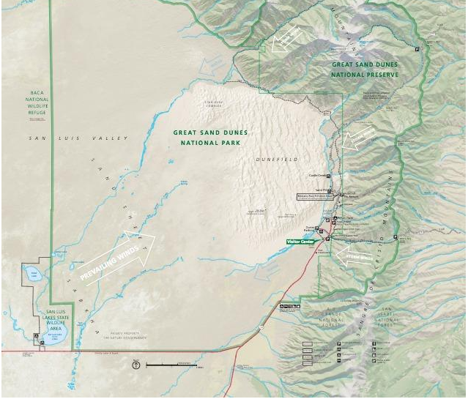
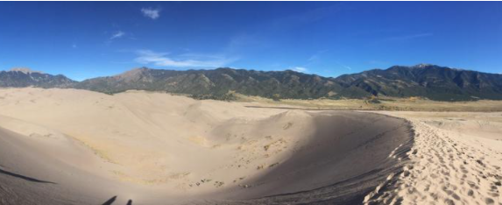
National Parks Service map of Great Sand Dunes National Park. (Public domain.)
Over time, sand dunes form between a windy, sandy area and mountain range.
Great Sand Dunes National Park, Colorado
with the San Juan Mountains visible in the distance.
(Credit: Cole Schubert. Public domain.)
Location #2
Notes:
https://www.usgs.gov/science-support/osqi/yes/national-parks/great-sand-dunes-national-park-and-preserve
https://www.usgs.gov/science-support/osqi/yes/national-parks/geology-great-sand-dunes-national-park

Slide 24
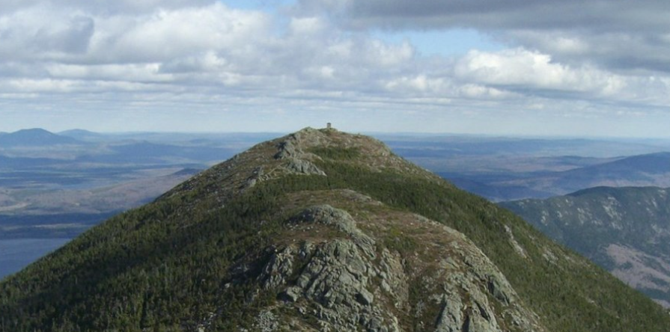
Over time, mountains became shorter and rounder.
On the Appalachian Trail (NPS)
computed by Hans Braxmeier, GFDL, via Wikimedia Commons
Location #3
Notes:
https://www.nps.gov/appa/index.htm
https://store.usgs.gov/map-locator

Slide 25
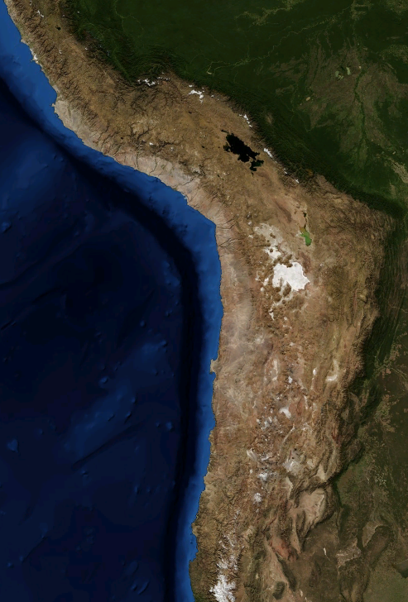
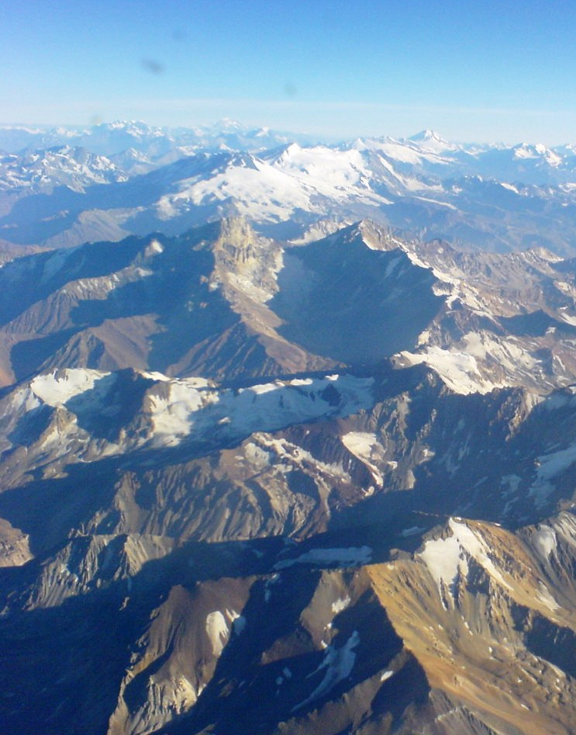
A mountain range becomes taller along the coast.
Jorge Morales Piderit via Wiki Commons
A deep ocean trench is found along the coast.
Image: NASA
Location #4
Notes:
https://www.ngdc.noaa.gov/mgg/image/2minrelief.html
https://www.nps.gov/subjects/geology/plate-tectonics-subduction-zones.htm
https://www.google.com/maps/@-21.5140602,-69.6320482,4685228m/data=!3m1!1e3
Photo by Matheus Frade on Unsplash

Slide 26
Lesson 6 Focus/ Unit Central Question
What can cause Earth’s surface to look the way it does?
Lesson 6 Focus and Unit Central Question
What can cause Earth’s surface to look the way it does?
Look back to your first answer.
How would you answer now?
What do you want to change or add?

Slide 27
Meta Moment
How did using evidence support your learning throughout this unit?

Slide 28
Content Deepening: Teacher Follow-up
Find your Mash-up handout that you “dotted” at the beginning of the week.
Re-dot the statements now that you have experienced the lessons in your unit.
Green dot: The idea is accurate
Yellow dot: The idea is partially accurate or I’m not sure.
Red dot: The idea is inaccurate.
Go public!
Add dots to the right side of the poster.
Notes:
Call attention to the original Mash-up poster

Slide 29
Common Student Ideas
If you are still unsure of the ideas on the mash-up use
Common Student Ideas
Content Deepening document

Slide 30
Content Deepening: STeLLA Strategies
Which STeLLA strategies were focal in lessons 5 and 6?
How did these focal strategies help support your thinking as a learner?
How will you use these STeLLA strategies to reveal, support, and challenge student thinking?
Notes:
Add notes for transition into whole group, bring effective science teaching charts
How do you think CSW can help your Ss? Why is that important?
Journal…
How did the experience invite you into wondering and learning?
What are the features that supported your curiosity and engagement?

Slide 31
Curriculum Binders
What might these strategies look like in practice in this unit?
Analysis of Lesson Guides and Teacher/Student Dialogue
Jigsaw lessons to identify STeLLA strategies

Slide 32
Effective Science Teaching and Learning
Reflect on our work together since we began with the summer institute.
What would you add, revise, or delete on your Effective Science Teaching and Learning chart?

Slide 33
Lesson Plan Analysis: Science Storyline
Practice telling a coherent story with the science ideas that develop throughout your assigned lesson.

Slide 34
Tell the Story…
Example Sentence Stems
Yesterday we learned…
Today we’ll answer the focus question...
We’ll figure out the phenomenon/problem...
Today we learned…
Tomorrow we’ll answer…
Notes:
Ask about the ? Strategy in the chart. Teachers may mention 5-8 in addition to F.
Ask where you would expect to see Strategy H
Emphasize Strategy F – how do student ideas get revealed and developed during the activity? (Emphasize all three stages of F)
If this is charted earlier along with F, G, and H, refer to this chart as the group lines up in order of assigned lessons.
Less formal than NGT – most of the work is done verbally

Slide 35
Lesson Plan Analysis: STeLLA Strategies
Share the focal STeLLA Strategies for your lesson. How do the focal STeLLA Strategies support
revealing and moving student thinking forward?
students figuring out key science ideas?
How do the STeLLA Strategies contribute to
the design of lessons across the unit?
student construction of the science content storyline?

Slide 36
Planning for Spring
Review calendars for our synchronous Study Group work.
Identify who will be able to teach a lesson and review sign up for filming

Slide 37
Focus Questions
What can cause the surface of the Earth to look the way it does?
How can we build coherence within and across lessons to help students craft a storyline of key science ideas?
How can we be intentional about how we move student thinking forward?

Slide 38
Reflection
How will the STeLLA Strategies support your planning and enactment of lessons?
What is one aspiration you have for the spring semester around STeLLA?

