Slide 1

STeLLA Scale Up and Sustainability Study (SSUP)
Day 1
Science Teachers Learning From Lesson Analysis

Slide 2
Welcome to the STeLLA Winter Institute!
In your table groups, share the following information:
  One thing that brought you joy and revitalized you over the break.
  One thing that you are looking forward to getting out of our time together.

Slide 3
STeLLA Program Goals
Deepen knowledge of teaching and learning
Increase ability to analyze and reflect on teaching and learning
Increase ability to use content knowledge and knowledge of teaching and learning to transform classroom practice
Deepen teacher content knowledge
Increase student learning in science

Slide 4
Winter Institute at a Glance
Day 1 | Day 2
Opening | Opening
Fall video reflection | Video Analysis
Content deepening: L1 Teacher setup Science learner experience Teacher debrief | Content deepening: L6-7 Teacher setup Science learner experience Teacher debrief
Video analysis | Curriculum binders
Content deepening: L2-5 + Lunch Teacher setup Science learner experience Teacher debrief | Lesson plan analysis and Telling the Story of the unit
Closing | Study group planning and closing

Slide 5
STeLLA Norms
The Basics
Arrive prepared and on time; stay for the duration
Remain attentive, thoughtful, and STeLLAful; eliminate interruptions (turn off cell phones, email)
Make room for participation from all (monitor your floor time)
The Heart of STeLLA Lesson Analysis
Keep the goal in mind: We are analyzing teaching to improve student learning
Share your ideas, uncertainties, confusions, disagreements, questions—open up time so this can happen!
Expect and ask questions to deepen everyone’s learning—honor needs!
Purpose: Build trust and develop a productive study group for all participants

Slide 6
Day 1 Focus Questions
Reflecting on the STeLLA Lenses and Strategies, how do we think our understanding and use of the strategies has changed or developed?
How can students be empowered to reveal their thinking and to listen to and interact with each other during classroom conversations?
How can we use our understanding of matter to figure out what was mixed with pond water that could have changed the water?

Slide 7
Discussion about Teaching the Fall Unit
What did you learn about your own growth and/or about student learning/thinking from watching your fall video and completing the reflection about STeLLA Strategies or completing the FAC’s for the pre-and posttests?
  Each teacher has 5 minutes to describe what she/he/they learned about personal growth and changes in student learning/understanding as a result of participating in the STeLLA PD program so far.
  Teachers may ask one another questions.
  The PD leader serves as a time-keeper only; teachers are in charge of the conversation.

Slide 8
Matter
Lesson 1: Anchor Phenomenon

Slide 9

Content Deepening: Teacher Set-up
How do you usually teach about matter?
  What do you want students to learn?
  What ideas do students struggle with?
Notes:
Slides 9 – 11 are placeholders for the anchor lesson slides

Slide 10
Content Deepening: Teacher Set-up
Consider the Ideas related to Matter Mash Up on p. __.
Add dots to the left-hand column as you analyze each idea.
  Green dot: science idea (accurate statement)
  Yellow dot: uncertain
  Red dot: common student idea (inaccurate statement)
Add sticky notes to clarify statements or add your own thoughts.
We’ll revisit these ideas periodically throughout the institute.
Notes:
Slides 9 – 11 are placeholders for the anchor lesson slides

Slide 11


The Situation
Notes:
https://pixabay.com/photos/lake-aerial-view-fields-meadows-2755907/

Slide 12

Lesson 1
Focus Question
How can the kids figure out what’s in the water that could have caused these changes?

Slide 13
Notice and Wonder
Looking at the two samples, what do you notice? What do you wonder ?
Notice | Wonder

Slide 14
Developing Models
Develop a model to show us what you're picturing.
  Imagine you zoom way WAY in to each sample.
  Use words, pictures, and/or symbols to show what each sample looks like.
Capture your questions at the bottom of the page.
Testable or non-testable?

Slide 15
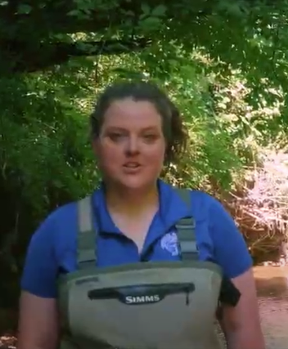
A Field Trip to the Tennessee Aquarium
Sarah is from the Tennessee Aquarium in Chattanooga, TN.
She is going to help us with our question:
How can the kids figure out what’s in the water that could have caused these changes?
Notes:
https://www.dropbox.com/sh/3ncw2sri0spfpe3/AACG0WViwHRu3P44B8t0-AL3a?dl=0

Slide 16
Our Questions
Write down your testable questions one per sticky note.
Notes:
Create a list of pollutants (salt, dirt, fertilizer, Soap, oil)
Generate ideas for testing
Explain that we have samples of these pollutants to investigate
How might we investigate these pollutants to find out if they are in the water?
*Why might it me helpful for each of our groups to record information in a similar way?
*Does anyone have ideas about how we can organize that information ?

Slide 17
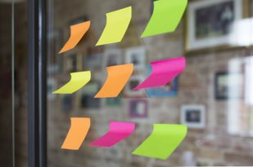
Anchor Phenomenon: Revising Our Questions
Building Our Driving Question Board
Consider all the questions you have written so far. Do you have new questions you can add?
  Write out your questions on sticky notes.
  Write one question per sticky note.

Slide 18
Content Deepening: Teacher Follow-up
Look at your Lesson 1 "Placemat:"
Which STeLLA Strategies were focal in this anchor lesson?
How did these focal strategies help support your thinking as a learner?
Notes: ideas that emerged, teacher moves, or thoughts about the experience you want to capture for yourself.
Notes:
Add notes for transition into whole group, bring effective science teaching charts
How do you think CSW can help your Ss? Why is that important?
Journal…
How did the experience invite you into wondering and learning?
What are the features that supported your curiosity and engagement?

Slide 19
Meta Moment
Journal . . .
What ideas do you want to add to your effective teaching and learning charts?
How did the experience engage your curiosity and make you wonder?
What role did using CSW stems play in the lesson?
What role did the "teacher/PDL" play in the process?

Slide 20
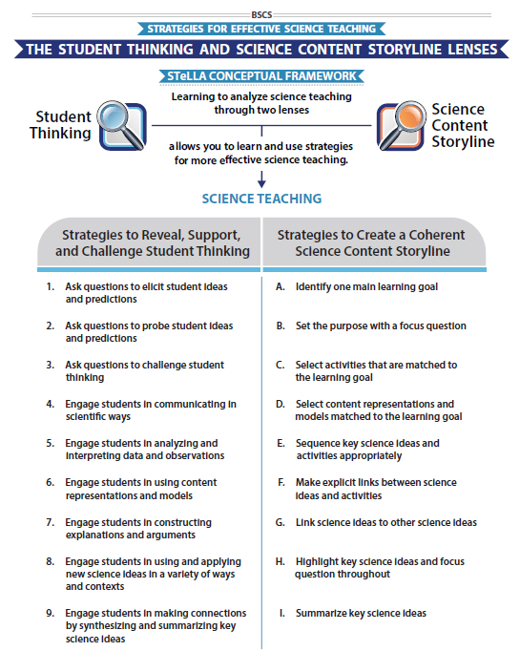
STeLLA Conceptual Framework
Focus Questions:
What are the STeLLA Lenses and Strategies, and why do we think they will make a difference in your science teaching?
How can students be empowered to reveal their thinking and to listen, probe, and challenge each other during classroom conversations?

Slide 21
Lesson Analysis: The Basics (pp. 1-2)
Viewing Basics
Analysis Basics
Viewing Basic #1: Look past the trivial, the little things that “bug” you.
Viewing Basic #2: Avoid the “this doesn’t look like my classroom” trap.
Viewing Basic #3: Avoid making snap judgments about the teaching or learning in the classroom you are viewing.
Analysis Basic #1: Focus on student thinking and the science content storyline
Analysis Basic #2: Look for evidence to support any claims
Analysis Basic #3: Look more than once
Analysis Basic #4: Consider alternative explanations and teaching strategies.
Notes:
Which stand out to you and why?

Slide 22
Preparing for Video Analysis: The Process
Identify - to create a shared understanding of the strategy
Analyze - to consider the influence of the use of strategy on student thinking and learning
Reflect and apply - to make the strategy part of our own practice
Notes:
We watch classroom video for 4 main purposes:
We’ve all read the strategy, but may have different mental images of what the strategies would look like in practice. The first role of video analysis is to make sure we have a common vision of the strategy - that we mean the same thing when we say the words selecting and engaging students with content representations and models. In the identify phase, we will make sure that we all see the same thing when we are talking about the strategy.
The second goal of video analysis is to see the potential of the strategy to impact student learning. We each have limited experiences in the classroom, and may not have thought about how our actions as teachers impact students’ opportunities to learn. In the analysis phase, we will consider the impact of the strategy on student thinking, and hone our skills as we develop a “student thinking lens.” To do this we make a claim about either the interesting student thinking made visible in the clip, or how the strategy influenced students’ ways of thinking.
Alternate 2: The second goal of video analysis is to see the potential of the strategy to impact student learning. We each have limited experiences in the classroom, and may not have thought about how our actions as teachers impact students’ opportunities to learn. In the analysis phase, we will consider the impact of the strategy on the classroom. In the case of these three strategies within the “science content storyline lens,” we want to think about where we see evidence of teacher planning and preparation that took these strategies into account and whether that preparation has an impact on student learning. To do this we make a claim about either the interesting student thinking made visible in the clip, or how we observed the strategy in practice..
In the analysis phase, we might also consider alternatives, what might I have done differently in this situation? Where would I like to know more about what a student is thinking or clarify what they mean. We might consider multiple ways of interpreting the teaching and learning in the selection. We’ll dig deeper into the analysis phase in future video analysis opportunities, but if you want to know more, refer to pg. 2 of the strategy document for norms for analysis.
The last goal of video analysis is to transfer what you learn by watching other teachers or discussing the strategy in action with your colleagues is to reflect and apply new learning to your own teaching practice.
This is a quick overview of the process we will use when viewing classroom video: Identify, Analyze, Reflect and Apply

Slide 23
Preparing for Video Analysis: The Context
This clip is from the end of Lesson 1 of 7 in the Matter unit. Students are wrapping up the anchor lesson by capturing and organizing questions for the driving question board.

Slide 24
Video Analysis: Belcastro_L1_C1
Identify
Analyze
  How did the teacher’s use of elicit and probe questions reveal, support, or challenge student thinking (or not)?
  How did the students’ initial questions about the phenomenon compare with our initial questions?
Reflect and apply
Add link
Notes:
n your journal,

Slide 25
Video Analysis: Belcastro_L1_C1
Identify
Analyze
Reflect and apply
  What did you learn from analyzing this video clip that you can apply to your own classroom?
Notes:
n your journal,

Slide 26
Content Deepening: Teacher Set-Up
Hold onto your seats, folks!
With a partner, review your thoughts on the Mash-Up
  Similarities and differences?

Slide 27
Link to our Last Lesson
Take a look at our Driving Question Board.
  What are our question clumps?
  Do we have new questions?

Slide 28
Lessons
2 & 3
Focus Question
What can we learn about the possible dangerous materials in the pond water?
What ideas and/or questions do you have?

Slide 29
Lesson 2: What could be in the water?
Sarah from the Tennessee Aquarium in Chattanooga, TN is going to help us with our question:
What can we learn about the possible dangerous materials in the pond water?
Link
Notes:
https://www.dropbox.com/sh/3ncw2sri0spfpe3/AACG0WViwHRu3P44B8t0-AL3a?dl=0

Slide 30
Dissolving and Solubility
Why do some substances dissolve?

Slide 31
Where did the salt go?
What are your predictions?
Cup
Salt
Water

Slide 32
Where did the salt go?
What does "Conservation of Mass" mean?
Can you use an example of your own?

Slide 33
Lesson 3: Testing the Water
Sarah is back!
She is going to help us learn more that will help us answer our question:
What can we learn about the possible dangerous materials in the pond water?
Notes:
https://www.dropbox.com/sh/3ncw2sri0spfpe3/AACG0WViwHRu3P44B8t0-AL3a?dl=0

Slide 34
Testing our Pollutants
pH
Temperature
Conductivity
Turbidity
What were your results?

Slide 35
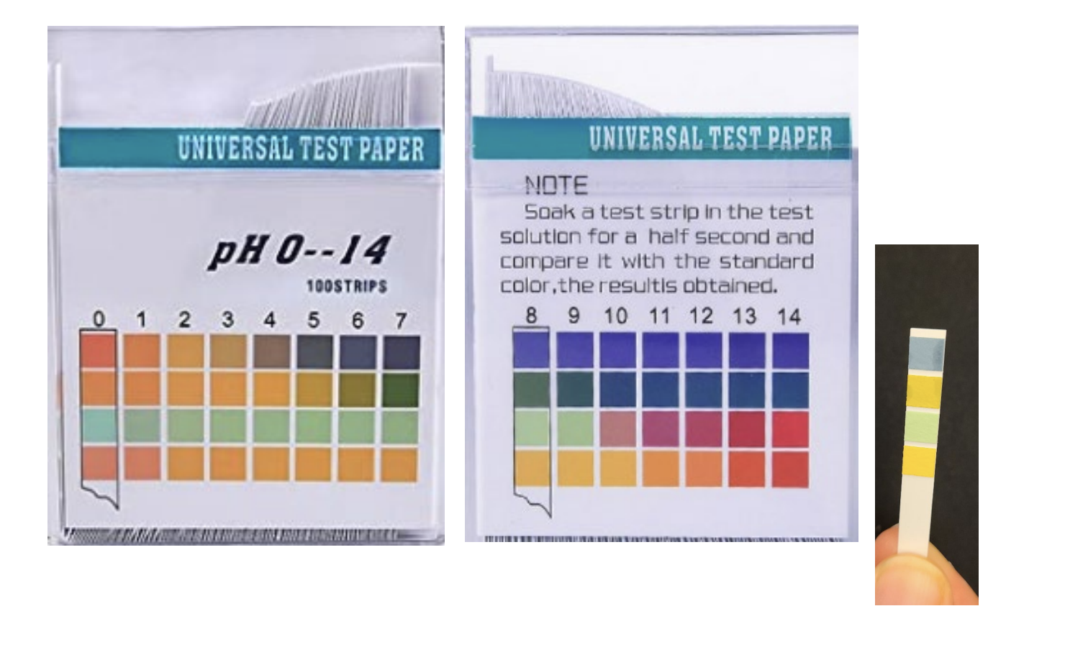
pH Scale

Slide 36
Mixtures with the Pollutants
As a class, for EACH water/pollution mixture:
Use a combination of words and pictures to show what you imagine you would see if you zoom WAY, WAY in on the water.
If any new questions come up, record them in your notebook for the Driving Question Board.

Slide 37
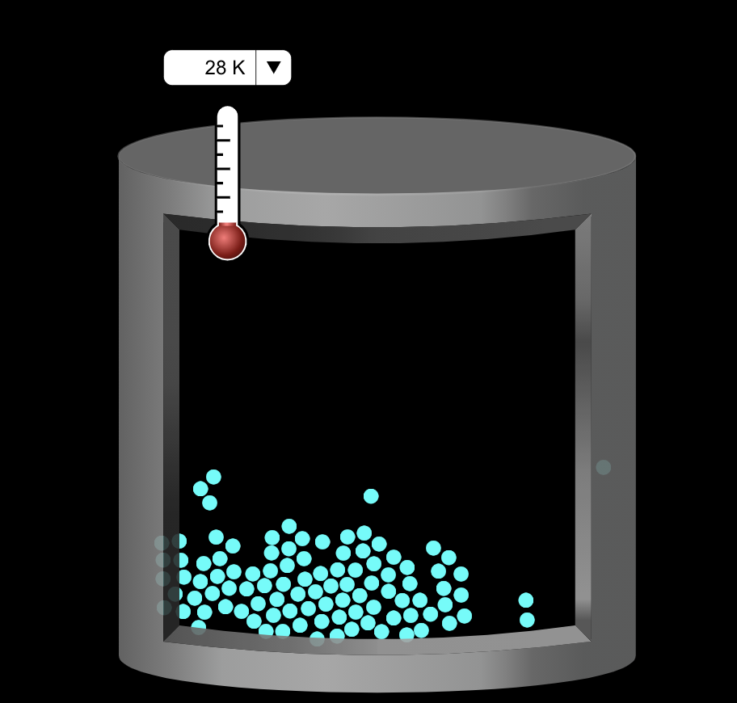
Considering Another Model
Here's one model scientists have developed to think about water when they zoom way, way in.
Image from the PhET Simulation
Link: https://phet.colorado.edu/sims/html/states-of-matter-basics/latest/states-of-matter-basics_en.html
Notes:
https://phet.colorado.edu/sims/html/states-of-matter-basics/latest/states-of-matter-basics_en.html

Slide 38
Checking Your Model
Does your model show how water particles mix with the pollutant's particles?
Create a caption
  I showed ______.
  This represents ____.

Slide 39
Eliminating Some Pollutants?
With what we know about the properties of pollutants, are there any we can eliminate from our possibilities of what is in the pond?

Slide 40
Lesson 4
Focus Question
What factors affect how soluble solids dissolve into water?
What do you think?

Slide 41
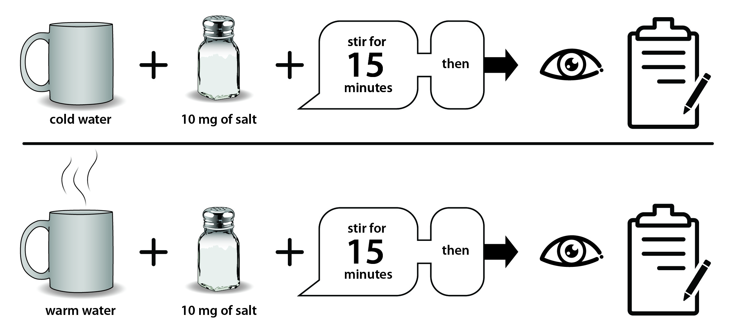
Example Investigation Plan

Slide 42
Communicating Our Results
Use your data to tell the class your results:
Claim: Salt dissolved __________ (faster/slower) in ________ (condition).
Evidence from your data: We know this because our data shows __________.

Slide 43
Lesson 5
Focus Question
How can we identify the pollutants in the pond water?
What do you think?

Slide 44
What evidence would support each claim?
Claims/Counter Claims | Evidence
There is fertilizer in the unhealthy pond water.
There is not fertilizer in the unhealthy pond water.
There is detergent in the unhealthy pond water.
There is not detergent in the unhealthy pond water.
There is salt in the unhealthy pond water.
There is not salt in the unhealthy pond water.

Slide 45

Example Investigation Plan

Slide 46
Write an Argument:
What pollutant is in the pond water?
Select a claim and support that claim with evidence.
  Include a statement about why you selected the evidence to support your claim.
  You can have more than one piece of evidence to support a claim.
  You may write more than one claim if you think the evidence supports more than claims.

Slide 47
Link to Next Lesson
Can the pollutants be removed from the water?

Slide 48
Content Deepening: Teacher Follow-up
Looking at lessons 2-5, record on your placemats:
Which STeLLA Strategies were focal in this anchor lesson?
Notes: ideas that emerged, teacher moves, or thoughts about the experience you want to capture for yourself.
Notes:
Add notes for transition into whole group, bring effective science teaching charts
How do you think CSW can help your Ss? Why is that important?
Journal…
How did the experience invite you into wondering and learning?
What are the features that supported your curiosity and engagement?

Slide 49
Day 1 Focus Questions
Reflecting on the STeLLA Lenses and Strategies, how do we think our understanding and use of the strategies has changed or developed?
How can students be empowered to reveal their thinking and to listen to and interact with each other during classroom conversations?
How can we use our understanding of matter to figure out what was mixed with pond water that could have changed the water?

Slide 50
Homework
Skim the Teacher Content Background Doc

Slide 51
Gots and Needs
Add one got or need to a sticky note and add to our poster on your way out.
Thanks, and we'll begin at 8:00 tomorrow morning!
Notes:
Slides 9 – 11 are placeholders for the anchor lesson slides

