Slide 1
STeLLA Scale Up and Sustainability Study (SSUP)
Day 2
Science Teachers Learning From Lesson Analysis

Slide 2
Reflection on Day 1
Add summary of Gots and Needs from Day 1

Slide 3
STeLLA Program Goals
Deepen knowledge of teaching and learning
Increase ability to analyze and reflect on teaching and learning
Increase ability to use content knowledge and knowledge of teaching and learning to transform classroom practice
Deepen teacher content knowledge
Increase student learning in science

Slide 4
Winter Institute at a Glance
Day 1 | Day 2
Opening | Opening
Fall video reflection | Video Analysis
Content deepening: L1 Teacher setup Science learner experience Teacher debrief | Content deepening: L6-7 Teacher setup Science learner experience Teacher debrief
Video analysis | Curriculum binders
Content deepening: L2-5 + Lunch Teacher setup Science learner experience Teacher debrief | Lesson plan analysis and Telling the Story of the unit
Closing | Study group planning and closing

Slide 5
STeLLA Norms
The Basics
Arrive prepared and on time; stay for the duration
Remain attentive, thoughtful, and STeLLAful; eliminate interruptions (turn off cell phones, email)
Make room for participation from all (monitor your floor time)
The Heart of STeLLA Lesson Analysis
Keep the goal in mind: We are analyzing teaching to improve student learning
Share your ideas, uncertainties, confusions, disagreements, questions—open up time so this can happen!
Expect and ask questions to deepen everyone’s learning—honor needs!
Purpose: Build trust and develop a productive study group for all participants

Slide 6
Day 2 Focus Questions
How can we build coherence within and across lessons to help students craft a storyline of key science ideas?
How can we be intentional about how we move student thinking forward?
How can we use our understanding of matter to figure out what was mixed with pond water that could have changed the water?

Slide 7
Preparing for Video Analysis: The Context
This is lesson 5 of 7 in the Matter unit. In this lesson, students have tested the unhealthy pond water for the properties previously studied about the pollutants and have summarized the results of that investigation. During this clip, they are working together to use those results to answer the Focus Question: How can we identify the pollutants in the pond water?

Slide 8
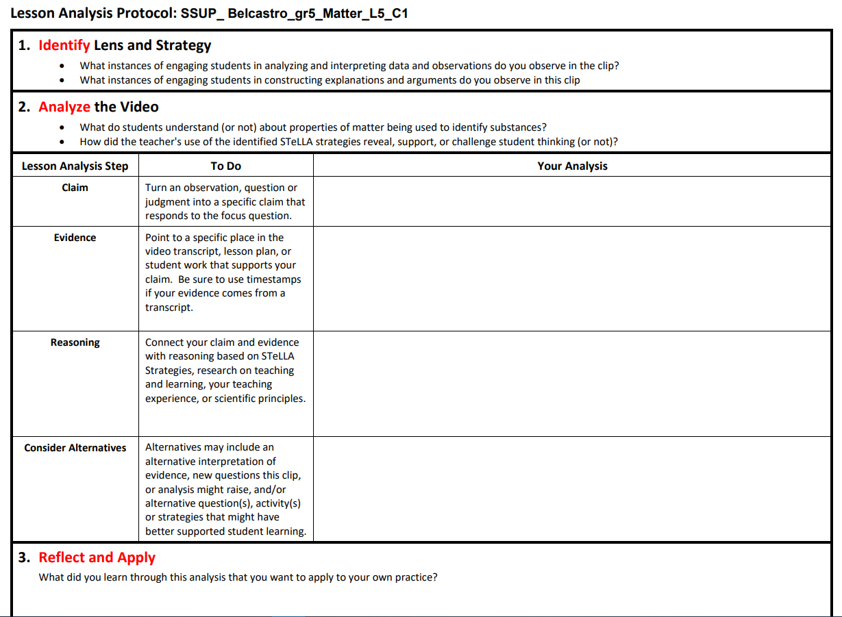
Video Analysis: Belcastro_L5_C1
Add link

Slide 9
Matter
Lessons 6-7

Slide 10

Content Deepening: Teacher Set-up
At this point in the unit, what ideas will students have about the pollutants in the pond water?
  What ideas will they "have"?
  What ideas will they struggle with?
  What other factors need to be considered
Notes:
Slides 9 – 11 are placeholders for the anchor lesson slides

Slide 11

Link to our Last Lesson
Turn and talk with a partner.
Share when you picture this pond water zoomed way, way in, what is the model you create in your mind to picture this pond water?

Slide 12
Returning to our DQB

Slide 13

Lesson 6
Focus Question
Can we get the water to be safe again?
Turn and talk with a partner

Slide 14

Removing pollutants
Could we boil the water in the pond to clean it?
What else could happen in a pond that would be similar to this process?

Slide 15
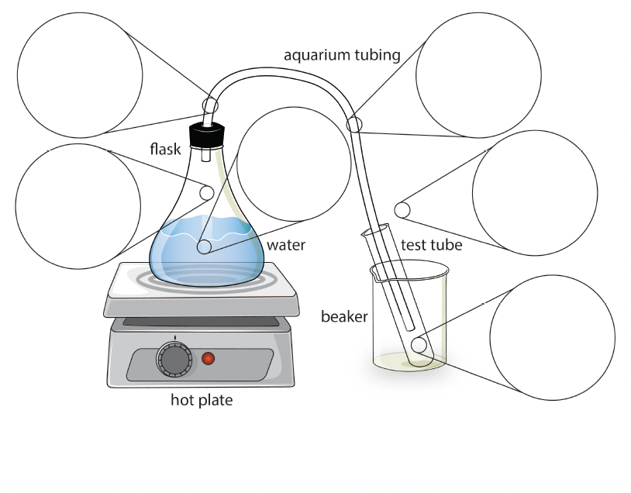
Water Distillation Apparatus
What do you notice?

Slide 16
Video of Distillation
Link to Video

Slide 17
Can we get the water to be safe again?
Do we have any evidence to help us answer the question of whether there is salt in the test tube in the end?
What claims can we make? Which claim has the strongest evidence?

Slide 18
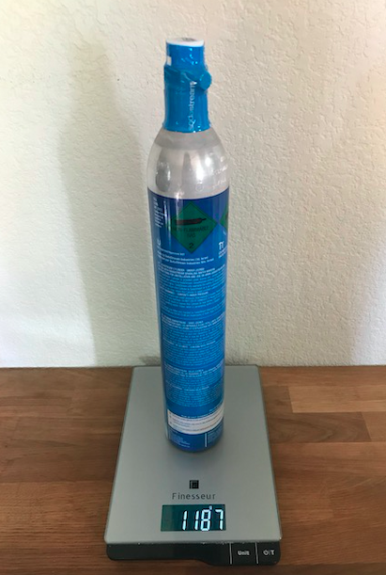
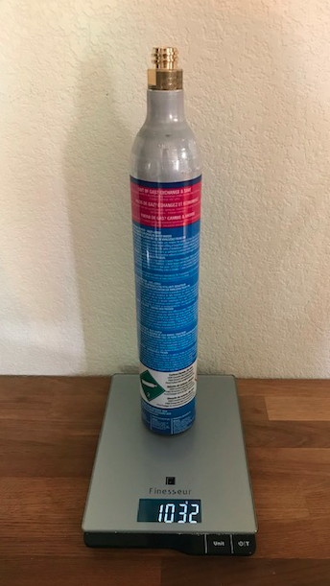

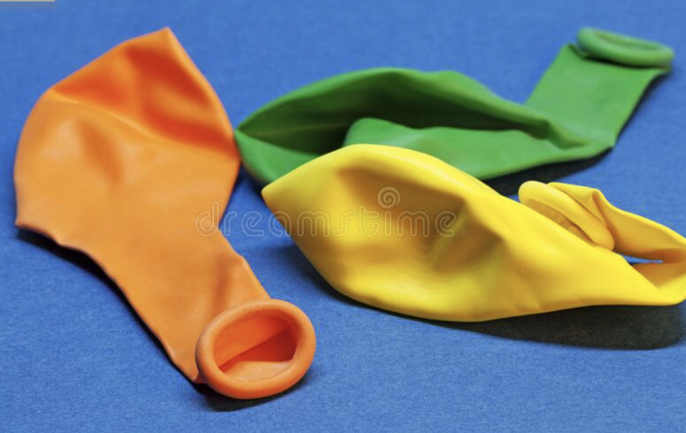
Observations about Gas
What do you think of when you hear the word "gas"?
What do these images show us? ​
What would you see if you zoomed way, way in? ​
Notes:
We’ve had the term ‘gas’ come up a few times today. When you all think of the word ‘gas,’ not like what we put in a car but in terms of what happened to the liquid water in the flask, what do you all think of?

Slide 19
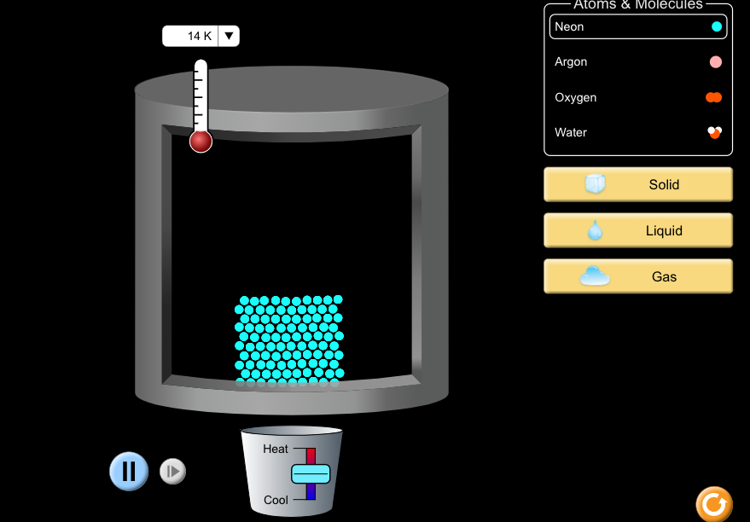

The PhET Computer Simulation
Link
Notes:
Pull up the PhET “States of Matter” simulation and select neon in the liquid phase to start. Say something like, “We’ve looked at how we represent particles that are liquid. Remind us, what do you notice when you look at how these particles look in a liquid.”
“Next, just like we did today with the distillation apparatus, we’ll apply some heat. Raise your hand when you notice the particles changing and you’d like to describe what you’re observing.”
Keep applying the heat until all the particles are in the gas state. Then ask, “If we look at this model of gas particles, how does this zoomed in picture compare to what you all drew for the balloon and the CO2 canisters?”

Slide 20
Revising our Diagrams
Take a minute to go back to your diagrams and add to or change the ideas you showed the first time.
Be sure your sketches show that gas is made of particles too small to be seen.

Slide 21
Idea Tracker
Question​ | What I Figured Out​
Can we get the water to be safe again? | Use complete sentences! ​ ​ ​ ​ ​ ​

Slide 22
Lesson 7
Focus Question
How did the pollutants get into the pond in the first place?

Slide 23
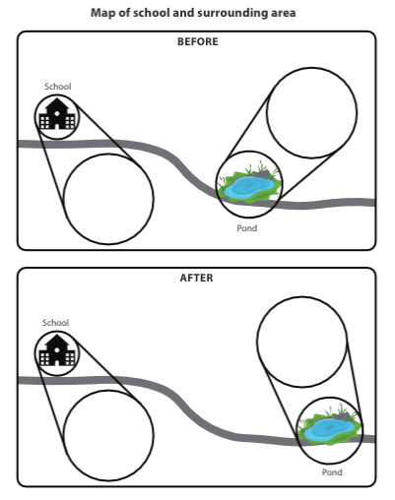
The Pond – School System
Think about how you would show a model to predict how you think the pollutants got into the water if the school was the source of the pollution.

Slide 24
Creating a Class Consensus Model
Discuss with your group: what have we already learned and how have we represented our learning?
  What evidence have we collected already that would be useful in developing our model?
  What models have we developed in past lessons that we can use here?
  What information in our progress trackers should we consider?
Remember to use our CSW sentence stems as you share your ideas.

Slide 25
Pause and Reflect
How did thinking about matter as particles help us figure out and represent our ideas in a model about what was happening in the pond?

Slide 26
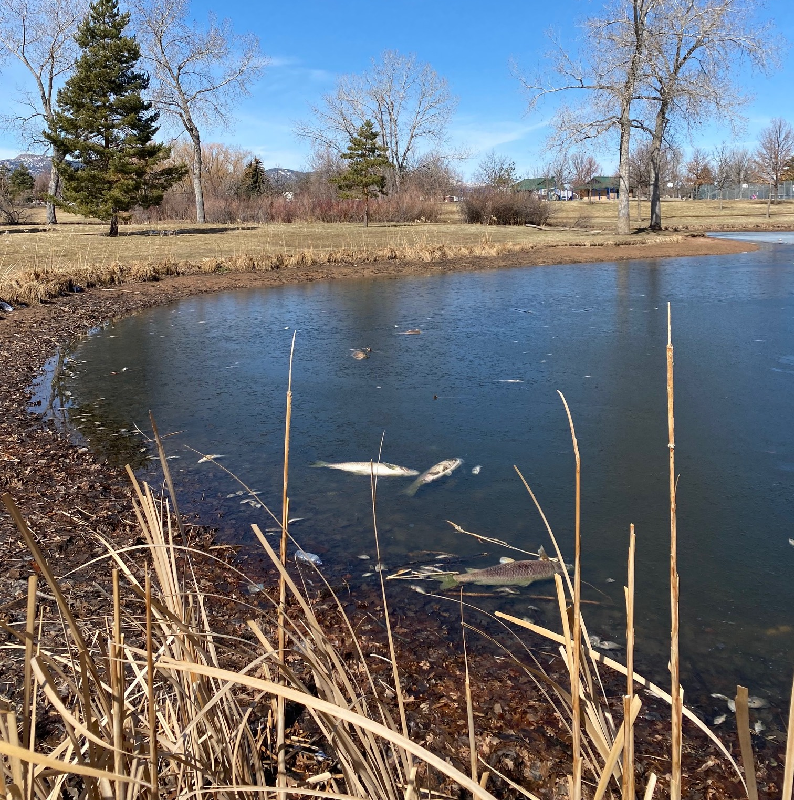
Pictures from Another School

Slide 27
Data from Another School
Test | Solubility | Conductivity | Turbidity | pH | Observations
Result | yes | A little | A little cloudy | 4-5 | murky
1. Of the pollutants that we studied, what could possibly be polluting their pond water?
2. What additional test or data would you like to collect to make you more confident in your claim?

Slide 28
What is your explanation for the mystery pollutant?
What claim can you make about what could possibly be polluting the other school's pond water and what additional test or data would make you more confident in your claim?
Support any claims with:
  data from your investigations
  ideas we have learned during our own investigations.
Test | Solubility | Conductivity | Turbidity | pH | Observations
Result | yes | A little | A little cloudy | 4-5 | murky

Slide 29
One last visit to our DQB

Slide 30
Content Deepening: Teacher Set-up
Find your Mash-up handout that you “dotted” at the beginning of the institute.
Re-dot the statements now that you have experienced the lessons in your unit.
  Green dot: The idea is accurate
  Yellow dot: The idea is partially accurate or I’m not sure.
  Red dot: The idea is inaccurate.
Go public!
  Add dots to the right side of the poster.
Notes:
Slides 9 – 11 are placeholders for the anchor lesson slides

Slide 31
Content Deepening: Teacher Follow-Up
Which STeLLA Strategies were focal in this lesson?
How did these focal strategies help support your thinking as a learner?
How will you use these STeLLA strategies to reveal, support and challenge student thinking?

Slide 32
Effective Science Teaching and Learning
Reflect on our work together since we began during the Summer Institute
What would you add, revise or delete on your effective science teaching and learning chart?

Slide 33
Curriculum Binders
Note the blank strategy column.
Jigsaw Lessons - Close read of ONE lesson to identify
  STeLLA Strategies and
  The story of science ideas.

Slide 34
Lesson Plan Analysis
Note how Strategies F, G, and H are written into the lesson.
Practice telling a coherent story with the science ideas that develop throughout your assigned lesson?
Notes:
Make sure Day 4 includes a HW assignment to read 1 lesson – jigsaw the lessons among the group. Orient each person to look at the lesson they read for HW

Slide 35
Tell the Story…
Example Sentence Stems
Yesterday we learned…
Today we’ll answer the focus question
We’ll figure out the phen/prob
Today we learned…
Tomorrow we’ll answer…
Notes:
Ask about the ? Strategy in the chart. Teachers may mention 5-8 in addition to F.
Ask where you would expect to see Strategy H
Emphasize Strategy F – how do student ideas get revealed and developed during the activity? (Emphasize all three stages of F)
If this is charted earlier along with F, G, and H, refer to this chart as the group lines up in order of assigned lessons.
Less formal than NGT – most of the work is done verbally

Slide 36
Lesson Plan Analysis: STeLLA Strategies
Share the STeLLA Strategy storyline for your lesson. How do the focal STeLLA Strategies support
  revealing and moving student thinking forward?
  students figuring out key science ideas?
Consider the pattern of STeLLA Strategies across the unit and the focal Strategies of each lesson. How do the focal STeLLA Strategies support
  student construction of the science content storyline?
Notes:
Make sure Day 4 includes a HW assignment to read 1 lesson – jigsaw the lessons among the group. Orient each person to look at the lesson they read for HW

Slide 37
Planning for Spring
Check calendars and CONFIRM dates/times for synchronous study group sessions!
Identify who will be able to teach a lesson and sign up for filming (Round 2).

Slide 38
Day 2 Focus Questions
How can we build coherence within and across lessons to help students craft a storyline of key science ideas?
How can we be intentional about how we move student thinking forward?
How can we use our understanding of matter to figure out what was mixed with pond water that could have changed the water?

Slide 39
Reflection
How will the STeLLA Strategies support your planning and enactment of lessons?
What is one aspiration you have for the spring semester around STeLLA?

