Slide 1

STeLLA Scale Up and Sustainability Study (SSUP)
Day 1
Science Teachers Learning From Lesson Analysis

Slide 2
Welcome & Introductions
Welcome to the STeLLA Summer Institute!
In your table groups, introduce yourselves by sharing the following information:
  Name
  Organization, district or school site.
  Your role
  One thing that you are looking forward to getting out of our week together.

Slide 3
STeLLA Program Goals
Deepen knowledge of teaching and learning
Increase ability to analyze and reflect on teaching and learning
Increase ability to use content knowledge and knowledge of teaching and learning to transform classroom practice
Deepen teacher content knowledge
Increase student learning in science

Slide 4
Week-at-a-Glance
Day 1 | Day 2 | Day 3 | Day 4 | Day 5
 | Opening | Opening | Opening | Opening
Opening | Lesson Analysis Purpose & Key Features STL Strategies 1, 2, 3 | Lesson Analysis Purposes & Key Features SCSL Strategies A, B, I/STL Strategy 9 | Lesson Analysis Purpose & Key Features SCSL Strategy 6/STL D Video Analysis | Lesson Analysis Purpose & Key Features SCSL Strategies F, G, H Video Analysis
Content Deepening through curriculum immersion
 | Content Deepening Teacher Set-up |  | Content deepening through curriculum immersion | Lesson Analysis: Tell the Story
Lunch | Lunch | Lunch | Lunch | Working Lunch: Prepare for Study Groups
Content deepening through curriculum immersion | Content deepening through curriculum immersion | Content deepening through curriculum immersion | Content deepening through curriculum immersion | Synthesize & Summarize: Represent the Lenses Strategies
Lesson Analysis Purpose & Key Features STL Strategy 4 | Lesson Analysis Purpose & Key Features STL Strategies 1, 2, 3 |  | Unit Study/Lesson Plan Review | Closing
Closing & HW STL 1, 2, 3 (read and Z-fold) | Closing & HW SCSL A, B, I/STL 9 (read & Z-fold) | Closing & HW STL 6/SCSL D (read & Z-fold) | Closing & HW SCSL F, G, H (read & Z-fold) Study unit & assigned lesson

Slide 5
STeLLA Norms
The Basics
Arrive prepared and on time; stay for the duration
Remain attentive, thoughtful, and STeLLAful; eliminate interruptions (turn off cell phones, email)
Make room for participation from all (monitor your floor time)
The Heart of STeLLA Lesson Analysis
Keep the goal in mind: We are analyzing teaching to improve student learning
Share your ideas, uncertainties, confusions, disagreements, questions—open up time so this can happen!
Expect and ask questions to deepen everyone’s learning—honor needs!
Purpose: Build trust and develop a productive study group for all participants

Slide 6
Day 1 Focus Questions
What patterns in temperature can you find on Earth at different times of the year?
What are the STeLLA Lenses and Strategies, and why do we think they will make a difference in your science teaching?
How can students be empowered to reveal their thinking and to listen to and interact with each other during classroom conversations?

Slide 7
Effective Science Teaching & Learning
What does effective science teaching and learning look like?
  What are teachers doing?
  What are students doing?
  What is the classroom like?
Teachers Doing | Students Doing
Classroom

Slide 8
Day 1 Focus Questions
What patterns in temperature can you find on Earth at different times of the year?
What are the STeLLA Lenses and Strategies, and why do we think they will make a difference in your science teaching?
How can students be empowered to reveal their thinking and to listen to and interact with each other during classroom conversations?

Slide 9

Content Deepening: Teacher Set-up
How do you usually teach Sun's effect on climate and seasons?
  What do you want students to learn?
  What ideas do students struggle with?
Notes:
Slides 9 – 11 are placeholders for the anchor lesson slides

Slide 10
Content Deepening: Teacher Set-up
Consider the Ideas related to Sun's effect on climate and seasons Mash Up on p. __.
Add dots to the left-hand column as you analyze each idea.
  Green dot: science idea (accurate statement)
  Yellow dot: uncertain
  Red dot: common student idea (inaccurate statement)
Add sticky notes to clarify statements or add your own thoughts.
We’ll revisit these ideas periodically throughout the week.
Notes:
Slides 9 – 11 are placeholders for the anchor lesson slides

Slide 11

Anchor Lesson Common Experience
Put on a "science learner hat"

Slide 12
Sun’s Effect on Climate and Seasons
Quick write: What patterns can we observe in Earth’s climate and seasons? What explains these patterns?

Slide 13
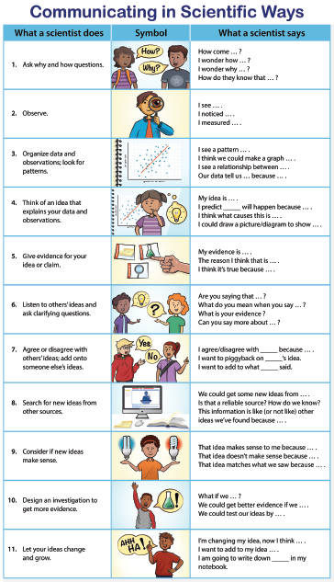
In what ways have you used any of these ways of communicating in scientific ways or sentence starters before?

Slide 14
What patterns in temperature can you find on Earth at different times of the year?
Ask yourself the question:
  What do I see?

Slide 15
What patterns in temperature can you find on Earth at different times of the year?
Ask yourself the question:
  What do I see?

Slide 16
What patterns in temperature can you find on Earth at different times of the year?
Ask yourself the questions:
What do I see?
What patterns can I identify?

Slide 17
What patterns in temperature can you find on Earth at different times of the year?

Slide 18
What patterns in temperature can you find on Earth at different times of the year?
  What do I see?
  What pattern can I identify?
  Which representation helped you the most? Why?

Slide 19
In what ways did you use any of these ways of communicating in scientific ways or sentence starters? How did they support your learning (or not)?

Slide 20
Driving Question Board (DQB)
1.
?
3.
2.
?
?
4
?
1.
1.
?
?
1.
?
1.
1.
?
?
1.
1.
1.
?
?
?

Slide 21
Unit Central Question
Why are some places on Earth hotter than others at different times of the year?

Slide 22
Content Deepening: Teacher Follow-up
What could one learn through this experience?
Notes:
Add notes for transition into whole group, bring effective science teaching charts
How do you think CSW can help your Ss? Why is that important?
Journal…
How did the experience invite you into wondering and learning?
What are the features that supported your curiosity and engagement?

Slide 23
Meta Moment
Journal….
What ideas do you want to add to your effective teaching and learning charts?
  How did the experience (e.g., aspects of the lesson) engage your curiosity and make you wonder?
  What role did using the CSW stems play in the lesson?
  What role did the “teacher/PDL” play in the process?
Notes:
Add notes for transition into whole group, bring effective science teaching charts
How do you think CSW can help your Ss? Why is that important?
Journal…
How did the experience invite you into wondering and learning?
What are the features that supported your curiosity and engagement?

Slide 24
STeLLA Norms
The Basics
Arrive prepared and on time; stay for the duration
Remain attentive, thoughtful, and STeLLAful; eliminate interruptions (turn off cell phones, email)
Make room for participation from all (monitor your floor time)
The Heart of STeLLA Lesson Analysis
Keep the goal in mind: We are analyzing teaching to improve student learning
Share your ideas, uncertainties, confusions, disagreements, questions—open up time so this can happen!
Expect and ask questions to deepen everyone’s learning—honor needs!
Purpose: Build trust and develop a productive study group for all participants

Slide 25
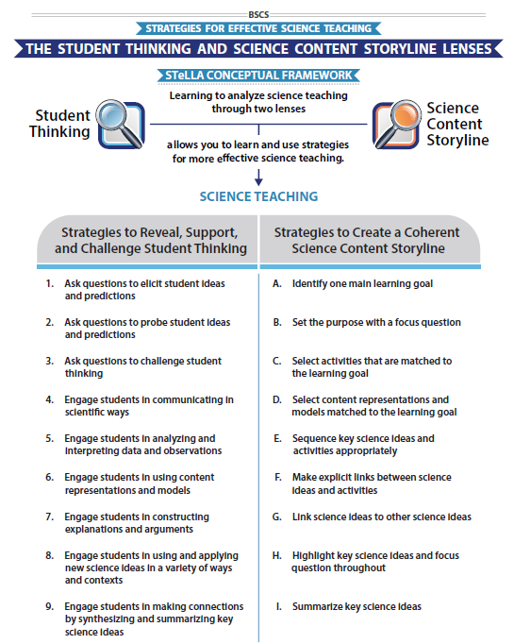
STeLLA Conceptual Framework
Focus Question:
How can students be empowered to reveal their thinking and to listen, probe, and challenge each other during classroom conversations?

Slide 26
STL Strategy 4: Communicating in Scientific Ways (CSW)
Read the Strategy Summary (p. 19) and complete the Student Thinking Lens Z-fold for STL Strategy 4: CSW
  Purpose
  Key Features
  Examples
Be prepared to share your ideas
Purpose: WHY it’s important
Key Features: WHAT does it look like in the classroom
Notes:
2 or 3 per room. No BSCS
**Blue box from slide 12 added here

Slide 27
STL Strategy 4: Communicating in Scientific Ways (CSW)
STL #X
Purpose
Key Features
Purpose: WHY it’s important
Key Features: WHAT does it look like in the classroom
Notes:
6 rooms
Jamboard
**Slide has been updated

Slide 28
Lesson Analysis: The Basics (pp. 1-2)
Viewing Basics
Analysis Basics
Viewing Basic #1: Look past the trivial, the little things that “bug” you.
Viewing Basic #2: Avoid the “this doesn’t look like my classroom” trap.
Viewing Basic #3: Avoid making snap judgments about the teaching or learning in the classroom you are viewing.
Analysis Basic #1: Focus on student thinking and the science content storyline
Analysis Basic #2: Look for evidence to support any claims
Analysis Basic #3: Look more than once
Analysis Basic #4: Consider alternative explanations and teaching strategies.
Notes:
Which stand out to you and why?

Slide 29
Preparing for Video Analysis: The Process
Identify - to create a shared understanding of the strategy
Analyze - to consider the influence of the use of strategy on student thinking and learning
Reflect and apply - to make the strategy part of our own practice
Notes:
We watch classroom video for 4 main purposes:
We’ve all read the strategy, but may have different mental images of what the strategies would look like in practice. The first role of video analysis is to make sure we have a common vision of the strategy - that we mean the same thing when we say the words selecting and engaging students with content representations and models. In the identify phase, we will make sure that we all see the same thing when we are talking about the strategy.
The second goal of video analysis is to see the potential of the strategy to impact student learning. We each have limited experiences in the classroom, and may not have thought about how our actions as teachers impact students’ opportunities to learn. In the analysis phase, we will consider the impact of the strategy on student thinking, and hone our skills as we develop a “student thinking lens.” To do this we make a claim about either the interesting student thinking made visible in the clip, or how the strategy influenced students’ ways of thinking.
Alternate 2: The second goal of video analysis is to see the potential of the strategy to impact student learning. We each have limited experiences in the classroom, and may not have thought about how our actions as teachers impact students’ opportunities to learn. In the analysis phase, we will consider the impact of the strategy on the classroom. In the case of these three strategies within the “science content storyline lens,” we want to think about where we see evidence of teacher planning and preparation that took these strategies into account and whether that preparation has an impact on student learning. To do this we make a claim about either the interesting student thinking made visible in the clip, or how we observed the strategy in practice..
In the analysis phase, we might also consider alternatives, what might I have done differently in this situation? Where would I like to know more about what a student is thinking or clarify what they mean. We might consider multiple ways of interpreting the teaching and learning in the selection. We’ll dig deeper into the analysis phase in future video analysis opportunities, but if you want to know more, refer to pg. 2 of the strategy document for norms for analysis.
The last goal of video analysis is to transfer what you learn by watching other teachers or discussing the strategy in action with your colleagues is to reflect and apply new learning to your own teaching practice.
This is a quick overview of the process we will use when viewing classroom video: Identify, Analyze, Reflect and Apply

Slide 30
Preparing for Video Analysis: The Context
Lesson Context:
This clip is from lesson 1 of 6 from the Sun's Effect on Climate unit. The teacher introduces the CSW chart and identifies which stems students could focus on for their discussions.

Slide 31
Video Analysis: Charles CSW Lesson 1
Identify
  What instances do you observe of using STL Strategy 4: Communicating in Scientific Ways?
Analyze
Reflect and apply
Add link

Slide 32
Video Analysis: Charles CSW Lesson 1
Identify
    What instances do you observe of using STL Strategy 4: Communicating in Scientific Ways?
Analyze
  What did the teacher do (or not) to promote the use of CSW stems or communicating like scientists?
Reflect and apply
Notes:
n your journal,

Slide 33
Video Analysis: Charles CSW Lesson 1
Identify
    What instances do you observe of using STL Strategy 4: Communicating in Scientific Ways?
Analyze
  What did the teacher do (or not) to promote the use of CSW stems or communicating like scientists?
Reflect and apply
  What did you learn from analyzing this video clip that you can apply to your own classroom?
Notes:
n your journal,

Slide 34
CSW and the Anchor Lesson
Read the handout with the following questions in mind:
  How does the anchor lesson set the stage for engaging in a 3D phenomenon/problem-focused set of lessons?
  How do the CSW sentence stems support the purposes of the anchor lesson?
Be prepared to share your ideas.
Notes:
Introduce reading on anchor lesson

Slide 35
Day 1 Focus Questions
What patterns in temperature can you find on Earth at different times of the year?
What are the STeLLA Lenses and Strategies, and why do we think they will make a difference in your science teaching?
How can students be empowered to reveal their thinking and to listen to and interact with each other during classroom conversations?

Slide 36
Reflection
Complete the Daily Reflection sheet (p. ___)

Slide 37
Homework
Read
  Introduction to the Student Thinking Lens (STL) (p. 9)
Read the Strategy Summary documents and complete the Z-fold for purpose and key features for each of the following strategies
  STL Strategy 1: Ask questions to elicit student ideas and predictions (pp. 11-12)
  STL Strategy 2: Ask questions to probe student ideas and predictions (pp. 13-14)
  STL Strategy 3: Ask questions to challenge student thinking (pp. 15-17)

