Slide 1

STeLLA Scale Up and Sustainability Study (SSUP)
Day 2
Science Teachers Learning From Lesson Analysis

Slide 2
Day 1 Reflections
Add day 1 reflections

Slide 3
STeLLA Program Goals
Deepen knowledge of teaching and learning
Increase ability to analyze and reflect on teaching and learning
Increase ability to use content knowledge and knowledge of teaching and learning to transform classroom practice
Deepen teacher content knowledge
Increase student learning in science

Slide 4
Week-at-a-Glance
Day 1 | Day 2 | Day 3 | Day 4 | Day 5
 | Opening | Opening | Opening | Opening
Opening | Lesson Analysis Purpose & Key Features STL Strategies 1, 2, 3 | Lesson Analysis Purposes & Key Features SCSL Strategies A, B, I/STL Strategy 9 | Lesson Analysis Purpose & Key Features SCSL Strategy 6/STL D Video Analysis | Lesson Analysis Purpose & Key Features SCSL Strategies F, G, H Video Analysis
Content Deepening through curriculum immersion
 | Content Deepening Teacher Set-up |  | Content deepening through curriculum immersion | Lesson Analysis: Tell the Story
Lunch | Lunch | Lunch | Lunch | Working Lunch: Prepare for Study Groups
Content deepening through curriculum immersion | Content deepening through curriculum immersion | Content deepening through curriculum immersion | Content deepening through curriculum immersion | Synthesize & Summarize: Represent the Lenses Strategies
Lesson Analysis Purpose & Key Features STL Strategy 4 | Lesson Analysis Purpose & Key Features STL Strategies 1, 2, 3 |  | Unit Study/Lesson Plan Review | Closing
Closing & HW STL 1, 2, 3 (read and Z-fold) | Closing & HW SCSL A, B, I/STL 9 (read & Z-fold) | Closing & HW STL 6/SCSL D (read & Z-fold) | Closing & HW SCSL F, G, H (read & Z-fold) Study unit & assigned lesson

Slide 5
Reconnections
How did you/we do with the STeLLA norms yesterday?
What could we add or modify in the norms to strengthen our community?

Slide 6
STeLLA Norms
The Basics
Arrive prepared and on time; stay for the duration
Remain attentive, thoughtful, and STeLLAful; eliminate interruptions (turn off cell phones, email)
Make room for participation from all (monitor your floor time)
The Heart of STeLLA Lesson Analysis
Keep the goal in mind: We are analyzing teaching to improve student learning
Share your ideas, uncertainties, confusions, disagreements, questions—open up time so this can happen!
Expect and ask questions to deepen everyone’s learning—honor needs!
Purpose: Build trust and develop a productive study group for all participants

Slide 7
Day 2 Focus Questions
What causes the average temperatures on Earth near the equator to be higher than the average temperatures on Earth far from the equator?
Why is it summer in the United States (North America) when it is winter in Argentina (South America)?
How can lesson analysis help us better understand how elicit, probe, and challenge questions reveal and challenge student thinking?
How can we develop a classroom culture focused on student thinking?

Slide 8
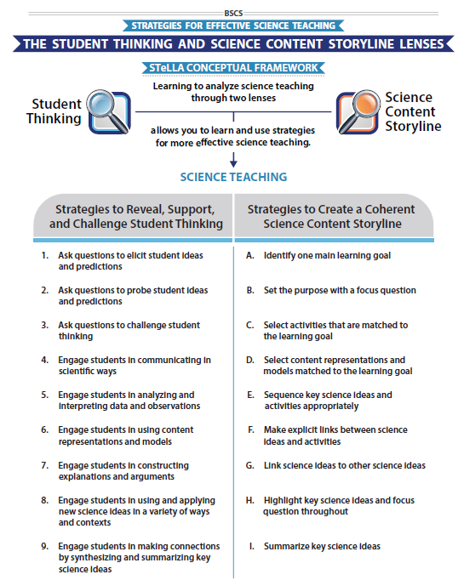
STeLLA Conceptual Framework

Slide 9
Student Thinking Lens Strategies
1, 2, and 3
Use your Z-fold to discuss the purposes and key features of
  STL Strategy 1: Ask questions to elicit student ideas and predictions
  STL Strategy 2: Ask questions to probe student ideas and predictions
  STL Strategy 3: Ask questions to challenge student thinking
Complete the chart for your assigned strategy
STL #X
Purpose
Key Features
Purpose: WHY it’s important
Key Features: WHAT does it look like in the classroom
Notes:
6 rooms
Jamboard
**Slide has been updated

Slide 10
Elicit vs Probe Questions
  What are some key differences between questions that elicit and questions that probe student ideas and predictions?

Slide 11
Probe vs. Challenge Questions
  What are some key differences between questions that probe student ideas and predictions and questions that challenge student thinking?
  What are leading questions? What does the strategy document say about this type of question?

Slide 12
Meta Moment
How has your thinking changed about these three questioning strategies?
Update your Z-fold

Slide 13
Preparing for Video Analysis: The Process
Identify - to create a shared understanding of the strategy
Analyze - to consider the influence of the use of strategy on student thinking and learning
Reflect and apply - to make the strategy part of our own practice
Notes:
We watch classroom video for 4 main purposes:
We’ve all read the strategy, but may have different mental images of what the strategies would look like in practice. The first role of video analysis is to make sure we have a common vision of the strategy - that we mean the same thing when we say the words selecting and engaging students with content representations and models. In the identify phase, we will make sure that we all see the same thing when we are talking about the strategy.
The second goal of video analysis is to see the potential of the strategy to impact student learning. We each have limited experiences in the classroom, and may not have thought about how our actions as teachers impact students’ opportunities to learn. In the analysis phase, we will consider the impact of the strategy on student thinking, and hone our skills as we develop a “student thinking lens.” To do this we make a claim about either the interesting student thinking made visible in the clip, or how the strategy influenced students’ ways of thinking.
Alternate 2: The second goal of video analysis is to see the potential of the strategy to impact student learning. We each have limited experiences in the classroom, and may not have thought about how our actions as teachers impact students’ opportunities to learn. In the analysis phase, we will consider the impact of the strategy on the classroom. In the case of these three strategies within the “science content storyline lens,” we want to think about where we see evidence of teacher planning and preparation that took these strategies into account and whether that preparation has an impact on student learning. To do this we make a claim about either the interesting student thinking made visible in the clip, or how we observed the strategy in practice..
In the analysis phase, we might also consider alternatives, what might I have done differently in this situation? Where would I like to know more about what a student is thinking or clarify what they mean. We might consider multiple ways of interpreting the teaching and learning in the selection. We’ll dig deeper into the analysis phase in future video analysis opportunities, but if you want to know more, refer to pg. 2 of the strategy document for norms for analysis.
The last goal of video analysis is to transfer what you learn by watching other teachers or discussing the strategy in action with your colleagues is to reflect and apply new learning to your own teaching practice.
This is a quick overview of the process we will use when viewing classroom video: Identify, Analyze, Reflect and Apply

Slide 14
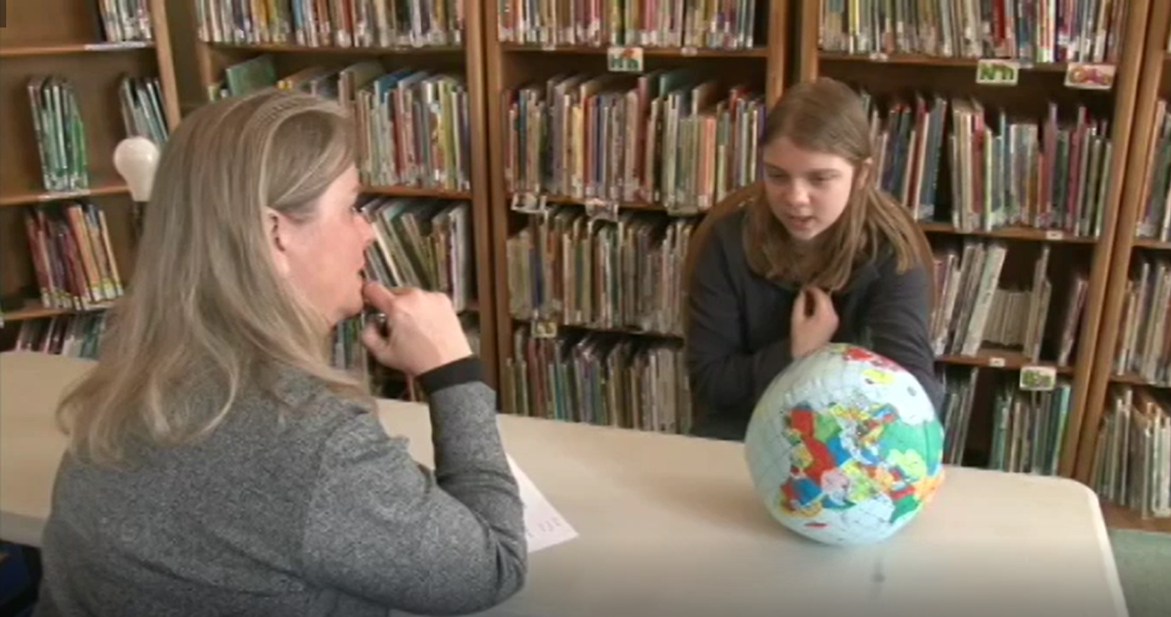
Preparing for Video Analysis: The Context
Roth/Lillian Pre-interview
Sun’s Effect on Climate and Seasons.
Unit Central Question:
Why are some places on Earth hotter than others at different times of the year?

Slide 15
Video Analysis: Roth/Lillian Pre-interview
Identify
  What instances do you observe of STL strategies elicit, probe, and/or challenge questions?
Analyze
Reflect and apply
Add link

Slide 16
Video Analysis: Roth/Lillian Pre-interview
Identify
  What instances do you observe of STL strategies elicit, probe, and/or challenge questions?
Analyze
  How did the interviewer’s use (or not) of elicit, probe, and/or challenge questions influence student predictions, ideas or thinking?
Reflect and apply
Notes:
n your journal,

Slide 17
Video Analysis: Roth/Lillian Pre-interview
Identify
  What instances do you observe of STL strategies elicit, probe, and/or challenge questions?
Analyze
  How did the interviewer’s use (or not) of elicit, probe, and/or challenge questions influence student predictions, ideas or thinking? scientists?
Reflect and apply
  What did you learn from analyzing this video clip that you can apply to your own classroom?
Notes:
n your journal,

Slide 18
Preparing for Video Analysis: The Context
Wade EPC- Lesson 1
This clip is from Lesson 1 of 6 of a unit titled, Sun’s Effect on Climate and Seasons.
The focus question for the lesson is:
What patterns in temperature can you find on Earth at different times of the year?
Students have just looked at a data table and transferred temperature data from the table onto a world map. During this clip they are sharing patterns they noticed in the data.

Slide 19
Video Analysis: Wade EPC L1
Identify
What instances do you observe of STL strategies elicit, probe, and/or challenge questions?
Analyze
Reflect and apply
Add link

Slide 20
Video Analysis: Wade EPC L1
Identify
  What instances do you observe of STL Strategies elicit, probe, and/or challenge questions?
Analyze
  How did the teacher’s use (or not) of elicit, probe, and/or challenge questions influence student predictions, ideas or thinking?
Reflect and apply

Slide 21
Video Analysis: Wade EPC L1
Identify
What instances do you observe of STL Strategies elicit, probe, and/or challenge questions?
Analyze
  How did the teacher’s use (or not) of elicit, probe, and/or challenge questions influence student predictions, ideas or thinking?
Reflect and apply
  What did you learn from analyzing this video clip that you can apply to your own classroom?
Notes:
Make sure convo links to anchor exp

Slide 22
Meta Moment
Journal….
What ideas do you want to add to your effective teaching and learning charts?
  How did the experience…

Slide 23

Content Deepening: Teacher Set-up
What is the story of learning so far....
Open your science notebook to review the learning from L1/Day 1.
Turn to a partner and practice telling the story of student learning.

Slide 24
Content Deepening: Teacher Set-up
Lesson 1: What patterns in temperature can you find on Earth at different times of the year?
Lesson 2: What causes the average temperatures on Earth near the equator to be higher than the average temperatures on Earth far from the equator?
Lesson 3: Why is it summer in the United States (North America) when it is winter in Argentina (South America)?
Notes:
Slides 9 – 11 are placeholders for the anchor lesson slides

Slide 25

Unit Central Question
Why are some places on Earth hotter than others at different times of the year?

Slide 26
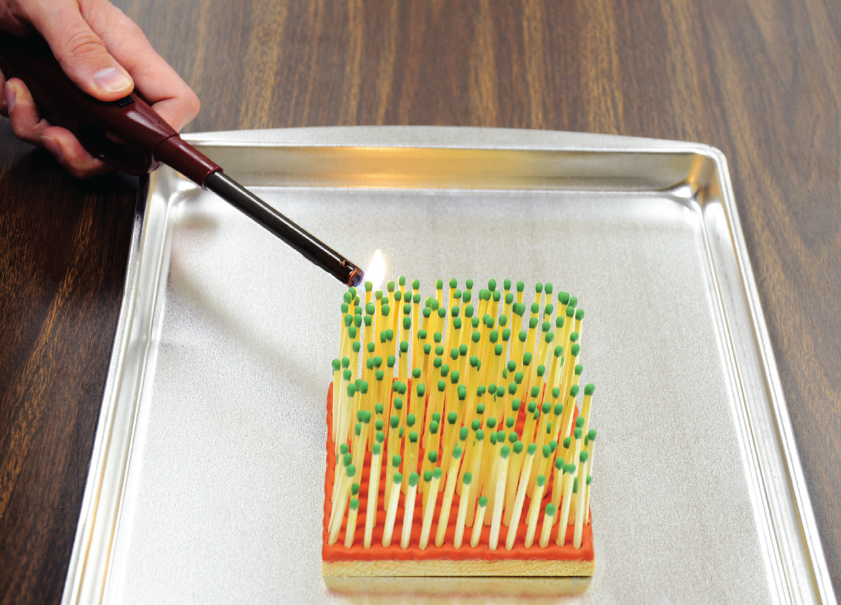

Slide 27
Energy Angles Investigation
What causes the average temperatures on Earth near the equator to be higher than the average temperatures on Earth far from the equator?

Slide 28
What do you notice?
Straight On | At an Angle

Slide 29
Analogy Map: Forest Fire
Part of the model | ...is/are like… | part of the real world | They are alike because | They are different because
A block of wood covered in clay |  | the ground in the forest | they both hold up the tree and matches. | the ground of the forest is not made of clay.
Matches standing up in the clay |  | the trees in the forest. | They are both standing up close to each other at different heights. | trees are bigger than matches and living things.
A hand with a lit match |  | lightning that could start a forest fire. | they can both cause a fire to start in a small area. | lightning just happens, you have to light a match.

Slide 30
Make connections…

Slide 31
Make connections…

Slide 32
Explanation
Respond to the question and be prepared to share your answer.
  What causes the average temperatures on Earth near the equator to be higher than the average temperatures on Earth far from the equator?
On chart paper
  Post your group’s response to the scientific question
    Include a statement that answers the question.
    Include the evidence you gathered from your investigation and use of models.
    Include a representation to show how you make sense of what’s happening in the real world.

Slide 33
Gallery Walk
Read what others have written
Provide at least one piece of feedback or advice
  I wonder…
  I noticed…
  Pose a question
Gather ideas from others to revise your explanation

Slide 34
Meta Moment
Think about the representations you’ve used during this experience so far.
  How did each representation influence your thinking?
  Which representations were easy to use? Harder to use? Why do you think so?
  What were the strengths and limitations of each representation?

Slide 35
Reflection
What can we say now about our unit central question: Why are some places on Earth hotter than others at different times of the year?

Slide 36
Driving Question Board (DQB)
?
?
?
?
?
?
?
?
?
?
?
?
?
?
?

Slide 37
Explore the Earth-Sun System
Use the provided materials to see if you can tell more of the story…
  Why are some places on Earth hotter than others at different times of the year?

Slide 38
Content Deepening: Teacher Follow-up
What could one learn through this experience?
What were examples of key elicit, probe, and challenge questions used during lessons 2 and 3?
Notes:
Add notes for transition into whole group, bring effective science teaching charts
How do you think CSW can help your Ss? Why is that important?
Journal…
How did the experience invite you into wondering and learning?
What are the features that supported your curiosity and engagement?

Slide 39
STeLLA STL Strategies 1, 2, and 3
What are the key similarities & differences between probe and challenge questions? Leading questions?

Slide 40
Practice Probe Questions: Interview Planning
The Task:
Practice using probe questions by posing an elicit question to a partner and then ask ONLY probe questions to find out what your partner thinks.
To prepare:
  Read your elicit question.
  Think about what ideas may be shared in your partner’s responses.
  Plan probe questions.
Practice:
  Round 1
  Round 2
Notes:
12 minutes
Describe the task – we will practice probe questions by interviewing each other. The challenge is to pose an elicit question to a colleague and then follow up by ONLY asking probe questions.
Pass out a different elicit question to each participant.
Prepare for interviewing each other.

Slide 41
Group Discussion about the Interviews
How did the interviews go? What was difficult? As an interviewer? As a responder?
What probe questions revealed interesting ideas?
Were any of your questions challenge questions?
Notes:
6 minutes
Discuss the questions on the slide.
If time, ask: How might doing more of this type of practice (with a partner or small group) help your teaching?

Slide 42
Practice Challenge Questions: Interview Planning
The Task:
Practice using challenge questions by posing an elicit question to a partner, asking probe questions, and then ask at least one challenge question to find out what your partner thinks.
To prepare:
  Read your elicit question.
  Think about what ideas may be shared in your partner’s responses.
  Plan probe and challenge questions.
Practice:
  Round 1
  Round 2
Notes:
12 minutes
Describe the task – we will practice probe questions by interviewing each other. The challenge is to pose an elicit question to a colleague and then follow up by ONLY asking probe questions.
Pass out a different elicit question to each participant.
Prepare for interviewing each other.

Slide 43
Group Discussion about the Interviews
How did the interviews go? What was difficult? As an interviewer? As a responder?
What probe and challenge questions revealed interesting ideas?
What role does content knowledge play in a teachers’ ability to ask productive probe and challenge questions?
Notes:
6 minutes
Discuss the questions on the slide.
If time, ask: How might doing more of this type of practice (with a partner or small group) help your teaching?

Slide 44
Day 2 Focus Questions
What causes the average temperatures on Earth near the equator to be higher than the average temperatures on Earth far from the equator?
Why is it summer in the United States (North America) when it is winter in Argentina (South America)?
How can lesson analysis help us better understand how elicit, probe, and challenge questions reveal and challenge student thinking?
How can we develop a classroom culture focused on student thinking?

Slide 45
Summarize and Synthesize
Journal…
How can lesson analysis [and other experiences] help us better understand how elicit, probe, and challenge questions reveal and challenge student thinking?
How can the STeLLA Student Thinking Lens Strategies (1-2-3-4) help us develop a culture of student thinking in our classrooms?
How could the strategies we’ve learned so far support our planning and enactment of lesson?
Notes:
Slide 38 – 39: Closing and reflection
10 min
4:05 – 4:15

Slide 46
Walk-n-talk
You will need
  a partner,
  your journal,
  sticky notes (if you prefer), and
  a writing utensil.
Instructions
  Share your responses to the synthesize and summarize questions.
  Capture new ideas in your journal.
  Time: 4 min out and 4 min back.
Notes:
Shift to whole group for final closing
4:40 – 4:30

Slide 47
Reflection
Complete the Daily Reflection
We are discussing elicit, probe and challenge questions to reveal student thinking. How do these types of questions resonate with your current questioning style? What role do you think the use of these questions play in revealing student thinking? Explain your thinking.
We have focused on developing a classroom culture that values student thinking. What challenges have you encountered when attempting to develop this type of classroom culture? How do you see the STeLLA strategies contributing to a culture that values student thinking?

Slide 48
Homework
Purpose: WHY it’s important
Key Features: WHAT does it look like in the classroom
Read
  Introduction to the Science Content Storyline Lens (pp 39-40)
  Student Ideas and Science Ideas Defined (pp. 7-8)
Read and complete the STL & SCSL Z-fold
  SCSL Strategy A: Identify one main learning goal
  SCSL Strategy B: Set the purpose with a focus question
  SCSL Strategy I: Summarize key science ideas
  STL Strategy 9: Engage students in making connections by synthesizing and summarizing key science ideas.
Notes:
3 min
Next week we will focus on the Science Content Storyline Lens and we will focus on a new content area: food webs. In preparation, here are your homework tasks.

