Slide 1

STeLLA Scale Up and Sustainability Study (SSUP)
Day 3
Science Teachers Learning From Lesson Analysis

Slide 2
Day 2 Reflections
Add reflections from day 2

Slide 3
STeLLA Program Goals
Deepen knowledge of teaching and learning
Increase ability to analyze and reflect on teaching and learning
Increase ability to use content knowledge and knowledge of teaching and learning to transform classroom practice
Deepen teacher content knowledge
Increase student learning in science

Slide 4
Week-at-a-Glance
Day 1 | Day 2 | Day 3 | Day 4 | Day 5
 | Opening | Opening | Opening | Opening
Opening | Lesson Analysis Purpose & Key Features STL Strategies 1, 2, 3 | Lesson Analysis Purposes & Key Features SCSL Strategies A, B, I/STL Strategy 9 | Lesson Analysis Purpose & Key Features SCSL Strategy 6/STL D Video Analysis | Lesson Analysis Purpose & Key Features SCSL Strategies F, G, H Video Analysis
Content Deepening through curriculum immersion
 | Content Deepening Teacher Set-up |  | Content deepening through curriculum immersion | Lesson Analysis: Tell the Story
Lunch | Lunch | Lunch | Lunch | Working Lunch: Prepare for Study Groups
Content deepening through curriculum immersion | Content deepening through curriculum immersion | Content deepening through curriculum immersion | Content deepening through curriculum immersion | Synthesize & Summarize: Represent the Lenses Strategies
Lesson Analysis Purpose & Key Features STL Strategy 4 | Lesson Analysis Purpose & Key Features STL Strategies 1, 2, 3 |  | Unit Study/Lesson Plan Review | Closing
Closing & HW STL 1, 2, 3 (read and Z-fold) | Closing & HW SCSL A, B, I/STL 9 (read & Z-fold) | Closing & HW STL 6/SCSL D (read & Z-fold) | Closing & HW SCSL F, G, H (read & Z-fold) Study unit & assigned lesson

Slide 5
STeLLA Norms
The Basics
Arrive prepared and on time; stay for the duration
Remain attentive, thoughtful, and STeLLAful; eliminate interruptions (turn off cell phones, email)
Make room for participation from all (monitor your floor time)
The Heart of STeLLA Lesson Analysis
Keep the goal in mind: We are analyzing teaching to improve student learning
Share your ideas, uncertainties, confusions, disagreements, questions—open up time so this can happen!
Expect and ask questions to deepen everyone’s learning—honor needs!
Purpose: Build trust and develop a productive study group for all participants

Slide 6
Reconnection: Walk-about-Review
My Ideas | Round 1 | Round 2
Recollection
Name
Insight
Name
Application
Name

Slide 7
Day 3 Focus Questions
Why is one main learning goal (SCSL Strategy A) essential for coherence of the Science Content Storyline?
How does the use of a focus question (SCSL Strategy B) contribute to the coherence of the Science Content Storyline?
How does synthesizing and summarizing key science ideas (SCSL I/STL 9) contribute to the coherence of the science content storyline?
Why is it warmer in the summer than in the winter?

Slide 8
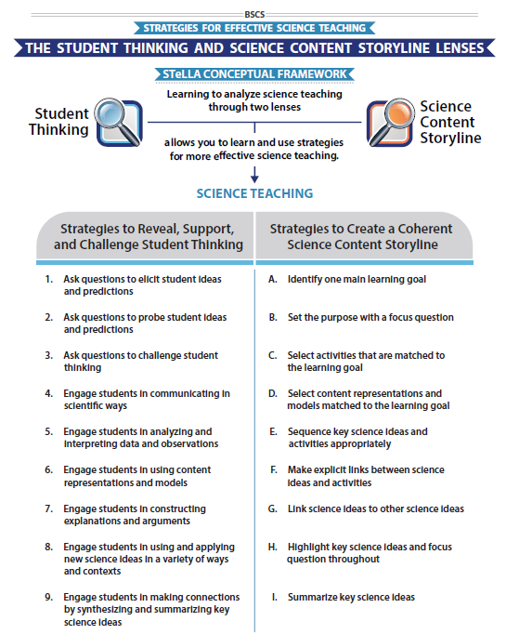
STeLLA Conceptual Framework

Slide 9
Science Content Storyline Lens Strategies
A, B, and I
Student Thinking Lens Strategy 9
In your grade level team
Complete the chart for your assigned strategy
Review the charts of others for any clarifications or questions.
SCSL/STL #X
Purpose
Key Features
Purpose: WHY it’s important
Key Features: WHAT does it look like in the classroom
Notes:
6 rooms
Jamboard
**Slide has been updated

Slide 11
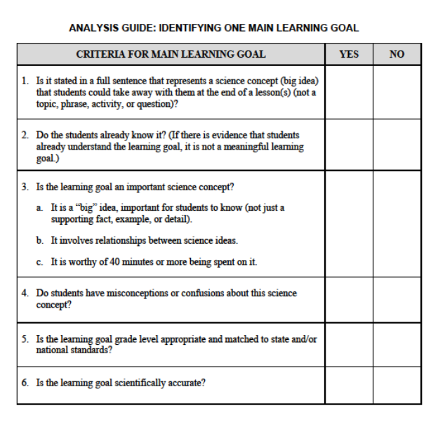
Analysis Guide: Main Learning Goal (p. 3-3)
Analysis guides include
questions that guide analysis,
ways to capture information, and
often, prompts to strengthen the artifact being analyzed.
Notes:
How did the AG support your understanding of the strategy?

Slide 12
Candidate Main Learning Goals
Practice identifying one main learning goal using the MLG Analysis Guide
  Climate and seasons
  Students analyze maps to identify patterns in average temperature in the US.
  Average temperatures are higher near the equator than near the poles at all times of the year.
  Climate and weather are equivalent terms.
  How does the tilt of Earth impact climate and seasons?
  Earth is closer to the Sun in the July than in the January.
  Differential heating of Earth’s surface is due to the spherical shape of Earth which changes the angle at which the Sun’s light strikes the surface.

Slide 13
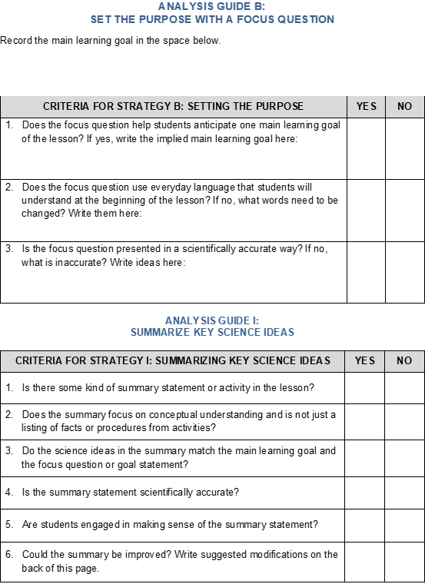
Analysis Guide: Focus Questions
(p. 3-7)
How did the Analysis Guide enhance your understanding of the strategy?
Why do you think the analysis guides for SCSL strategies B and I are on the same page?

Slide 14
Candidate Focus Questions
MLG: Because Earth is a sphere, the Sun’s light hits Earth’s curved surface more directly close to the equator and less directly closer to the poles. The difference in the angle of sunlight striking Earth’s surface at different latitudes creates uneven heating.
Candidate Focus Questions
Which candidate focus question would be best for this main learning goal?

Slide 15
SCSL Strategies A and B
With a partner
Sort the cards to match the main learning goals and focus questions
Compare your organization to that of another group’s.

Slide 16
Analysis Guide: SCSL Strategy B & I,
STL 9 (p. X)
Why do we put the main learning goal at the top of the analysis guide?
How do the questions in the analysis guides link to the development of a coherent science content storyline?

Slide 17
Meta Moment
Journal
How do main learning goals, focus questions, and synthesis/summary support teacher planning for a coherent science content storyline? Student learning?

Slide 18
Lesson Analysis: The Basics (pp. 1-2)
Viewing Basics
Analysis Basics
Viewing Basic #1: Look past the trivial, the little things that “bug” you.
Viewing Basic #2: Avoid the “this doesn’t look like my classroom” trap.
Viewing Basic #3: Avoid making snap judgments about the teaching or learning in the classroom you are viewing.
Analysis Basic #1: Focus on student thinking and the science content storyline
Analysis Basic #2: Look for evidence to support any claims
Analysis Basic #3: Look more than once
Analysis Basic #4: Consider alternative explanations and teaching strategies.
Notes:
Which stand out to you and why?

Slide 19
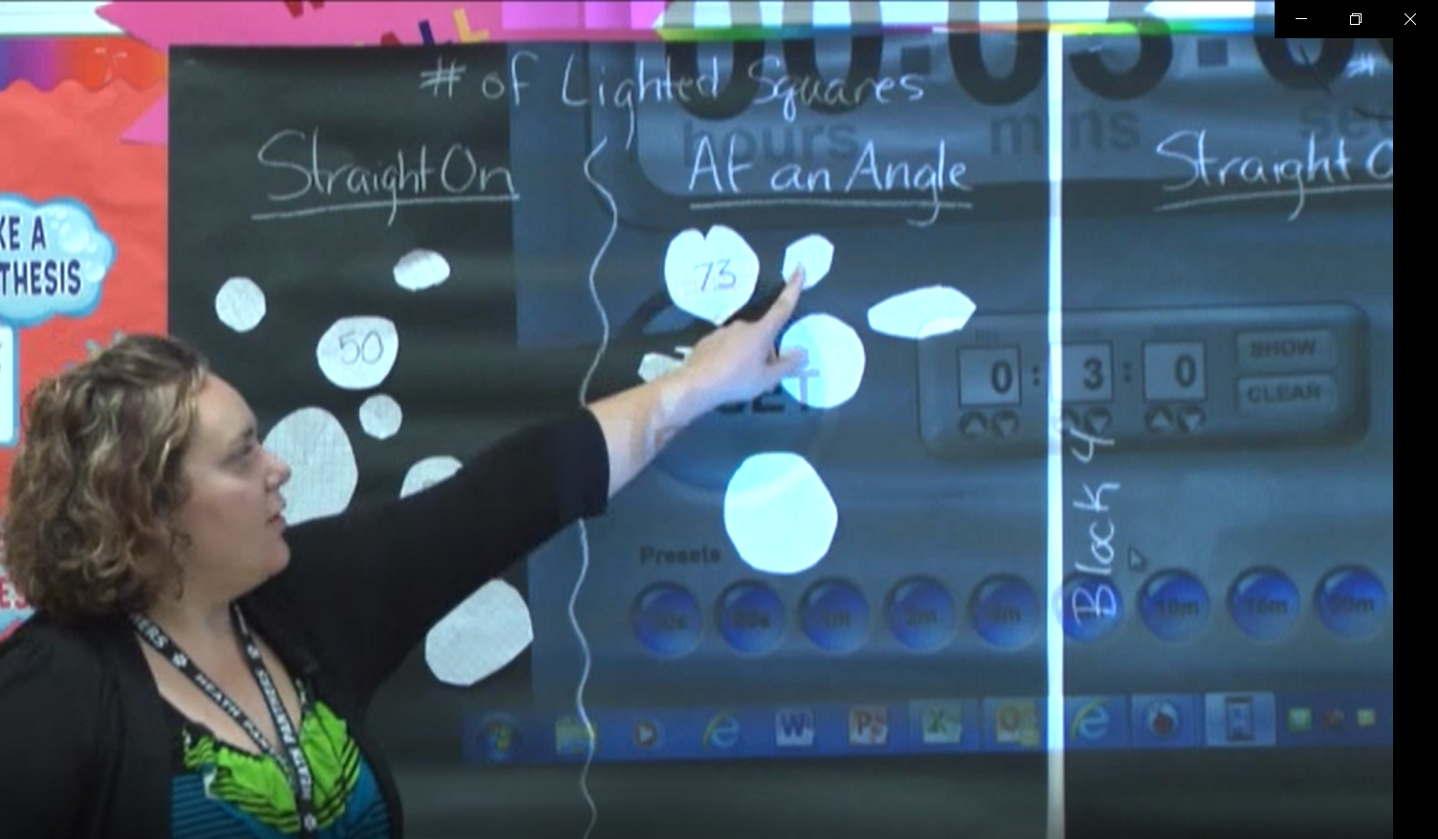
Preparing for Video Analysis: The Context
Lesson Context: This clip is from the second day of lesson 2 of Sun's Effect on Climate and Seasons unit.
Lesson 2 Main Learning Goal:
Because Earth is a sphere, the sun’s light hits Earth’s curved surface more directly close to the equator and less directly closer to the poles. The difference in the angle of sunlight striking Earth’s surface at different latitudes causes uneven heating.
Lesson 2 Focus Question:
What causes the average temperatures on Earth near the equator to be higher than the average temperatures on Earth far from the equator?

Slide 20
Video Analysis: Mawlawi_SECL2
Identify
Analyze
  To what extent does the teacher in the videoclip stay focused on the MLG of the lesson?
  To what extent is the MLG a quality MLG?
Reflect and apply
Add link

Slide 21
Analysis Guide: Main Learning Goal
Analyze
To what extent does the MLG from the videoclip(s) match the MLG identified in the lesson?
To what extent is the MLG a quality goal?

Slide 22
Video Analysis: Mawlawi_SECL2
Identify
Analyze
  To what extent does the teacher in the videoclip stay focused on the MLG of the lesson?
  To what extent is the MLG a quality MLG?
Reflect and apply
  What did you learn from analyzing this video clip that you can apply to your own classroom?
Notes:
n your journal,

Slide 23
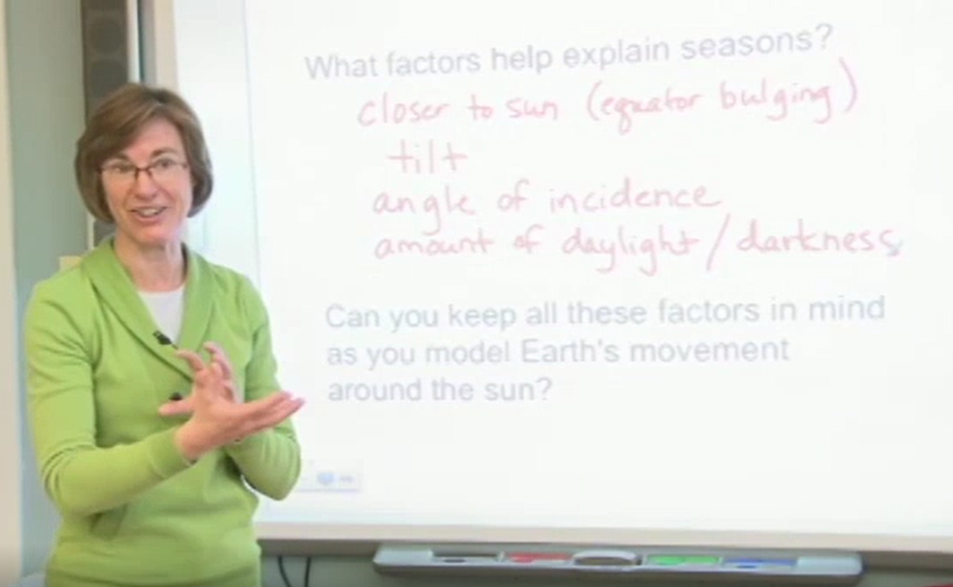
Preparing for Video Analysis: The Context
Lesson Context:
Clip 2 is from the beginning of lesson 6 of an early version of the Sun's Effect on earth's Climate and Seasons. Clip 3 is from the end of the lesson.

Slide 24
Video Analysis: Hannigan C2-3 SCSL B/I-STL 9
Identify
  What instances do you observe of SCSL Strategies B & I/STL Strategy 9?
Analyze
Reflect and apply
Add link

Slide 25
Analysis Guide: SCSL Strategy
B & I/
STL 9
Analyze Part 1
What is the quality of the focus question and synthesis/summary highlighted in the videoclips?

Slide 26
Video Analysis: Hannigan C2-3 SCSL B/I-STL 9
Identify
  What instances do you observe of SCSL Strategies B & I/STL Strategy 9?
Analyze
Reflect and apply
  What did you learn from analyzing this video clip that you can apply to your own classroom?
Notes:
n your journal,

Slide 27

Content Deepening: Teacher
Set-up
What were the focus questions and main learning goals for Lessons 1, 2, and 3?
How were the lessons synthesized and summarized?
How would you tell the story of the unit so far?
Lesson 4 Focus Question
Why is it warmer in the summer than in the winter

Slide 28

Explore the Earth-Sun System
Use the provided materials to see if you can tell more of the story…
  Why are some places on Earth hotter than others at different times of the year?

Slide 29
Explanation
Respond to the question and be prepared to share your answer.
  Why are some places on Earth hotter than others at different times of the year?
Now think about these two phenomena:
  Places on Earth near the equator tend to have higher average temperatures; places near the poles tent to have lower average temperatures.
  Places in the northern hemisphere tend to have higher average temperatures from Jun-Aug and lower average temperatures from Dec-Feb. Places in the southern hemisphere tend to have lower average temperatures from Jun-Aug and higher average temperatures from Dec-Feb.

Slide 30
Explanation
Unit Central Question: Why are some places on Earth hotter than others at different times of the year?
On chart paper, post your group’s response to the unit central question. Include
    a statement that answers the question.
    the evidence you gathered from your investigation and use of models.
    a representation to show how you make sense of what’s happening in the real world.
Test your explanation.
    What would change if Earth’s tilt was less than 23.5 degrees?
    What would change if Earth’s tilt was more than 23.5 degrees?

Slide 31
Meta Moment 1
Task/Action | Benefit for Your Learning
Flashlight/tray with representations
Ball and stick physical representation
Ball and stick/hula hoop physical representation
Explanation

Slide 32
Reflection
What can we say now about our unit central question: Why are some places on Earth hotter than others at different times of the year?

Slide 33
Driving Question Board (DQB)
?
?
?
?
?
?
?
?
?
?
?
?
?
?
?

Slide 34
Content Deepening: Teacher Follow-up
What could one learn from this experience?

Slide 35
STeLLA Conceptual Framework

Slide 36
Identifying Strategies in Our Content Experiences
How did the PD Leader model the use of Strategies A, B, I and 9 in our content experience today?
If you were to construct a MLG from our content experiences today, what would it be?
What was the focus questions for the content experiences today?
  How did the FQs set you up for the learning?
How did you experience synthesizing and summarizing?

Slide 37
Meta Moment
Journal…
What would you add to our effective science T&L chart?
How do these strategies help teachers plan for coherence? How do these strategies help students develop the intended science content storyline?

Slide 38
Effective Science Teaching & Learning
What does effective science teaching and learning look like?
  What are teachers doing?
  What are students doing?
  What is the classroom like?
Teachers Doing | Students Doing
Classroom

Slide 39
Day 3 Focus Questions
Why is one main learning goal (SCSL Strategy A) essential for coherence of the Science Content Storyline?
How does the use of a focus question (SCSL Strategy B) contribute to the coherence of the Science Content Storyline?
How does synthesizing and summarizing key science ideas (SCSL I/STL 9) contribute to the coherence of the science content storyline?
Why is it warmer in the summer than in the winter?

Slide 40
Reflection
Complete the daily reflection

Slide 41
Homework
Read the Strategy Summary documents and complete the Z-fold for purpose and key features for each of the following strategies
  STL Strategy 6: Engage students in developing and using content representations and models (pp. 27-28)
  SCSL Strategy D: Select content representations and models matched to the learning goal (pp. 47-48)

