Slide 1

STeLLA Scale Up and Sustainability Study (SSUP)
Day 4
Science Teachers Learning From Lesson Analysis

Slide 2
Day 3 Reflections
Add day 3 reflections

Slide 3
STeLLA Norms
The Basics
Arrive prepared and on time; stay for the duration
Remain attentive, thoughtful, and STeLLAful; eliminate interruptions (turn off cell phones, email)
Make room for participation from all (monitor your floor time)
The Heart of STeLLA Lesson Analysis
Keep the goal in mind: We are analyzing teaching to improve student learning
Share your ideas, uncertainties, confusions, disagreements, questions—open up time so this can happen!
Expect and ask questions to deepen everyone’s learning—honor needs!
Purpose: Build trust and develop a productive study group for all participants

Slide 4
STeLLA Program Goals
Deepen knowledge of teaching and learning
Increase ability to analyze and reflect on teaching and learning
Increase ability to use content knowledge and knowledge of teaching and learning to transform classroom practice
Deepen teacher content knowledge
Increase student learning in science

Slide 5
Week-at-a-Glance
Day 1 | Day 2 | Day 3 | Day 4 | Day 5
 | Opening | Opening | Opening | Opening
Opening | Lesson Analysis Purpose & Key Features STL Strategies 1, 2, 3 | Lesson Analysis Purposes & Key Features SCSL Strategies A, B, I/STL Strategy 9 | Lesson Analysis Purpose & Key Features SCSL Strategy 6/STL D Video Analysis | Lesson Analysis Purpose & Key Features SCSL Strategies F, G, H Video Analysis
Content Deepening through curriculum immersion
 | Content Deepening Teacher Set-up |  | Content deepening through curriculum immersion | Lesson Analysis: Tell the Story
Lunch | Lunch | Lunch | Lunch | Working Lunch: Prepare for Study Groups
Content deepening through curriculum immersion | Content deepening through curriculum immersion | Content deepening through curriculum immersion | Content deepening through curriculum immersion | Synthesize & Summarize: Represent the Lenses Strategies
Lesson Analysis Purpose & Key Features STL Strategy 4 | Lesson Analysis Purpose & Key Features STL Strategies 1, 2, 3 |  | Unit Study/Lesson Plan Review | Closing
Closing & HW STL 1, 2, 3 (read and Z-fold) | Closing & HW SCSL A, B, I/STL 9 (read & Z-fold) | Closing & HW STL 6/SCSL D (read & Z-fold) | Closing & HW SCSL F, G, H (read & Z-fold) Study unit & assigned lesson

Slide 6
Day 4 Focus Questions
Why are summer days longer than winter days? How does the amount of daylight affect the temperature of an area?
Why are some places on Earth hotter than others at different times of the year?
How can developing and using content representation and models selected for their match to the main learning goal help students explain phenomena or solve problems?
How does the intentional use of Student Thinking Lens Strategies support a classroom culture of making thinking visible?

Slide 7
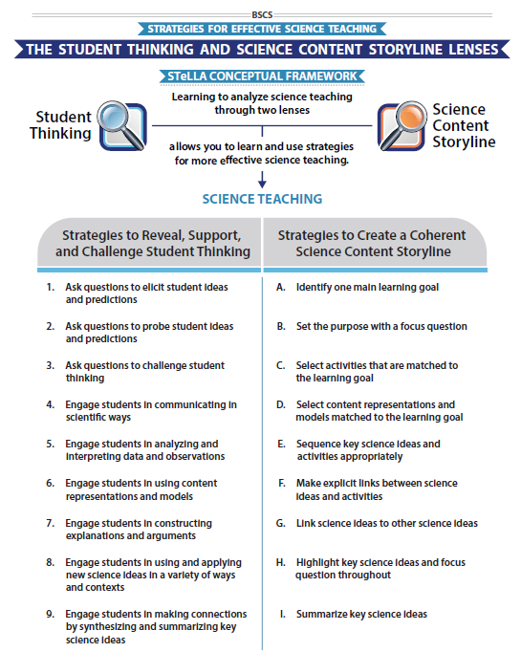
STeLLA Conceptual Framework

Slide 8
Science Content Storyline Lens Strategy D
Student Thinking Lens Strategy 6
SCSL/STL #X
Purpose
Key Features
Complete the chart for your assigned strategy
Review the charts of others for any clarifications or questions.
Purpose: WHY it’s important
Key Features: WHAT does it look like in the classroom
Notes:
6 rooms
Jamboard
**Slide has been updated

Slide 9
Analysis Guide: Content Reps & Models
Review the Analysis Guide for Strategy D.
What would you expect to find in a high-quality content representation or model?
Notes:
Jigsaw

Slide 10
Using the Analysis Guide: Models & Content Reps
What were the main learning goal and focus question for the Lesson 3 content deepening experience?
What science ideas were highlighted in the Lesson 3 experience?
Using your analysis guide, consider how well the system diagrams were matched to the main learning goal?

Slide 11
Using the Analysis Guide: Models & Content Reps
Use the analysis guide to evaluate one of the content representations or models used in your content deepening experience.
Notes:
Use UPDATED analysis Guide for strategy C
MLG L5 ET: Energy can be transformed—it can change from potential energy to kinetic energy.
FQ L5 ET: Where does the energy of a moving object come from?

Slide 12
Reflection
Journal…
How might the use of analysis guides develop teachers’ habits of mind in lesson planning?

Slide 13
Lesson Analysis: The Basics (pp. 1-2)
Viewing Basics
Analysis Basics
Viewing Basic #1: Look past the trivial, the little things that “bug” you.
Viewing Basic #2: Avoid the “this doesn’t look like my classroom” trap.
Viewing Basic #3: Avoid making snap judgments about the teaching or learning in the classroom you are viewing.
Analysis Basic #1: Focus on student thinking and the science content storyline
Analysis Basic #2: Look for evidence to support any claims
Analysis Basic #3: Look more than once
Analysis Basic #4: Consider alternative explanations and teaching strategies.
Notes:
Which stand out to you and why?

Slide 14
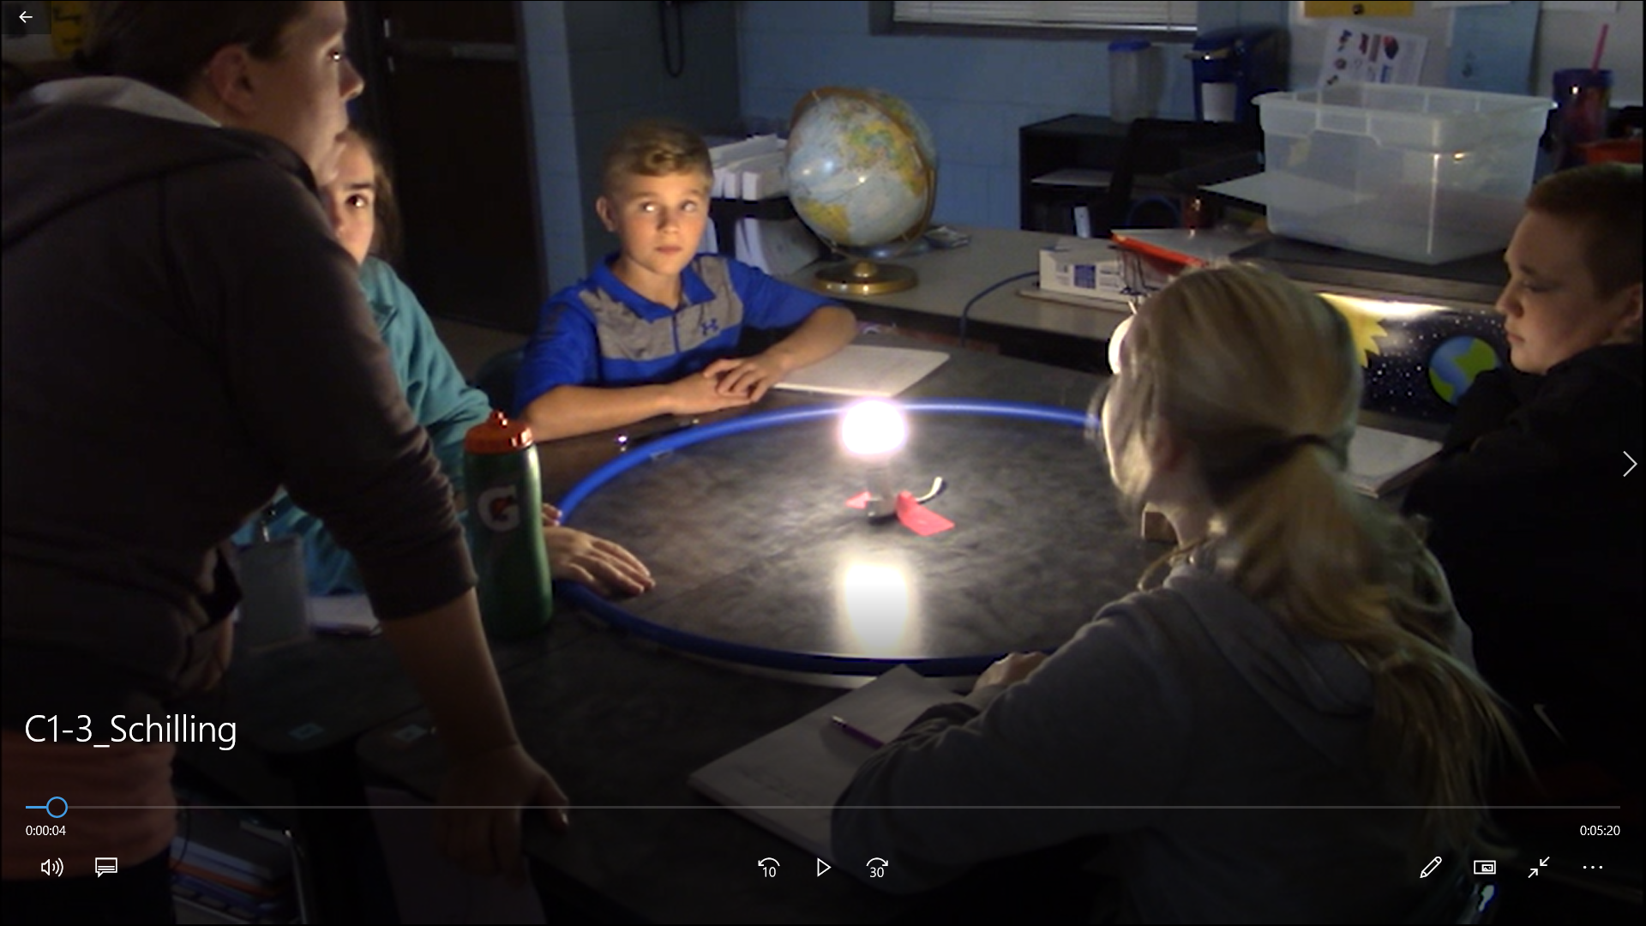
Preparing for Video Analysis: The Context
Lesson Context:
Lesson 3 of 7 from the middle school unit (most similar to lesson 4 in the grade 5 unit in three segments)
In the first segment, students work in small groups and use their prior knowledge to manipulate a model to explain seasonal temperature patterns.
The last segment shows the whole group discussion after a small group.

Slide 15
Video Analysis: Schilling, SEC L3
Identify
  What instances of engaging student in developing and using content representations or models do you observe?
  What instances do you observe of STL strategies elicit, probe, and/or challenge questions?
Analyze
Reflect and apply
Add link

Slide 16
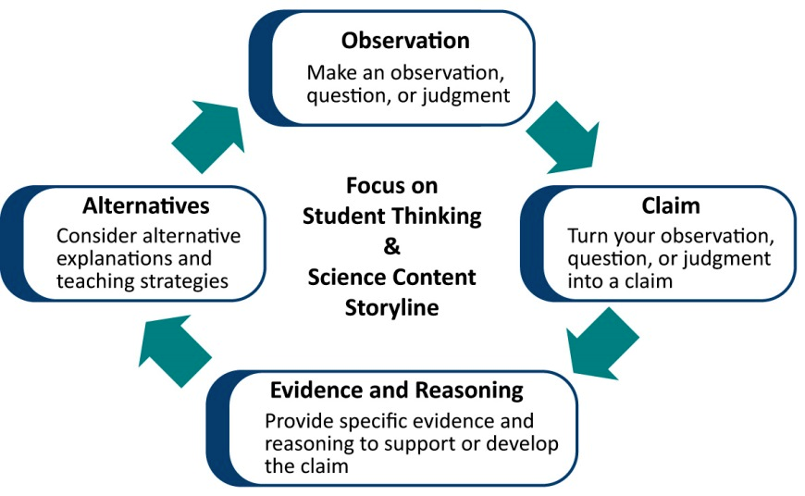
Learning from Lesson Analysis
Notes:
Reconnect to the process we used yesterday for analyzing the clips. Use this to transition to the new LAP tool being introduced.

Slide 17
Lesson Analysis Protocol
Add link
Notes:
Include image of appropriate LAP—be sure Identify and Analyze questions match the LAP from the appropriate video and lesson set.

Slide 18
Lesson Analysis Protocol:
Belcastro SEC Lesson 4 Clip 1
1. Identify the Lens & Strategy What instances of asking questions that probe and challenge student thinking do you observe? What instances of developing and using models do you observe?
2. Analyze the Video Using the Analysis Question(s) What do students seem to understand (or not) about the sun’s effect on climate and seasons? How did the use of the identified strategies make student thinking more visible?
Lesson Analysis Step | To Do | Your Analysis
Claim | Turn an observation, question or judgment into a specific claim that responds to the focus question. | MY CLAIM: This group of students uses the model of the Earth-Sun system to reason about the patterns of temperatures on Earth at different times of the year. They reason with the model (physical representation) to help negotiate their understanding that the amount of light hitting the northern hemisphere, southern hemisphere, and equator at different positions in Earth’s orbit influences the seasons in the hemispheres. They seem to have at least the beginnings of scientifically accurate understanding of a causal explanation of patterns in temperature at different times of the year.
Evidence and Reasoning | Point to a specific place in the video transcript, lesson plan, or student work that supports your claim. Connect your claim and evidence with reasoning based on STeLLA Strategies, research on learning, your teaching experience, or scientific principles. Also look for evidence that challenges your claim. | MY EVIDENCE: For example, after the teacher’s challenge question for students to use their vocabulary words at 50.2, two different students talk about the equator and northern hemisphere getting more light than the southern hemisphere when the Earth is at position 1. Christina says “more on the equator” and “it’s also more bright on the northern hemisphere” at 1:10.2-1:06.2. Another boy says, “it’s [sunlight’s] not as much [in the southern hemisphere] at 1:18.0. From 1:25.8 through 3:13.0 two students have different ideas about what is happening to Earth at position 3 and then seem to negotiate an accurate understanding using words like “more bright” and “not as much” to describe the amount of sunlight or directness of sunlight at different places. MY REASONING: According to the NGSS, when students are developing and using models they are engaging with models that can be content representations or physical representations, think about the strengths and limitations of the model in comparison to the real world, and reason with the model. In this clip, Students reason with models. Students use the word “because” to link their observations (of light and maybe patterns identified earlier) that places near the equator are warmer because they get more sunlight and that because of the amount of sunlight, the northern hemisphere is in summer when the North Pole is pointing toward the Sun and the southern hemisphere is in winter when the North Pole is pointing toward the Sun with each having opposite seasons when the North Pole is pointed away from Sun.
Alternatives | Consider an alternative interpretation or explanation. Consider new questions this might raise. Consider alternative question(s), activity(s), or strategies. | I wonder how she’ll help students use this model (and others) to get at the influence of day length on avg. temperatures at different times of year. I wish that the kids could have left the model on the floor so the sun didn’t move so much! I wonder how she sets up her classroom so that students work together!
3. Reflect on Lessons Learned from the Process Teachers reflect on the experience.
Notes:
Add notes about introducing the LAP

Slide 19
Lesson Analysis Protocol
Add link
Notes:
Include image of appropriate LAP—be sure Identify and Analyze questions match the LAP from the appropriate video and lesson set.

Slide 20
Day 4 Focus Questions
Why are summer days longer than winter days? How does the amount of daylight affect the temperature of an area?
Why are some places on Earth hotter than others at different times of the year?
How can developing and using content representation and models selected for their match to the main learning goal help students explain phenomena or solve problems?
How does the intentional use of Student Thinking Lens Strategies support a classroom culture of making thinking visible?

Slide 21

Content Deepening: Teacher Set-up
What can students say so far about why some places on Earth are hotter than others at different times of the year?
  What ideas will they “have”?
  What ideas will they struggle with?
What other factors need to be considered?
Notes:
Slides 9 – 11 are placeholders for the anchor lesson slides

Slide 22

Lesson 5
Focus Question
Why are summer days longer than winter days? How does the amount of daylight affect the temperature of an area?

Slide 23
Day Length
Use the physical model from Lesson 4 to show another group why summer days are longer than winter days?
Use the physical model from Lesson 4 to show another group how day length influences temperature in a particular area.

Slide 24
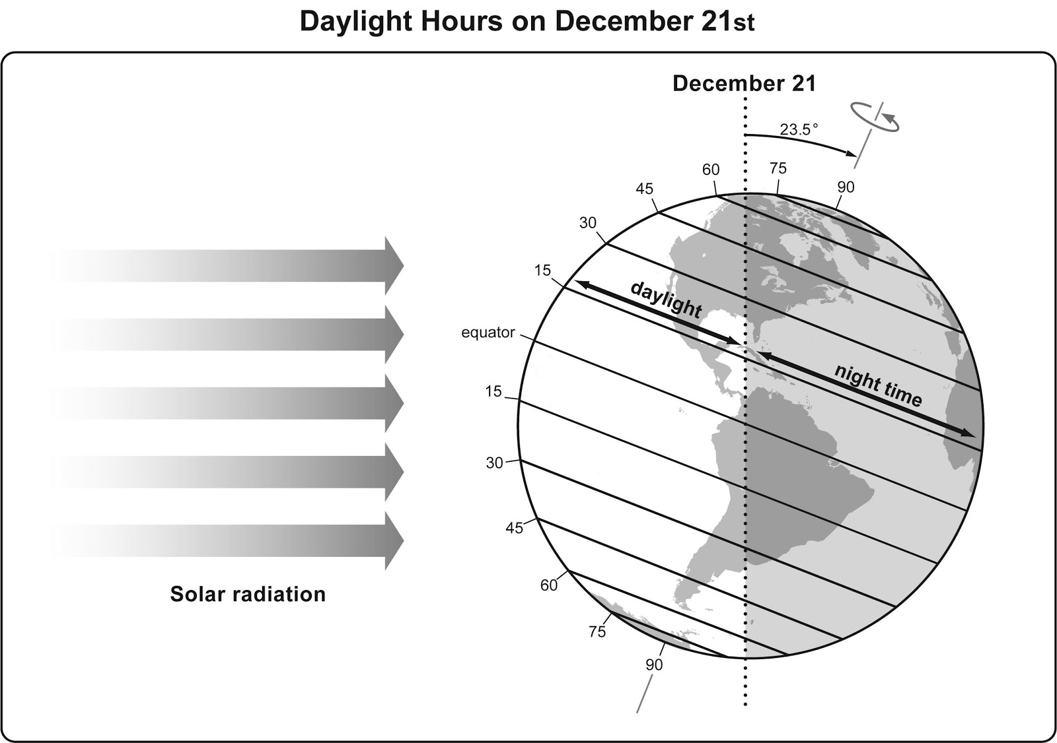
Using Data and Representations
What do you notice about the representation of the Earth?

Slide 25
Using Data and Representations
Discuss the following questions in your teams.
  How does length of day change with latitude? (Share two examples.)
  Are parts of Earth always dark? If yes, use latitude to describe where.
  Are parts of Earth always in light? If yes, use latitude to describe where.
  At which latitude is there equal lengths of day and night?

Slide 26
Lesson 5
Focus Question
Why are summer days longer than winter days? How does the amount of daylight affect the temperature of an area?

Slide 27
Bringing it all together….
Unit Central Question: Why are some places on Earth hotter than others at different times of the year?
What key science ideas were developed in each lesson?
Lesson 1
Lesson 2
Lesson 3
Lesson 4
Lesson 5

Slide 28
Bringing it all together….
Unit Central Question: Why are some places on Earth hotter than others at different times of the year?
Explanation: Post your group’s response to the unit central question on chart paper
  Include a statement that answers the question.
  Include the evidence you gathered from your investigations and use of models.
  Include a representation to show how you make sense of what’s happening in the real world.

Slide 29
Driving Question Board (DQB)
?
?
?
?
?
?
?
?
?
?
?
?
?
?
?

Slide 30
Scenarios: Use and Apply Your Ideas
What causes the average temperature of Lagos, Nigeria to be higher in July when it gets ~12 hours of sunlight than the average temperature in Anchorage, AK when it gets ~24 hours of sunlight/day in July?
Choose one other challenge.

Slide 31
Meta Moment
How did developing and using models support your learning throughout this unit?

Slide 32
Content Deepening: Teacher Follow-up
Find your Mash-up handout that you “dotted” at the beginning of the week.
Re-dot the statements now that you have experienced the lessons in your unit.
  Green dot: science idea (accurate statement)
  Yellow dot: uncertain
  Red dot: common student idea (inaccurate statement)
Go public!
  Add dots to the right side of the poster.
Notes:
Slides 9 – 11 are placeholders for the anchor lesson slides

Slide 33
Common Student Ideas
If you are still unsure of the ideas on the mash-up use
  Common Student Ideas
  Content Deepening document

Slide 34
Day 4 Focus Questions
Why are summer days longer than winter days? How does the amount of daylight affect the temperature of an area?
Why are some places on Earth hotter than others at different times of the year?
How can developing and using content representation and models selected for their match to the main learning goal help students explain phenomena or solve problems?
How does the intentional use of Student Thinking Lens Strategies support a classroom culture of making thinking visible?

Slide 35
Unit Review
What would you expect to see in a model STeLLA unit of instruction?
Read
  Unit Overview
  Your assigned lesson plan
Be prepared to “tell the science story” of your lesson as we build the storyline across the unit.
Be prepared to share how your lesson is similar to and different from what you experienced this week.

Slide 36
Revisit:
Effective Science Teaching & Learning
What does effective science teaching and learning look like?
  What are teachers doing?
  What are students doing?
  What is the classroom like?
Teachers Doing | Students Doing
Classroom

Slide 37
Reflection
We have been discussing and using content representations and models. How has their use impacted your own learning about energy?
How has your understanding of elicit, probe, and challenge questions been refined through our work today?
How does the teacher’s use of elicit, probe, and challenge questions influence students’ ability to productively develop and use content representations and models to make sense of phenomenon?

Slide 38
Homework
Read the Strategy Summary documents and complete the Z-fold for purpose and key features for each of the following strategies
  SCSL Strategy F: Make explicit links between science ideas and activities (pp. 53-56)
  SCSL Strategy G: Link science ideas to other science ideas (pp. 57-58)
  SCSL Strategy H: Highlight key science ideas and focus questions throughout (pp. 59-60)
Read and be prepared to tell the story of your assigned lesson from the Unit Review

