Slide 1
STeLLA Scale Up and Sustainability Study (SSUP)
Day 2
Science Teachers Learning From Lesson Analysis

Slide 2
Day 1 Reflections
Add ideas from participants’ day 1 reflections

Slide 3
STeLLA Program Goals
Deepen knowledge of teaching and learning
Increase ability to analyze and reflect on teaching and learning
Increase ability to use content knowledge and knowledge of teaching and learning to transform classroom practice
Deepen teacher content knowledge
Increase student learning in science

Slide 4
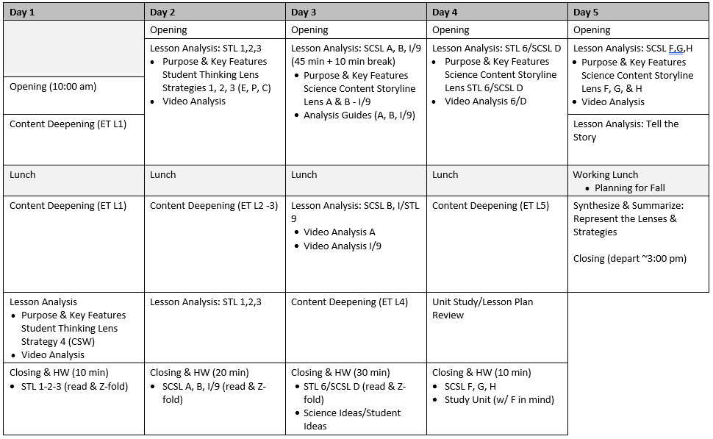
Week-at-a-Glance

Slide 5
Reconnections
How did you/we do with the STeLLA norms yesterday?
What could we add or modify in the norms to strengthen our community?

Slide 6
STeLLA Norms
The Basics
Arrive prepared and on time; stay for the duration
Remain attentive, thoughtful, and STeLLAful; eliminate interruptions (turn off cell phones, email)
Make room for participation from all (monitor your floor time)
Purpose: Build trust and develop a productive study group for all participants
The Heart of STeLLA Lesson Analysis
Keep the goal in mind: We are analyzing teaching to improve student learning
Share your ideas, uncertainties, confusions, disagreements, questions—open up time so this can happen!
Expect and ask questions to deepen everyone’s learning—honor needs!

Slide 7
Day 2 Focus Questions
How can lesson analysis help us better understand how elicit, probe, and challenge questions reveal and challenge student thinking?
How can we develop a classroom culture focused on student thinking?
What happens to motion energy when objects collide?
How can we change the amount of motion energy of an object?

Slide 8
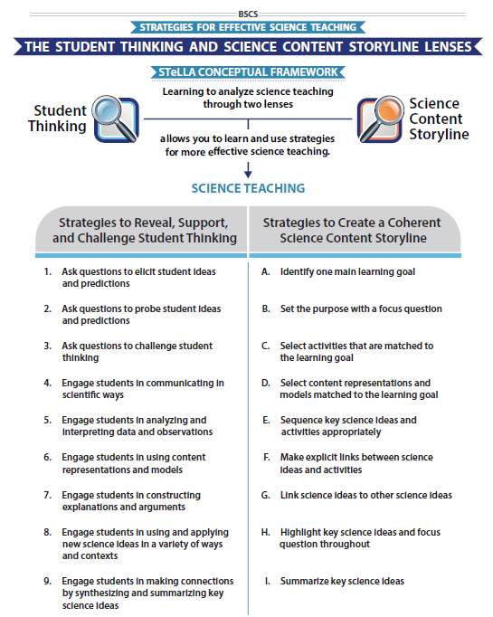
STeLLA Conceptual Framework

Slide 9
Student Thinking Lens Strategies 1, 2, and 3
Use your Z-fold to discuss the purposes and key features of
STL Strategy 1: Ask questions to elicit student ideas and predictions
STL Strategy 2: Ask questions to probe student ideas and predictions
STL Strategy 3: Ask questions to challenge student thinking
Complete the chart for your assigned strategy
STL #X
Purpose
Key Features
Purpose: WHY it’s important
Key Features: WHAT does it look like in the classroom
Notes:
6 rooms
Jamboard
**Slide has been updated

Slide 10
Elicit vs Probe Questions
What are some key differences between questions that elicit and questions that probe student ideas and predictions?

Slide 11
Probe vs. Challenge Questions
What are some key differences between questions that probe student ideas and predictions and questions that challenge student thinking?
What are leading questions? What does the strategy document say about this type of question?

Slide 12
Meta Moment
How has your thinking changed about these three questioning strategies?
Update your Z-fold

Slide 13
Preparing for Video Analysis: The Process
Identify - to create a shared understanding of the strategy
Analyze - to consider the influence of the use of strategy on student thinking and learning
Reflect and apply - to make the strategy part of our own practice
Notes:
We watch classroom video for 4 main purposes:
We’ve all read the strategy, but may have different mental images of what the strategies would look like in practice. The first role of video analysis is to make sure we have a common vision of the strategy - that we mean the same thing when we say the words selecting and engaging students with content representations and models. In the identify phase, we will make sure that we all see the same thing when we are talking about the strategy.
The second goal of video analysis is to see the potential of the strategy to impact student learning. We each have limited experiences in the classroom, and may not have thought about how our actions as teachers impact students’ opportunities to learn. In the analysis phase, we will consider the impact of the strategy on student thinking, and hone our skills as we develop a “student thinking lens.” To do this we make a claim about either the interesting student thinking made visible in the clip, or how the strategy influenced students’ ways of thinking.
Alternate 2: The second goal of video analysis is to see the potential of the strategy to impact student learning. We each have limited experiences in the classroom, and may not have thought about how our actions as teachers impact students’ opportunities to learn. In the analysis phase, we will consider the impact of the strategy on the classroom. In the case of these three strategies within the “science content storyline lens,” we want to think about where we see evidence of teacher planning and preparation that took these strategies into account and whether that preparation has an impact on student learning. To do this we make a claim about either the interesting student thinking made visible in the clip, or how we observed the strategy in practice..
In the analysis phase, we might also consider alternatives, what might I have done differently in this situation? Where would I like to know more about what a student is thinking or clarify what they mean. We might consider multiple ways of interpreting the teaching and learning in the selection. We’ll dig deeper into the analysis phase in future video analysis opportunities, but if you want to know more, refer to pg. 2 of the strategy document for norms for analysis.
The last goal of video analysis is to transfer what you learn by watching other teachers or discussing the strategy in action with your colleagues is to reflect and apply new learning to your own teaching practice.
This is a quick overview of the process we will use when viewing classroom video: Identify, Analyze, Reflect and Apply

Slide 14
Preparing for Video Analysis: The Context
This is an interview with a high school student who has previously taken a high school chemistry course but had no previous courses in physics. The interviewer is trying to find out what this student thinks about energy and how it changes using an example of a hand crank flashlight.
Jody Bintz/Chandler Pre-interview

Slide 15
Video Analysis: Bintz/ Chandler Pre-Interview
Identify
What instances do you observe of STL strategies elicit, probe, and/or challenge questions?
Analyze
Reflect and apply
Add link

Slide 16
Video Analysis: Bintz/ Chandler Pre-Interview
Identify
What instances do you observe of STL strategies elicit, probe, and/or challenge questions?
Analyze
How did the interviewer’s use (or not) of elicit, probe, and/or challenge questions influence student predictions, ideas or thinking?
Reflect and apply
Notes:
n your journal,

Slide 17
Video Analysis: Bintz/ Chandler Pre-Interview
Identify
What instances do you observe of STL strategies elicit, probe, and/or challenge questions?
Analyze
How did the interviewer’s use (or not) of elicit, probe, and/or challenge questions influence student predictions, ideas or thinking? scientists?
Reflect and apply
What did you learn from analyzing this video clip that you can apply to your own classroom?
Notes:
n your journal,

Slide 18
Preparing for Video Analysis: The Context
This clip is from Lesson 1 of 5 in the Energy, Every Day, Everywhere unit.
In this lesson students are introduced to the anchoring phenomenon, a toy car launcher system. Students first share what they know and wonder about energy, explore the car launcher system, and develop a Driving Question Board.
In this clip, the students are sharing their initial ideas about the lesson Focus Question, “How do we know if something has energy?”

Slide 19
Video Analysis: SSUP_ET_KY GR4_SG1_L1_Osborne_C1
Identify
What instances do you observe of Student Thinking Lens Strategies elicit, probe, and/or challenge questions?
Analyze
Reflect and apply
Add link

Slide 20
Video Analysis: SSUP_ET_KY GR4_SG1_L1_Osborne_C1
Identify
What instances do you observe of Student Thinking Lens Strategies elicit, probe, and/or challenge questions?
Analyze
How did the teacher’s use (or not) of elicit, probe, and/or challenge questions influence student predictions, ideas or thinking?
What interesting student thinking was made visible?
Reflect and apply
Notes:
n your journal,

Slide 21
Video Analysis: SSUP_ET_KY GR4_SG1_L1_Osborne_C1
Identify
What instances do you observe of Student Thinking Lens Strategies elicit, probe, and/or challenge questions?
Analyze
How did the teacher’s use (or not) of elicit, probe, and/or challenge questions influence student predictions, ideas or thinking?
What interesting student thinking was made visible?
Reflect and apply
What did you learn from analyzing this video clip that you can apply to your own classroom?
Notes:
n your journal,

Slide 22
Meta Moment
Journal….
What ideas do you want to add to your effective teaching and learning charts?
How did the experience…

Slide 23
Content Deepening: Teacher Set-up
What is the story of learning so far....
Open your science notebook to review the learning from L1/Day 1.
Turn to a partner and practice telling the story of student learning.

Slide 24
Content Deepening: Teacher Set-up
Lesson 1: How do we know if something has energy?
Lesson 2: What happens to motion energy when objects collide?
Lesson 3: How can we change the amount of motion energy of an object?

Slide 25
Energy, Every Day, Everywhere
Lesson 2
Patterns of Energy in Collisions

Slide 26
Unit Central Question: How does the energy of an object or system change?

Slide 27
Focus Question
What happens to energy when objects collide?

Slide 28
Marble – ruler system
Identify the parts of the marble – ruler system.
What observable changes are happening in the system?

Slide 29
Representing energy in the system
Draw a representation of the red marble before and after the push
Before the push
After the push

Slide 30
Energy bars can represent energy
No energy
Some energy
Lots of energy

Slide 31
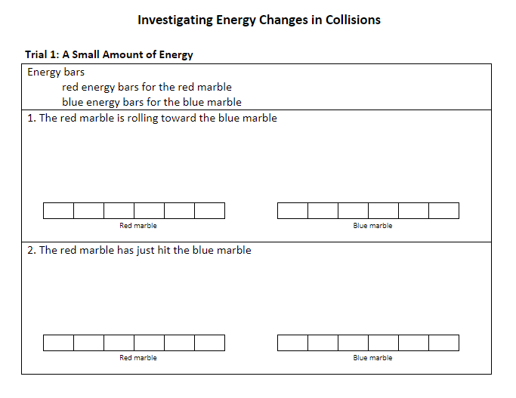
Investigating energy changes in collisions

Slide 32
Science ideas we've figured out
Science Ideas We've Figure Out
-
-
-
-
-

Slide 33
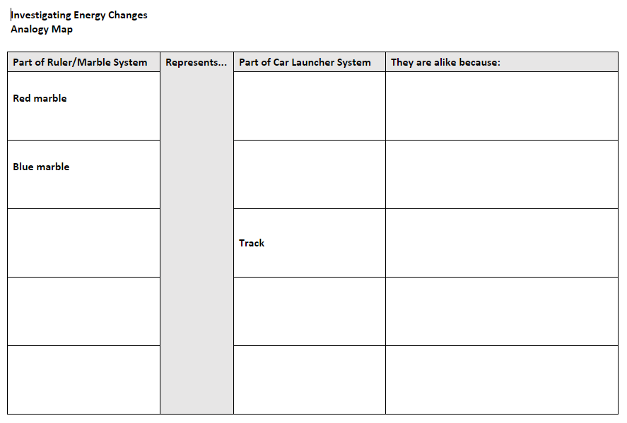
Analogy Map - comparing systems

Slide 34
Focus Question
What happens to energy when objects collide?

Slide 35
Next steps
Are there other ways to change the amount of motion energy of an object?

Slide 36
Break
See you "tomorrow"!

Slide 37
Energy, Every Day, Everywhere
Lesson 3
Predicting Changes in Energy

Slide 38
Unit Central Question
How does the energy of an object or system change?

Slide 39
Focus Question
How can we change the amount of motion energy of an object?

Slide 40
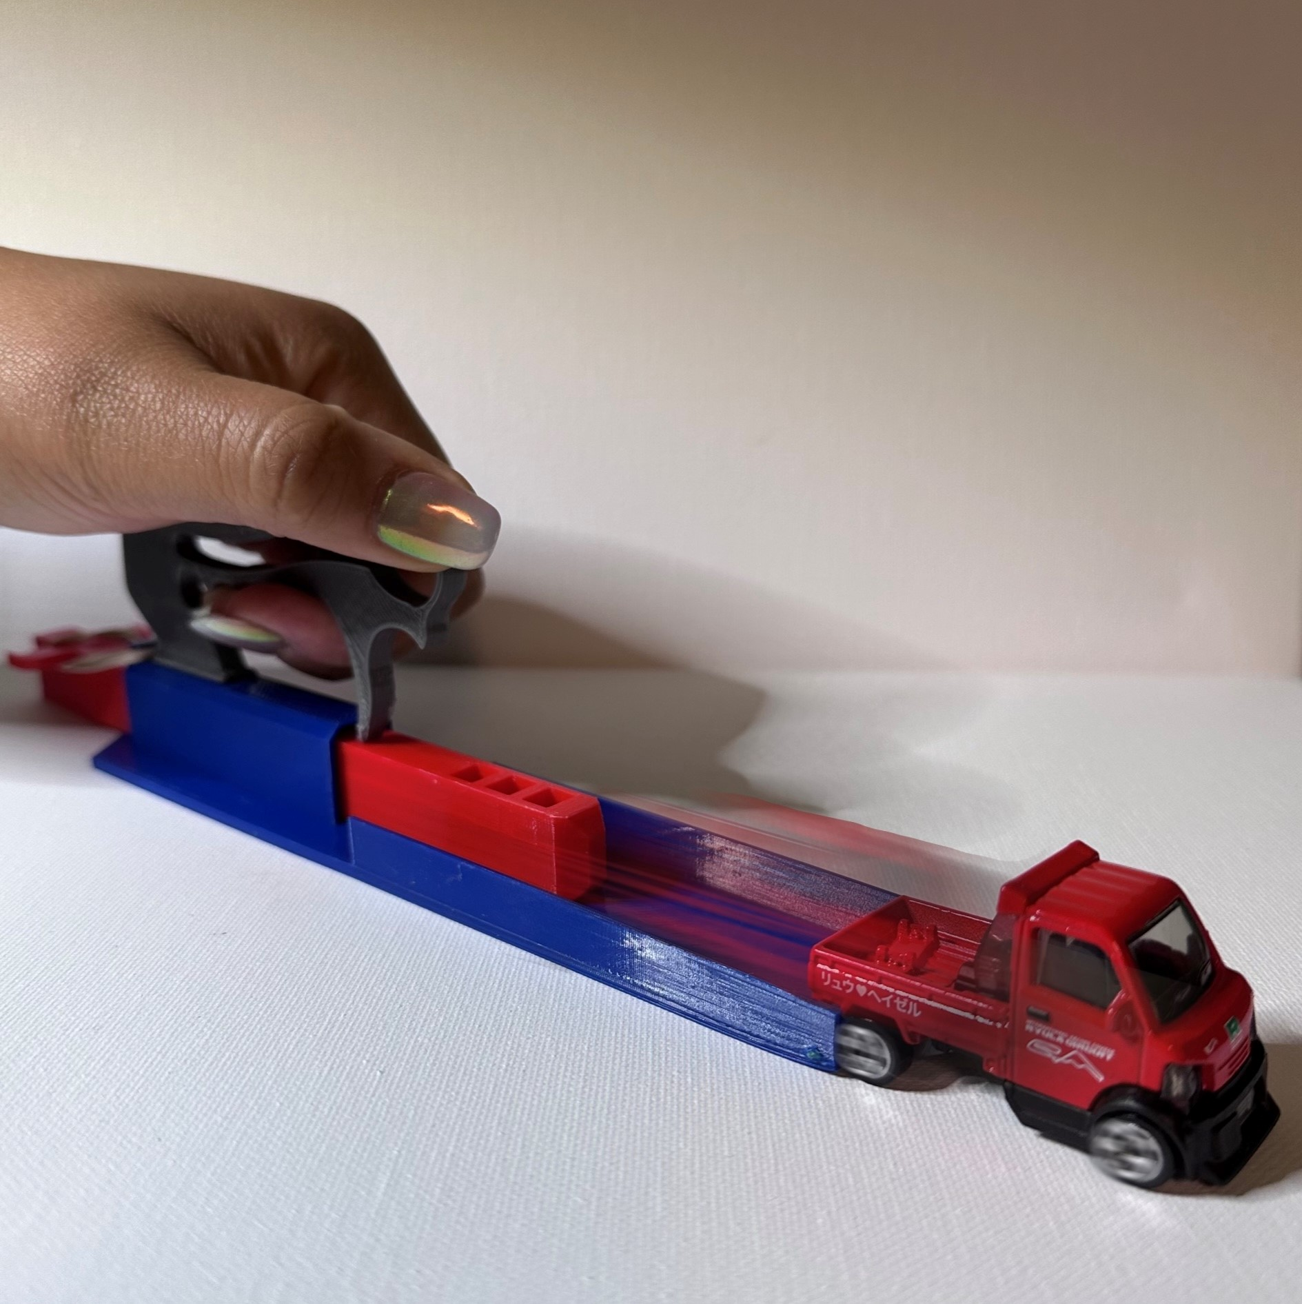
Changing energy: car launcher system

Slide 41
Changing energy: marble – ruler system
How could we change the amount of energy in the marble – ruler system?

Slide 42
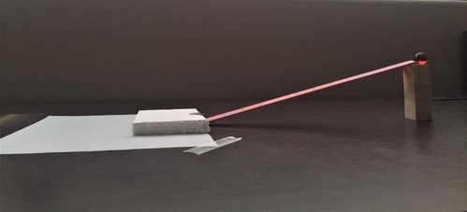
Marble – ruler system

Slide 43
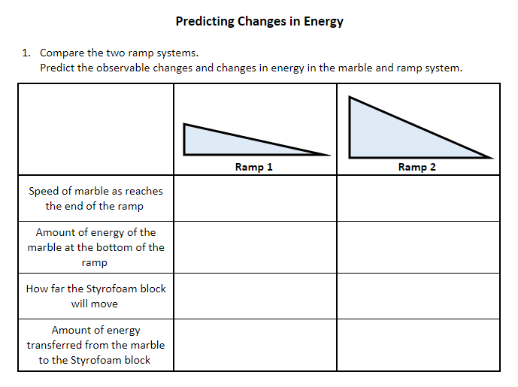
Predicting changes in energy

Slide 44
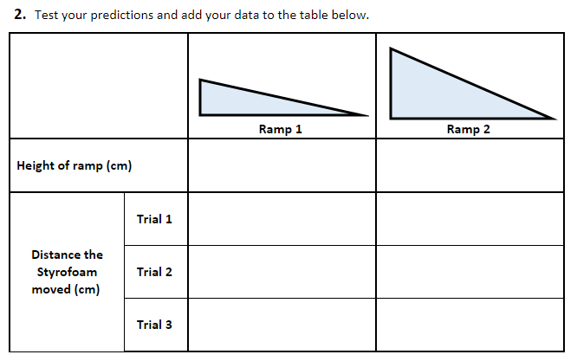
Test your predictions

Slide 45
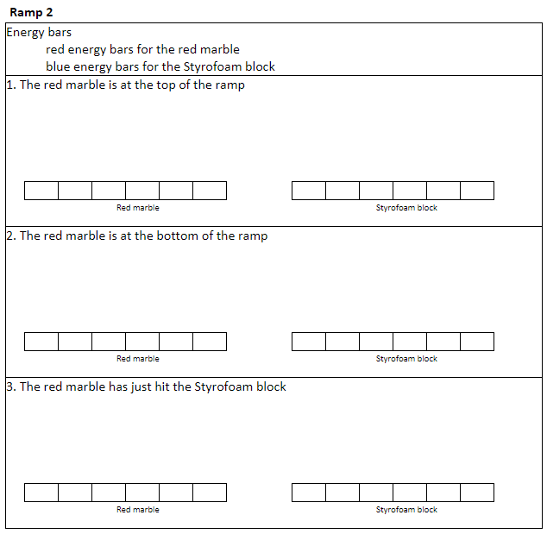
Representing energy with energy bars

Slide 46
Science ideas we've figured out
Science Ideas We've Figure Out
-
-
-
-
-

Slide 47
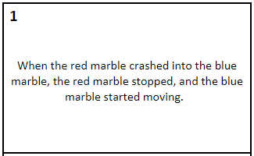
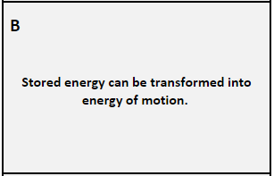
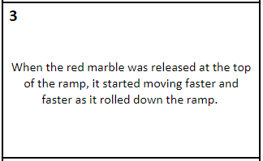
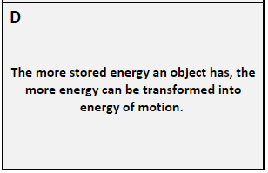
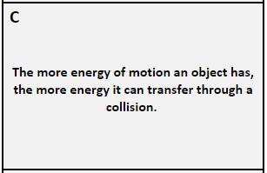
Scientific Explanations: Linking observations and science ideas
Match the observed change in the system with a science idea

Slide 48
Focus Question
How can we change the amount of
motion energy of an object?

Slide 49
Driving Question Board (DQB)
?
?
?
?
?
?
?
?
?
?
?
?
?
?
?

Slide 50
Next steps
Next class we will investigate...

Slide 51
Content Deepening: Teacher Follow-up
What could one learn through this experience?
What were examples of key elicit, probe, and challenge questions used during lessons 2 and 3?

Slide 52
STeLLA STL Strategies 1, 2, and 3
What are the key similarities & differences between probe and challenge questions? Leading questions?

Slide 53
Practice Probe Questions: Interview Planning
The Task:
Practice using probe questions by posing an elicit question to a partner and then ask ONLY probe questions to find out what your partner thinks.
To prepare:
Read your elicit question.
Think about what ideas may be shared in your partner’s responses.
Plan probe questions.
Practice:
Round 1
Round 2

Slide 54
Group Discussion about the Interviews
How did the interviews go? What was difficult? As an interviewer? As a responder?
What probe questions revealed interesting ideas?
Were any of your questions challenge questions?

Slide 55
Practice Challenge Questions: Interview Planning
The Task:
Practice using challenge questions by posing an elicit question to a partner, asking probe questions, and then ask at least one challenge question to find out what your partner thinks.
To prepare:
Read your elicit question.
Think about what ideas may be shared in your partner’s responses.
Plan probe and challenge questions.
Practice:
Round 1
Round 2

Slide 56
Group Discussion about the Interviews
How did the interviews go? What was difficult? As an interviewer? As a responder?
What probe and challenge questions revealed interesting ideas?
What role does content knowledge play in a teachers’ ability to ask productive probe and challenge questions?

Slide 57
Day 2 Focus Questions
How can lesson analysis help us better understand how elicit, probe, and challenge questions reveal and challenge student thinking?
How can we develop a classroom culture focused on student thinking?
What happens to motion energy when objects collide?
How can we change the amount of motion energy of an object?

Slide 58
Summarize and Synthesize
Journal…
How can lesson analysis [and other experiences] help us better understand how elicit, probe, and challenge questions reveal and challenge student thinking?
How can the STeLLA Student Thinking Lens Strategies (1-2-3-4) help us develop a culture of student thinking in our classrooms?
How could the strategies we’ve learned so far support our planning and enactment of lesson?

Slide 59
Reflection
Complete the Daily Reflection
We are discussing elicit, probe and challenge questions to reveal student thinking. How do these types of questions resonate with your current questioning style? What role do you think the use of these questions play in revealing student thinking? Explain your thinking.
What challenges do you anticipate, or have you encountered when trying to develop a classroom culture that values student thinking? How do you see the STeLLA strategies contributing to a culture that values student thinking?
What was the evidence for energy transfers and energy transformations in the marble/ramp system we used today?

Slide 60
Homework
Read
Introduction to the Science Content Storyline Lens (pp. 39-40)
Student Ideas and Science Ideas Defined (pp. 7-8)
Read and complete the STL & SCSL Z-fold
SCSL Strategy A: Identify one main learning goal
SCSL Strategy B: Set the purpose with a focus question
SCSL Strategy I: Summarize key science ideas
STL Strategy 9: Engage students in making connections by synthesizing and summarizing key science ideas.
Purpose: WHY it’s important
Key Features: WHAT does it look like in the classroom

