Slide 1
STeLLA Scale Up and Sustainability Study (SSUP)
Virtual Session 2
Science Teachers Learning from Lesson Analysis (STeLLA)

Slide 2
Welcome
Share a joy (large or small) that you experienced since we last met.
Share a hope for your STeLLA Program experience.

Slide 3
STeLLA Program Goals
Deepen knowledge of teaching and learning
Increase ability to analyze and reflect on teaching and learning
Increase ability to use content knowledge and knowledge of teaching and learning to transform classroom practice
Deepen teacher content knowledge
Increase student learning in science

Slide 4
Agenda
Opening
The Case for the Science Content Storyline Lens
The Case for the Student Thinking Lens
Closing

Slide 5
STeLLA Norms
Purpose: Build trust and develop a productive study group for all participants
The Basics
Arrive prepared and on time; stay for the duration
Remain attentive, thoughtful, and mindful of our community; eliminate interruptions (turn off cell phones, email)
Make room for participation from all (monitor your floor time)
The Heart of STeLLA Lesson Analysis
Keep the goal in mind: We are analyzing teaching to improve student learning
Share your ideas, uncertainties, confusions, disagreements, questions—open up time so this can happen!
Expect and ask questions to deepen everyone’s learning—honor needs!

Slide 6


Making the Case
Focus Question
What are the STeLLA Lenses and Strategies, and why do we think they will make a difference in your science teaching?

Slide 7
TIMSS Video Study Research Questions
What does science teaching look like in different countries?
What can we learn from looking at science teaching practice in higher-achieving countries?

Slide 8
Comparing the U.S. to Higher Achieving Countries
Czech Republic
Japan
Australia
Netherlands
United States

Slide 9
What makes a difference?
What Science Teaching Looks Like: An International Perspective
What struck you about this article?
What does science teaching look like in different countries?
What can we learn from looking at science teaching practice in higher-achieving countries?

Slide 10
Conceptual Links
Doing activities with no content
Learning content with weak or no conceptual links
Learning Content with strong conceptual links

Slide 11
What does science teaching look like?
Watch two video clips of 8th-grade science
  A U.S. classroom
  A Japanese classroom
What do you notice about these two classrooms?
In which classroom are students more likely to learn? Why do you think so?
U.S. Classroom
Japanese Classroom

Slide 12
Making links: Science Content Storyline Lens
Step 1
Journal: What ideas do you want to add to your effective teaching and learning charts?
Step 2
Read and annotate: First three sections of the Introduction to the Science Content Storyline Lens. (Stop before “What is challenging…)
  What links do you see between the findings in the TIMSS and the Introduction to the Science Content Storyline Lens?

Slide 13
Making the Case
Focus Question
What are the STeLLA Lenses and Strategies, and why do we think they will make a difference in your science teaching?

Slide 14
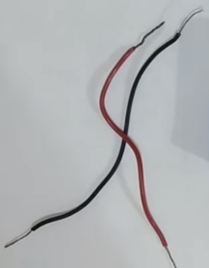
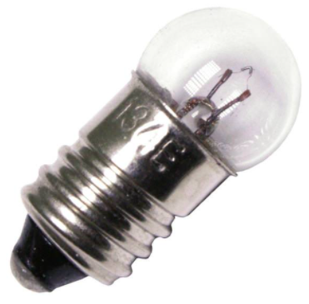
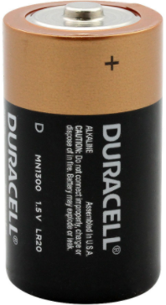
Research about how students learn science
Private science challenge:
    You have a flashlight bulb, a battery, and one piece of wire. With just these materials, can you make the light bulb light up? Why or why not?
    Use pictures and words to explain your thinking.
Notes:
Image sources:
Light bulb image: https://www.lightbulbs.com/product/ge-25354/?source=GooglePPC-ProductAds&gclid=Cj0KCQjw2or8BRCNARIsAC_ppya4RwSfFNjWcfh4swmimrEvx4OZUeIXnZYDXbByOZNQ8LXSic6mum4aAvOMEALw_wcB
Battery image: https://www.batteryjunction.com/mn-1300.html?gclid=Cj0KCQjw2or8BRCNARIsAC_ppybk0DOC05oIp_sZFVYP5LXsaMwQs6MUP1O2gn73Dwu15PK5UlD8VocaAoFZEALw_wcB
Wire image: https://www.youtube.com/watch?v=29c3MVOZueE

Slide 15
Minds of Our Own
As you watch the video, think about:
How do the Harvard graduates answer the question about how to light a bulb with a battery and piece of wire?
How does Jennifer answer this question? Before instruction? After instruction? Toward the end of the interview?
How does Jennifer’s teacher, Mr. Carter, react to Jennifer’s responses?
Discussion question:
What does this video clip communicate about effective science teaching and learning?
https://www.learner.org/series/minds-of-our-own/1-can-we-believe-our-eyes/
Notes:
https://www.learner.org/series/minds-of-our-own/1-can-we-believe-our-eyes/
C1 - 1:23 - 3:53
C2 - 19:35 - 25:48
C3 - 46:26 - 50:16

Slide 16


How People Learn/How Students Learn
Science
Scan the five key findings.
Individually, read your assigned finding(s) and consider the implications for effective science classrooms.
  A = 1 & 4
  B = 2 & 5
  C = 3 & 4 or 5
What are the key ideas communicated by the authors?
How did these findings play out in the circuit video clip?
Be prepared to share your ideas with the group
Notes:
Don’t think we have time for this. Keep the reading in the binder for teacher reference.

Slide 17
Making links: Student Thinking Lens
Step 1
Journal: What ideas do you want to add to your effective teaching and learning charts?
Step 2
Read and annotate: Introduction to the STeLLA Student Thinking Lens
  What links do you see between the findings in Minds of Our Own, How People/Students Learn, and the Introduction to Student Thinking Lens?

Slide 18
Revisit Effective Science Teaching Charts
What new features can we add to our description of effective science teaching?
Are there ideas we should modify or delete?

Slide 19
Making the Case
Focus Question
What are the STeLLA Lenses and Strategies, and why do we think they will make a difference in your science teaching?

Slide 20
Reflection
Complete the Reflection sheet
What are your first reactions to the STeLLA claim that it is important to plan and analyze science teaching through the Student Thinking and Science Content Storyline Lenses? What was convincing or not convincing to you and why?

Slide 21
Homework
Re-read
  Introduction to the Student Thinking Lens (STL) (p. 9)
Read the Strategy Summary documents and complete the Z-fold for purpose and key features for the following strategy:
  STL Strategy 4: Engage students in Communicating in Scientific Ways (pp. ___)

