Slide 1
STeLLA Scale Up and Sustainability Study (SSUP)
Summer Kick-off
Month, Day, 2023
Notes:
What is my role for the summer? What is my time commitment?
What is the kick-off? What is my role?
What do I need to do to prepare for the summer?
What are the units?
How does STeLLA attend to equity?

Slide 2
Welcome & Introductions
Introductions in Break-out Rooms
Name, role, school, & district
What will bring/is bringing you joy this summer?
I am here because…
Next Steps
Listen for patterns in your responses

Slide 3
Focus Questions
What is STeLLA and what will this experience be like?
What is the STeLLA Scale-up and Sustainability Study and what will be my role/responsibilities?
What are the benefits of joining the STeLLA professional learning program?

Slide 4
Working in Community: Using Norms
Why are norms important?
Add ideas to Jamboard
How have you used norms in the past?
Unmute and share your responses

Slide 5
How we’ll work: STeLLA Norms
The Basics
Arrive prepared and on time; stay for the duration.
Remain attentive, thoughtful, and mindful of our community; eliminate interruptions.
Make room for participation from all and monitor your talk time.
The Heart
Keep the goal in mind: We are analyzing teaching to improve student learning.
Share your ideas, uncertainties, disagreements, and questions.
Expect and ask questions to deepen everyone’s learning!

Slide 6
STeLLA Program Goals
Deepen knowledge of teaching and learning
Increase ability to analyze and reflect on teaching and learning
Increase ability to use content knowledge and knowledge of teaching and learning to transform classroom practice
Deepen teacher content knowledge
Increase student learning in science
Notes:
What resonates w/ you about these goals? Jam to mark up and discuss the text.

Slide 7
Effective Science Teaching and Learning
Quickwrite:
What does effective science teaching and learning look like?
What are teachers doing?
What are students doing?
What is the classroom like?
Be prepared to share your ideas
Teacher Doing | Students Doing
Classroom

Slide 8
A Little Background: Science Teachers Learning from Lesson Analysis
STeLLA is:
A video-based approach to professional learning that focuses teachers’ attention on key features of effective science instruction.

Slide 9
STeLLA Conceptual Framework

Slide 10
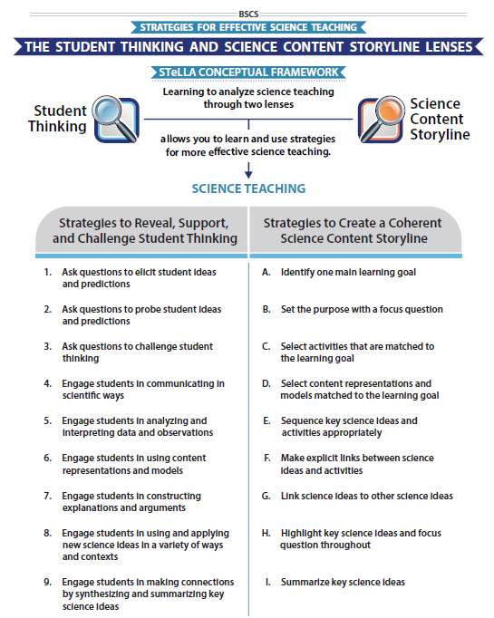
STeLLA Conceptual Framework
High-leverage teaching strategies

Slide 11
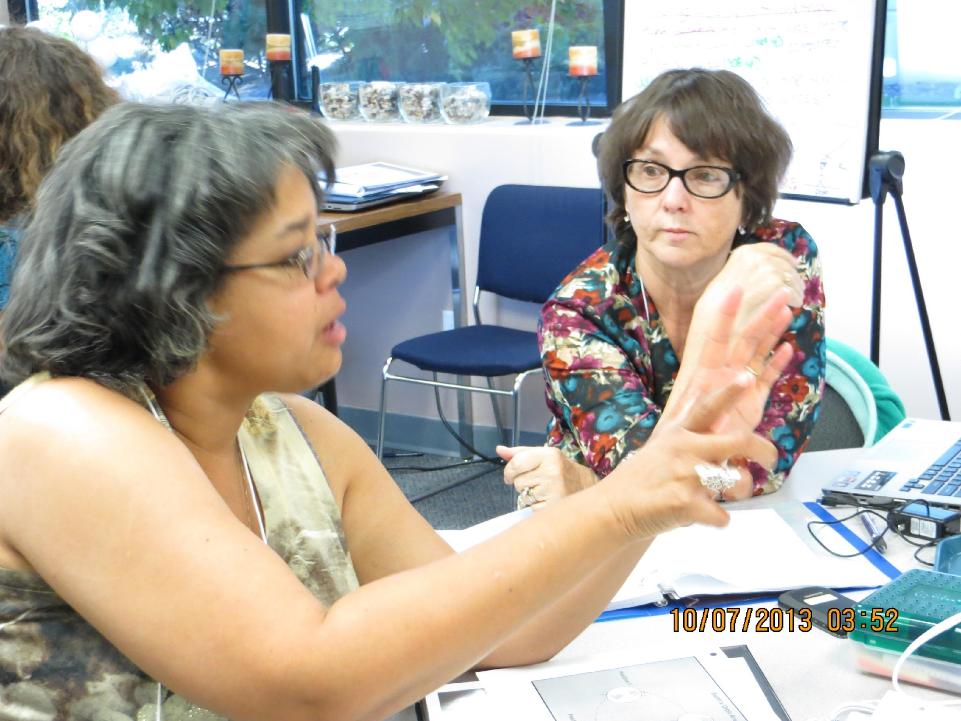
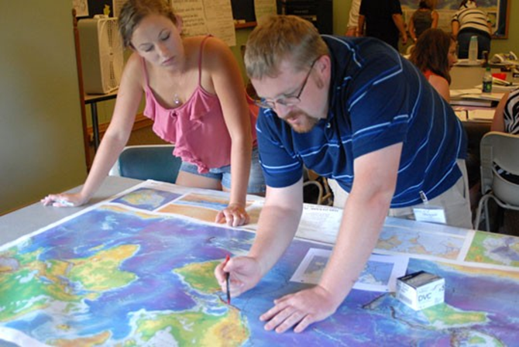
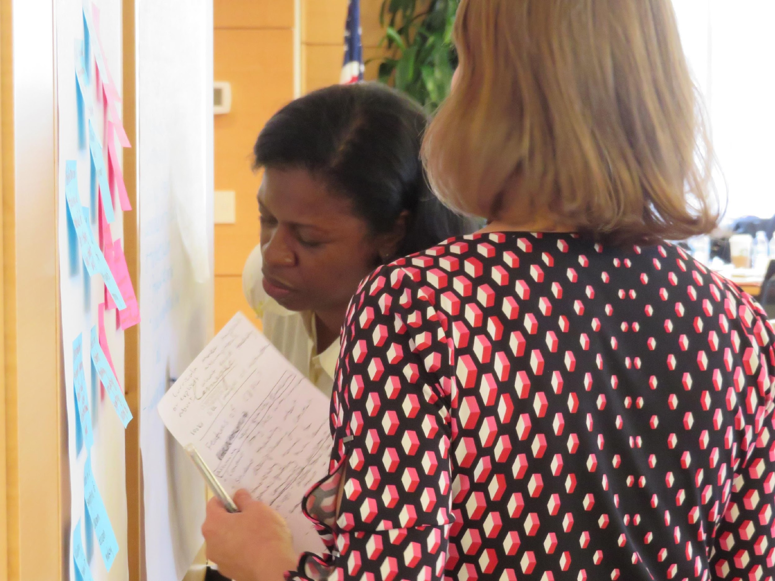
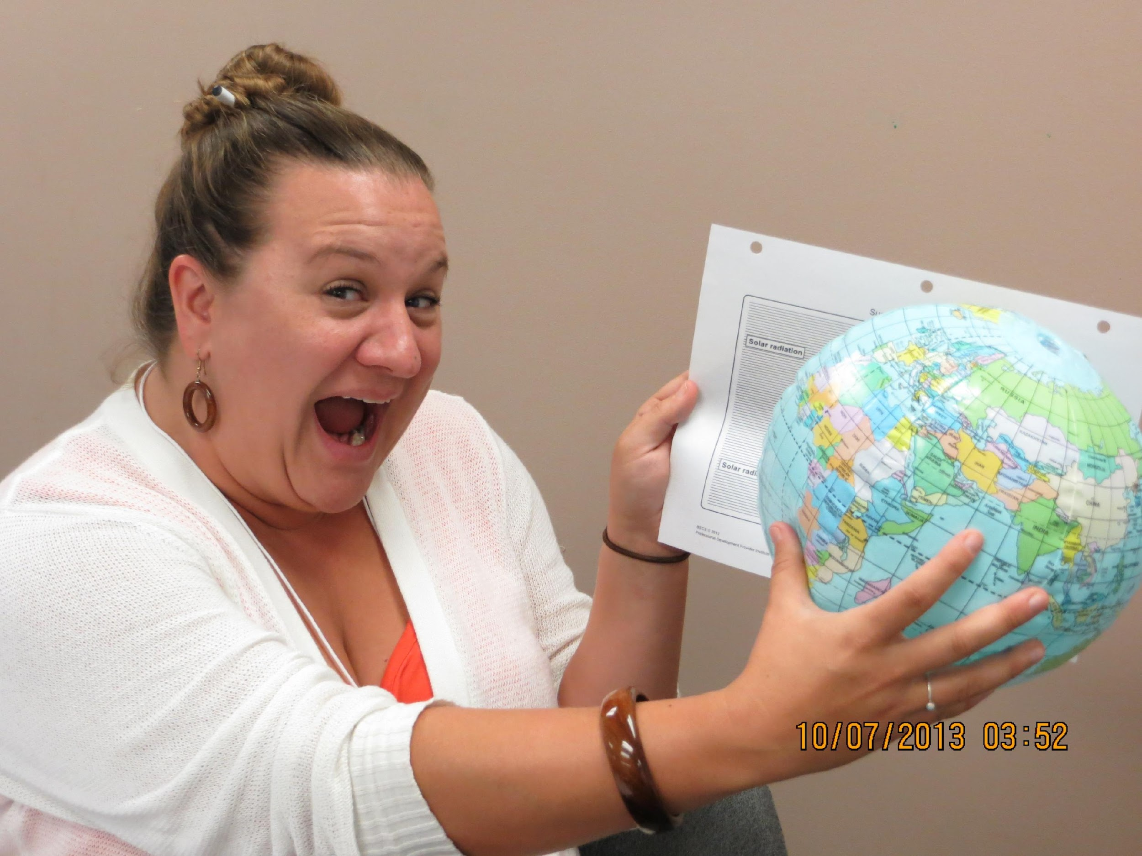
The STeLLA Experience
Small Learning Communities
Analyze video of other teachers
Analyze our own video
Classroom Use of
Model Units
Plan, do, & reflect on practice
Collect artifacts
Notes:
PLCs in SGs during institutes and study group sessions
Institutes range from 5 to 10 day summer institutes

Slide 12
STeLLA Theory of Change
Program
Teacher Outcomes
Student Outcomes
Teacher Science Content Knowledge
STeLLA Professional Development
Program
Student Science Content Knowledge
Teaching Practice
Teacher Pedagogical Content Knowledge

Slide 13
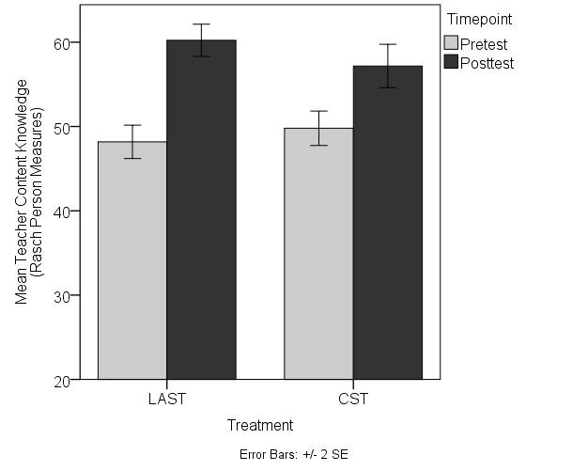
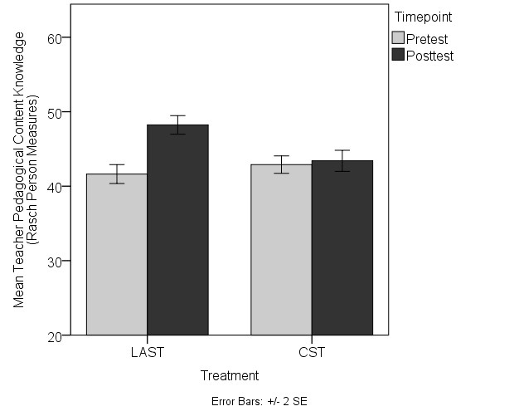
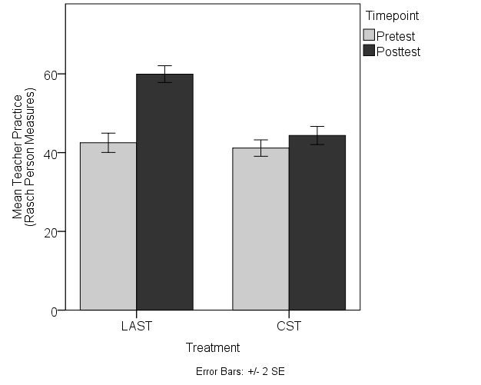
Results
Teacher Science Content Knowledge
Teacher Pedagogical Content Knowledge
p<0.001
Hedges’ g=0.66
p<0.001
Hedges’ g=1.17
STeLLA PD Content Deepening
STeLLA PD Content Deepening
Teaching Practice
Student Science Content Knowledge
p<0.001
Hedges’ g=2.05
STeLLA PD Content Deepening

Slide 14
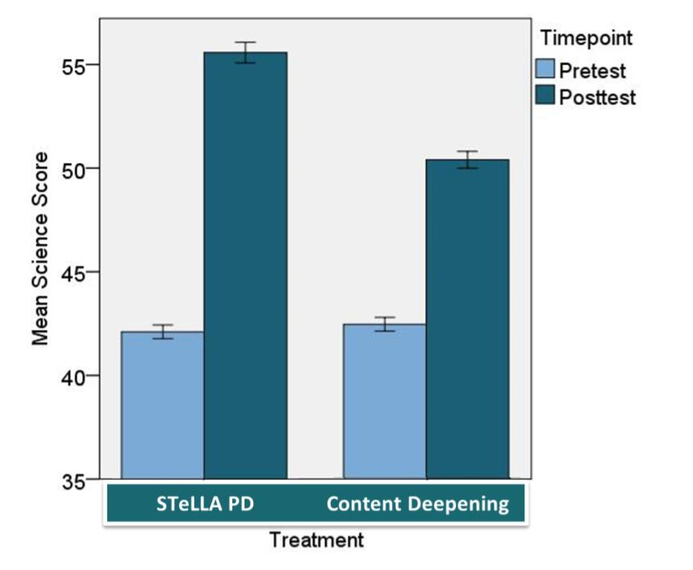
Results
Student Science Content Knowledge
p<0.001
Hedges’ g=0.68
Notes:
Susan…the transition out could be something like…this program has impact and is worthy of scaling and sustaining.

Slide 15
Key SSUP Study Objectives
Led by BSCS PDLs
PILOT Teachers
Cohort 1
Led by Local PDLs
Cohort 2
STeLLA &
Business-as-Usual Teachers
Cohort 3
STeLLA &
Business-as-Usual Teachers
Led by Local PDLs
Notes:
Develop local leaders and infrastructure
to deliver the STeLLA program and revise leadership program using continuous feedback and implementation data and
for sustainability and continued scaling of the STeLLA program.

Slide 16
Program Form
Virtual Kick-off
1-wk Summer Institute
Content Deepening in STeLLA Unit
Content Deepening in STeLLA Unit
Enact Fall Unit
Asynchronous work
4, 3-hr Virtual Study Group Sessions
Institute Experiences
Study Group Experiences
2-day Winter Institute
Lesson Analysis of Other Teachers
Lesson Analysis of Teachers in Our Study Group
Enact Spring Unit
Asynchronous work
4, 3-hr Virtual Study Group Sessions

Slide 17
Next Steps
Day 1 | Day 2 | Day 3 | Day 4 | Day 5
Opening | Opening | Opening | Opening | Opening
 | Lesson Analysis | Lesson Analysis | Lesson Analysis | Lesson Analysis
Content Deepening
 | Content Deepening |  | Content Deepening | Lesson Analysis: Tell the Story
Lunch | Lunch | Lunch | Lunch | Working Lunch: Prepare for the Fall
Making the Case | Content Deepening | Content Deepening | Content Deepening | Synthesize & Summarize
Lesson Analysis | Lesson Analysis |  | Unit Study/Lesson Plan Review | Closing (Depart at around 3:00 p.m.)
Closing & HW | Closing & HW | Closing & HW | Closing & HW
Summer Institute!
Location: Knoxville, TN
Start: July 18, coffee at 8:00 am EST
Daily: 8:30 am – 4:30 pm
Anticipate homework each evening
End: July 22, 3:00 pm
Notes:
and we will be talking about the homework that needs to be done before summer institute at the end of the session.

Slide 18
TENTATIVE Study Groups
KY 4th
Energy Transfer & Earth’s Changing Surface
KY 5th
Sun’s Effect on Climate and Seasons & Matter
TN 4th
Energy Transfer & Earth’s Changing Surface
TN 5th
Sun’s Effect on Climate and Seasons & Matter
Amanda Prewitt (Madison)
Patti Works (PIMSER)
Teena Liles* (Carter)
Myssi Turner (Campbell)
Becky Reister (Madison)
Nora Boggs (Letcher)
Beth Terry (Letcher)
Gina Dotson (Letcher)
Kim Zeidler-Watters (PIMSER)
Jody Bintz, BSCS
Jolee Connor (Boone)
Barbara Stegman (Boone)
Kyle Norris (Boone)
Myssi Weatherley (Boone)
Mary Beltcher (KYValleyCo)
Amy Poltson (Perry)
TBD Pulaski
TBD Rowan [Julia Rawlings]
Jessica Henderson-Rockette
Monica Hayes
Megan Burnette
Lauren Barnes (Knox)
Callie Beeler (Knox)
Monica Brown (Knox)
Carrie Killeffer (Knox)
Deborah Magers (Knox)
Heather Worley (Knox)
Amy Wyatt (Knox)
Andrea Berry (Knox)
Rachel Cox (Knox)
Matthew Horton (Knox)
Megan Grauer (Knox)
Brittany McCarter (Knox)
Destina LaRue (Knox)
Holly Hemphill (Knox)
Monica Edmonds (Knox)
Sherri Roberts (Knox)
Andrea Berry (Knox)
Amy Charles (Anderson)
Aimee Archer (Knox)
Molly Paulson (Knox)
Constance Lundy (Anderson)
Alyssa Rasch (Anderson)
Rebecca Taylor (Hamilton)
Tiffany York (Hamilton)
Kim Thompson (Boone)
Stephanie Harmon (PIMSER)
Tara Carter (Rockcastle)
Lauren Collins (Rockcastle)
Abbey Reynolds (Rockcastle)
Bonita Pack (Campbell)
Heather Hathorn (Mclean)
Brittany Crawford
Katie Neil
Jennifer Rodabaugh
Vickie Stem
Montana Ashley (Anderson)
Caitlin Campbell (Hamilton)
Celesta Carter (Hamilton)
Melonie Denton (Rutherford)
Taylor Snow (Rutherford)
Jaimie Stanton (Hamilton)
Bailey Masters (Rutherford)
Stephanie Finley
Dara Wade
Hunter Cross (Rutherford)
Lichelle Leonard (Rutherford)
Mary Beth White (Rutherford)
Laura Bishop (Anderson)
Amber Wollner (Hamilton)

Slide 19
Teacher Responsibilities for Research Study
Participate in all program components
Summer & winter institutes
Asynchronous learning experiences
Synchronous, virtual study groups (4 fall/4 spring)
Teach two STeLLA units (1 in fall and 1 in spring) & video record two lessons (equipment provided)
Complete teacher surveys and knowledge assessments (summer 2022 and end of semester spring 2023)
Administer student knowledge assessment (1 before fall unit and 1 after spring unit)

Slide 20
Focus Questions
What is STeLLA and what will this experience be like?
What is the STeLLA Scale-up and Sustainability Study and what will be my role/responsibilities?
What are the benefits of joining the STeLLA professional learning program?

Slide 21
Closing
What is something you are excited about the STeLLA Program?
What is something that you are still wondering about the STeLLA Program?

Slide 22
Homework
Before the Summer Institute:
Read the Educational Leadership article: "What Science Teaching Looks Like: An International Perspective" by Kathleen Roth and Helen Garnier
Highlight key ideas
Be prepared to discuss the findings outlined in the article during the Making the Case session on Monday, July 17,2023
We’ll see you in July!

