Slide 1
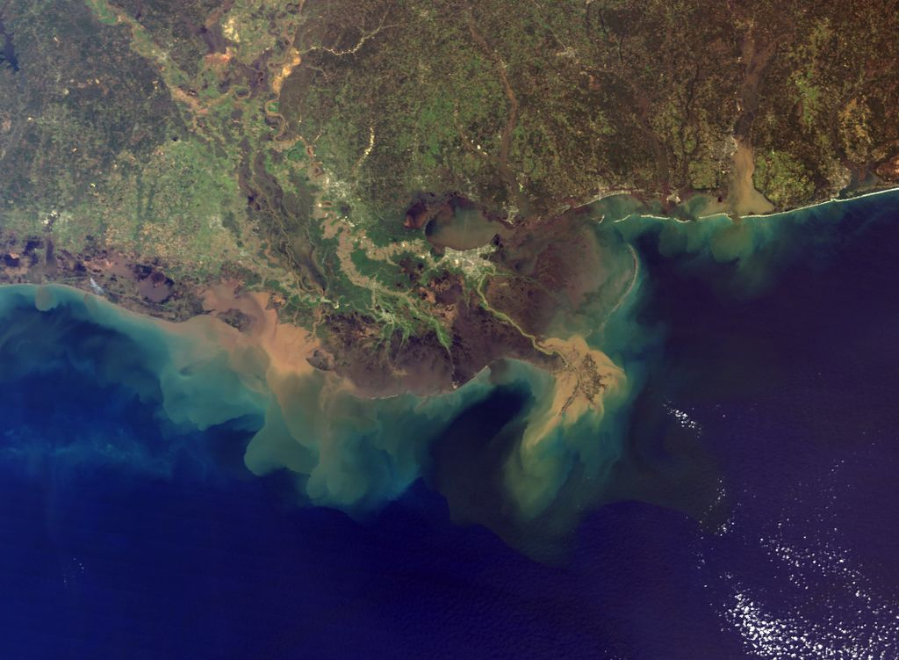
Earth’s Changing Surface
Lesson 1
Has Earth’s surface always looked this way? Why or why not?

Slide 2
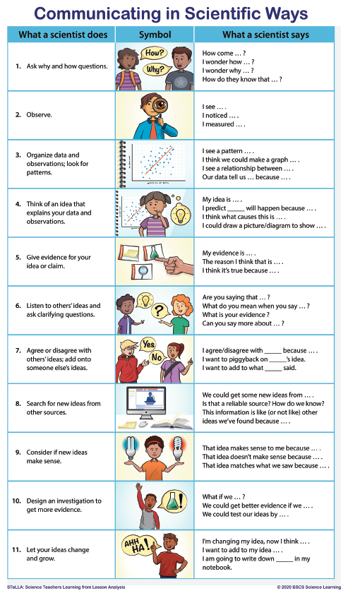

Slide 3
What do we know and wonder about Earth’s surface?
What we know
What we wonder

Slide 4
Lesson 1 Focus Questions
Has Earth’s surface always looked this way? Why or why not?
Focus Questions: Has Earth’s surface always looked this way? Why or why not?
I think that Earth’s surface [has / has not] always looked this way because …​
Write your ideas here.

Slide 5
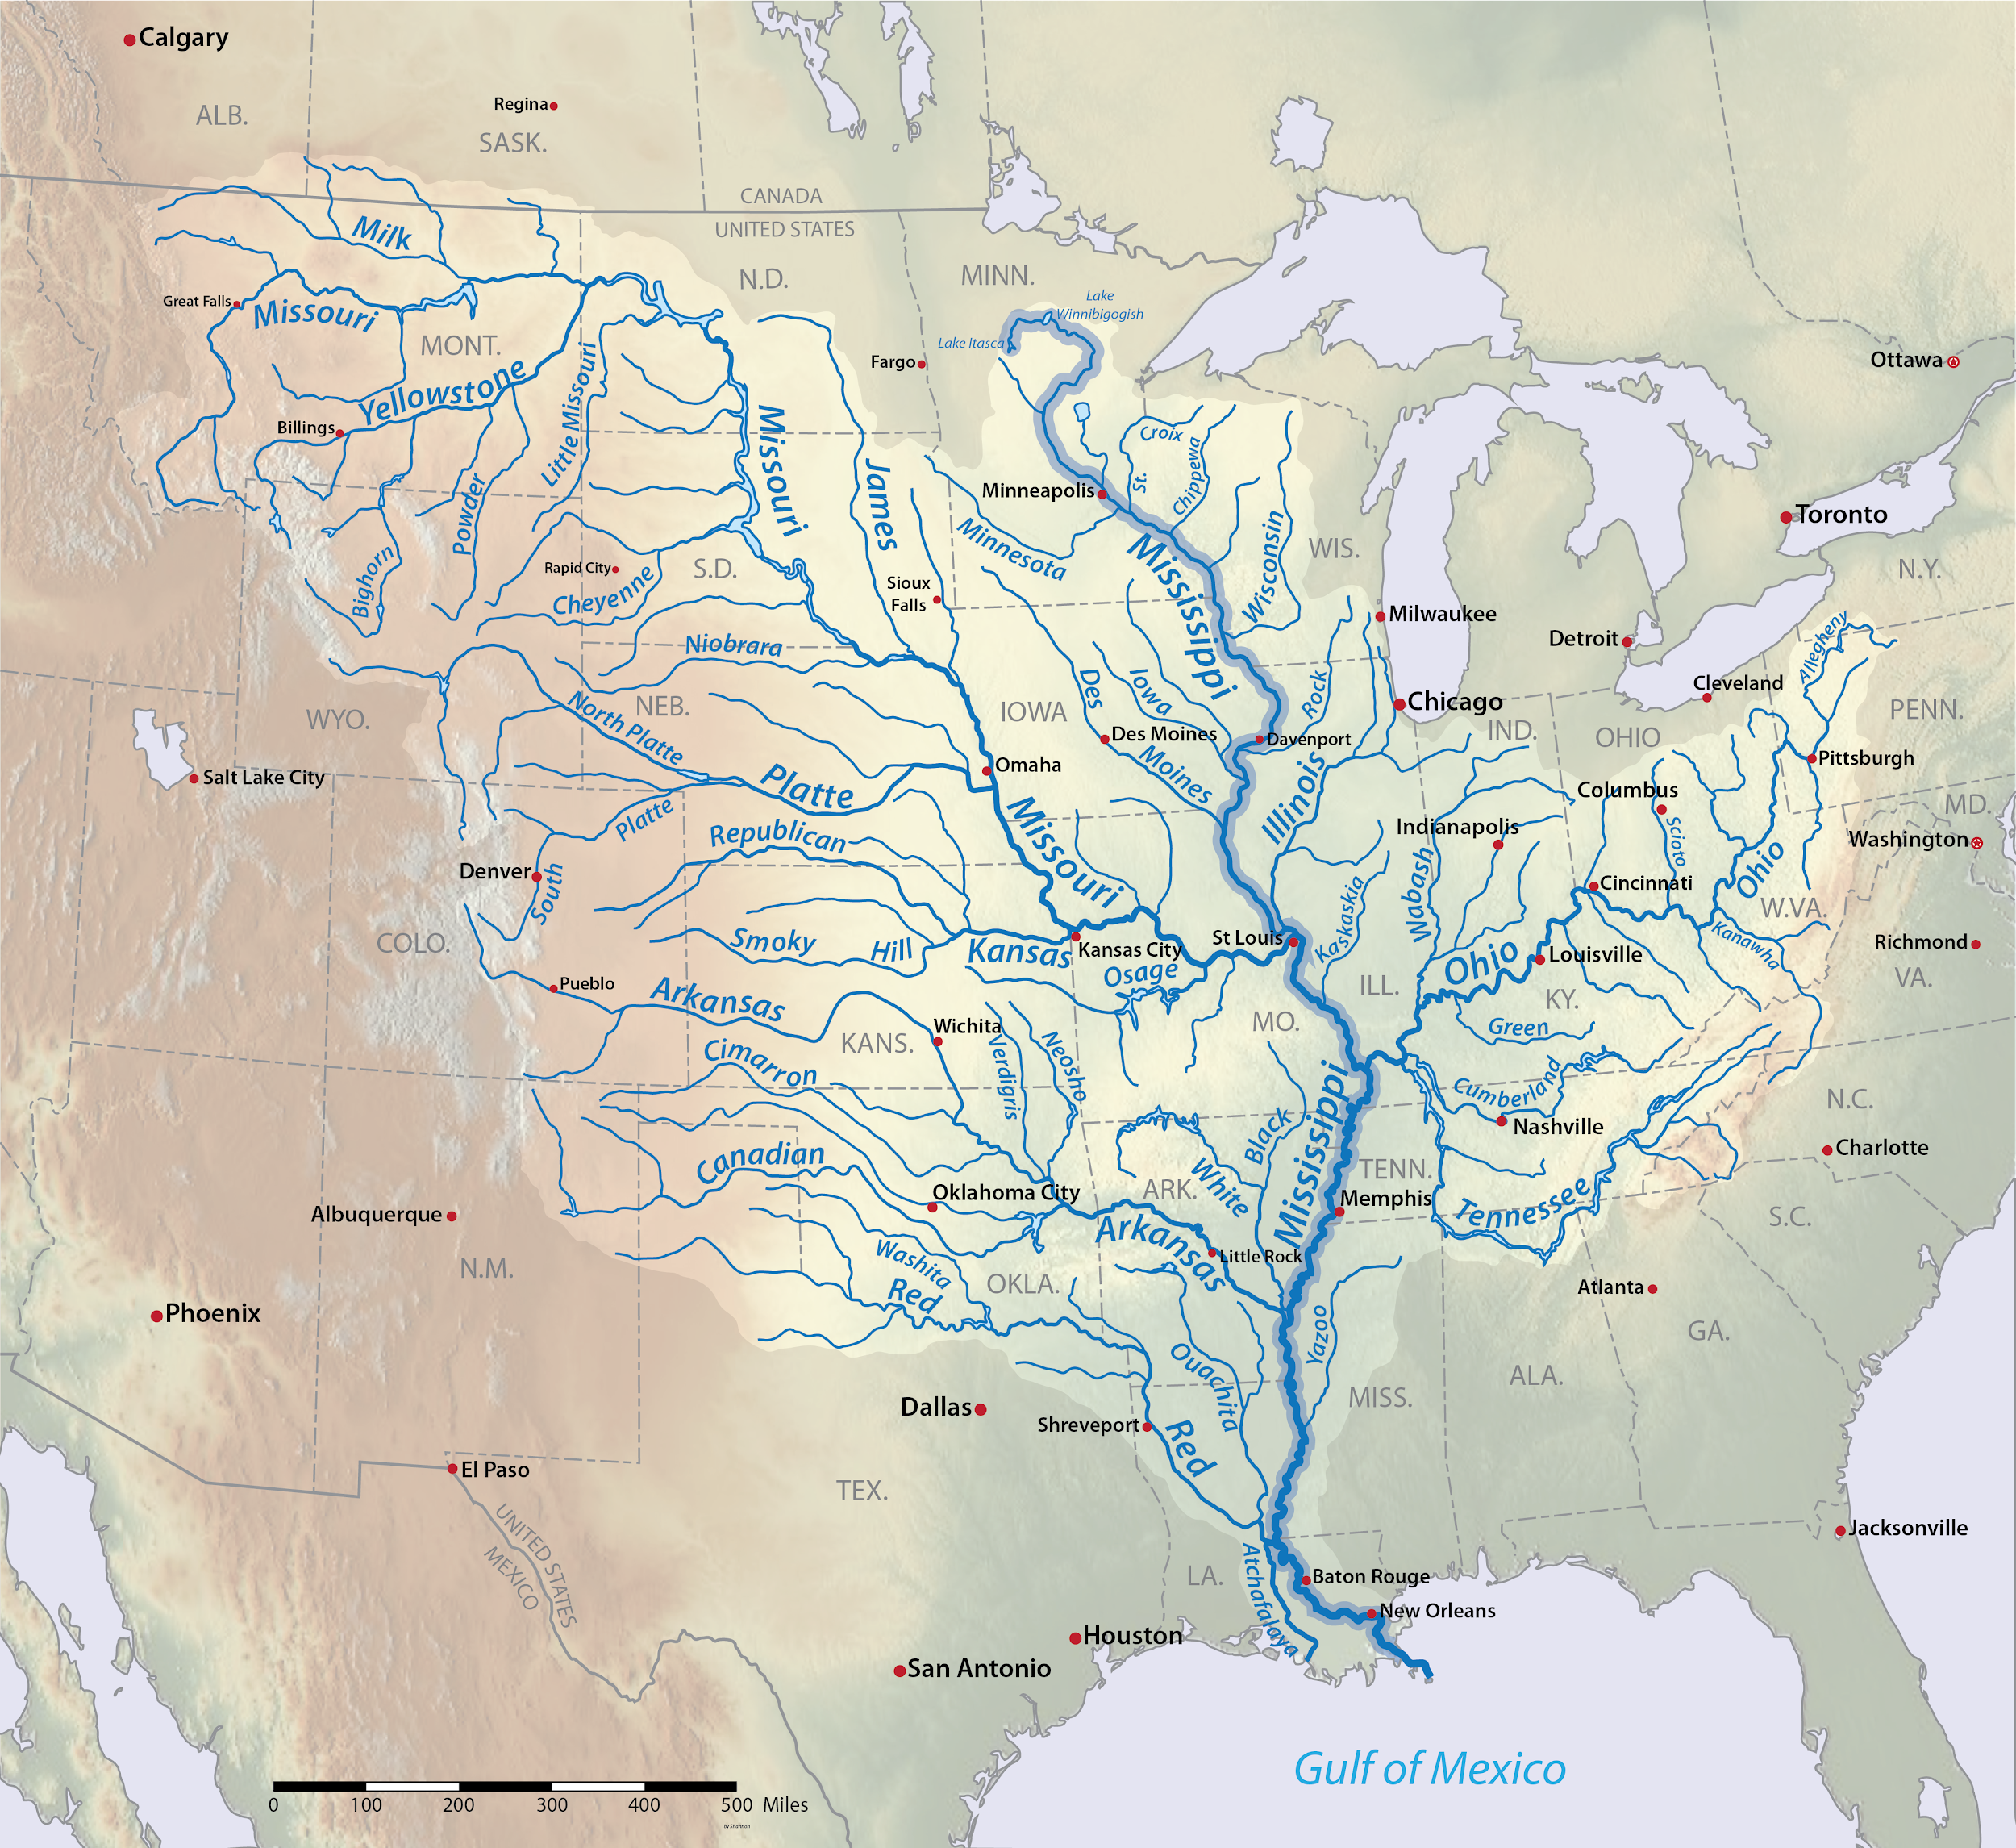
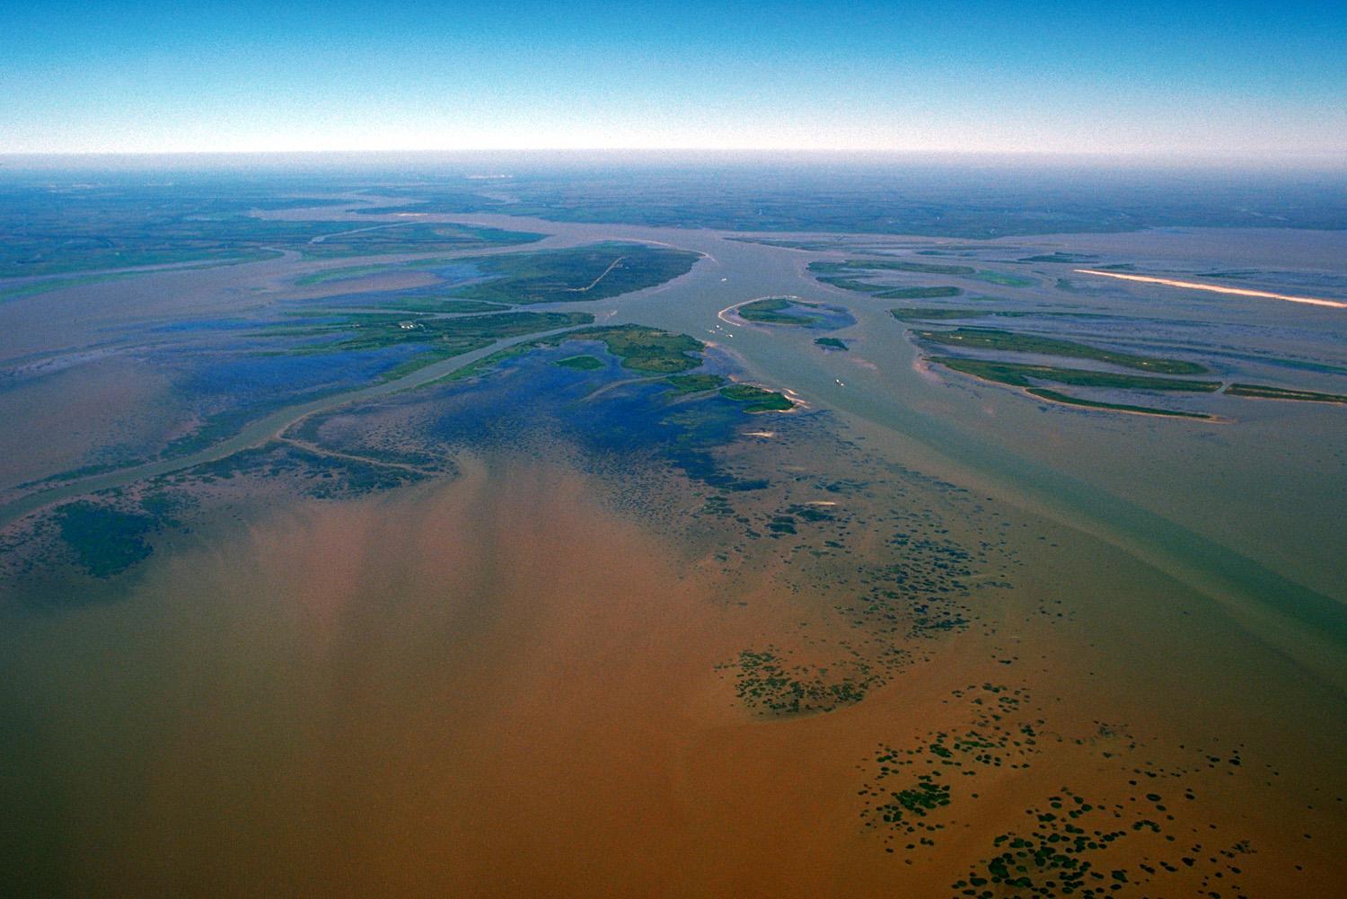
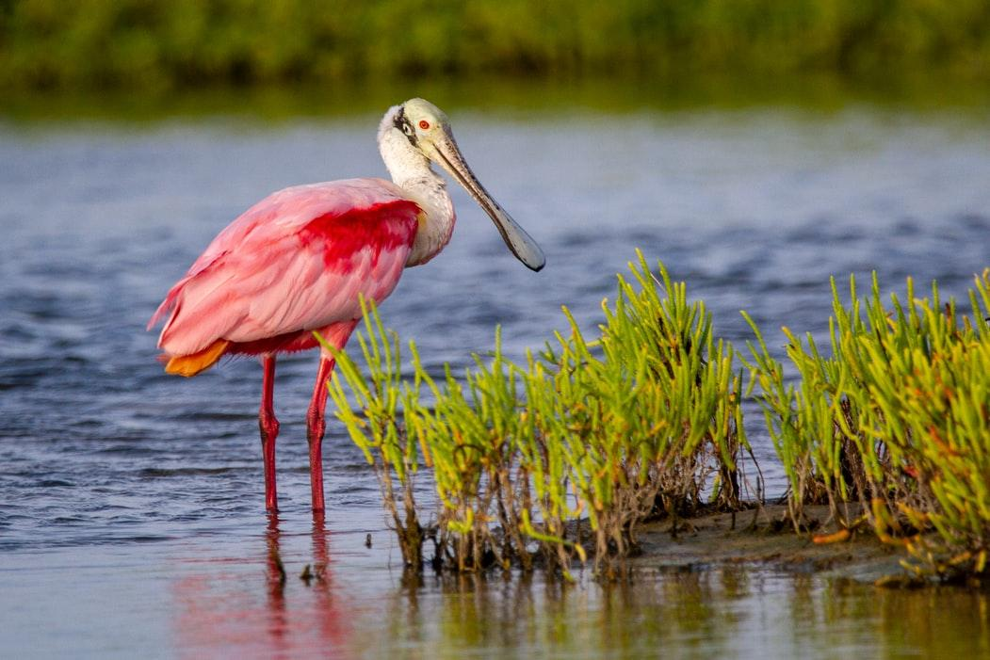
Photo by Joshua J. Cotten on Unsplash
Photo by Joshua J. Cotten on Unsplash

Slide 6
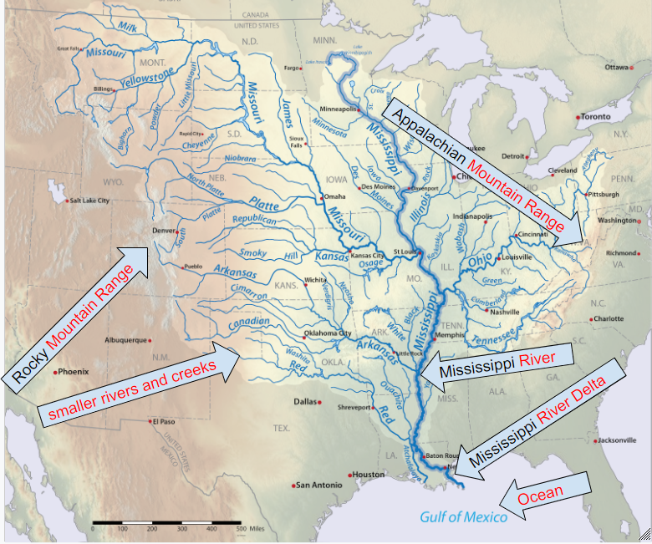

Slide 7
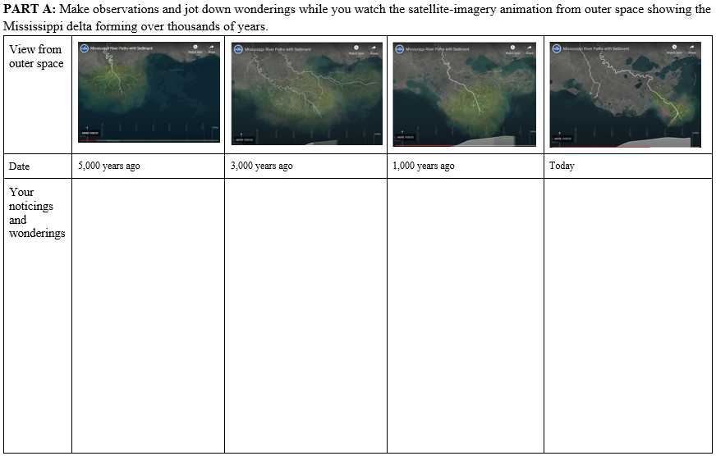
HO1.3 How does land change to form a delta?
animation link

Slide 8
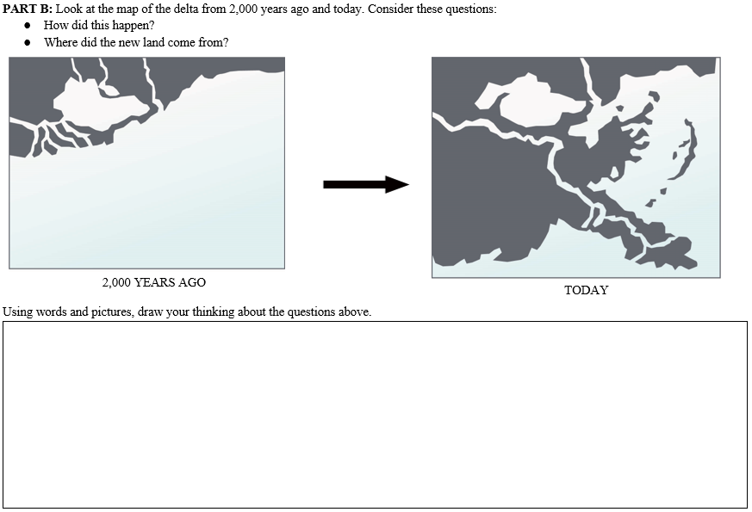
HO1.3 How does land change to form a delta?

Slide 9
How did this happen?
How did the delta form?
What are your ideas?
Share with your group.

Slide 10
Our Driving Question Board
Driving Question Board Protocol
The 1st team reads their question aloud to the class and then posts it on the Driving Question Board (DQB).
Students who are listening should raise their hand if their team has a question that relates to the question that was just read aloud.
The 1st team selects the next team whose hand is raised.
The 2nd team reads their question, says why or how it relates, and then posts it near the question it most relates to on the DQB.
The student selects the next student. We will continue until every team has at least one question on the DQB.

Slide 11
Lesson 1 Focus Questions
Focus Questions: Has Earth’s surface always looked this way? Why or why not?
How would you answer this question now?
Share your new ideas with a partner.
I think that Earth’s surface [has / has not] always looked this way because …​

Slide 12
What can cause Earth’s surface to look the way it does?
Lesson 2 Focus Question
What causes deltas to form?
What questions on our DQB will help us answer this Unit Central Question?

