Slide 1
Earth’s Changing Surface
Lesson 2
What causes deltas to form?

Slide 2
What did we figure out?
Lesson 1 Focus Questions
Has Earth’s surface always looked this way? Why or why not?
How did we answer these questions in our last class?

Slide 3
Lesson 2 Focus Question
What causes deltas to form?
Write down how you think deltas might form.
Lesson 2 Focus Question:
What causes deltas to form?
I think deltas form at the end of a river because …

Slide 4
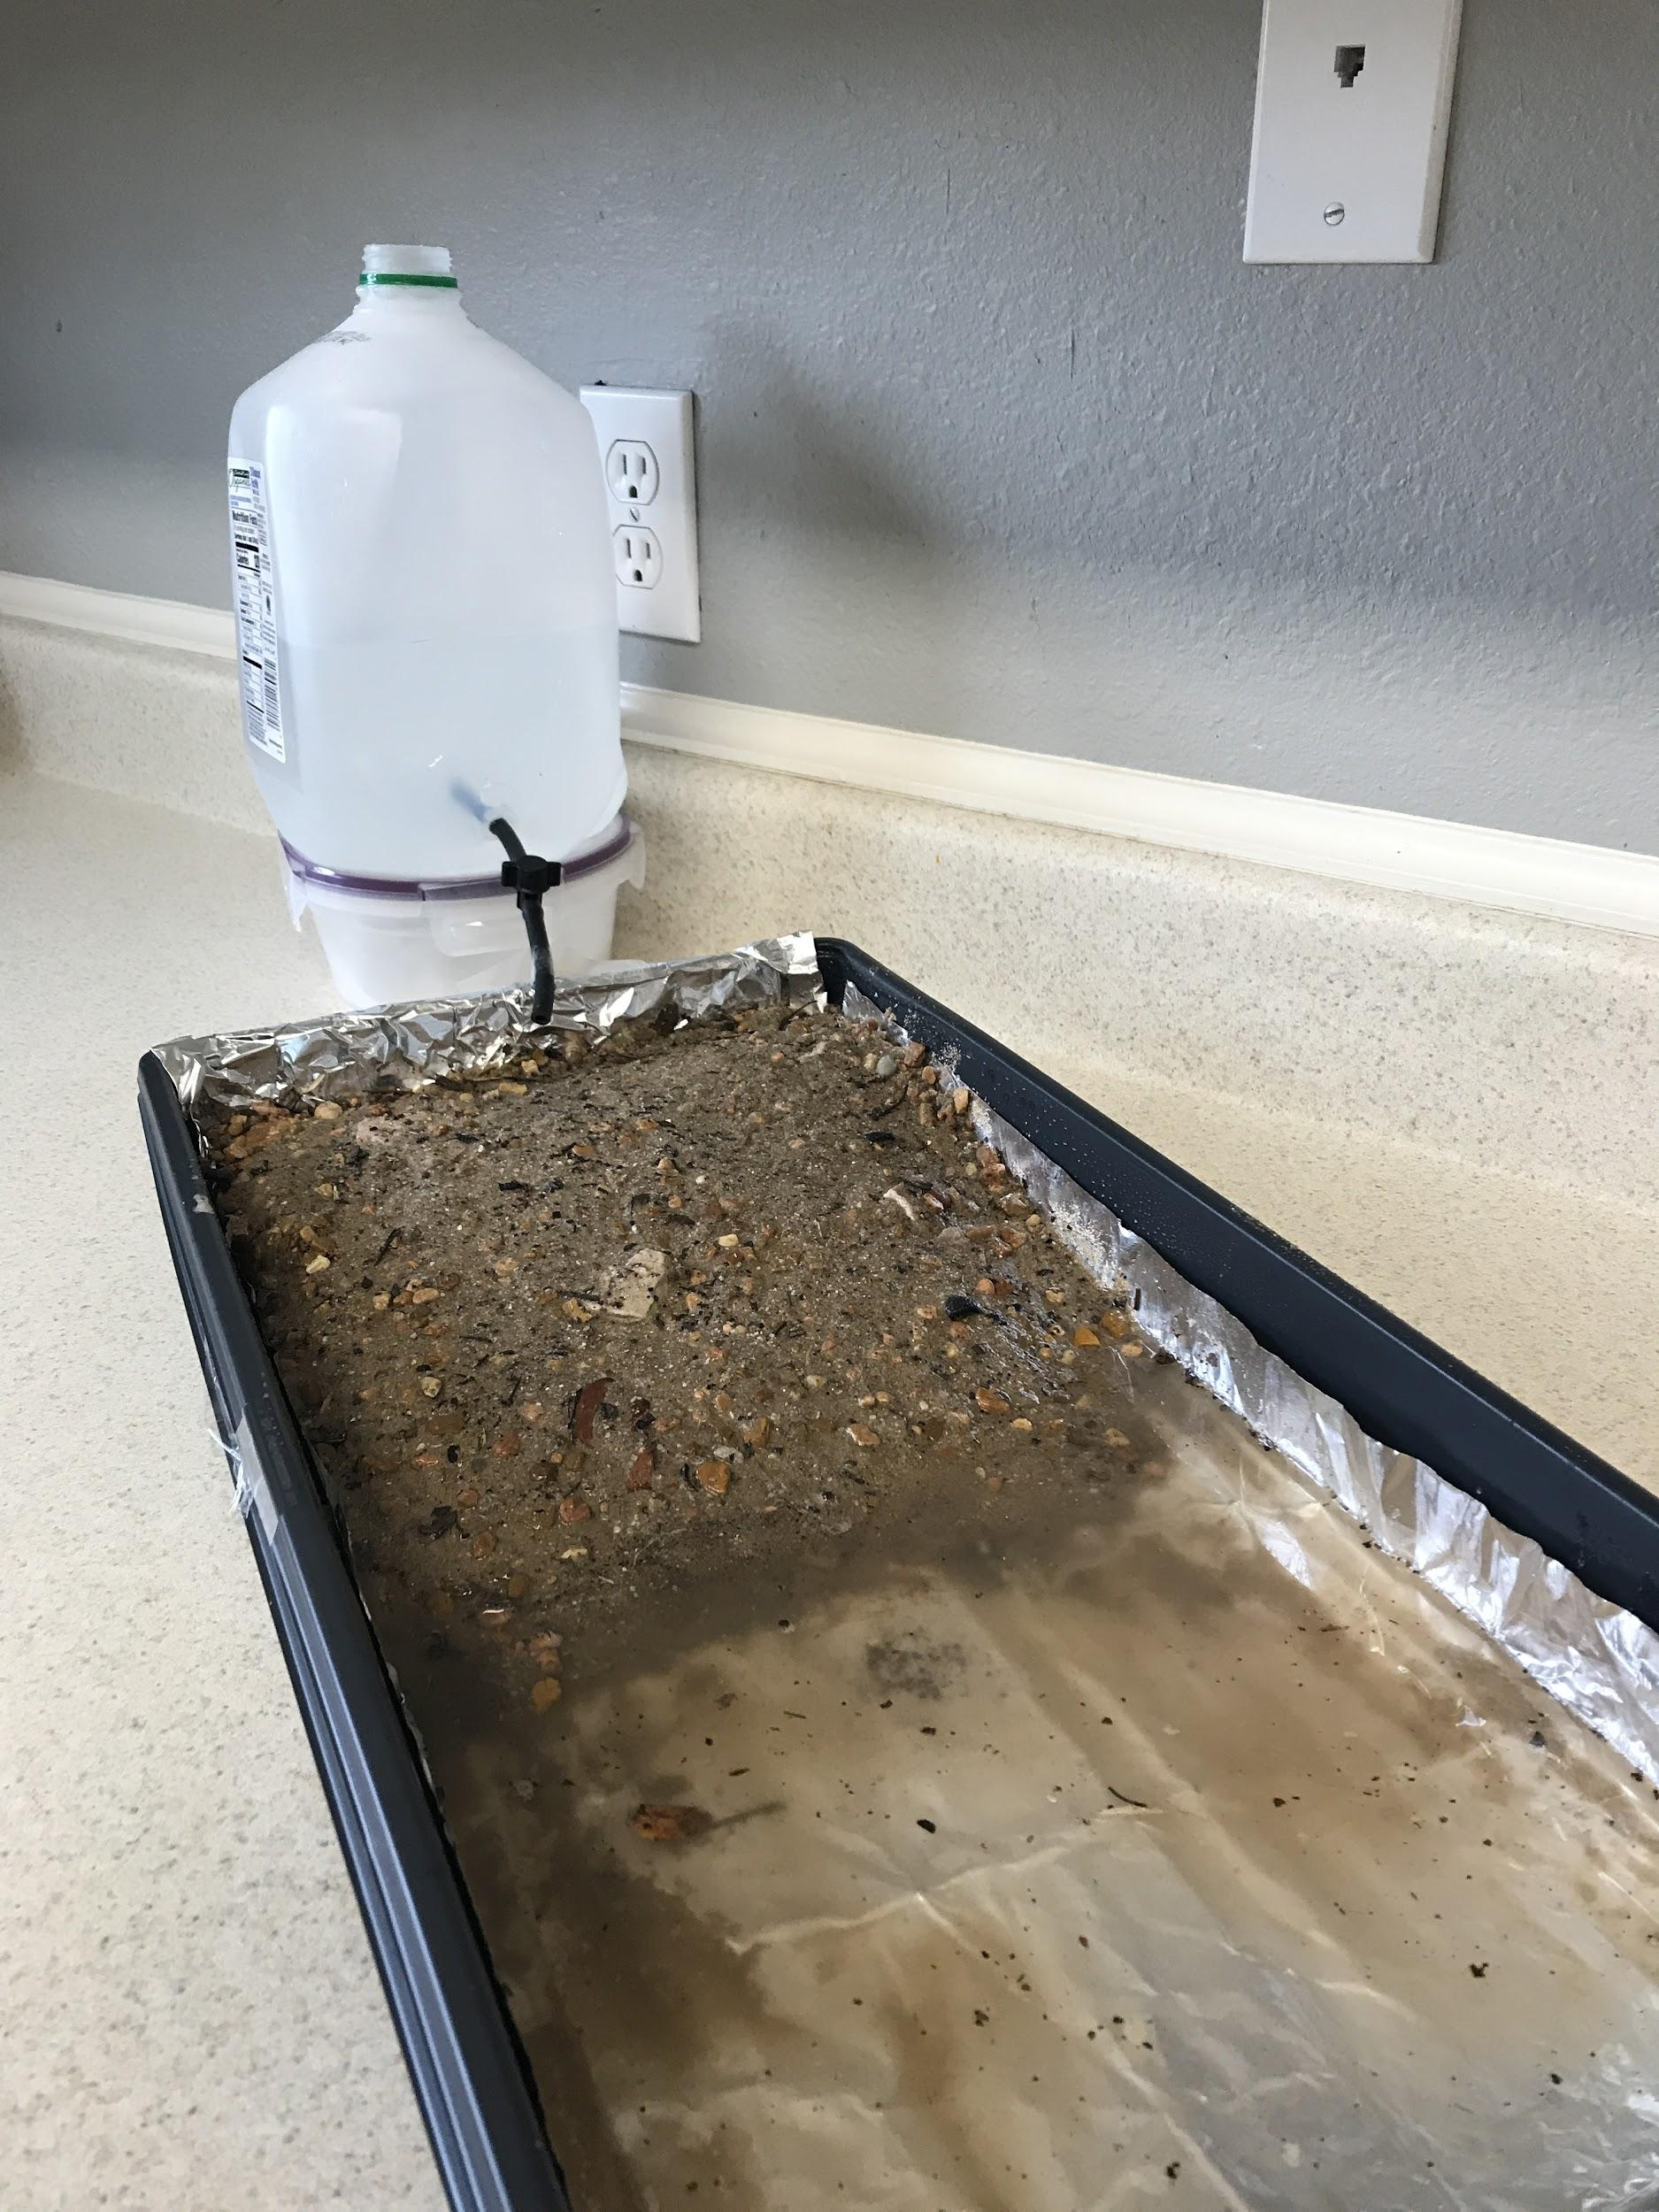
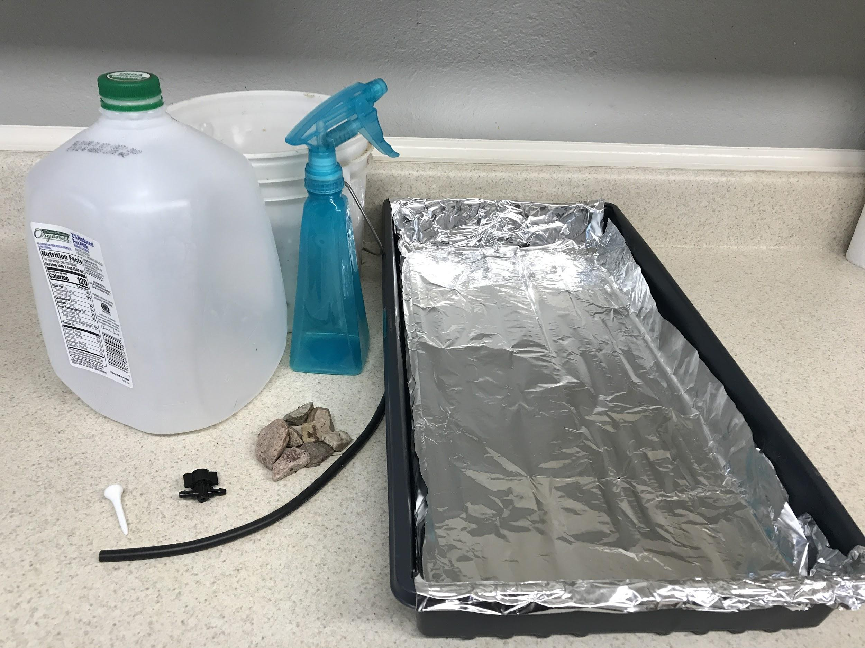
Investigating a River

Slide 5
Investigating a River
?
?
When we release the water, what do you think will happen?
?
?
As you investigate, look for
where you see flowing water moving earth materials to a new location and
where the earth materials are left, or deposited, in a new location.

Slide 6
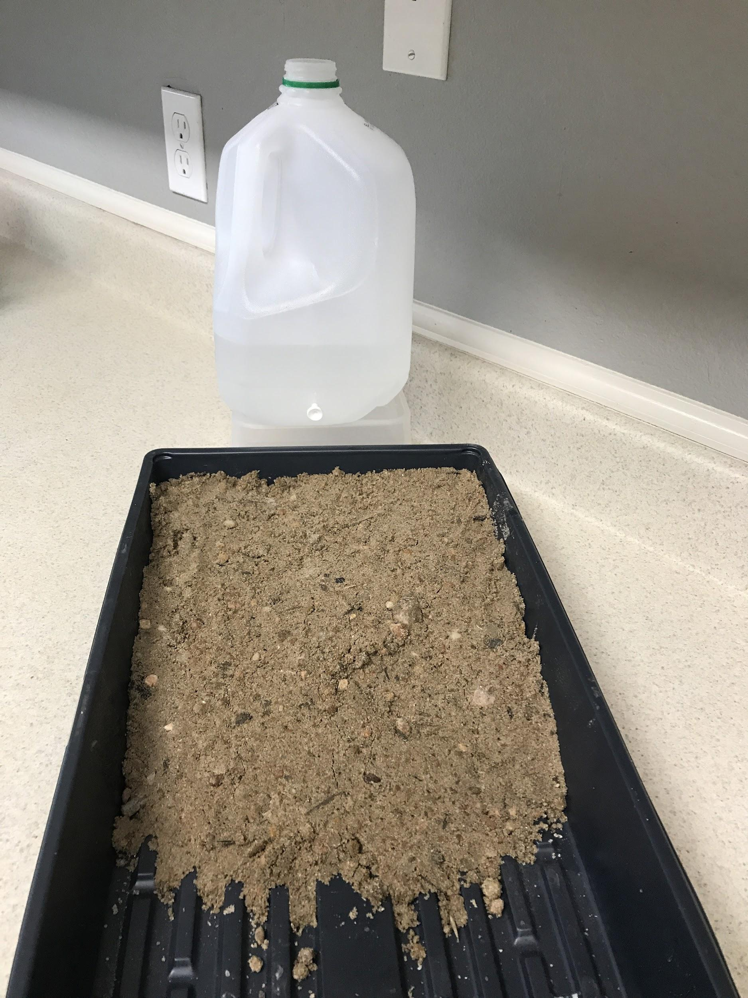
Investigating a River
As you investigate, look for
where you see flowing water moving earth materials to a new location and
where the earth materials are left, or deposited, in a new location.

Slide 7
How did water change the land?
Where did you see earth materials move because of the water?
How will this help us answer our focus question?
Can you use ideas about speed and energy to explain how earth materials move?
Where do the earth materials go?
Do all earth materials move the same?
What new questions do you have?
What evidence did you get from investigating with a stream table?

Slide 8
Investigating a River
As you investigated, you looked for
where you see flowing water moving earth materials to a new location and
where the earth materials are left, or deposited, in a new location.
Erosion: the process where flowing water or wind moves earth materials, such as sand, soil, gravel, and rocks, to a different location.
Deposition: when eroded earth materials, such as sand, soil, gravel, and rocks are deposited, or dropped, in a new location.

Slide 9
Lesson 2 Focus Question
What causes deltas to form?
Write down how deltas form.
Lesson 2 Focus Question:
What causes deltas to form?
I think deltas form at the end of a river because …
Deltas form because ...
Remember to use ideas about erosion and deposition!

