Slide 1
Earth’s Changing Surface
Lesson 3
What can change how fast deltas grow?

Slide 2
What did we figure out?
Lesson 2 Focus Question
What causes deltas to form?
How did we answer this question in our last class?

Slide 3
Lesson 3 Focus Question
What can change how fast deltas grow?
What are your ideas about what can change how fast a delta grows?
Write your ideas here.
Be ready to share some ideas with the class!
Lesson 3 Focus Question:
What can change how fast deltas grow?
Things that speed it up
Things that slow it down

Slide 4
How can we use our stream table to investigate our ideas?
Think-Pair-Share
Talk about your ideas with a partner.
Record your ideas on part 1 of the handout.

Slide 5
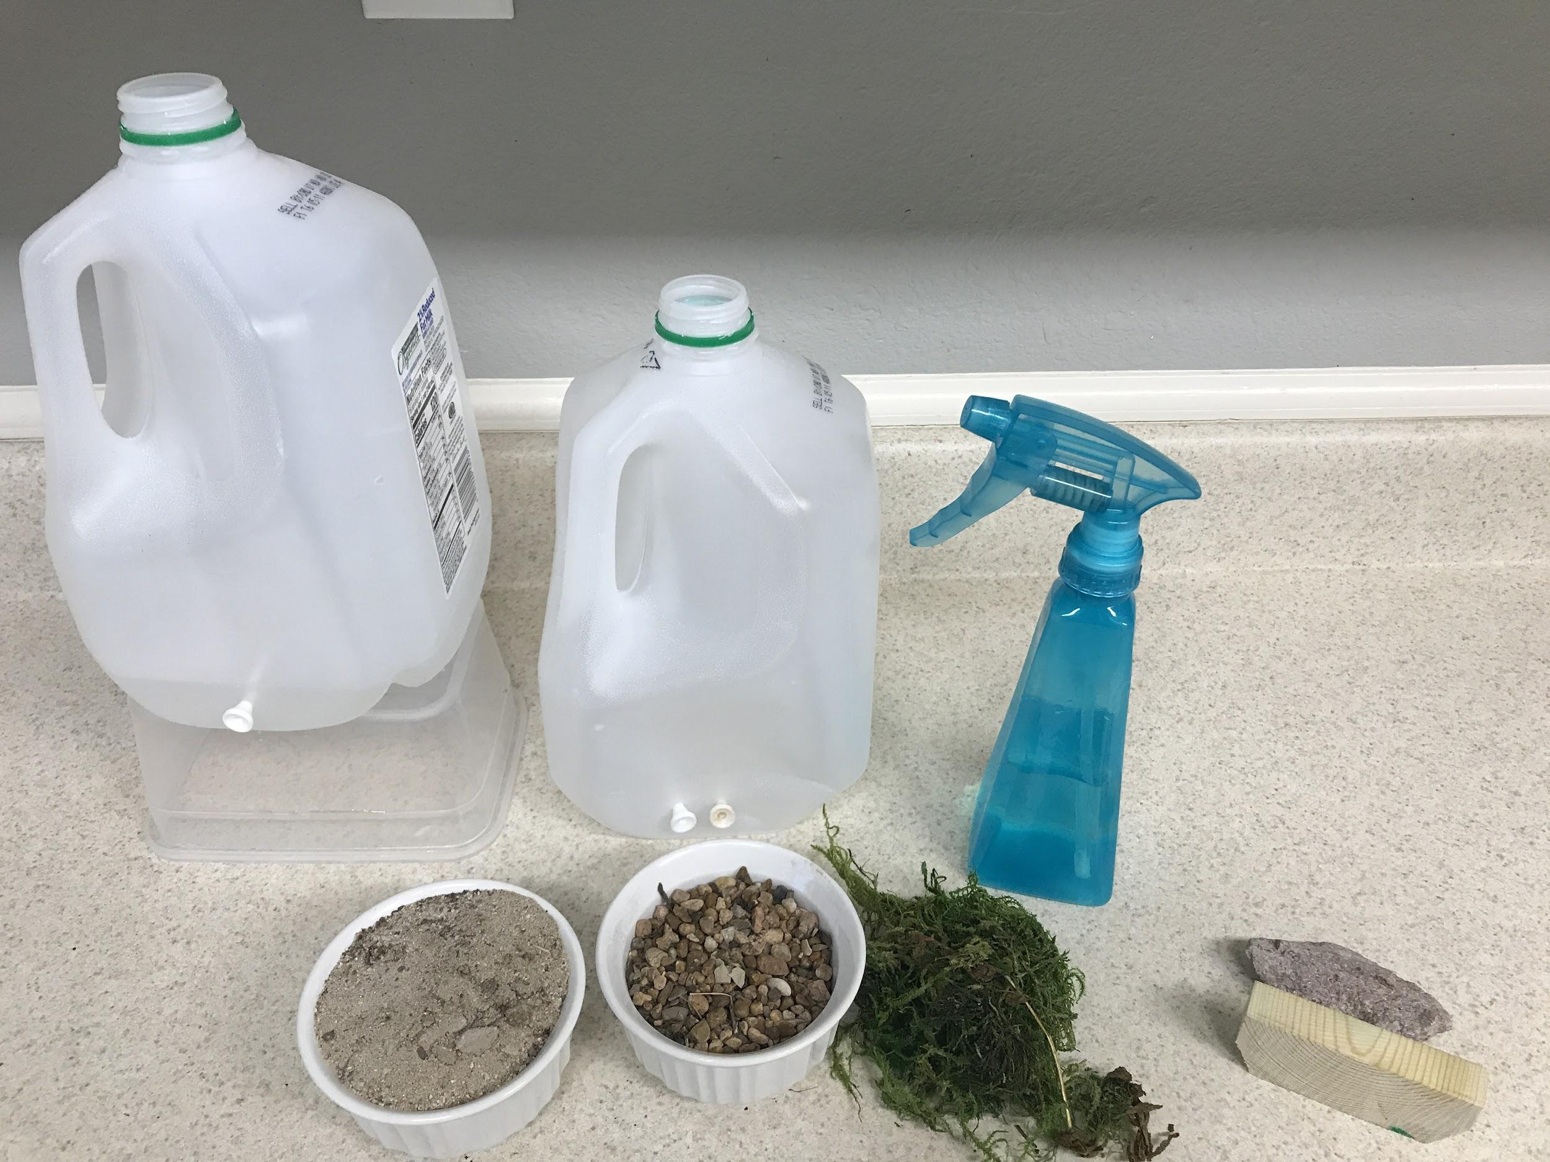
Designing an Investigation
How will we use these materials to test our conditions?
Conditions to test
a bigger river
precipitation
sandy soil versus rocks
a lot of vegetation, like grass and trees
faster water flow

Slide 6
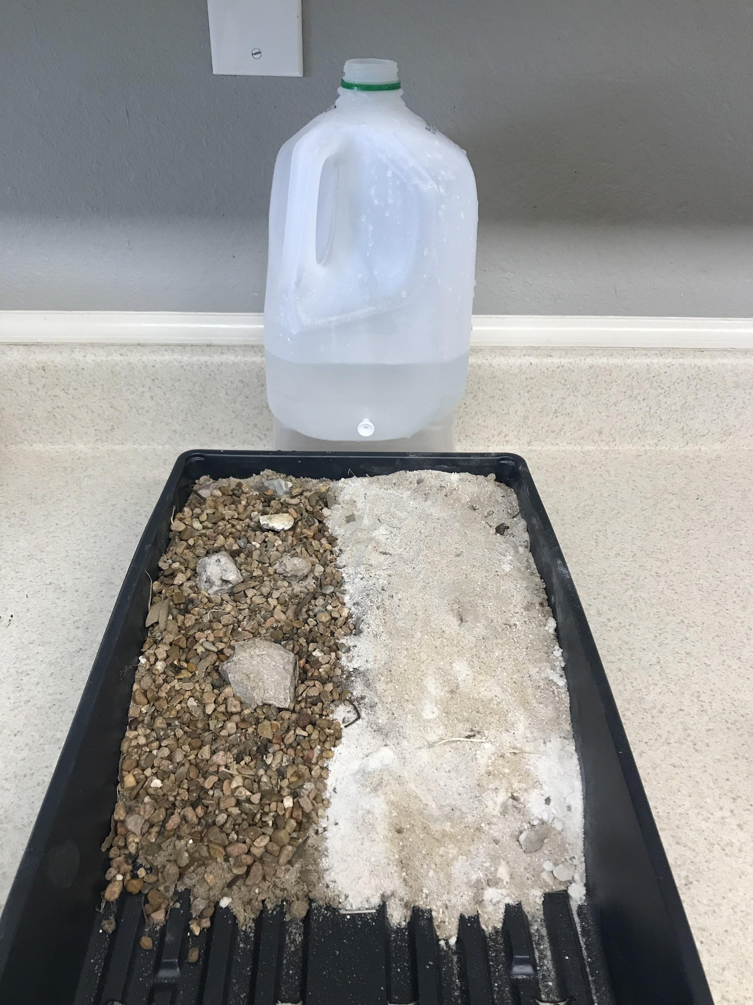
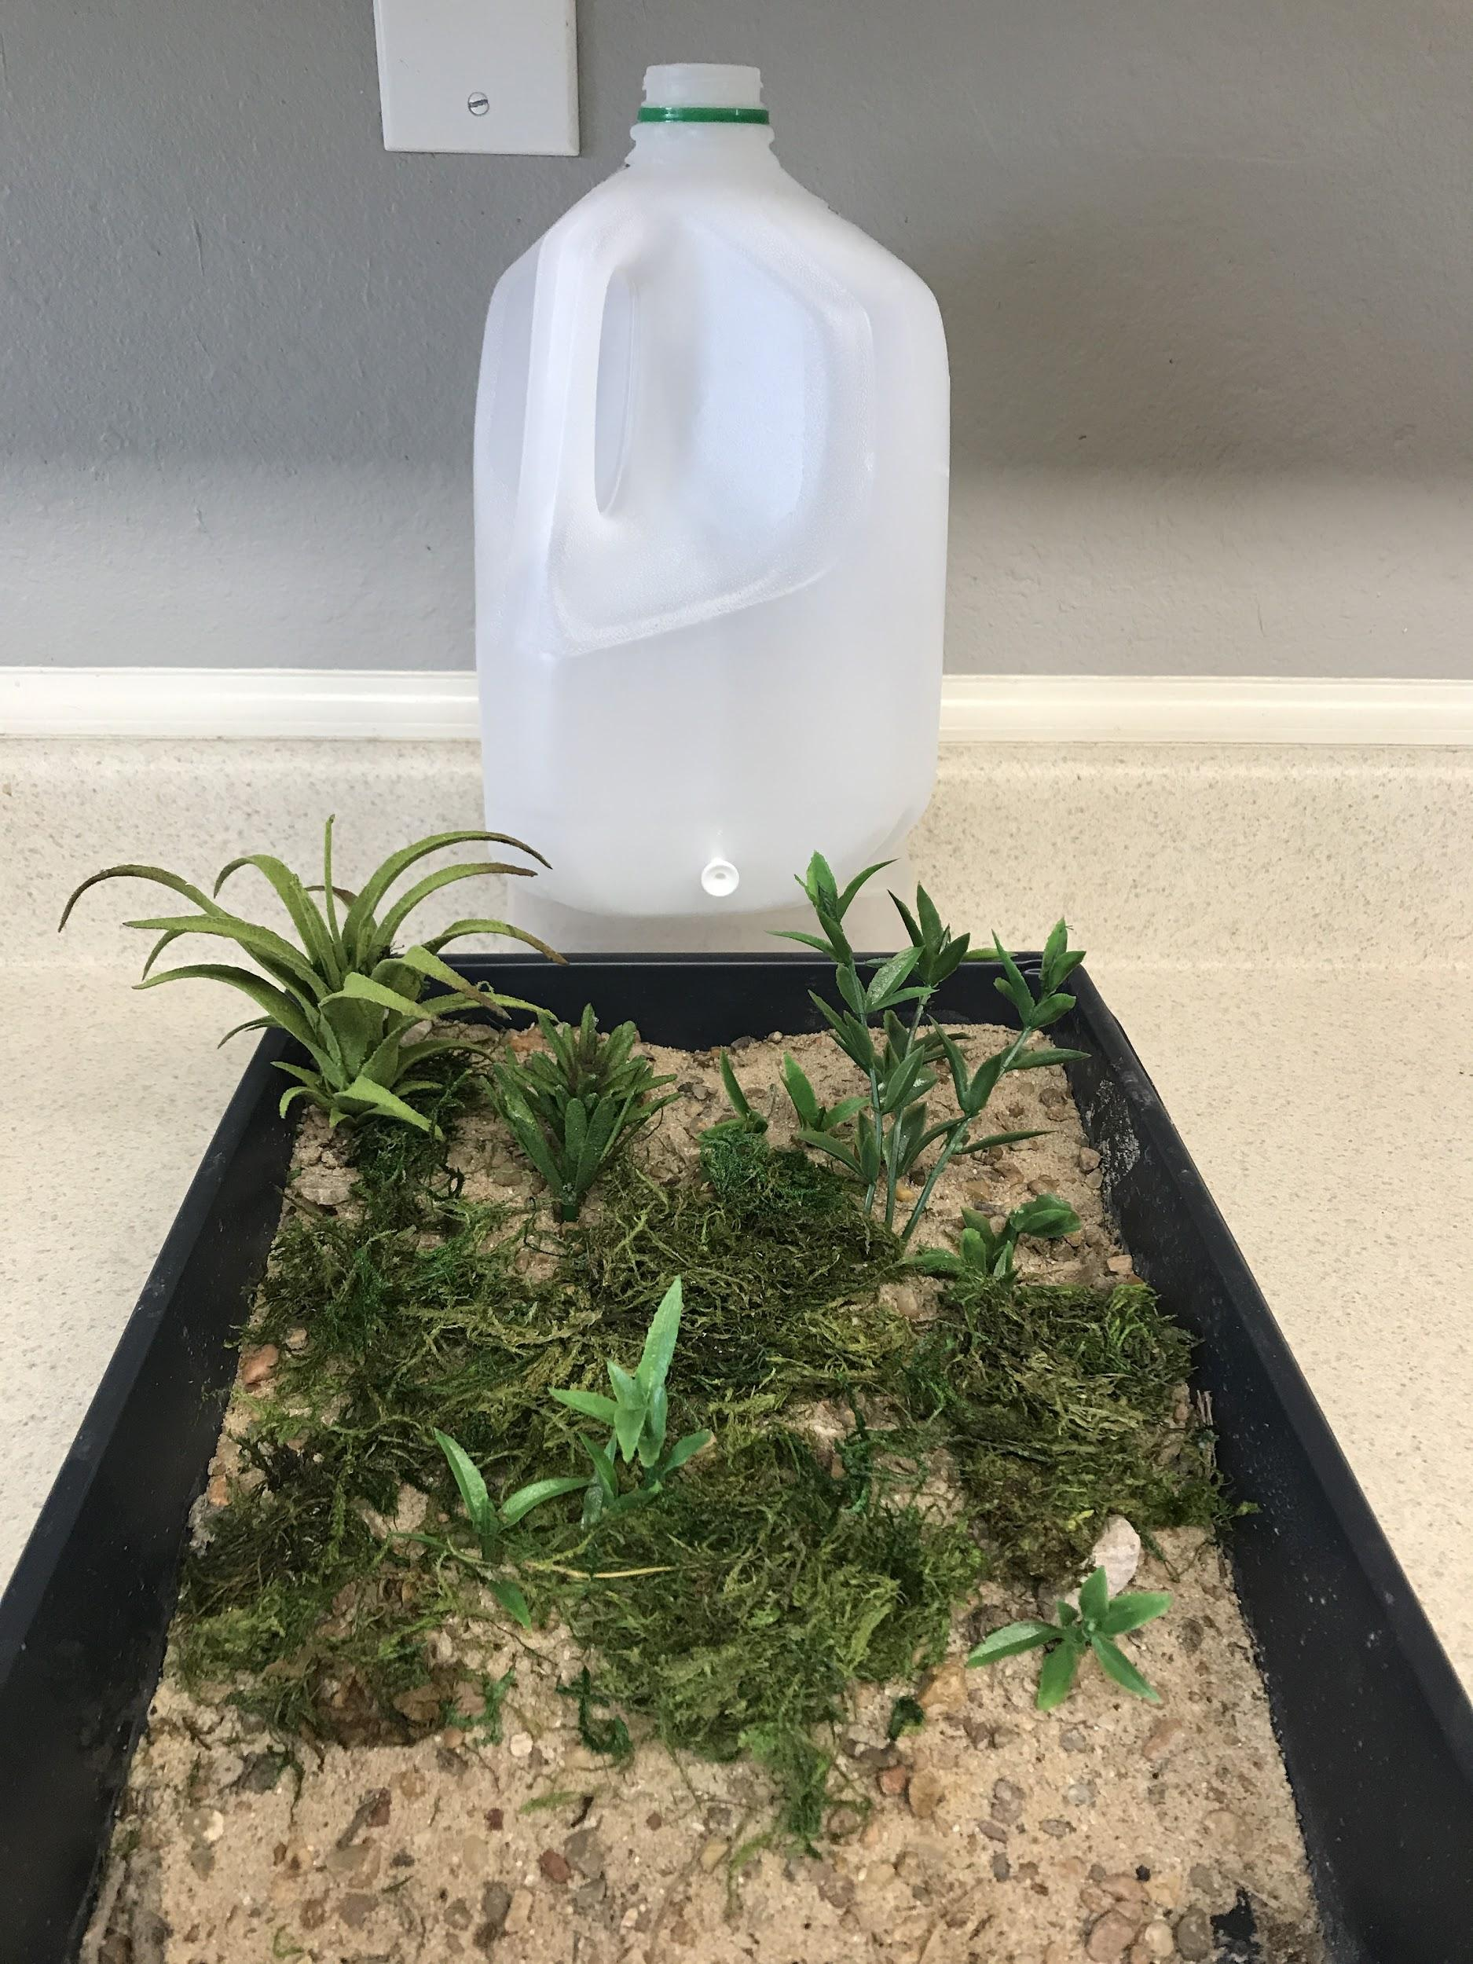
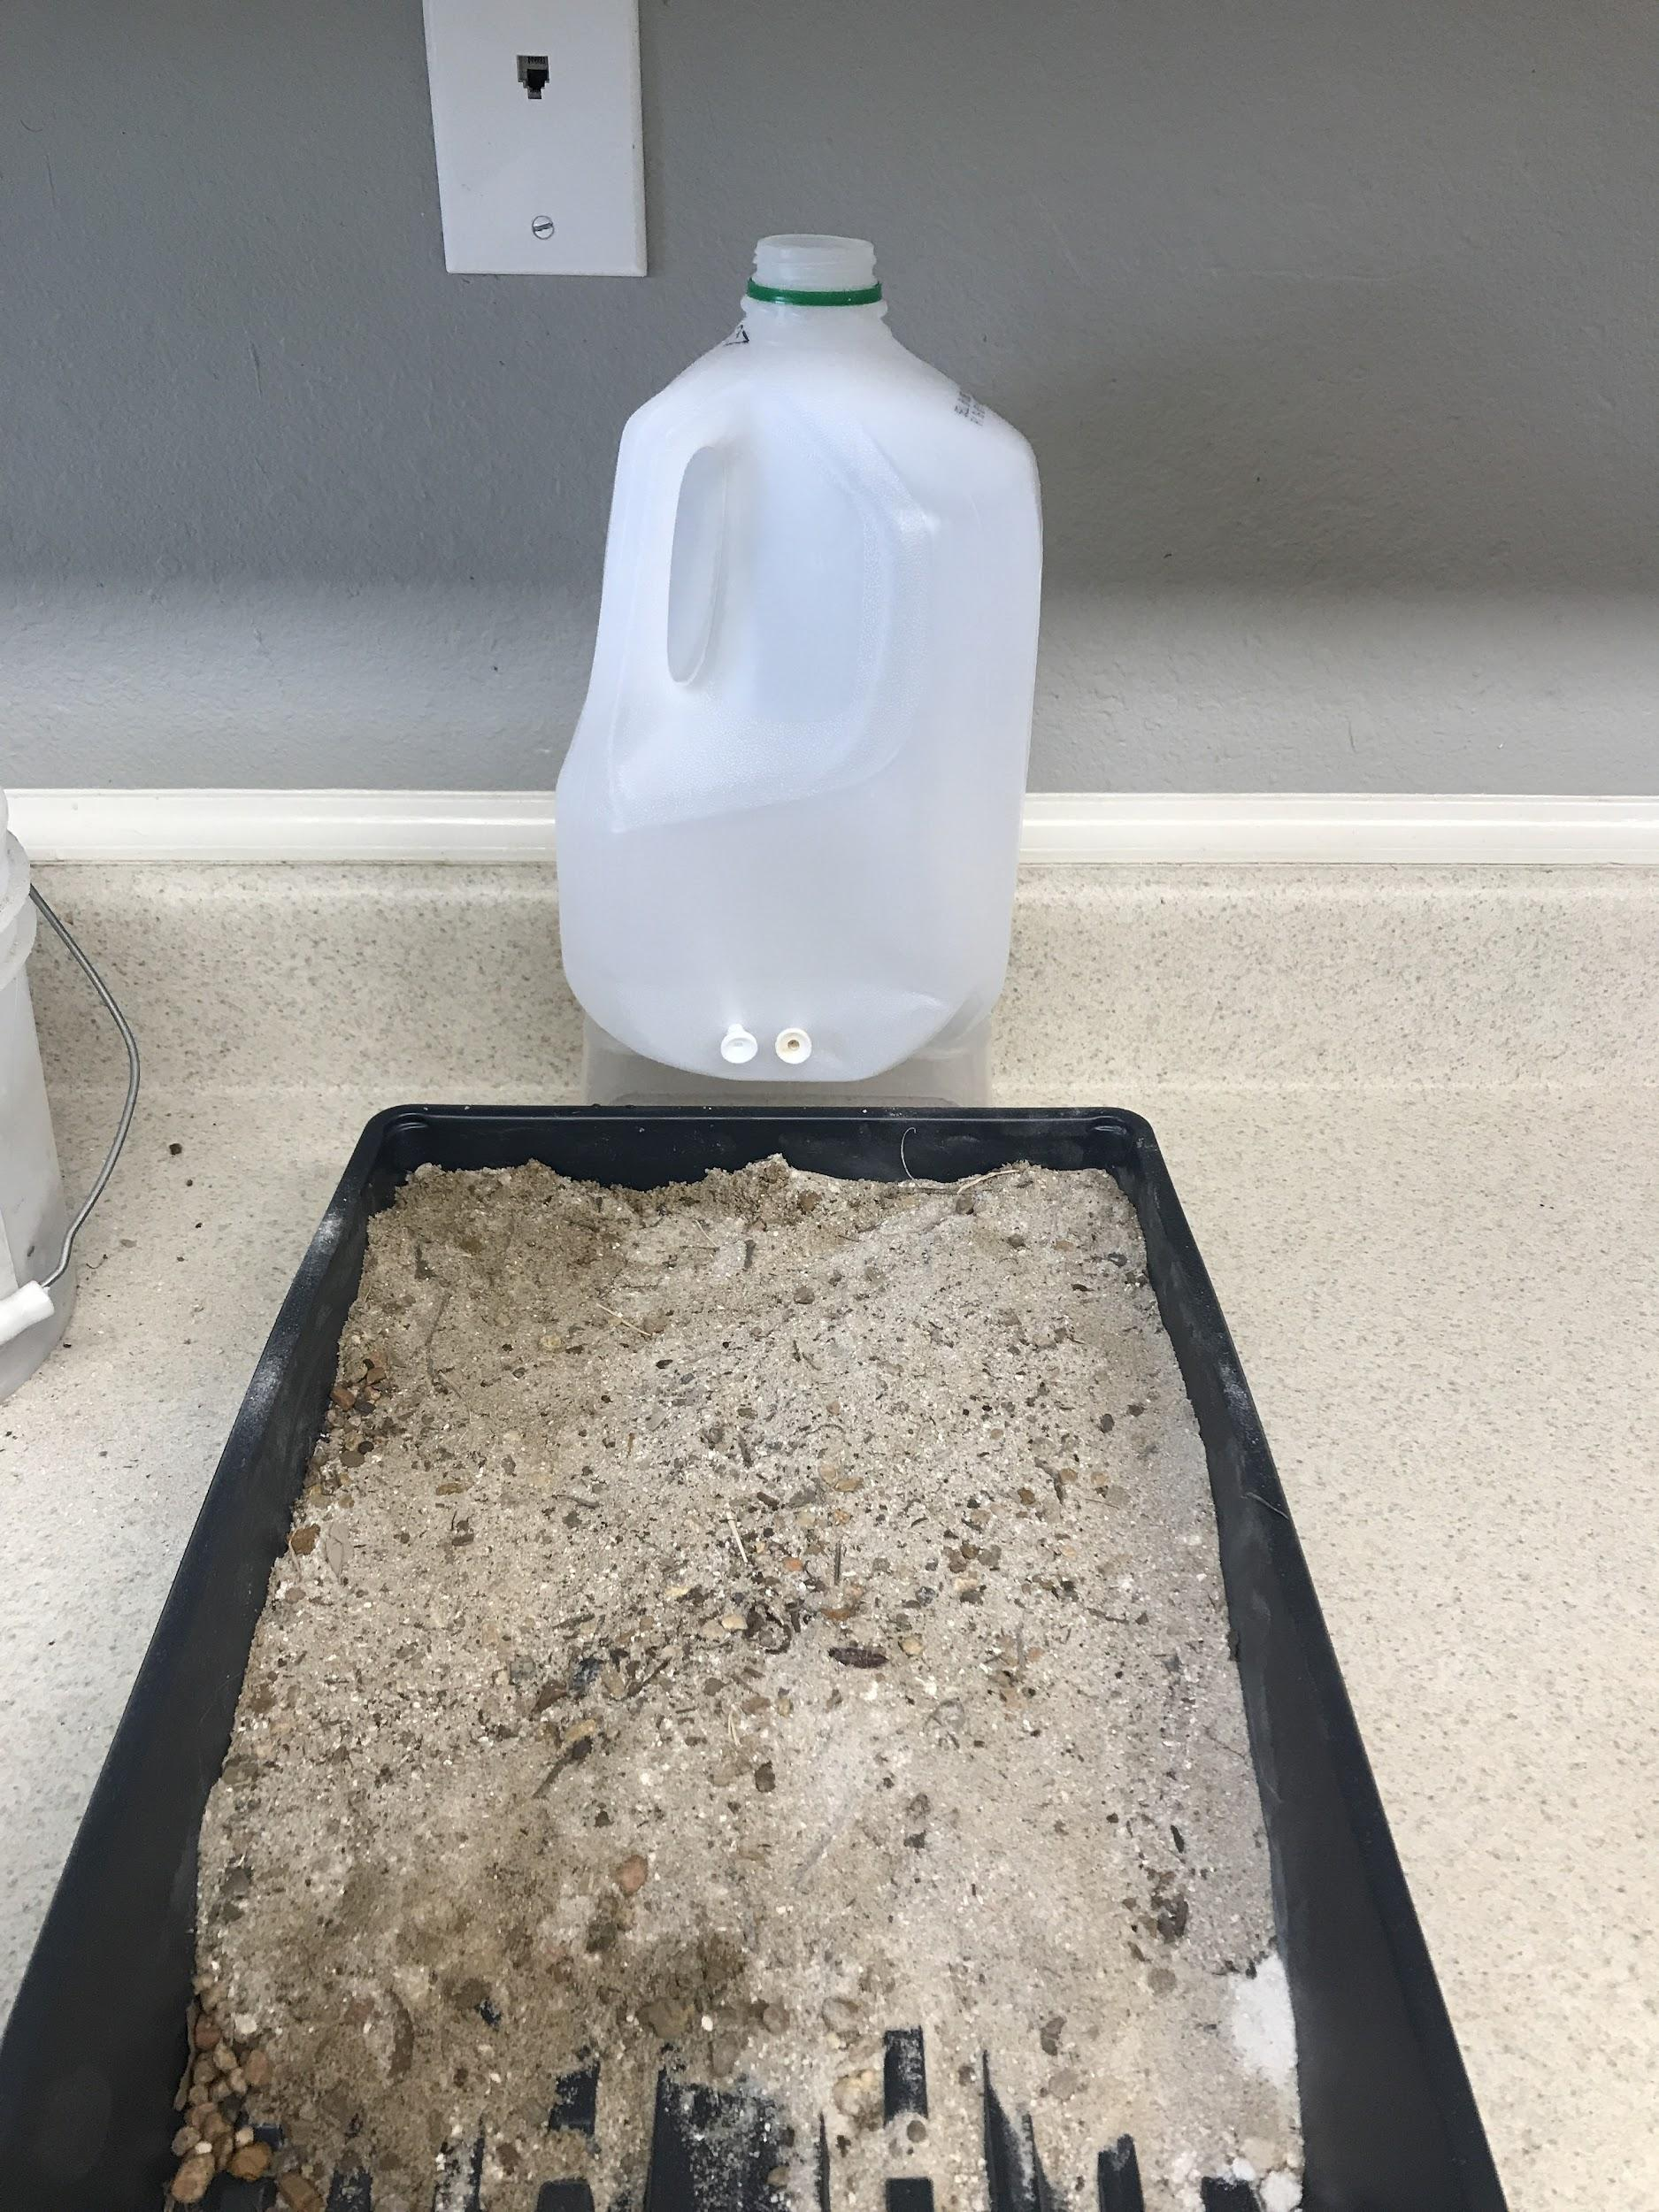
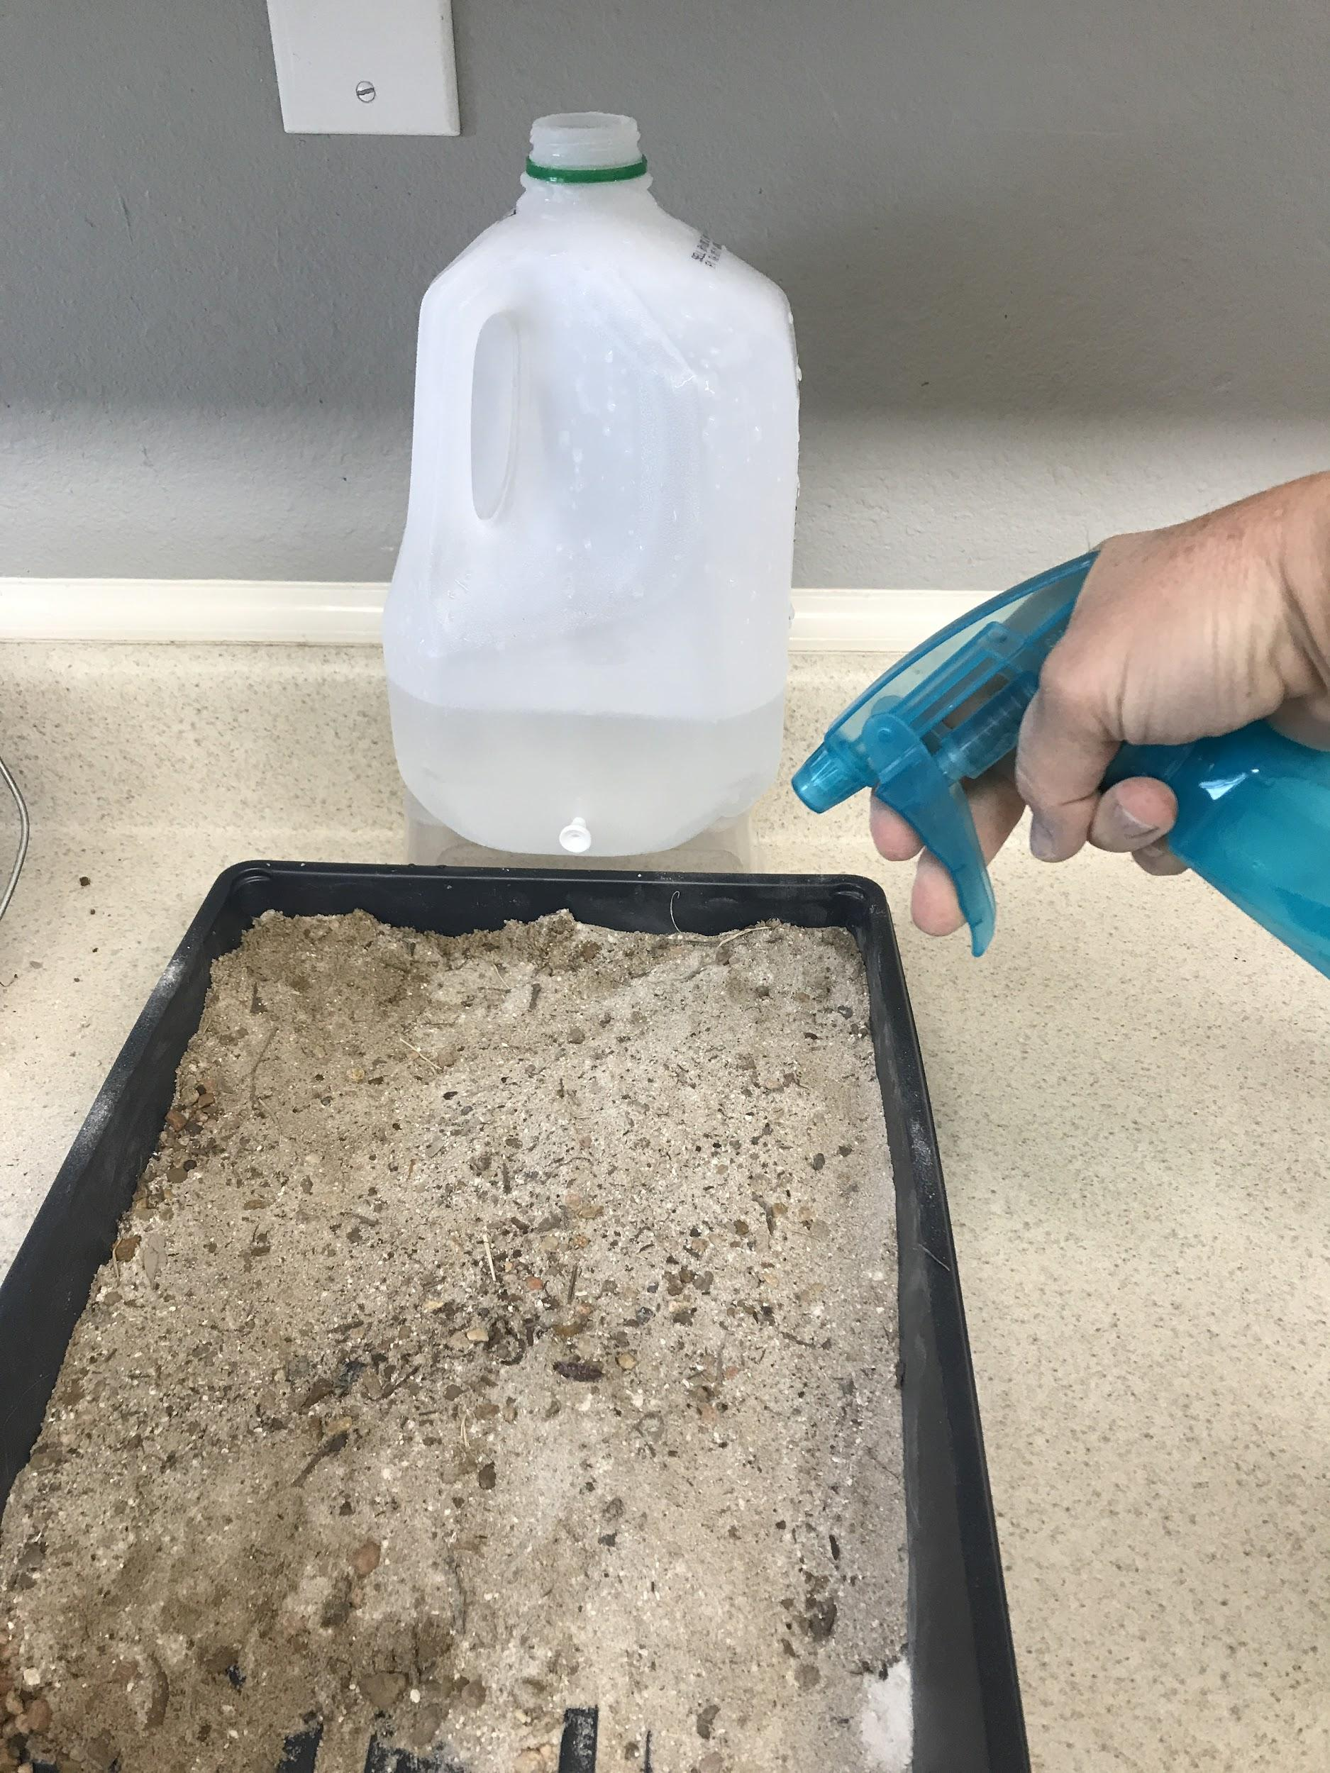
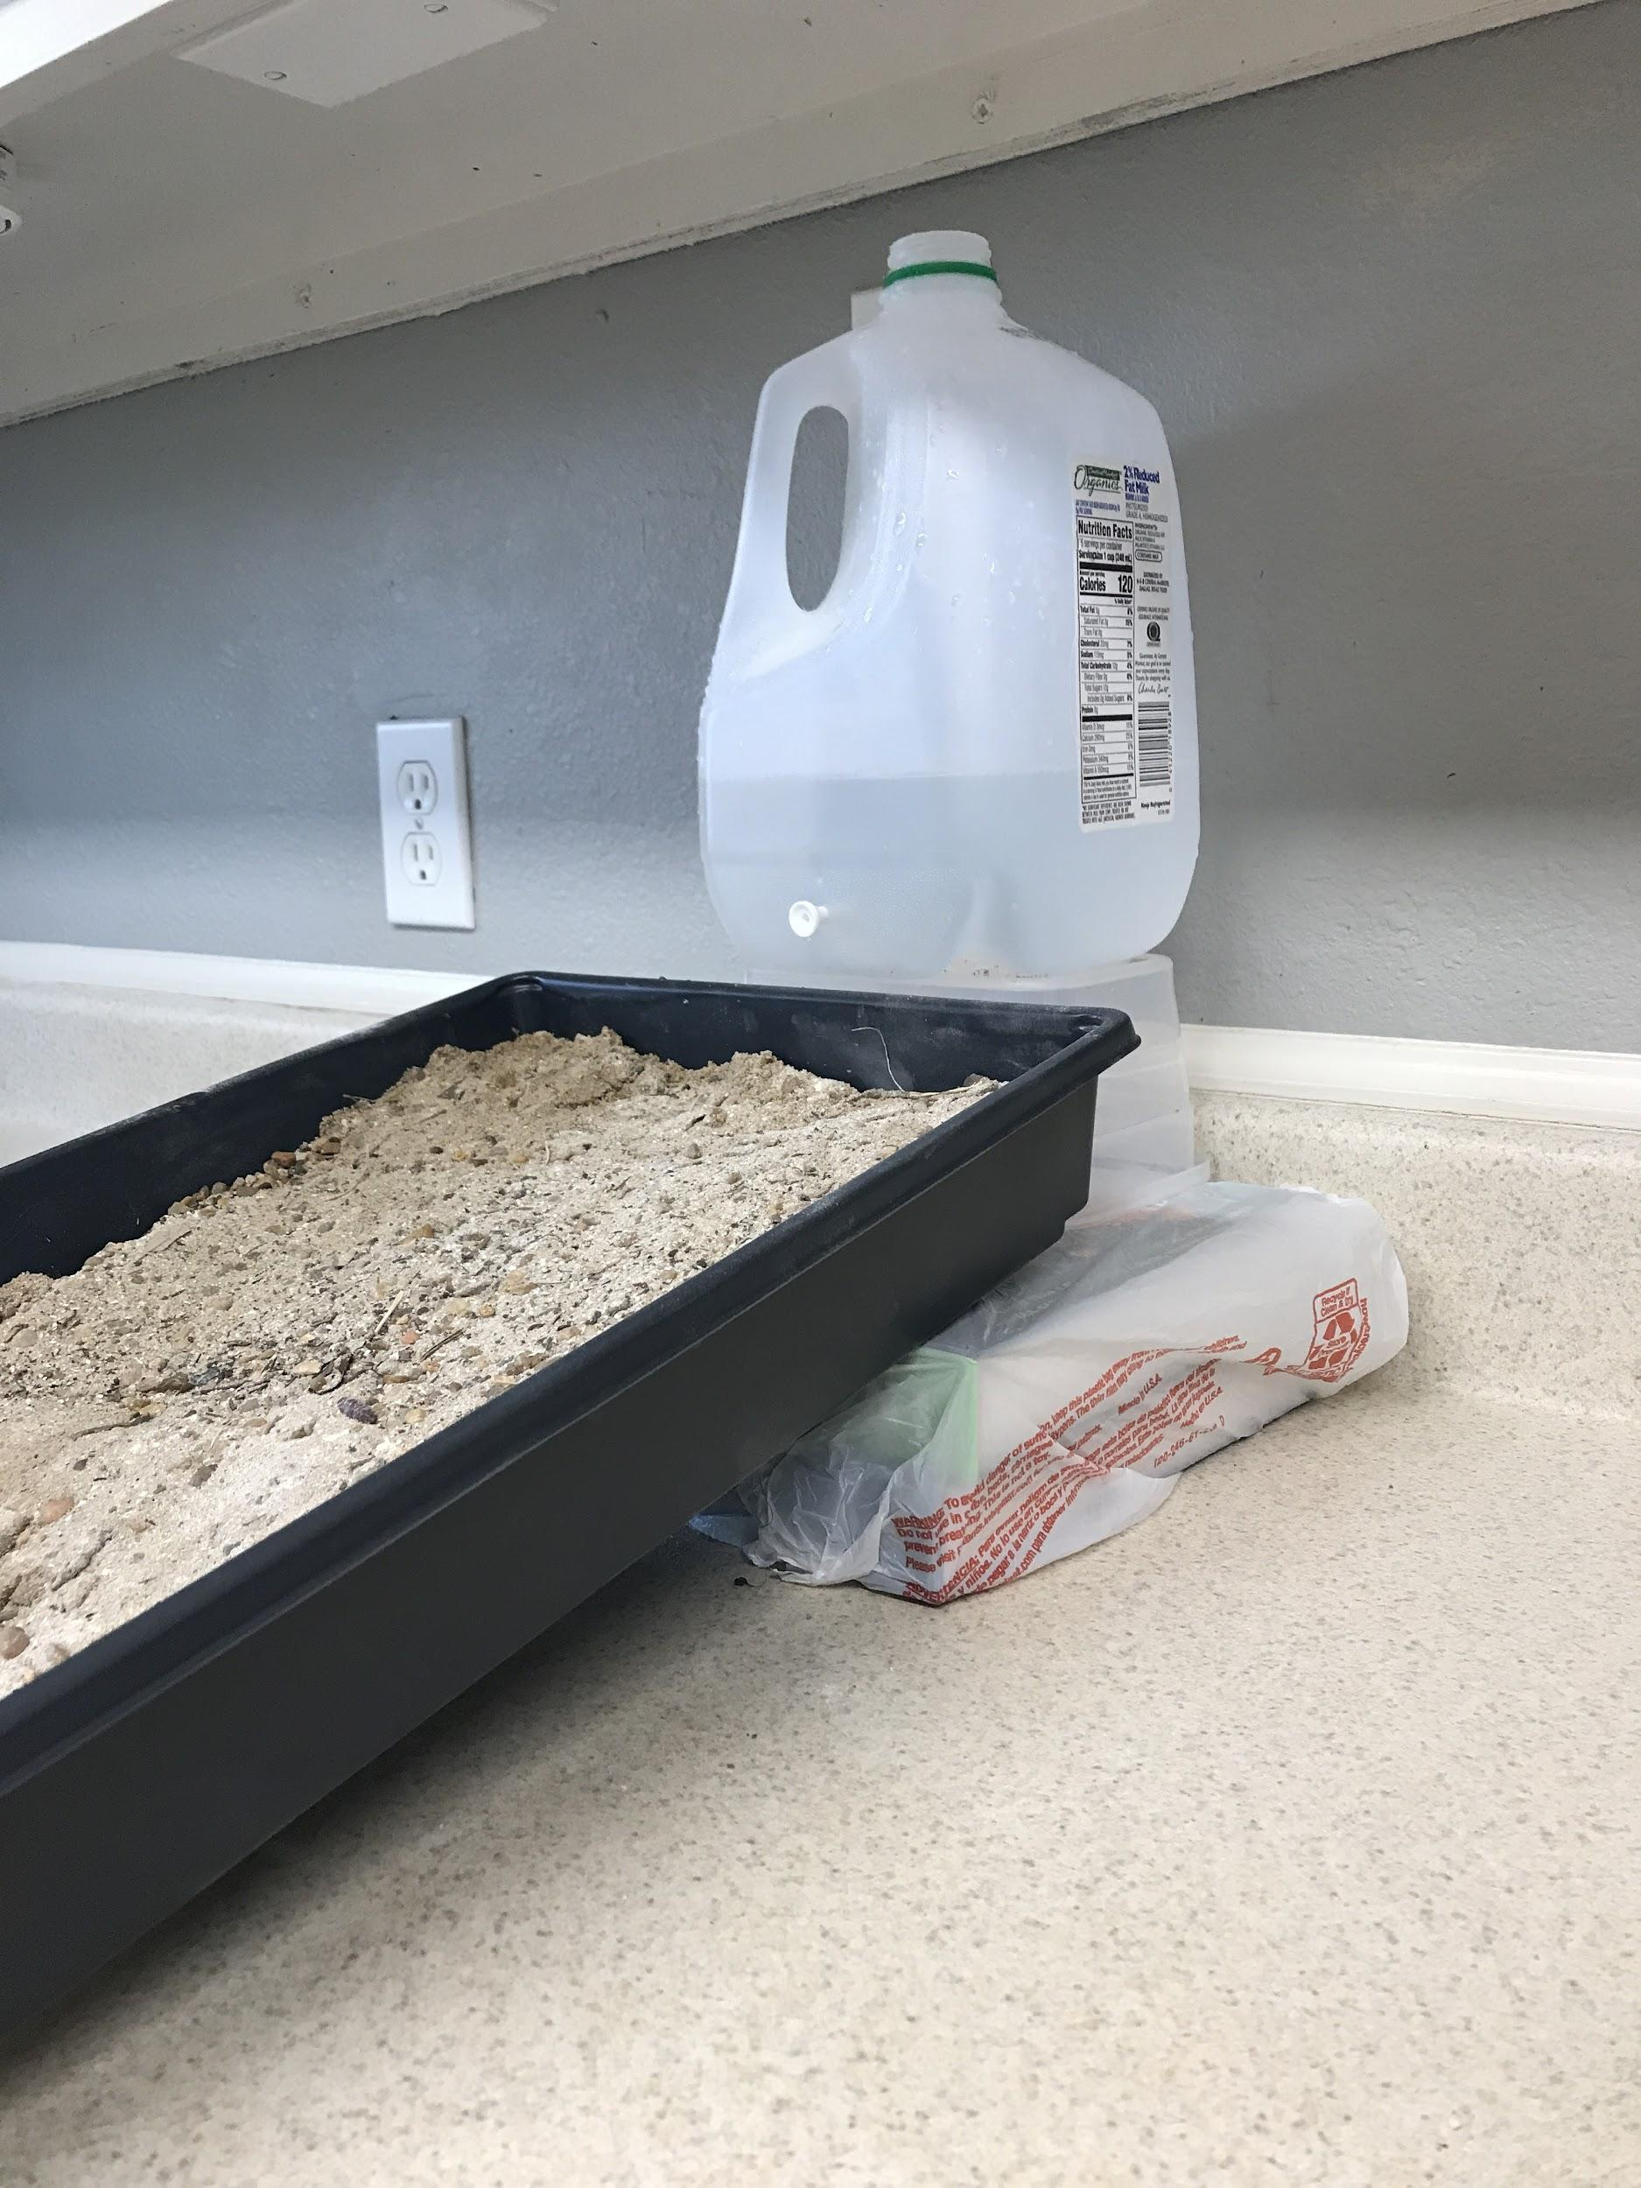
rocks and sand
plastic plants for vegetation
two holes for more water
books for steeper slope
spray bottle for rain

Slide 7
Stream Table from Lesson 2 (comparison)
NOTE TO TEACHER: Insert video from Lesson 2 stream table for students to use as a comparison.

Slide 8
Investigation Follow-up
What can we say about what changes how fast a delta can grow?
What can you say about erosion and deposition?
What is our evidence?
What did we figure out?
Record data from other teams in part 3 of your handout.

Slide 9
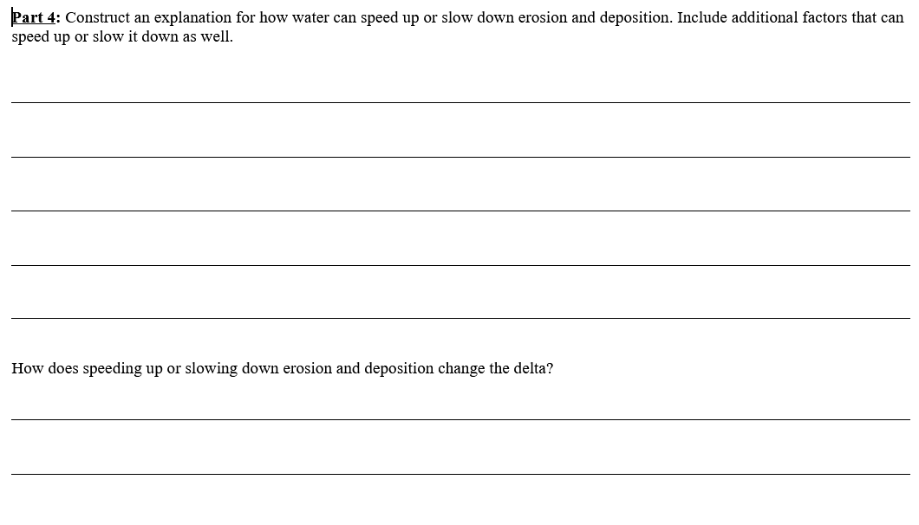
Putting It All Together
What can change how fast deltas grow?
Answer our focus question by completing part 4 of your handout.

Slide 10
What’s next?
What we know from earlier reading
The Mississippi River has been known to flood a lot, but there are so many towns and neighborhoods along the Mississippi.
There are also a lot of ships going up and down the river carrying goods to different ports.
To protect homes along the river, people, and boats, they have built dams and levees along the river to control the water.
Do you think building dams would affect erosion and deposition?
Do you think it would affect delta formation?

