Slide 1
Earth’s Changing Surface
Lesson 5
Where does the soil and rock in a delta come from, and where does it go? Does the rock and soil ever change?

Slide 2


What have we figured out?
What have we figured out about how deltas grow and shrink?

Slide 3

Lesson 5 Focus Questions
Where does the soil and rock in a delta come from, and where does it go?
Does the rock and soil ever change?
Lesson 5 Focus Questions:
Where does the soil and rock in a delta come from, and where does it go?
Does the rock and soil ever change?

Slide 4



Investigating to Answer Our Focus Questions
Complete investigation A.
2. When you finish investigation A, work with your group and
read the Lesson Focus Questions,
talk about any ideas the activity gave you to answer the focus questions, and
write your ideas in your science notebook (in complete sentences).
3. Repeat with investigations B and C.

Slide 5
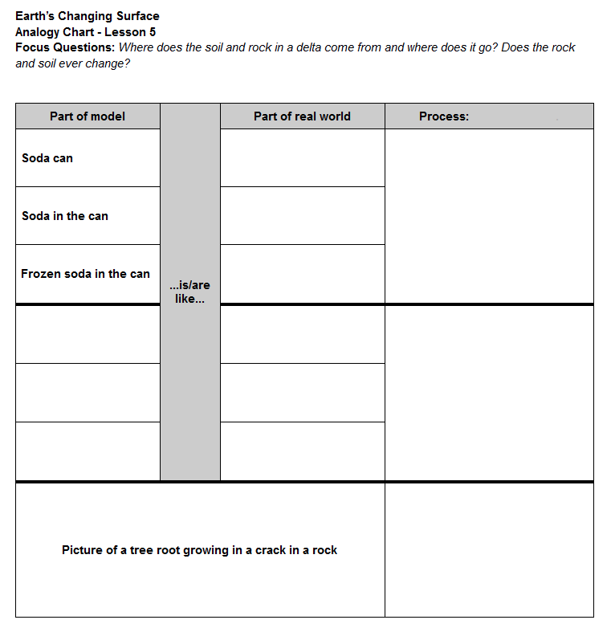
Analogy Chart

Slide 6
Investigating to Answer Our Focus Questions
Complete investigation A.
2. When you finish investigation A, work with your group and
read the Lesson Focus Questions,
talk about any ideas the activity gave you to answer the focus questions, and
write your ideas in your science notebook (in complete sentences).
3. Repeat with investigations B and C.

Slide 7
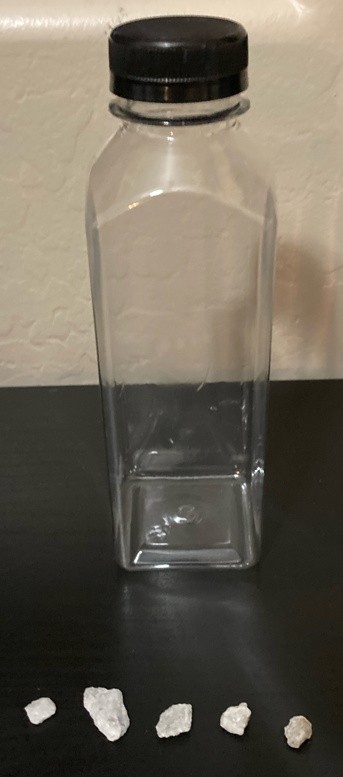
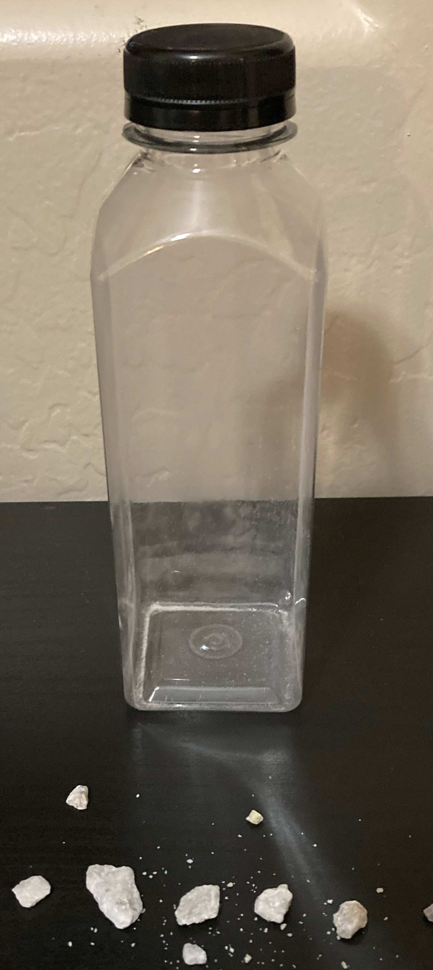
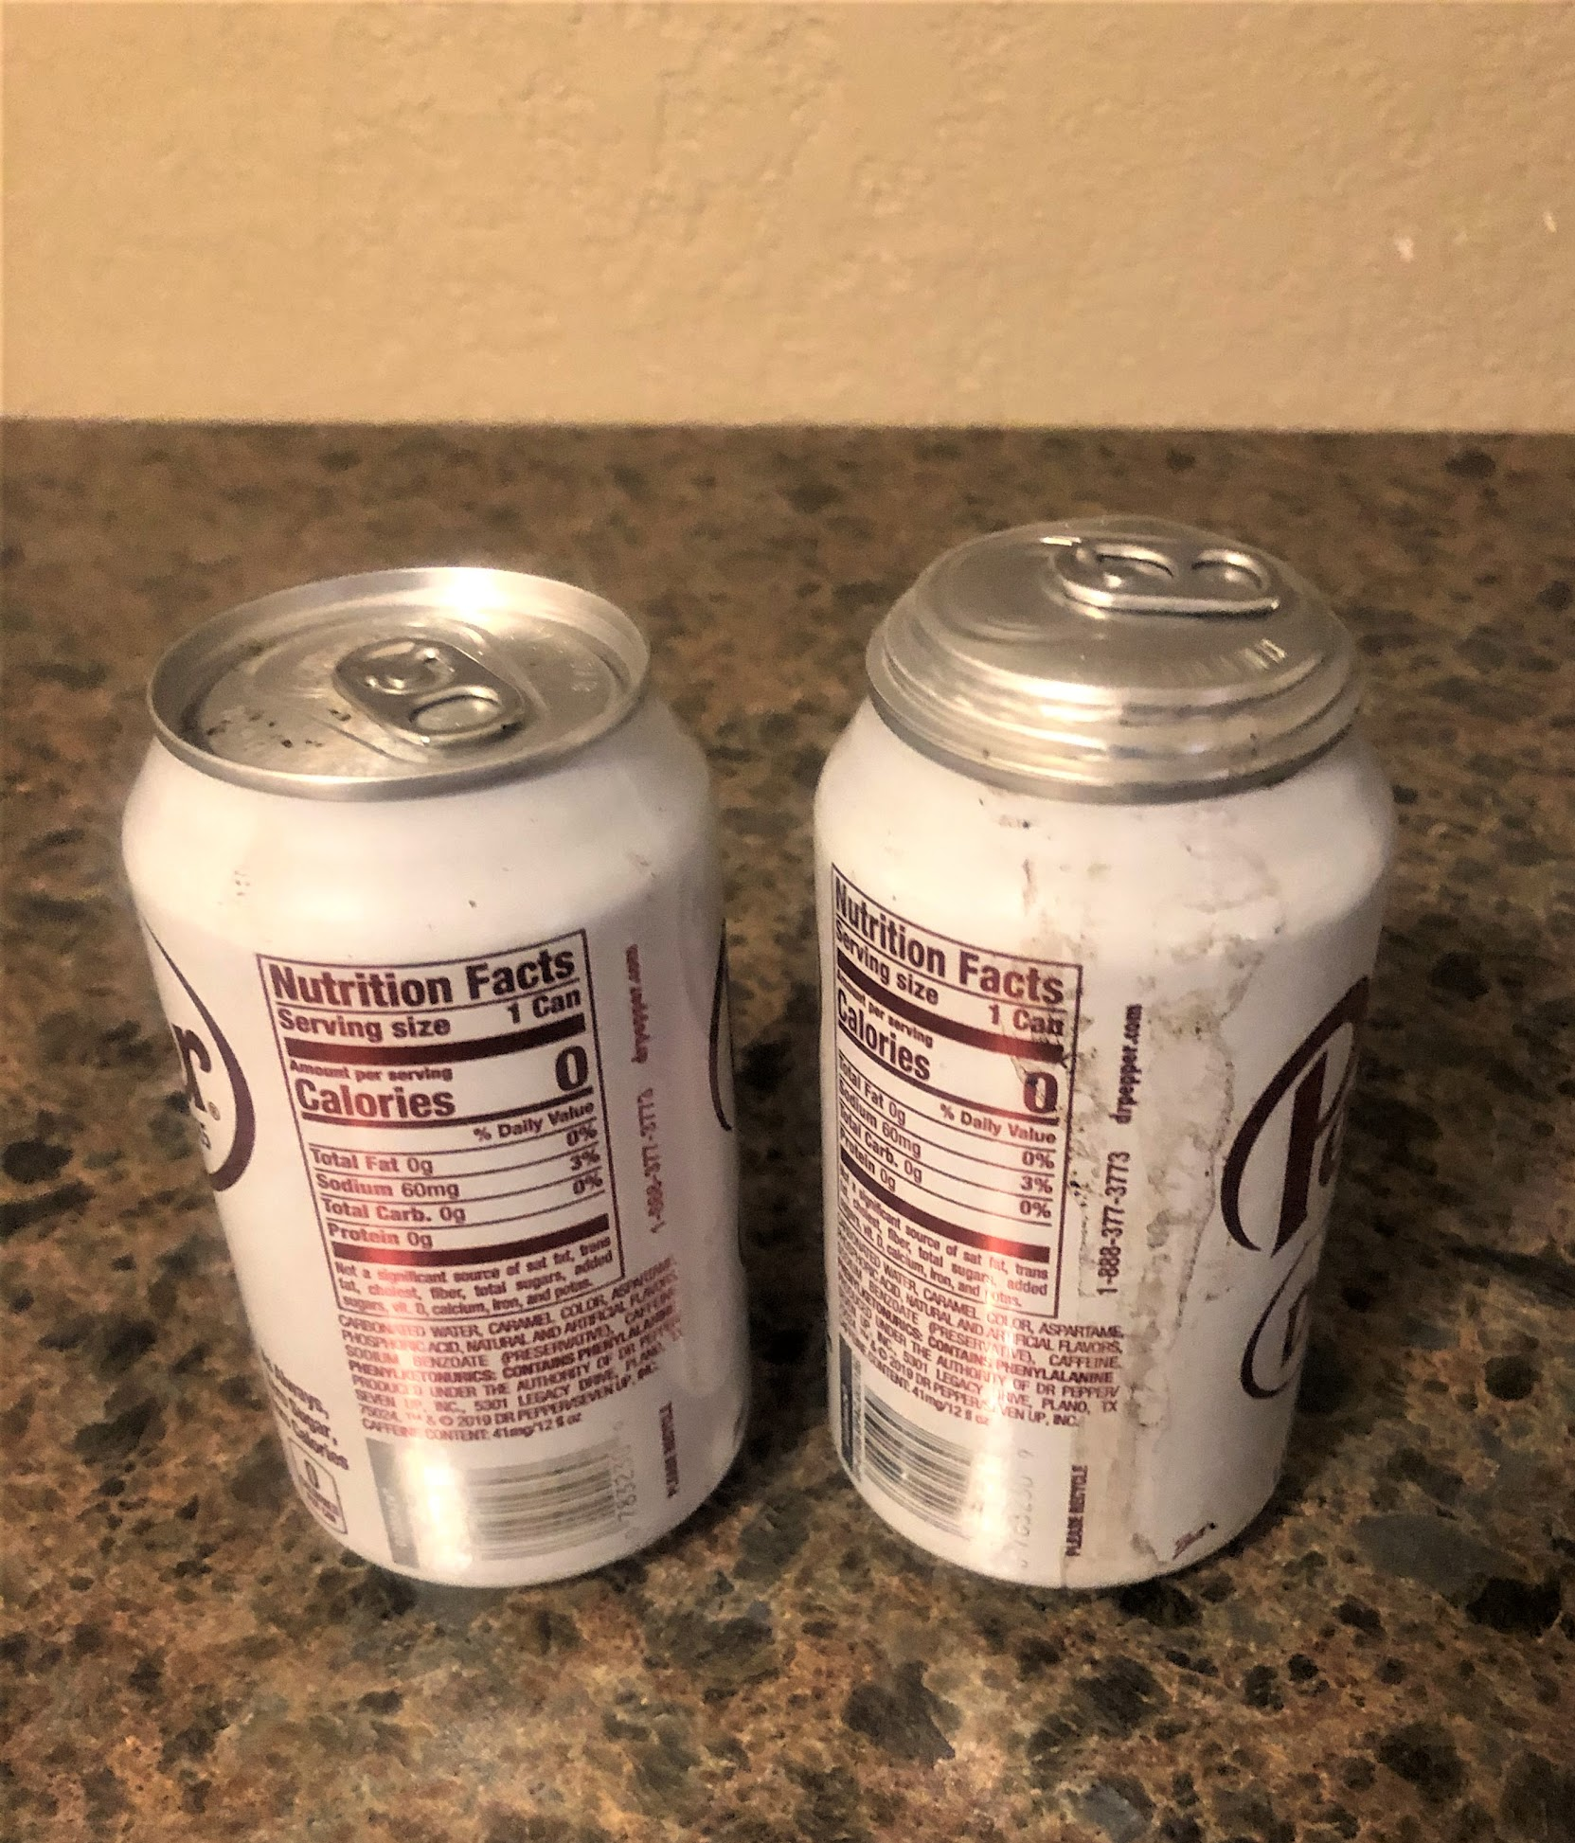
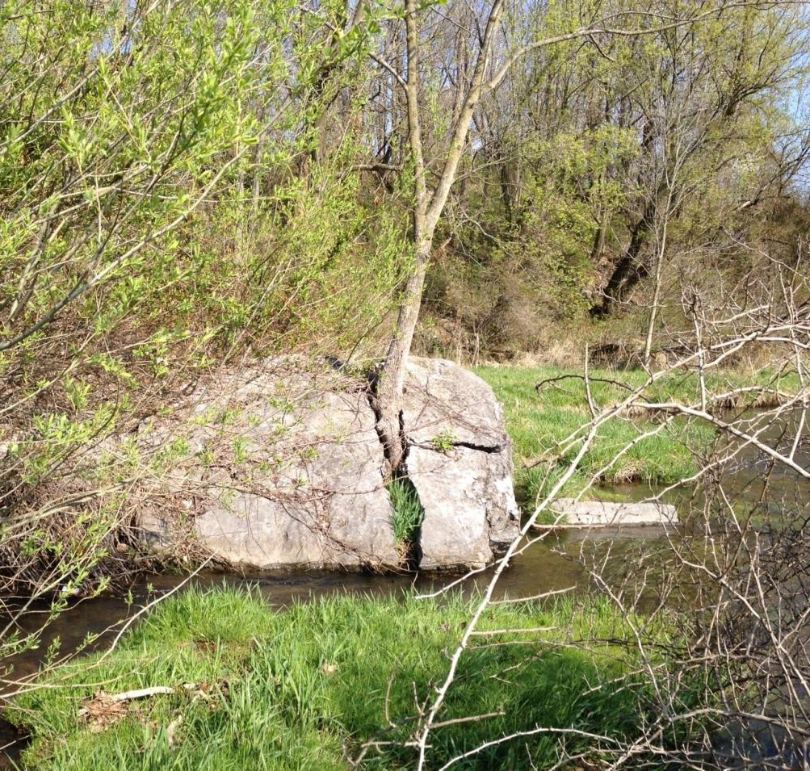
What do these investigations have in common?

Slide 8
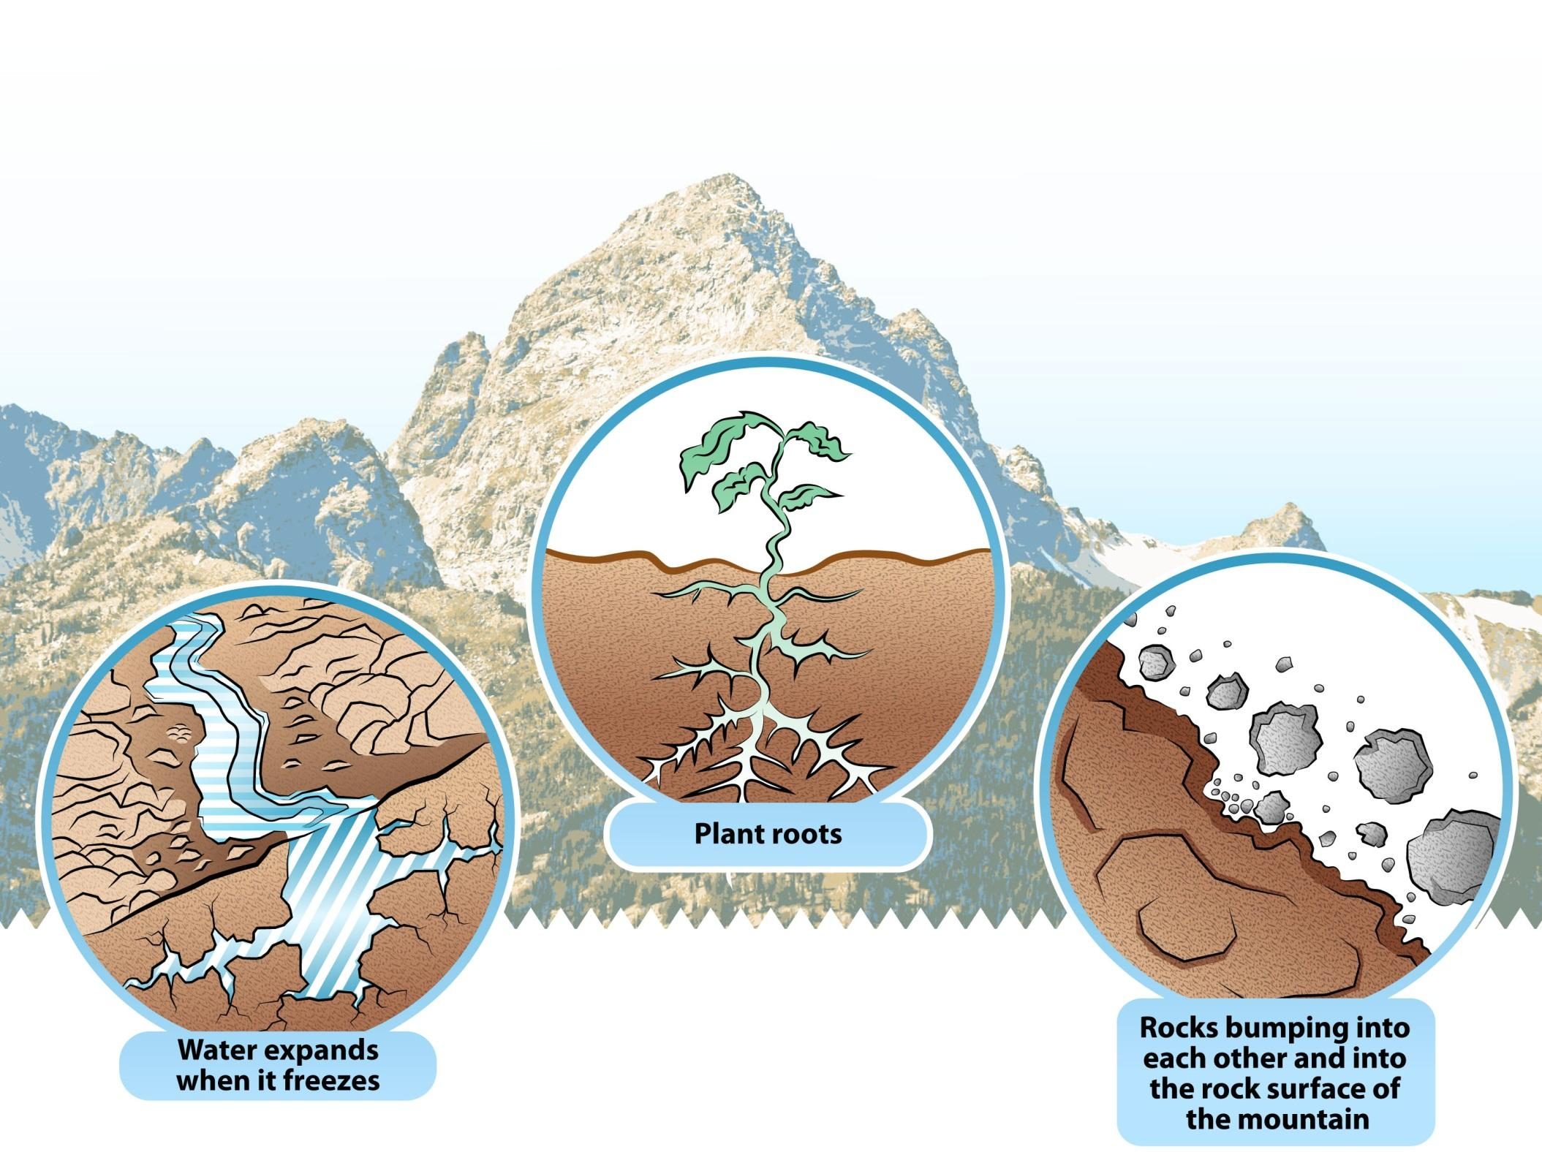
Weathering Processes
Weathering: the process that causes rock to crack, crumble, and break down into smaller and smaller pieces

Slide 9
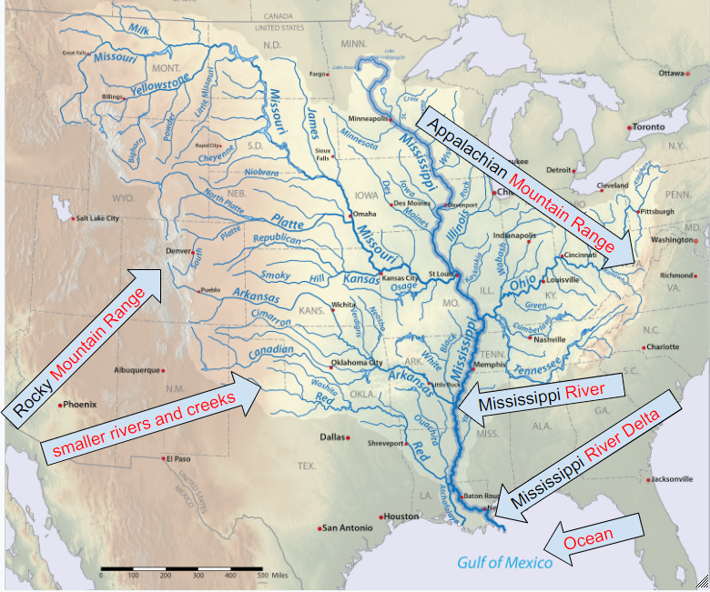

Slide 10
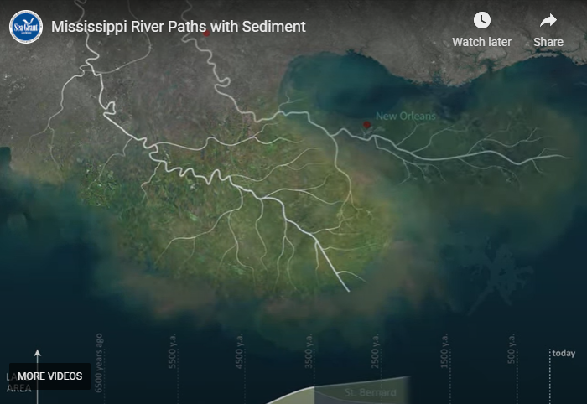
The Life of the Mississippi Delta
animation link

Slide 11
Putting It All Together
Why does the Mississippi delta look the way it does?
Lesson 5 Focus Questions
Where does the soil and rock in a delta come from, and where does it go?
Does the rock and soil ever change?
Lesson 5 Focus Questions:
Where does the soil and rock in a delta come from, and where does it go?
Does the rock and soil ever change?
Write an explanation to answer the focus questions.
Draw sketches to help explain your thinking.

Slide 12
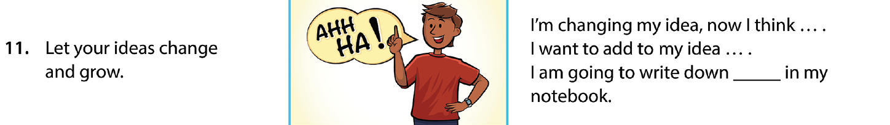
How have your ideas changed?
Turn and talk with your partner.
Use row #11 from the CSW poster if you need help getting started.
What questions from our DQB can we answer now?

Slide 13
What other landforms can we explain?

