Slide 1
Energy: Every Day, Everywhere
Lesson 1:
Launching an Investigation of Energy

Slide 2
What do we know and wonder about energy?
Know | Wonder

Slide 3
Lesson 1: Focus Question
How do we know if something has energy?

Slide 4
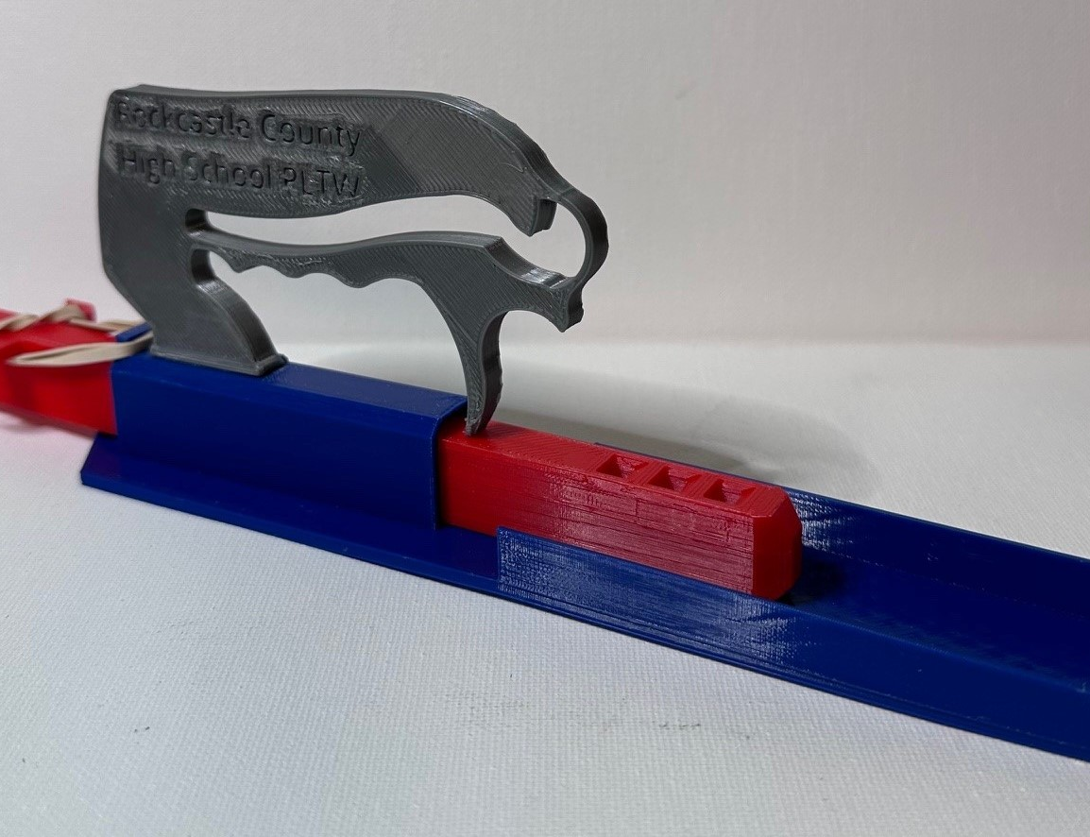
Car Launcher System
Identify the parts of the car launcher system.

Slide 5
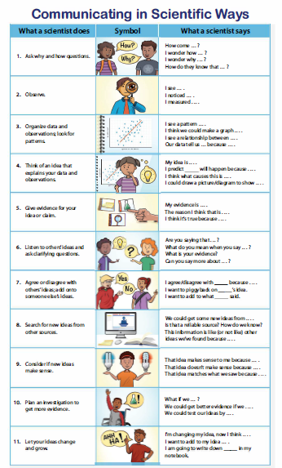
Communicating is Scientific ways

Slide 6
Car Launcher System
Do any of the parts of the car launcher system have energy?

Slide 7
Explore the Car Launcher System
Launch the car one time.
Add observations to the “Notice” column.
Add a question to the “Wonder” column.
Something to investigate
Question about energy
Continue this process 3-4 times, adding noticings and wonderings.
Know | Wonder

Slide 8
Class Notice and Wonder Chart
Know | Wonder

Slide 9
Lesson 1: Focus Question
How do we know if something has energy?

Slide 10
Generate Questions
Write your questions on sticky notes.
Write one question per sticky note.
Write in complete sentences.
Write big and bold so your questions are easy to read.

Slide 11
Driving Question Board (DQB)
?
?
?
?
?
?
?
?
?
?
?
?
?
?
?

Slide 12
Unit Central Question
How does the energy of an object or system change?

Slide 13
How did using the CSW sentence stems help you think like a scientist?

Slide 14
Next Steps
Next class, we will investigate ...

