Slide 1
Energy: Every Day, Everywhere
Lesson 5: Energy Coming and Going

Slide 2
Important Science Ideas We Have Figured Out

Slide 3
Lesson 5: Focus Question
Where does the energy come from, and where does it go when changes happen in a system?

Slide 4
Energy System Diagram
System Diagram Key Components
The parts of the system
Observable changes taking place
Where in the system are energy changes occurring?
Where does the energy come from?
Where does the energy come go?

Slide 5
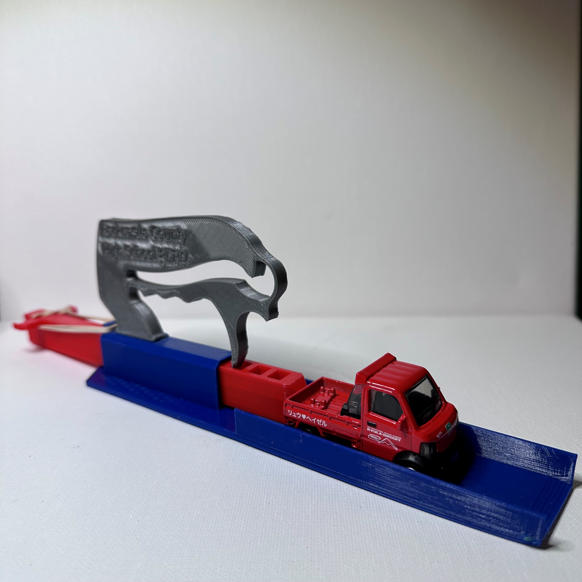
System Diagram: Car Launcher System

Slide 6
Car Launcher System Diagram: Feedback
Use sticky notes to give feedback to the other group with which you traded system diagrams.​
Does the system diagram identify the key components?​
  The parts of the system
  Observable changes taking place
  Where in the system are energy changes occurring?
  Where does the energy come from?
  Where does the energy come go?

Slide 7
Car Launcher System Diagram: Revisions
Use the feedback you received from the other group to revise your energy system diagram.​
  Sort and group the sticky notes.​
  Discuss as a group if you will accept or reject each piece of feedback. ​
  Make your revisions by using a single line through changes and using a different color for added information.​

Slide 8
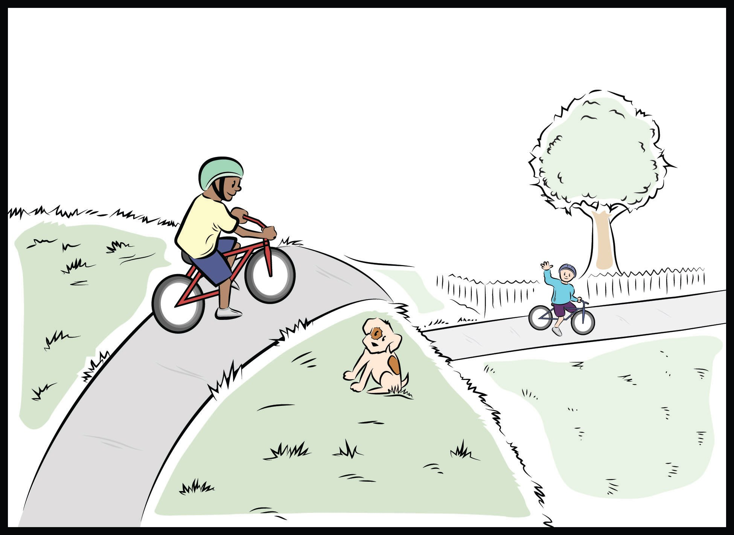
Mumford and Leroy’s Big Crash!
Part 1

Slide 9
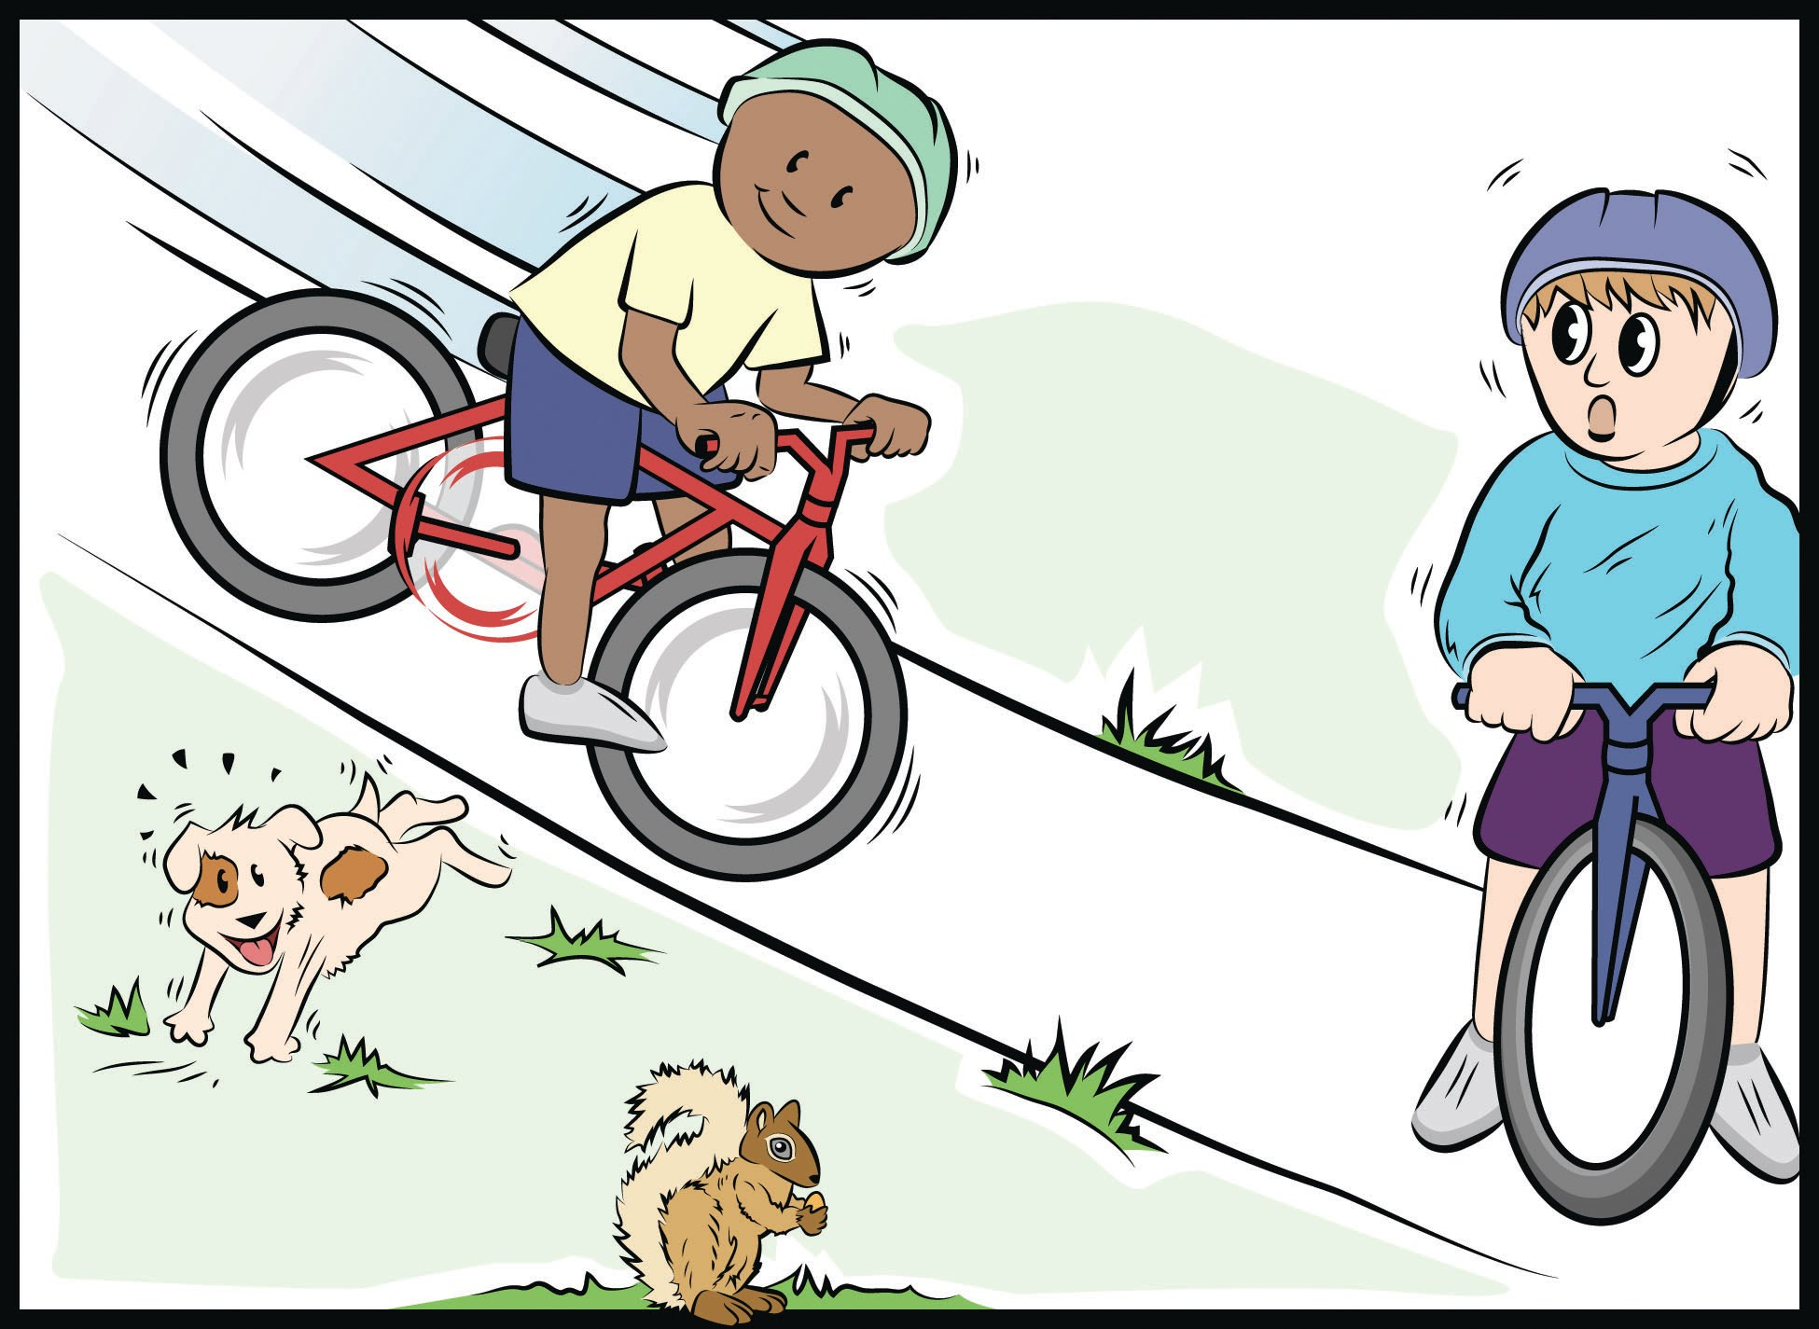
Mumford and Leroy’s Big Crash! (Part 1 cont’d)
Make a prediction in your science notebook about what you think will happen next.
I predict when Mumford and Leroy collide ...
I think the energy change(s) will be ...
I think this because ...

Slide 10
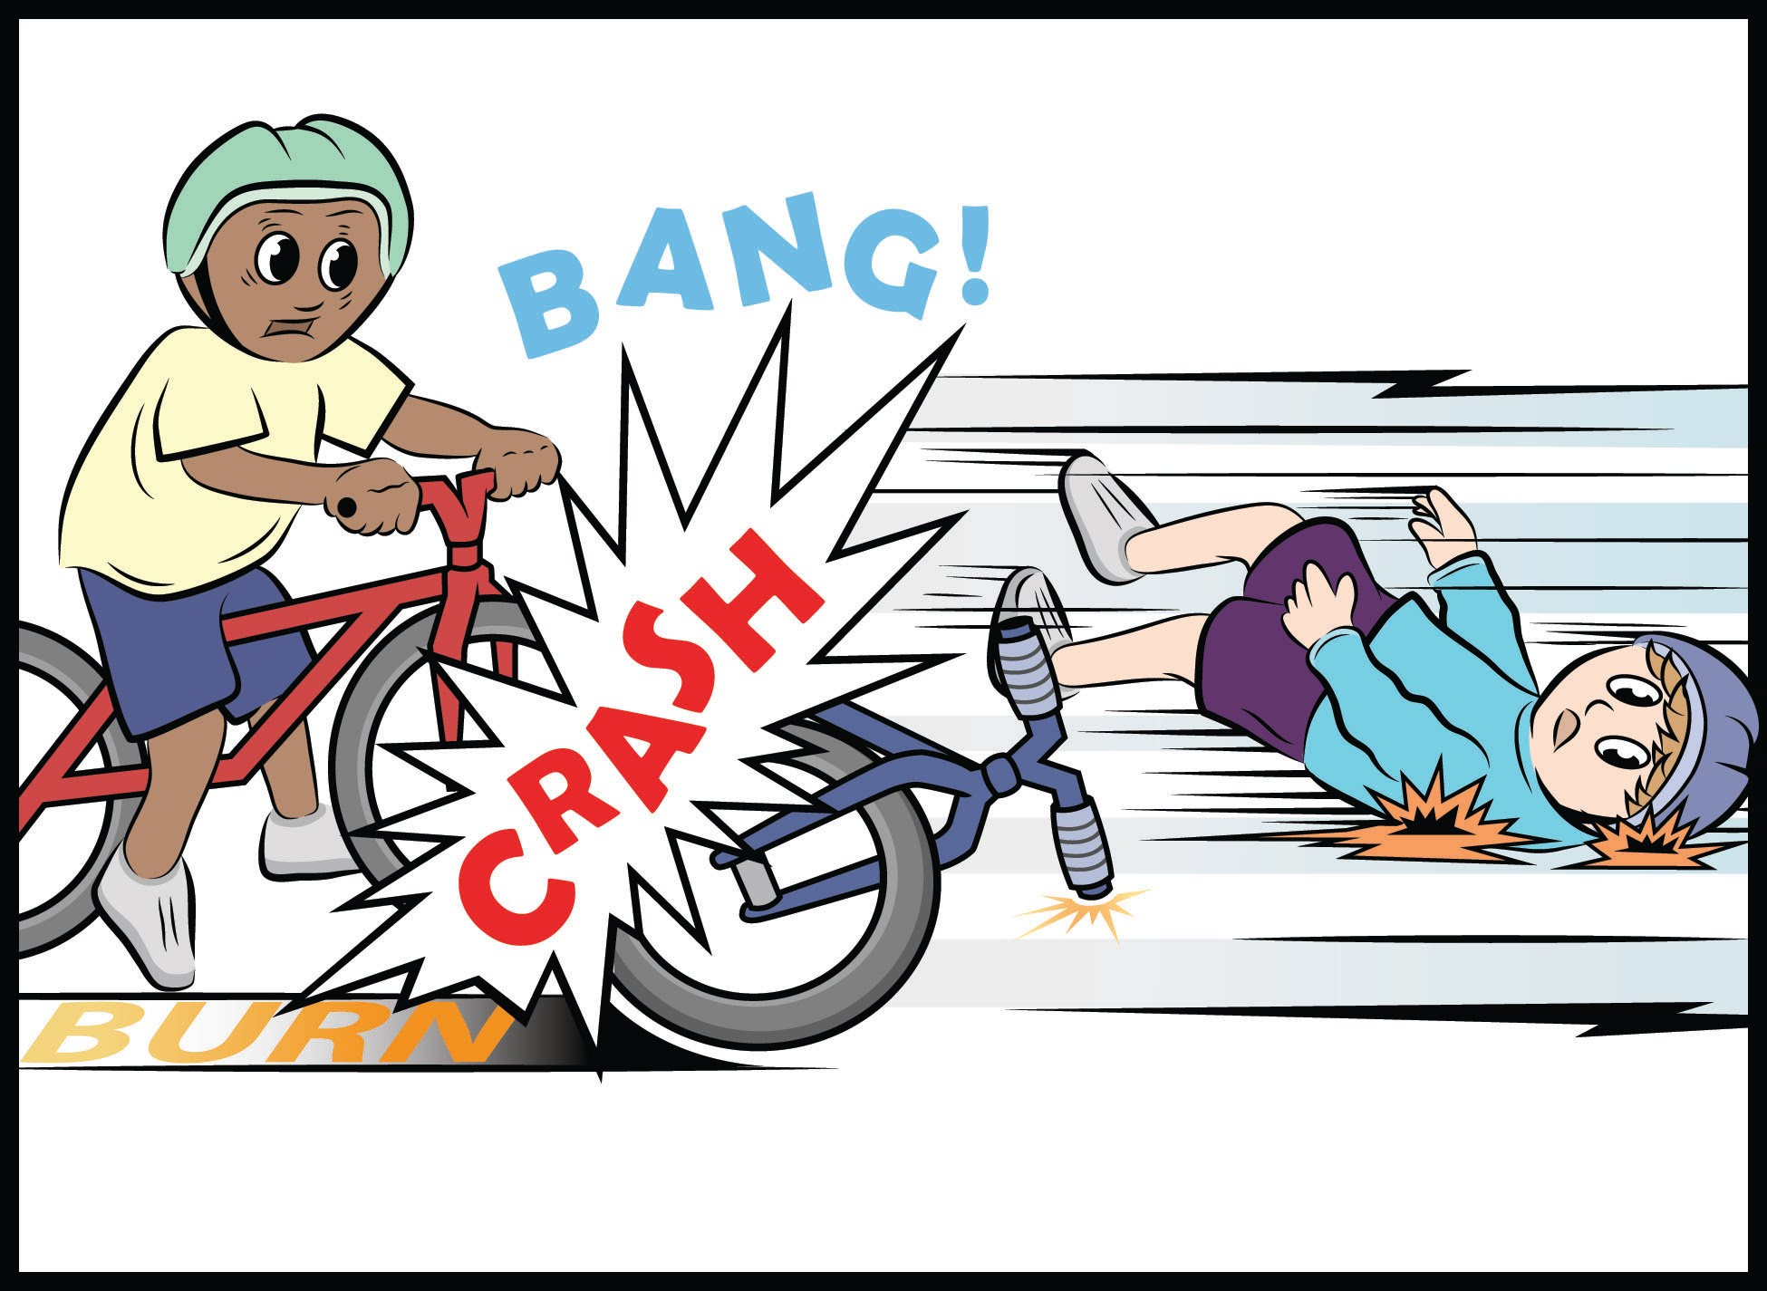
Mumford and Leroy’s Big Crash!
Part 2
Make a list of observable changes that happened when Mumford started down the hill and then collided with Leroy.

Slide 11
Mumford and Leroy’s Big Crash! System Diagram
Mumford is at the top of the hill. Leroy is at the bottom of the hill.
Mumford is rolling down the hill. Leroy is at the bottom of the hill.
Mumford collides with Leroy.
For each stage of the bike crash identify:
  The parts of the system
  Observable changes taking place
  Where in the system are energy changes occurring?
  Where does the energy come from?
  Where does the energy come go?

Slide 12
Mumford and Leroy’s Big Crash!
Explain the energy changes in energy that happened during the bike crash.
Explain how these changes are similar to or different from the changes in the car launcher system.

Slide 13
Unit Central Question
    How does the energy of an object or system change?

