Slide 1
Sun’s Effect on Climate
Lesson 3

Slide 2
Unit Central Question
Why are some places on Earth hotter than others at different times of the year?

Slide 3
Link to Previous Lesson
Think-Pair-Share
What did you learn last time that might help you answer our Unit Central Question?
Why are some places on Earth hotter than others at different times of the year?
Use your science notebook and graphs and charts for evidence.

Slide 4
Link to Previous Lesson
Here’s what we know so far …
Earth is round like a ball, so the Sun’s light hits some places more directly and other places less directly.
The sunlight is more intense (more concentrated) near the equator, so average temperatures are higher.
The sunlight is less intense (more spread out) as we move closer to the poles, so average temperatures are lower in those places.

Slide 5
Lesson 3 Focus Question
Why is it summer in the United States (North America) when it is winter in Argentina (South America)?

Slide 6
What do you think now about the focus question?
I think it is summer in the Northern Hemisphere at the same time it is winter in the Southern Hemisphere because .

Slide 7
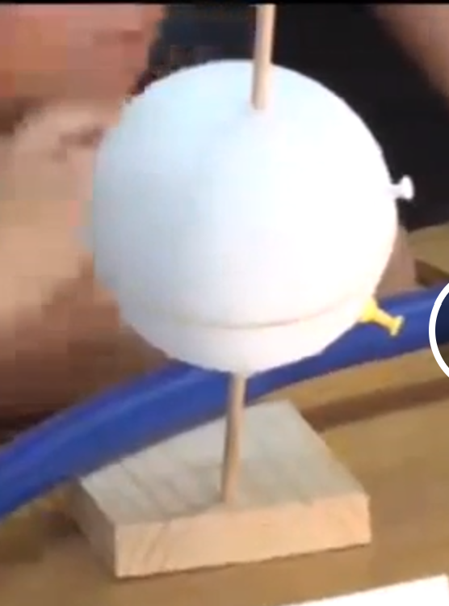
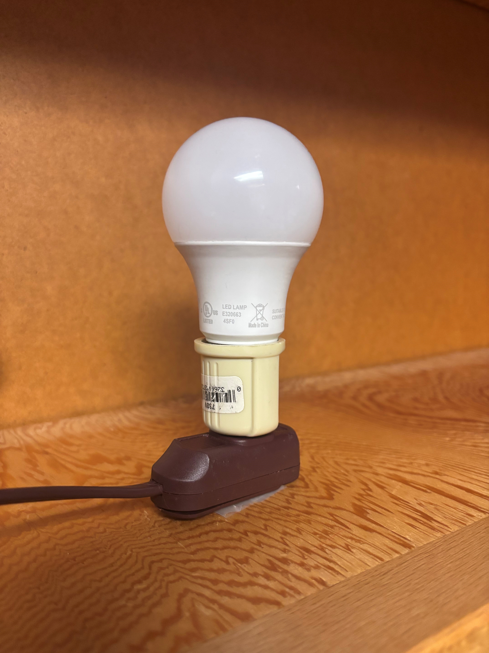
Investigation 1: What does Earth’s orbit around the Sun look like?
What does each of these materials represent in our model of Earth’s relationship to the Sun?
hula hoop
lightbulb and base
Styrofoam ball and stick
rubber band
pushpins

Slide 8
Investigation 1: What does Earth’s orbit around the Sun look like?
Use these materials to show how you think Earth orbits the Sun during one year.
Make sure everyone has a chance to work with the materials and is adding ideas.
Think about the focus question as you work.

Slide 9
Investigation 1: What does Earth’s orbit around the Sun look like?
First, let’s think about our model.
How do you think this representation of Earth and the Sun are like the real thing?
In what ways is our representation different from the real Earth and Sun?

Slide 10
Investigation 1: What does Earth’s orbit around the Sun look like?
Now, let’s have a group demonstrate how Earth orbits the Sun each year.
Where would different places on Earth have summer and winter in your orbit?
Observe and listen carefully as each team shares.
I/We (agree/disagree) because ___________.
Our evidence is _______________________.

Slide 11
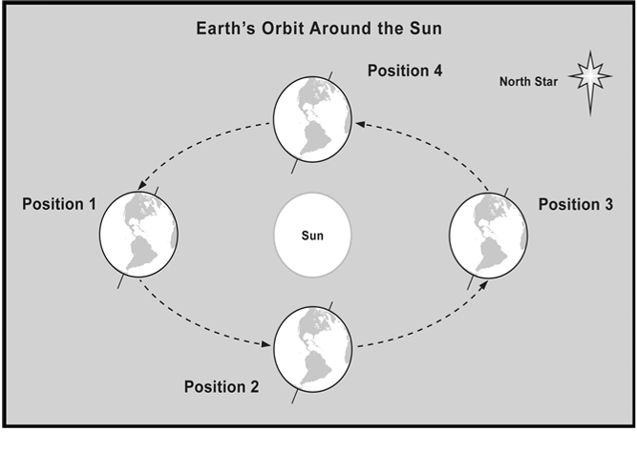
Investigation 2: Why does Earth’s tilt matter?

Slide 12
Investigation 2: Why does Earth’s tilt matter?
What do you notice about Earth’s tilt on its axis in this diagram?
How can we make sure our Earth model’s axis always tilts in the proper direction?
Pay attention to the North Star!

Slide 13
Investigation 2: Why does Earth’s tilt matter?
Let’s move Earth for another year in its orbit around the Sun.
In each of the four positions on the diagram,
record which season the Northern Hemisphere experiences.
record which season the Southern Hemisphere experiences.
Be prepared to share your ideas about the Lesson Focus Question: Why is it summer in the United States (Northern Hemisphere) when it is winter in Argentina (Southern Hemisphere)?

Slide 14
Investigation 2: Why does Earth’s tilt matter?
Let’s first look at Earth in position 1.
What part of Earth receives more sunlight?
What season is it in the Northern Hemisphere when Earth is in that position?
What season is it in the Southern Hemisphere?
During which months of the year is Earth moving between positions 1 and 2?

Slide 15
Investigation 2: Why does Earth’s tilt matter?
What about Earth in position 3?
What part of Earth receives more sunlight?
What season is it in the Northern Hemisphere when Earth is in that position?
What season is it in the Southern Hemisphere?
During which months of the year is Earth moving between positions 3 and 4?

Slide 16
Investigation 2: Why does Earth’s tilt matter?
What seasons do we experience in positions 2 and 4?
Describe Earth’s tilt in positions 2 and 4 relative to the Sun.
What does that say about the amount of sunlight each hemisphere receives in those positions?

Slide 17
Investigation 2: Why is it summer in the United States when it is winter in Argentina?
Use the Earth-Sun model to explain your answers to these questions:
Is Earth closer to the Sun when it is summer in the United States?
Is Earth closer to the Sun when it is summer in Argentina?
If Earth is not closer to the Sun in the summer, how can you explain why we have higher average temperatures in the summer?

Slide 18
Investigation 2: Why is it summer in the United States when it is winter in Argentina?
It is summer in the United States when it is winter in Argentina because ________________.
My evidence from our Earth-Sun model is ____________________________.
Record your ideas in your science notebook.

Slide 19
Lesson Summary: Key Science Ideas
Earth’s tilt never changes directions. It always points in one direction—toward the North Star.
Earth’s North Pole does not always point toward the Sun. Sometimes, it points away from the Sun.

Slide 20
Lesson Summary: Key Science Ideas
When the North Pole points toward the Sun, the South Pole points away from the Sun.
When Earth is in position 1, the Northern Hemisphere experiences summer and the Southern Hemisphere experiences winter.

Slide 21
Summary: Why is it summer in the United States when it is winter in Argentina?
Find your earlier answer to the Lesson Focus Question in your science notebook.
Do you still agree with your earlier ideas?
What would you like to add? Change?
Write a new summary to explain why people in the United States do not experience the same seasons as people in Argentina.
Use evidence from the Earth-Sun model.

Slide 22
Introducing the Driving Question Board (DQB)
3.
1.
2.
?
?
?
4
1.
?
?
1.
1.
1.
?
?
?
1.
?
1.
1.
?
?
1.
1.
1.
?
1.
?
?
?

Slide 23
In the next lesson, you will think about …
Does the angle of sunlight and the tilt of Earth changes the angle of sunlight that different places on Earth receive?

