Slide 1
Sun’s Effect on Climate
Lesson 6

Slide 2
Unit Central Question
Why are some places on Earth hotter than others at different times of the year?

Slide 3
Link to previous lessons
In past few lessons, we have been learning about how the Sun’s light energy affects the temperatures on Earth.
With your partner, talk about these questions:
What did we learn about the angle of sunlight as it strikes Earth’s surface?
How does the angle affect the average temperature?

Slide 4
Lesson Focus Questions
Why are some places on Earth hotter than others at different times of the year?

Slide 5
Lesson 6 Focus Questions
Today’s Lesson Focus Questions will help us put all our ideas together.
We have completed activities and collected a lot of data to help us answer our Unit Central Question: Why are some places on Earth hotter than others at different times of the year?

Slide 6
Lesson 6 Focus Questions
Why are some places on Earth hotter than others at different times of the year?
How can we use what we have learned to answer our Unit Central Question?

Slide 7
Introduction to Today’s Challenges
In small groups, you will work on one or more assigned challenges to show your understanding about why different places on Earth have different temperatures.
To do this, you will use the ideas we reviewed today as you think about the challenges.

Slide 8
Today’s Challenges
Challenge #1
Explain why the average summer temperature in Barrow, Alaska, is 4 5°F even though there are 24 hours of sunlight while Lagos, Nigeria, with only 12 hours of sunlight a day, reaches a temperature of 82°F.
Challenge #2
What do you notice about the temperatures in Belem, Brazil? Why do you think Belem, Brazil, does not have summer and winter like we do in the United States?
Challenge #3
Why is the average temperature higher in Santa Rosa, Argentina, when the average temperature in Richmond, Virginia is lower?
Why is the average temperature lower in Santa Rosa, Argentina, when the average temperature in Richmond, Virginia is higher?
Challenge #4
Which friend do you most agree with?
Describe your thinking about why it is warmer in the summer than in the winter.

Slide 9
Today’s Challenges
What to do:
First, talk to your team about your ideas related to your assigned challenge.
Then, write your answers individually in sentences in your science notebook.
Include labeled diagrams and/or drawings to help explain your ideas.
Also include any patterns we have observed and cause-effect relationships we discussed throughout our lessons.

Slide 10
Today’s Challenges: Let’s share our ideas about the challenges.
Challenge #1
Explain why the average summer temperature in Barrow, Alaska, is 4 5°F even though there are 24 hours of sunlight while Lagos, Nigeria, with only 12 hours of sunlight a day, reaches a temperature of 82°F.
Challenge #2
What do you notice about the temperatures in Belem, Brazil? Why do you think Belem, Brazil, does not have summer and winter like we do in the United States?
Challenge #3
Why is the average temperature higher in Santa Rosa, Argentina, when the average temperature in Richmond, Virginia is lower?
Why is the average temperature lower in Santa Rosa, Argentina, when the average temperature in Richmond, Virginia is higher?
Challenge #4
Which friend do you most agree with?
Describe your thinking about why it is warmer in the summer than in the winter.

Slide 11
Lesson Summary
Let’s return to our Unit Central Question: Why are some places on Earth hotter than others at different times of the year?
Think about the two parts to the question:
Why are some places hotter than others, in general?
Why are some places hotter at different times of the year?

Slide 12
Lesson Summary
Share a few ideas with your partner. Include the ideas discussed in each of our lessons:
Angle of sunlight or sunlight spread out or more concentrated
Tilt of Earth
Orbit of Earth around the Sun
Length of daylight
Labeled diagram (model)
Patterns that apply
Cause-effect relationships

Slide 13
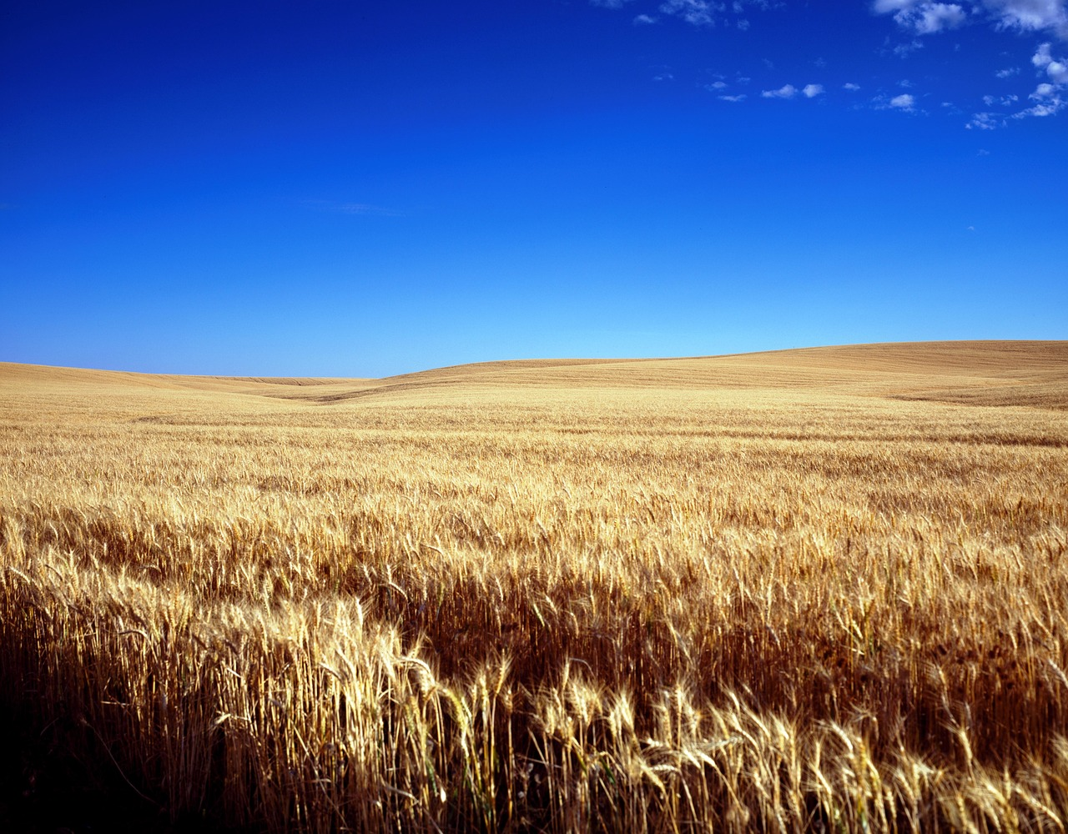
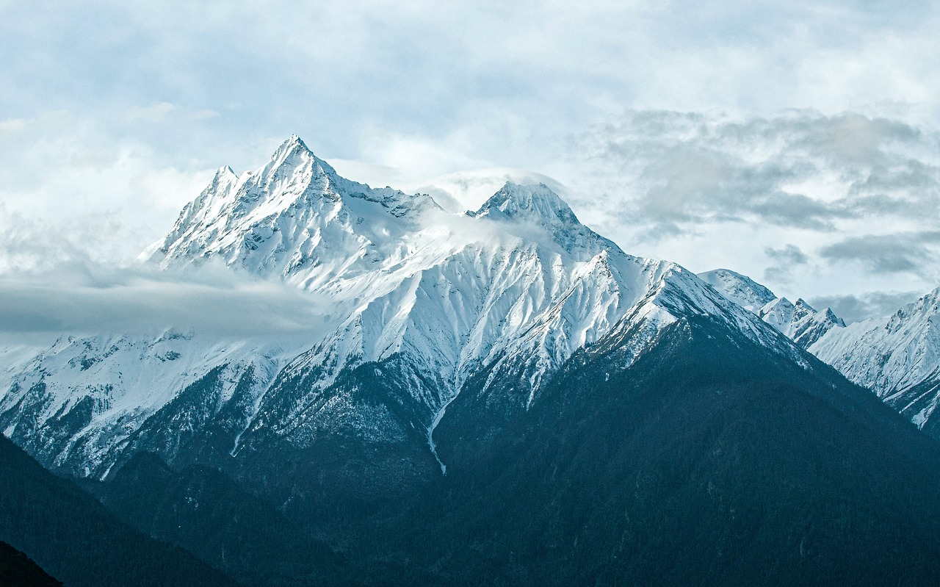
Link to Future Lessons on Climate and Weather
Seasonal climate--whether it is hot or cold at different times of the year--greatly influences the daily weather.
Seasonal climate is predictable over time, and weather is the amount of daily variability within the seasonal climate.
Image by FRANK ELISANTE from Pixabay
Image by Falkenpost from Pixabay
Image by sun jib from Pixabay

Slide 14
Meta Moment
How did developing and using models support your learning throughout this unit?
How did using the Communicating in Scientific Ways strategies help you learn?

