Slide 1
A Study of Matter and Energy in Systems
Lesson 1

Slide 2
Unit Central Question
How do matter and energy move
through a system as living things interact
with each other and their environment?

Slide 3
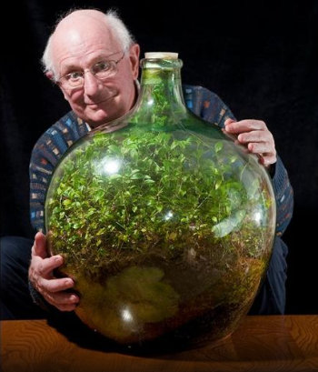
Life in a Bottle
Step 2.
Watch the videoclip
Consider
How does the plant stay alive?

Slide 4
Life in a Bottle
Step 3.
Read the article, underlining ideas that help answer your questions

Slide 5
Lesson 1 Focus Question
What are the characteristics of a system?

Slide 6
Life in a Bottle
Step 5.
Draw a picture of the terrarium
Label the parts, or components of the terrarium
Include any inputs to and outputs of the terrarium
Step 6.
Read the information about systems and system models

Slide 7
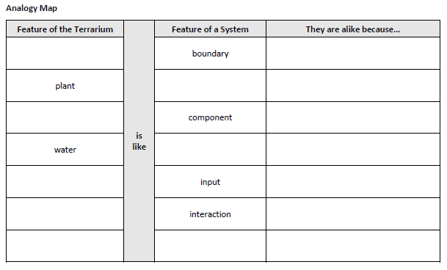
A Terrarium System

Slide 8
A Terrarium System
Step 8.
Revise your initial model of the terrarium
Add labels showing the characteristics of a system

Slide 9
Lesson 1 Focus Question
What are the characteristics of a system?
Revisit your early ideas.
If your thinking has changed, add to or revise your ideas using a different color pen/pencil

