Slide 1
A Study of Matter and Energy in Systems
Lesson 2

Slide 2
Unit Central Question
How do matter and energy move
through a system as living things interact
with each other and their environment?

Slide 3
Lesson 2 Focus Question
Where do the atoms that a plant uses
in photosynthesis come from?
Where do they go?

Slide 4
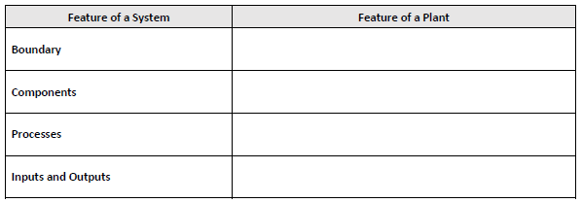
A Plant as a System
Step 2.
How can the terrarium plant be considered a system?

Slide 5
Testing for Carbon Dioxide
Step 3.
Observe the demonstration
Step 4.
Draw a labeled diagram of the investigation setup
Use a different color to show the results of the investigation

Slide 6
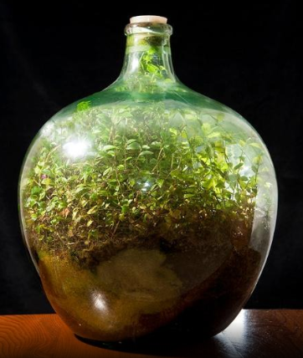
Where Does the Carbon Go?
Step 5.
Read the article
Annotate the text
Discuss the Stop and Think Questions with your group
Draw a diagram of the important ideas in the article
Be prepared to share your ideas with the whole class

Slide 7
Photosynthesis Produces Oxygen
Step 7.
Read the procedure for the leaf disk investigation
Make sure everyone in your group understands the purpose for each step
Steps 8 – 9.
Record the number of leaf disks floating in each solution
Graph your data

Slide 8
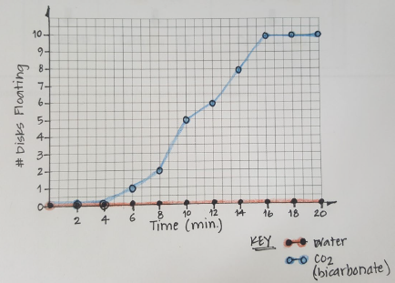
Leaf Disk Investigation
Number of Leaf Disks Floating in Water and Bicarbonate Solution
WIS
WIS
WIM
WIM
Add arrows
WIS
WIM

Slide 9
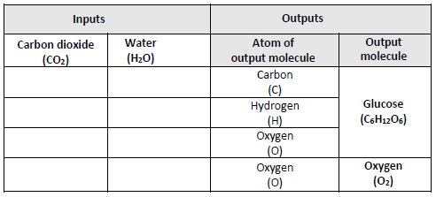
Where Does the Oxygen Come From?
Step 11.
Read and annotate the article
Step 12.
Place a check mark to show which molecule is the source of the atoms in the output molecules

Slide 10
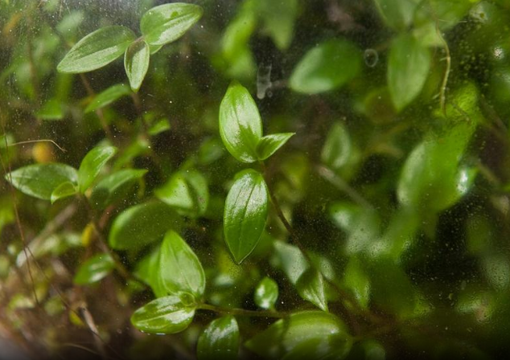
A Plant as a System
Step 13.
Create a model that shows how the plant in the terrarium is a system
Add labels showing the characteristics of a system to your model

Slide 11
Lesson 2 Focus Question
Where do the atoms that a plant uses in photosynthesis come from? Where do they go?
Revisit your early ideas and consider the activities you completed.
If your thinking has changed, add to or revise your ideas using a different color pen/pencil

