Slide 1
A Study of Matter and Energy in Systems
Lesson 3

Slide 2
Unit Central Question
How do matter and energy move
through a system as living things interact
with each other and their environment?

Slide 3
Lesson 3 Focus Question
What is the role of energy in creating the outputs of photosynthesis?

Slide 4
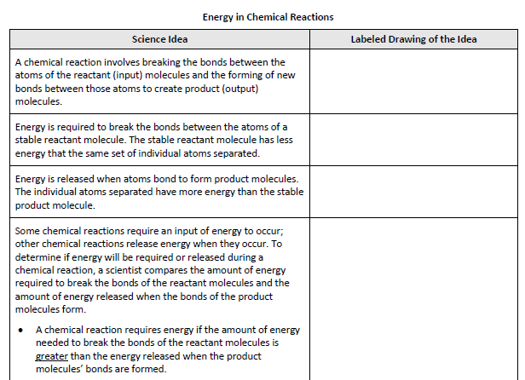
Energy Transfer in Photosynthesis

Slide 5
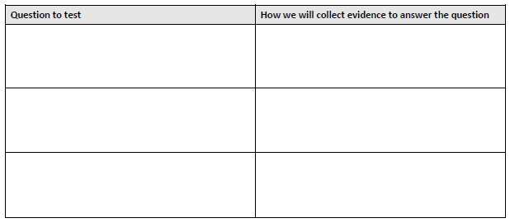
Energy Transfer in Photosynthesis
Step 3.
Discuss possible questions you could test
Star the question your group would most like to test

Slide 6
Energy Transfer in Photosynthesis
Step 4.
Set up your investigation and record your data
Include the data from leaf disks placed in the dark
Step 5.
Graph your data, labeling axes and variables

Slide 7
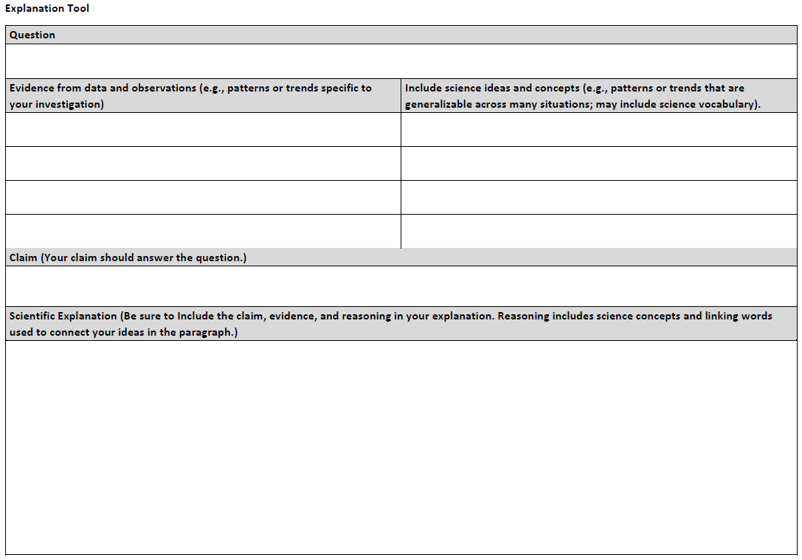
Scientific Explanation
Write a scientific explanation that answers the question your group investigated.

Slide 8
CCCR Consider-Contribute-Consult-Revise
Consider and think individually. Write down your best ideas.
Contribute your ideas with a partner.
Consult your partner.
Revise your ideas.
Make revisions in a different colored pen or pencil

Slide 9
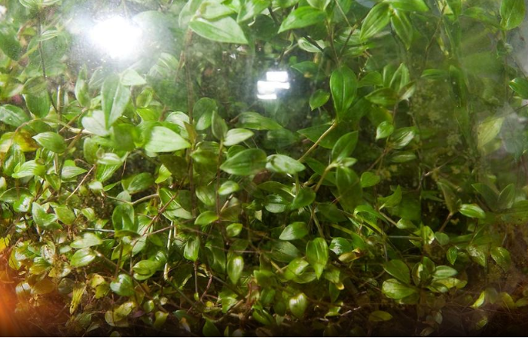
A Plant as a System
Step 7.
Add ideas about energy transfer to your model of the terrarium plant system.

Slide 10
Lesson 3 Focus Question
What is the role of energy in creating the outputs of photosynthesis?
Revisit your early ideas and consider the activities you completed.
If your thinking has changed, add to or revise your ideas using a different color pen/pencil

