Slide 1
A Study of Matter and Energy in Systems
Lesson 4

Slide 2
Unit Central Question
How do matter and energy move
through a system as living things interact
with each other and their environment?

Slide 3
Lesson 4 Focus Question
How do plants use the outputs of photosynthesis?

Slide 4
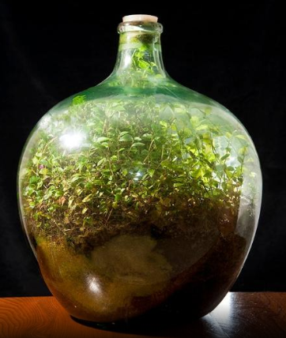
Plant Growth
Step 2.
Read the article
Annotate the text
Discuss the Stop and Think Questions with your group
Be prepared to share your ideas with the whole class

Slide 5
Testing for Starch in Plants
Step 3.
Watch the demonstration of a chemical test for the presence of starch in a plant’s leaves
Draw a labeled diagram of your observations

Slide 6
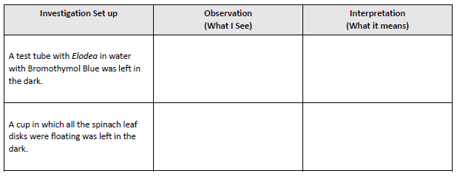
How do Plants Obtain Energy?
Step 4.
Observe plants and leaf disks placed in the dark
Step 5.
Read and annotate the information about seed germination

Slide 7
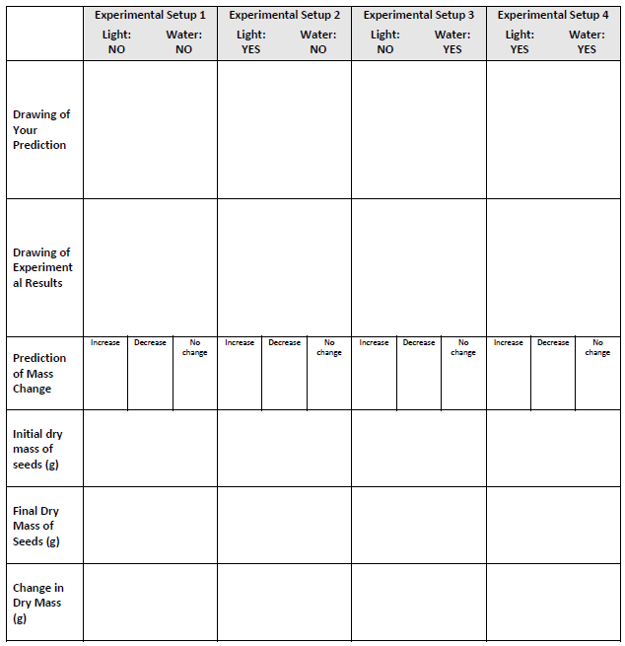
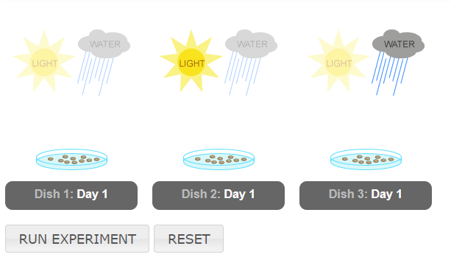
Radish Seed Simulation
Step 6.
Read the directions in the box, “Setup the Experiment”
Draw a labeled diagram of your predictions

Slide 8
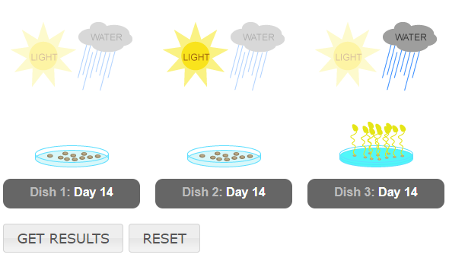
Radish Seed Simulation
“Run the Experiment”
Add a labeled diagram of the results
Predict whether the mass of the plant material increased, decreased, or stayed the same

Slide 9
Radish Seed Simulation
Click “Get Results”
Record the results of the experiment

Slide 10
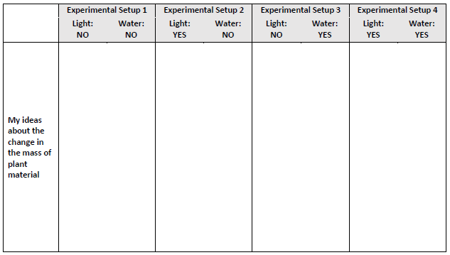
Radish Seed Simulation
Step 7.
Write your best ideas about why the mass of the plant material increased, decreased, or stayed the same

Slide 11
Getting Energy from Glucose
Step 8.
Read and annotate the article, Getting Energy from Glucose: Cellular Respiration
Step 9.
Read and annotate the article, Conservation of Mass
Use pop beads to assemble one glucose molecule

Slide 12
Getting Energy from Glucose
Step 9.
Read and annotate the article, Conservation of Mass
Use pop beads to assemble one glucose molecule
Make a key should the color of each type of atom
Determine the number of oxygen molecules needed to produce the output molecules of CO₂ and H₂O
Step 10.
Using a different color, revise or add to your ideas in Step 7

Slide 13
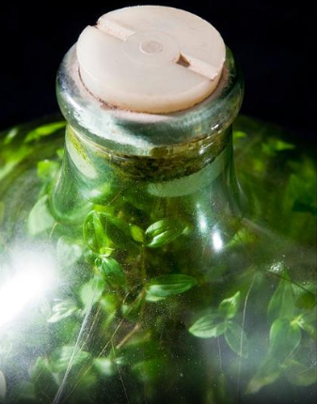
A Plant as a System
Step 11.
Add ideas about cellular respiration to your model of the terrarium plant system
Include labels to help others understand your model

Slide 14
Lesson 4 Focus Question
How do plants use the outputs of photosynthesis?
Revisit your early ideas and consider the activities you completed.
If your thinking has changed, add to or revise your ideas using a different color pen/pencil

