Slide 1
A Study of Matter and Energy in Systems
Lesson 5

Slide 2
Unit Central Question
How do matter and energy move
through a system as living things interact
with each other and their environment?

Slide 3
Lesson 5 Focus Question
How do other organisms use the outputs of photosynthesis?

Slide 4
Cellular Respiration in Other Organisms
Step 2.
Read and annotate the article, Cellular Respiration in Other Organisms
Step 3.
Draw a labeled diagram of the demonstration to confirm CO₂ is produced during anaerobic respiration

Slide 5
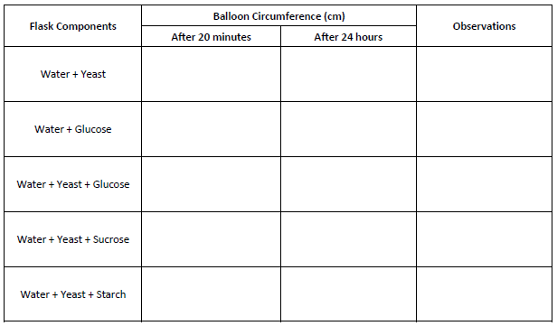
Cellular Respiration in Yeast
Steps 4.
Draw a labeled diagram of the demonstration to explore CO₂ production by yeast
Step 5.
Record the data from the demonstration

Slide 6
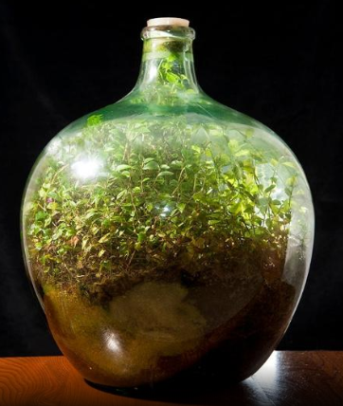
Decomposition and Compost
Step 6.
Read the article
Annotate the text

Slide 7
Microorganisms as a System
Step 7.
Add ideas about cellular respiration conducted by microorganisms to your model
Include labels to help others understand your model

Slide 8
Lesson 5 Focus Question
How do other organisms use the outputs of photosynthesis?
Revisit your early ideas and consider the activities you completed.
If your thinking has changed, add to or revise your ideas using a different color pen/pencil

