Slide 1
A Study of Matter and Energy in Systems
Lesson 7

Slide 2
Unit Central Question
How do matter and energy move
through a system as living things interact
with each other and their environment?

Slide 3
Lesson 7 Focus Question
How does a change in one component of the biosphere system affect the other components of the system?

Slide 4
Effects of Rising CO₂ Levels on Plants
Step 2.
What might be the effects of rising carbon dioxide levels on plants?
Record your predictions
Include reasons for your predictions

Slide 5
Two Claims about Effects of Rising CO₂
Claim A
Rising carbon dioxide levels will benefit plants and humans because it will result in increased rates of photosynthesis and greater crop yields.
Claim B
Rising carbon dioxide levels will prove harmful to plants and humans because of the damaging effects of climate change.
Which claim best matches your team’s predictions?

Slide 6
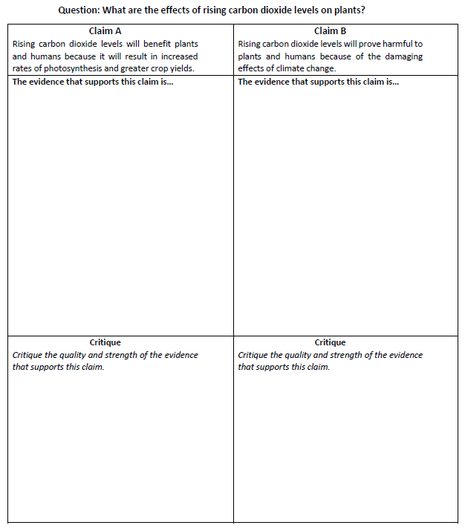
Scientific Argumentation
Step 4.
Read and annotate the article, Ask the Experts: Does Rising CO₂ Benefit Plants?
Identify evidence that supports your assigned claim
Critique the quality and strength of the evidence

Slide 7
Scientific Argumentation
Step 5.
Determine if:
One claim has stronger evidence and reasoning to support it, while the other claim can be refuted
Neither claim has strong enough evidence and reasoning to support or refute it; more evidence is needed to answer the question
Evidence for both claims may be combined to create an even stronger claim

Slide 8
Scientific Argumentation
Write a scientific argument that answers the question
Which claim about the effects of rising CO₂ levels on plants is best supported by evidence and reasoning?
Your argument should include:
Your claim (a, b, or c)
Relevant evidence and reasoning that supports your claim
Scientific reasoning the critiques the evidence and evaluates your claim
A rebuttal that refutes the other two claims

Slide 9
Scientific Argumentation
Step 6.
Give feedback:
Exchange your team’s argument with a member of another team
Read your partner’s argument
Ask questions to clarify your understanding of what your partner wrote
Provide two pieces of productive feedback on sticky notes
Return the argument and sticky notes to your partner
Revise your argument based on the feedback your team received

Slide 10
Unit Central Question
How do matter and energy move
through a system as living things interact
with each other and their environment?
Step 7.
Revise your early ideas on page 1 of Lesson 1 using a different color pen/pencil
Write a reflection summarizing the changes in your thinking and what caused your ideas to change
Be prepared to share your reflection with the class

Slide 11
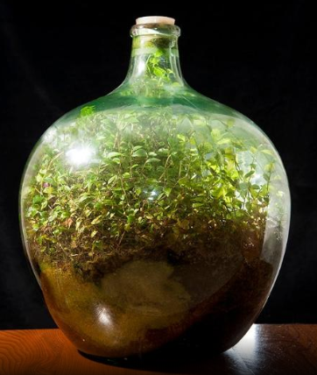
Systems and System Models
Step 8.
How did thinking about systems and system models help you understand interactions of matter and energy (or not)?
How did thinking about systems and system models help you develop a strong scientific argument (or not)?

