Slide 1
A Study of Changes in Populations
Lesson 1

Slide 2
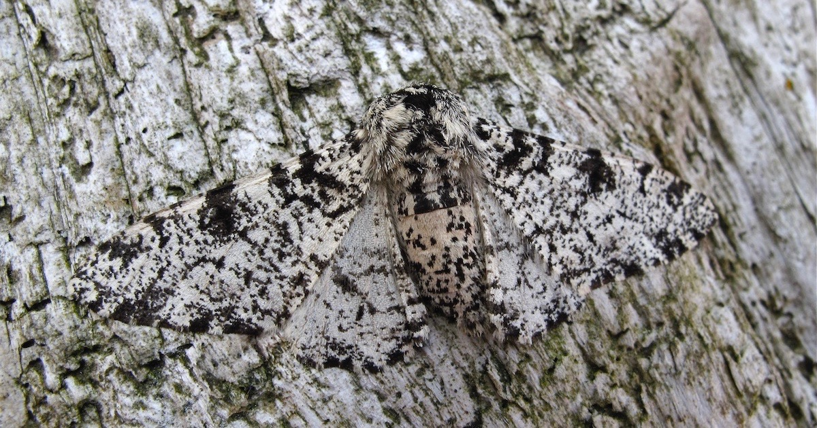
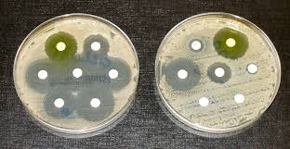
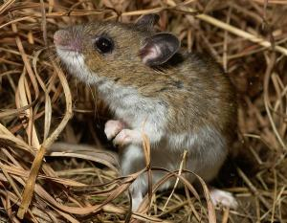
https://evolutionnews.org/2018/09/listen-dead-peppered-moths-cant-evolve/
https://en.wikipedia.org/wiki/Antimicrobial_resistance
https://nature.mdc.mo.gov/discover-nature/field-guide/deer-mouse

Slide 3
Unit Central Question
What is the process that leads to changes in populations of organisms over time?

Slide 4
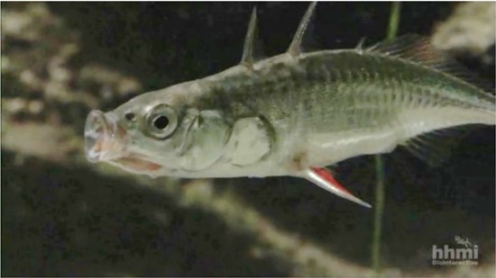
A Phenomenal Fish Story
Step 2.
Preview the card set
Watch the videoclip
Consider
What is happening to the stickleback fish?
What might be causing it to happen?

Slide 5
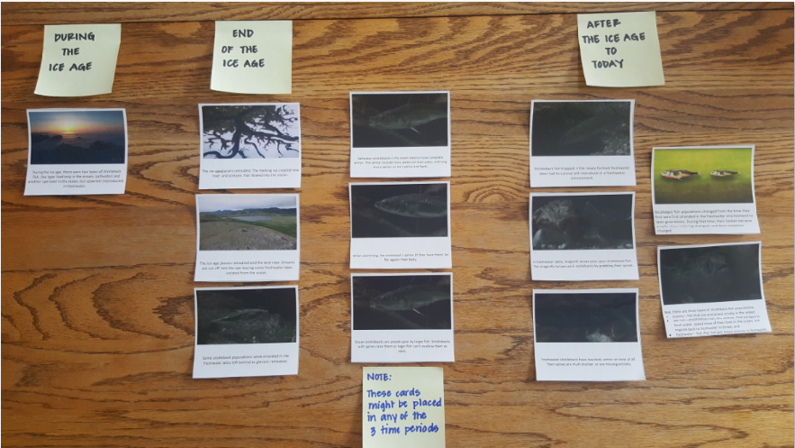
A Phenomenal Fish Story
Step 3.
Review the card set
Group cards into
During the ice age
At the end of the ice age
After the ice age to today
Step 4.
Add sticky note headers and sequence cards to tell the story of the Stickleback.

Slide 6
A Phenomenal Fish Story
Gallery Walk
How are others’ arrangements similar? Different?
Share findings back in-home group. Consider:
Will you revise your sequences?
If so, how?
Whole group discussion and representation.
What happened to the Stickleback population over time?
Note: Leave cards on your table!

Slide 7
Lesson 1 Focus Question
What are possible explanations for how a population of organisms gains or loses characteristics?

Slide 8
Two Views about Changes in Populations
Similarities
Differences
Scientist 1 | Scientist 2

Slide 9
Two Views about Changes in Populations
CAUSE
EFFECT
Scientist 1
What might scientist 1 say causes the change in the stickleback population?
Scientist 2?
How can you use your Stickleback story cards to help you identify the “effect” on the Stickleback population?
Scientist 2

Slide 10
Lesson 1 Focus Question
What are possible explanations for how a population of organisms gains or loses characteristics?
Revisit your early ideas.
Use a colored pen/pencil to
label ideas consistent with Scientist 1.
label ideas consistent with Scientist 2.
If your thinking has changed, add to or revise your response using a different color pen/pencil.

