Slide 1
A Study of Changes in Populations
Lesson 2

Slide 2
Unit Central Question
What is the process that leads to changes in populations of organisms over time?

Slide 3
Lesson 2 Focus Question
What would happen to a population if there were a change in the environment where the population lived?

Slide 4
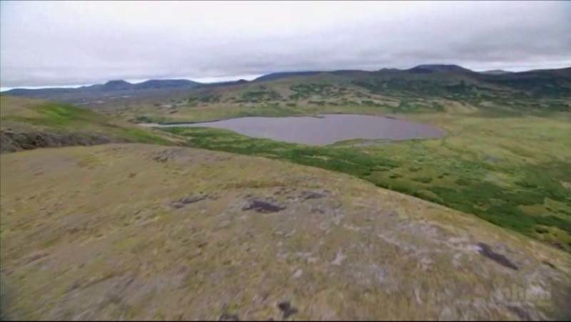
Loberg Lake: A Fish Story
Read Loberg Lake: A Fish Story
Annotate the text
Discuss the Stop and Think questions in your team
Be prepared to share your ideas with the whole group
Draw a timeline to represent what happened in Loberg Lake.

Slide 5
Two Views about Changes in Populations
Which statement represents your thinking about the traits an organism can pass to its offspring?

Slide 6
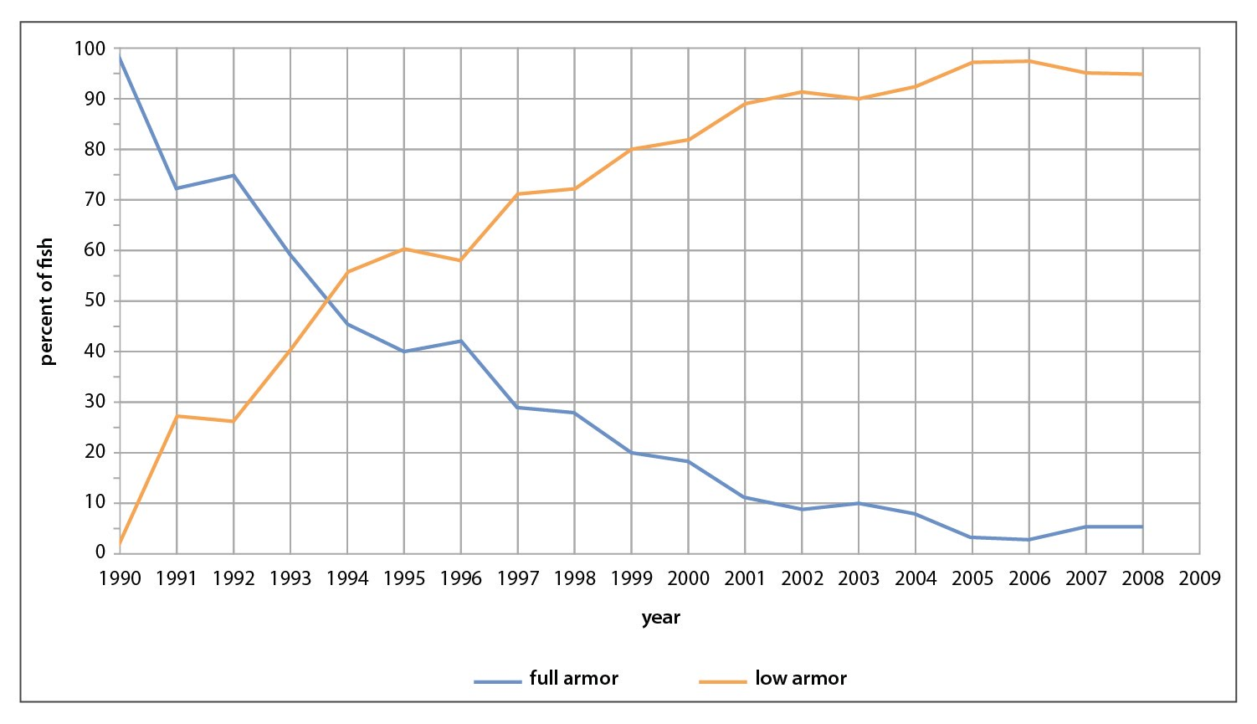
Stickleback in Loberg Lake
Percent of Fish in Population Sample with Full and Low Body Armor
WIS
WIS
WIM
WIM
Add arrows
WIS
WIM

Slide 7
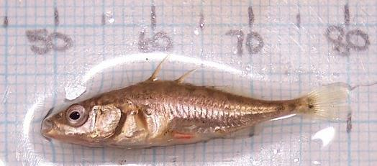
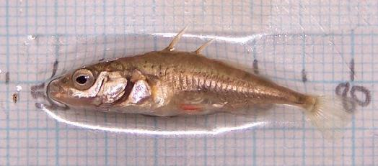
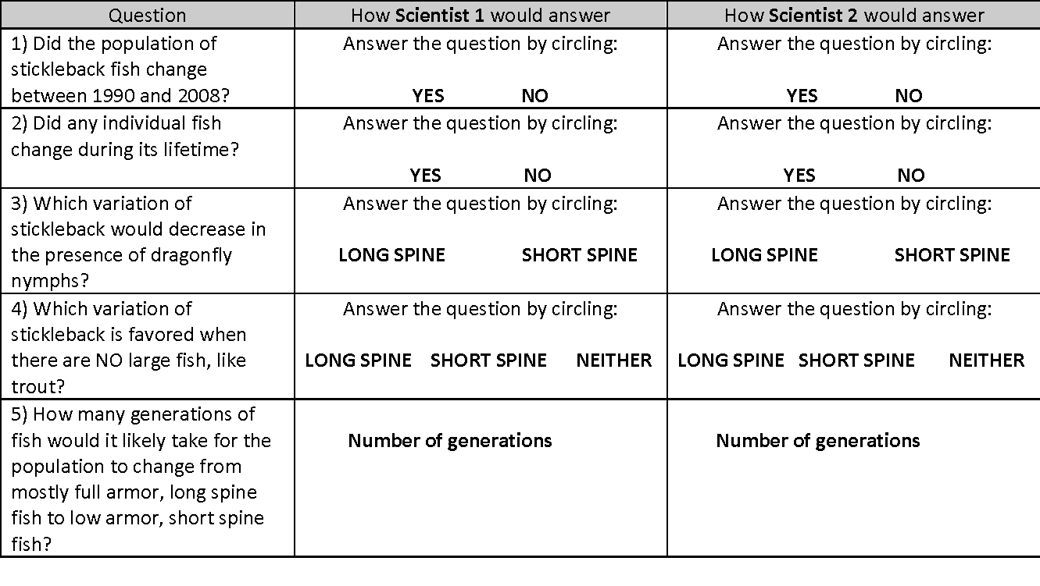
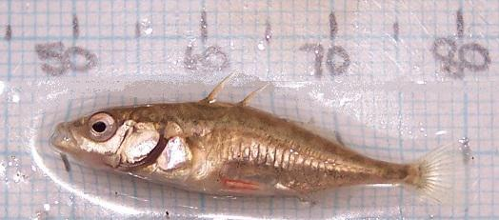
Stickleback Fish at Three Time Points in Adult Life
Respond to the questions.
Be prepared to share your ideas.
Refer to the scientists’ ideas in STEP 4.
12 months
18 months
24 months

Slide 8
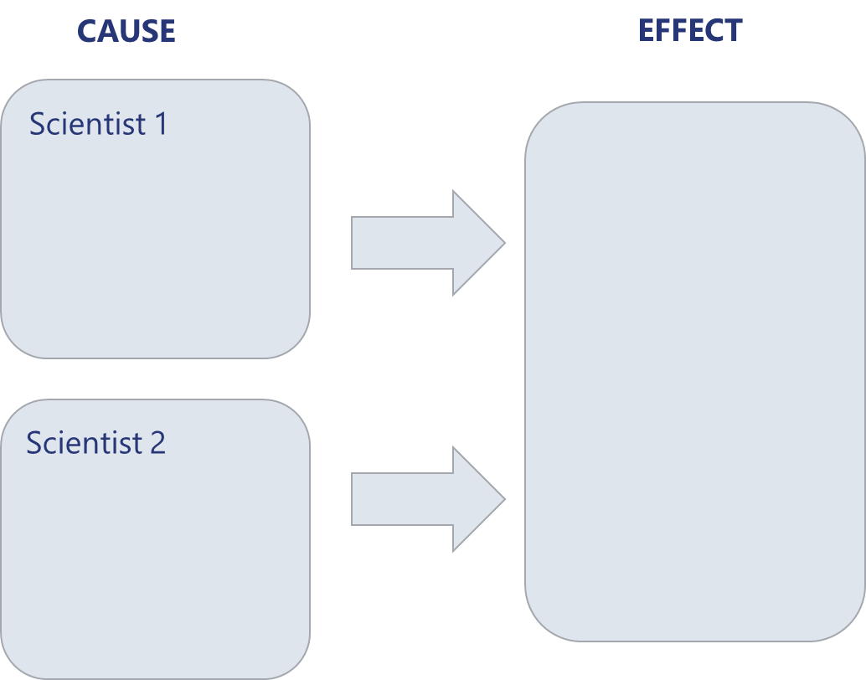
Two Views about Changes in Populations
Lesson 1 STEP 9
Consider the question:
Which “cause” is best supported by the evidence so far?
Record your ideas in the space provided in Lesson 2 STEP 10
Be prepared to share your ideas.

Slide 9
Lesson 2 Focus Question
What would happen to a population if there were a change in the environment where the population lived?
Use a colored pen/pencil to
label Scientist 1 as Lamarck.
label Scientist 2 as Darwin.
Be prepared to share your ideas about responses to the questions in STEP 12.

