Slide 1
A Study of Changes in Populations
Lesson 3

Slide 2
Unit Central Question
What is the process that leads to changes in populations of organisms over time?

Slide 3
Lesson 3 Focus Question
What evidence supports Darwin’s ideas idea of how populations of organisms change over time?

Slide 4
Four Factors of Natural Selection
Factor 1: More individuals are born than can survive and reproduce.
Factor 2: Individuals within a population inherit traits from their parents. These traits show variation.
Factor 3: Individuals in a population compete for limited resources (e.g., food, habitat, or mates).
Factor 4: Some offspring inherit variations of traits that help them better survive and reproduce in their environment.

Slide 5
Four Factors of Natural Selection
Factor 1: More individuals are born than can survive and reproduce. | Factor 2: Individuals within a population inherit traits from their parents. These traits show variation.
Factor 3: Individuals in a population compete for limited resources (e.g., food, habitat, or mates). | Factor 4: Some offspring inherit variations of traits that help them better survive and reproduce in their environment.

Slide 6
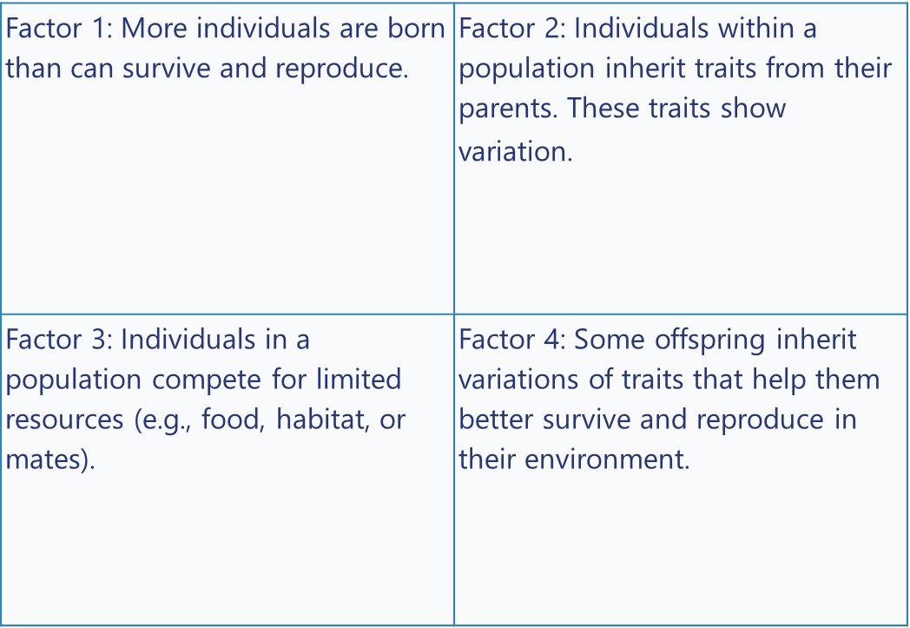
Field Guide to Stickleback
Field Guide to Stickleback
Stickleback are small fish that can be found in freshwater and in the ocean. They are one of the most scientifically studied fish in the world.
Appearance: Stickleback fish are between 30 and 80 mm (1 and 3 inches) in length. They vary in color with gray, olive, brown, and black fish. Many stickleback have spines on their back, with some also having spines on their underside. They do not have scales. However, some stickleback have bony armor plates along their body. Spines and armor can protect stickleback from predators.
Habitat: Stickleback live in shallow water near shores where there is usually a lot of plant life. They can be found in the ocean and in freshwater. There are 16 different species of stickleback fish, and the ocean-dwelling fish tend to have more body armor. The freshwater fish are less likely to have body armor. It is possible for ocean-dwelling fish to enter areas of freshwater during the time when females lay eggs.
Geography: Most species are found only in the Northern Hemisphere. There are a few species that can be found in the Southern Hemisphere. There are also species that travel into different areas at different times of the year, depending on the temperature.
Back to the Four Factors Chart

Slide 7
Aquarium Study
Think
Calculate and represent data in a table
Stickleback measurements
Represent the Study
Analyze the data and respond to questions

Slide 8
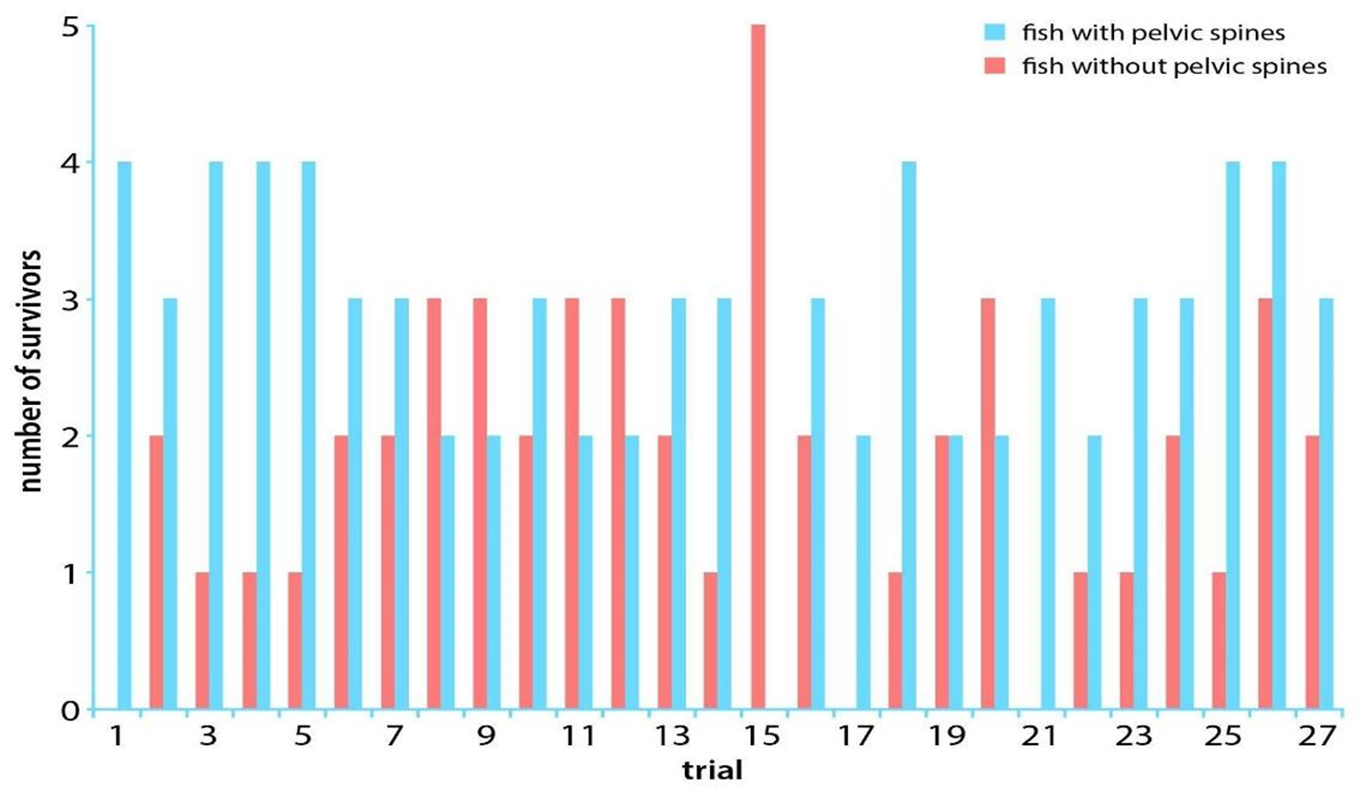
Aquarium Study Results
Back to the Four Factors Chart

Slide 9
Four Factors: Cause and Effect
Cause | Effect
Factor 1: More individuals are born than can survive and reproduce.
Factor 2: Individuals within a population inherit traits from their parents. These traits show variation.
Factor 3: Individuals in a population compete for limited resources (e.g., food, habitat, or mates).
Factor 4: Some offspring inherit variations of traits that help them better survive and reproduce in their environment.
Read the cards.
If the cause is on of the Four Factors, what is the effect?
Match the statements on the “effect” cards to the “cause”.
Be prepared to share your ideas.

Slide 10
Revisit: Lesson 3 Focus Question
What evidence supports Darwin’s ideas idea of how populations of organisms change over time?

